Slide 1
CSE 231: Numerical Analysis
Topics
Central difference Interpolation formulae: Gauss Forward Interpolation Formula, Gauss Backward Interpolation Formula
Lecture 11
Shipon Tarafdar.
Lecturer
Dept. of CSE
City University, Bangladesh

Slide 2
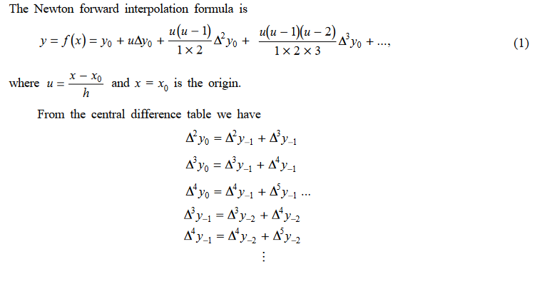
Gauss Forward Interpolation Formula

Slide 3
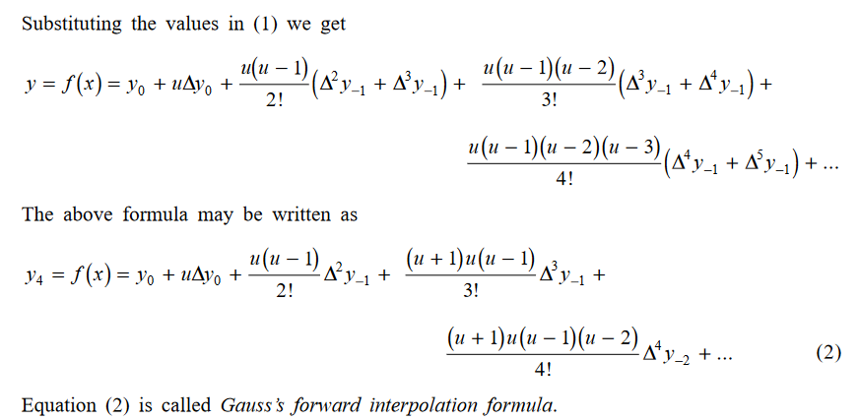
Gauss Forward Interpolation Formula (Cont.)

Slide 4
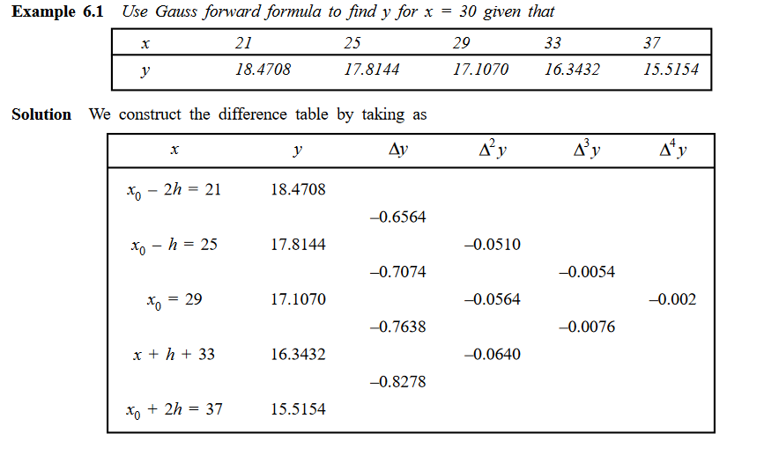
Gauss Forward Interpolation Formula (Cont.)

Slide 5
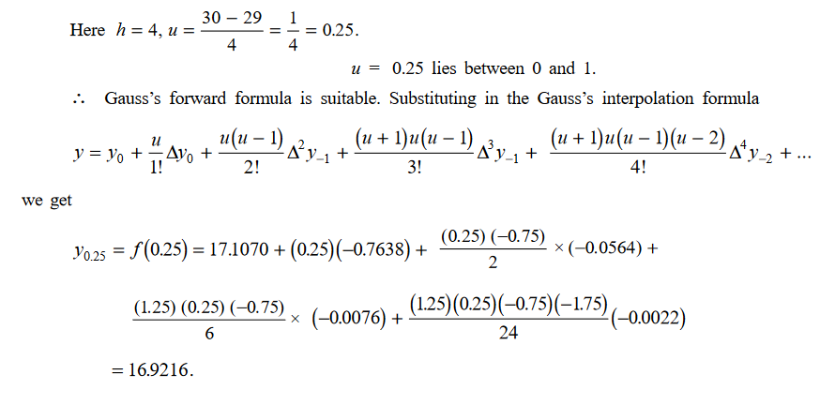
Gauss Forward Interpolation Formula (Cont.)

Slide 6
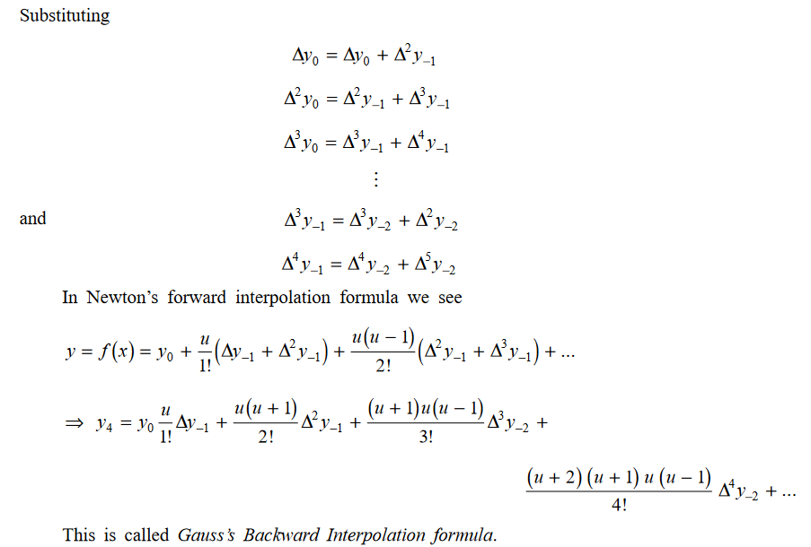
Gauss Backward Interpolation Formula

Slide 7
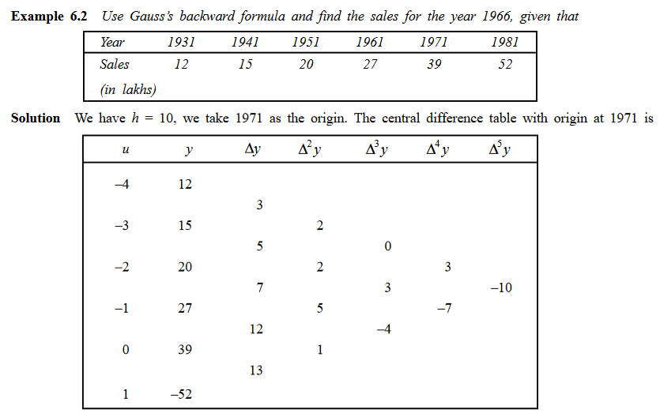
Gauss Backward Interpolation Formula (Cont.)

Slide 8
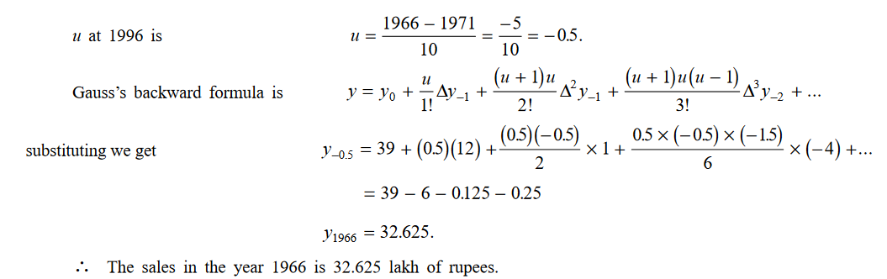
Gauss Backward Interpolation Formula (Cont.)

