Slide 1
CSE 231: Numerical Analysis
Topics
Central difference Interpolation formulae: Bessel’s Formula, Stirling’s Formula
Lecture 12
Shipon Tarafdar.
Lecturer
Dept. of CSE
City University, Bangladesh

Slide 2
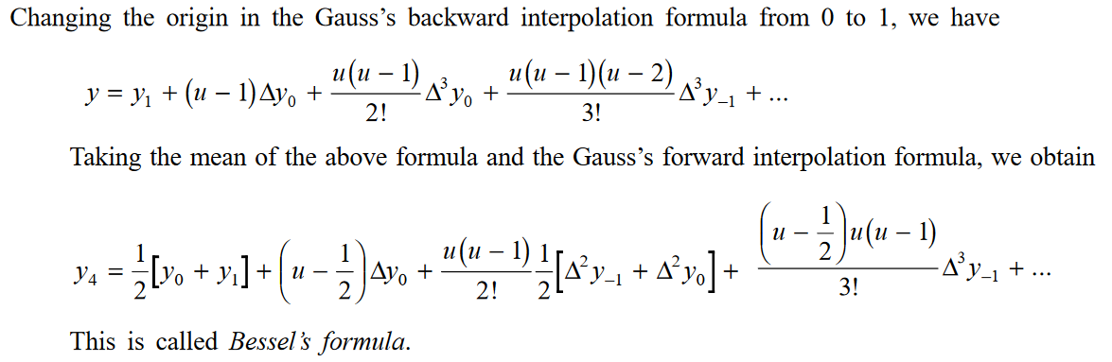
Bessel’s Formula

Slide 3
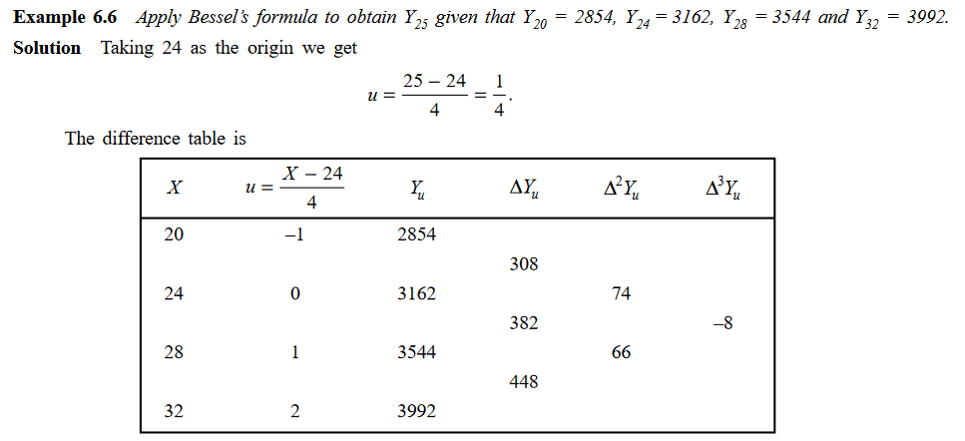
Bessel’s Formula (Cont.)

Slide 4
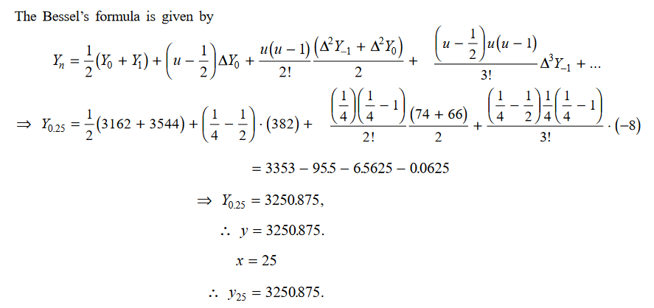
Bessel’s Formula (Cont.)

Slide 5
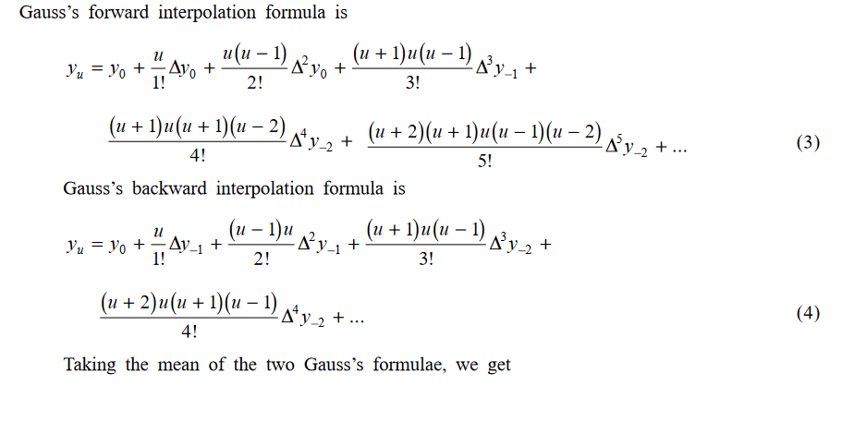
Stirling’s Formula

Slide 6
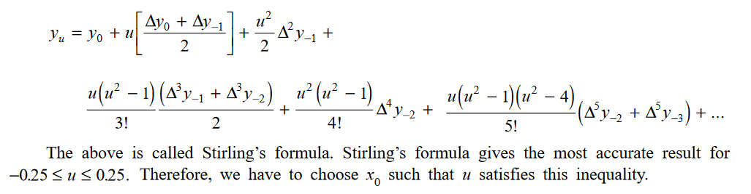
Stirling’s Formula (Cont.)

Slide 7
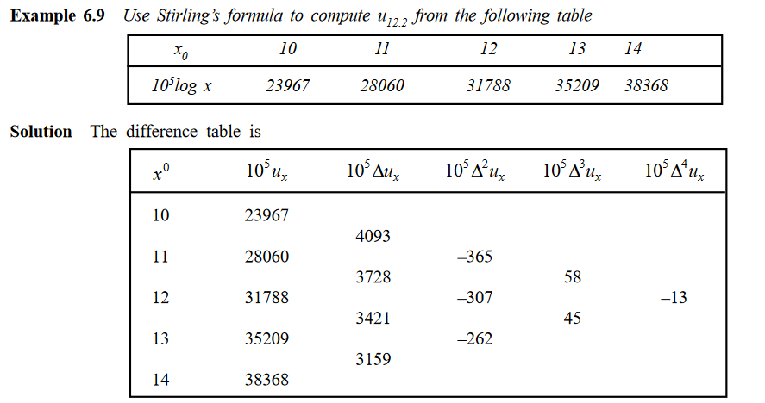
Stirling’s Formula (Cont.)

Slide 8
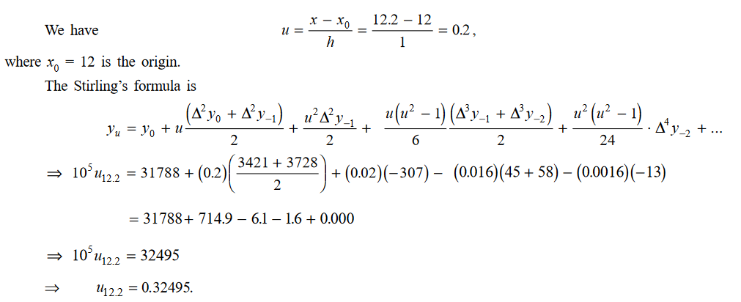
Stirling’s Formula (Cont.)

