Slide 1
Memory Hierarchy
CSE-413 Computer Architecture
Lecture 10

Slide 2
Memory Hierachy
Main Objectives of a Memory Hierarchy:
To minimize execution time of executing programs
To maximize the throughput of the computer
3. To minimize response time

Slide 3
Principle of locality
In computer architecture, locality of reference, also known as the principle of locality, is a term for the phenomenon in which the same values, or related storage locations, are frequently accessed, depending on the memory access pattern.
Temporal locality: The principle stating that if a data location is referenced then it will tend to be referenced again soon.
Spatial locality: The locality principle stating that if a data location is referenced, data locations with nearby addresses will tend to be referenced soon.

Slide 4
Memory Hierarchy
A memory hierarchy consists of multiple levels of memory with different speeds and sizes.
The faster memories are more expensive per bit than the slower memories and thus smaller.
Three technologies used in building memory hierarchies:
1. DRAM (Main memory)
2. SRAM (Cache)
3. Magnetic disk (Hard disk)

Slide 5

Memory Hierarchy
The goal is to provide the user with as much memory as is available in the cheapest technology, while providing access at the speed offered by the fastest memory.

Slide 6
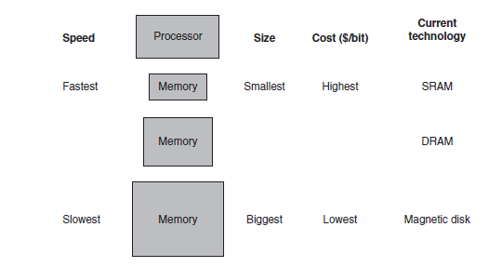
Memory Hierarchy

Slide 7
Data Hierarchy
The data is similarly hierarchical: a level closer to the processor is generally a subset of any level further away, and all the data is stored at the lowest level.
A memory hierarchy can consist of multiple levels, but data is copied between only two adjacent levels at a time, so we can focus our attention on just two levels. The upper level—the one closer to the processor—is smaller and faster than the lower level, since the upper level uses technology that is more expensive.
Within each level, the unit of information that is present or not is called a block or a line. Usually we transfer an entire block when we copy something between levels.

Slide 8
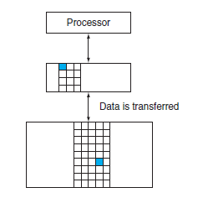
Data Hierarchy

Slide 9
Hit and Miss
If the data requested by the processor appears in some block in the upper level, this is called a hit
If the data is not found in the upper level, the request is called a miss. The lower level in the hierarchy is then accessed to retrieve the block containing the requested data.
The hit rate, or hit ratio, is the fraction of memory accesses found in the upper level; it is often used as a measure of the performance of the memory hierarchy.
The miss rate (1 - hit rate) is the fraction of memory accesses not found in the upper level.

Slide 10
Hit time and Miss Penalty
Hit time is the time to access the upper level of the memory hierarchy, which includes the time needed to determine whether the access is a hit or a miss. (Time to look through books on the desk)
The miss penalty is the time to replace a block in the upper level with the corresponding block from the lower level, plus the time to deliver this block to the processor.(time to search library shelves, find book, and bring it to the desk.)
Because the upper level is smaller and built using faster memory parts, the hit time will be much smaller than the time to access the next level in the hierarchy, which is the major component of the miss penalty.

Slide 11
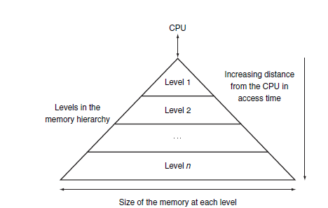
Continue
memory hierarchy uses smaller and faster memory technologies close to the processor.
Thus, accesses that hit in the highest level of the hierarchy can be processed quickly.
Accesses that miss go to lower levels of the hierarchy, which are larger but slower.

Slide 12
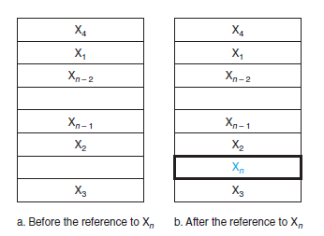
Cache
It refers to the level of memory hierarchy between the processor and main memory.
shows such a simple cache, before and after requesting a data item that is not initially in the cache. Before the request, the cache contains a collection of recent references X₁, X₂, . . . , X_{n - 1}, and the processor requests a word X_{n} that is not in the cache. This request results in a miss, and the word X_{n} is brought from memory into the cache.

Slide 13
Direct Mapped cache
How do we know if a data item is in the cache?
Moreover, if it is, how do we find it?
A cache structure in which each memory location is mapped to exactly one location in the cache is called direct mapped cache.
Almost all direct-mapped caches use this mapping to find a block:
(Block address) modulo (Number of blocks in the cache)

Slide 14
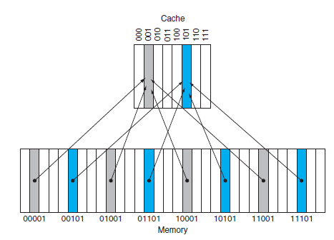
Continue
(Block address) modulo (Number of blocks in the cache)
If the number of entries in the cache is a power of 2, then modulo can be computed simply by using the low-order log₂ (cache size in blocks) bits of the address.
Thus, an 8-block cache uses the three lowest bits (8 = 2³) of the block address.

Slide 15
Tag
How do we know if a data item is in the cache?
We answer this question by adding a set of tags to the cache.
The tags Contain the address information required to identify whether a word in the cache corresponds to the requested word.
The tag needs only to contain the upper portion of the address, corresponding to the bits that are not used as an index into the cache.
In figure we need only the upper 2 of the 5 address bits in the tag, since the lower 3-bit index field of the address selects the block.

Slide 16
Valid Bit
We also need a way to recognize that a cache block does not have valid information.
For instance, when a processor starts up, the cache does not have good data, and the tag fields will be meaningless.
Even after executing many instructions, some of the cache entries may still be empty.
Thus, we need to know that the tag should be ignored for such entries.
The most common method is to add a valid bit to indicate whether an entry contains a valid address.
If the bit is not set, there cannot be a match for this block.

Slide 17
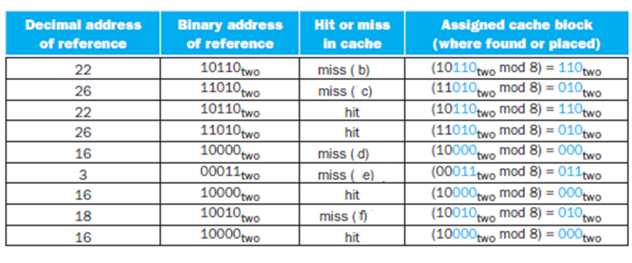
Accessing a cache-Example 1
Below is a sequence of nine memory references to an empty eight-block cache, including the action for each reference.

Slide 18
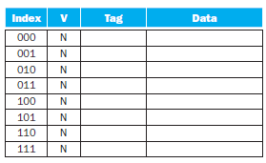
Figure a. The initial state of the cache after power-on

Slide 19
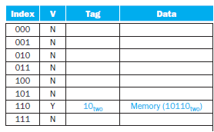
Figure b. After handling a miss address (10110_{two})

Slide 20
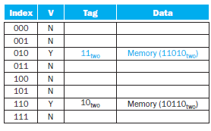
Figure c. After handling a miss address (11010_{two})

Slide 21
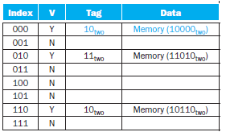
Figure d. After handling a miss address (10110_{two})

Slide 22
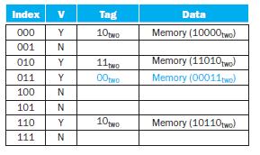
Figure e. After handling a miss address (00011_{two})

Slide 23
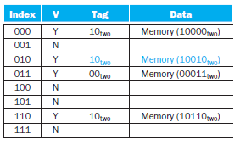
Figure f. After handling a miss address (10010_{two})

Slide 24
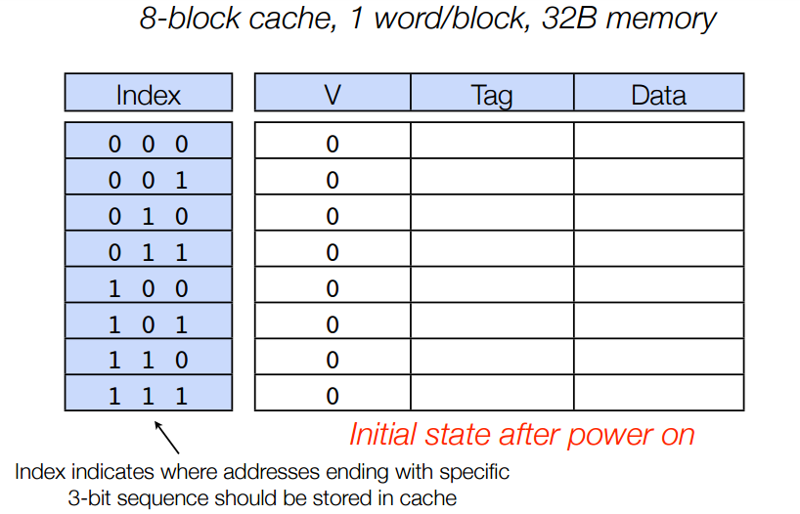
Accessing a cache-Example 2

Slide 25
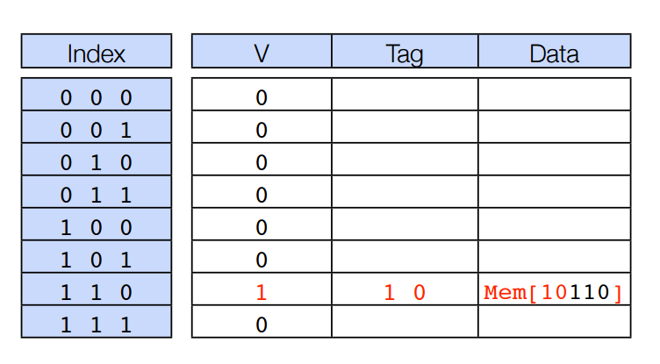
Accessing a cache-After handling miss of address 10110

Slide 26
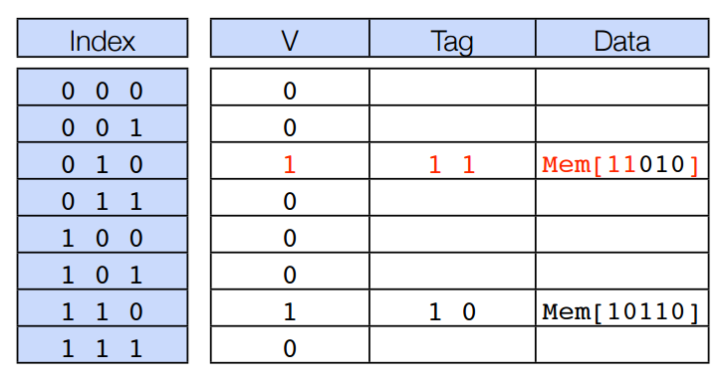
Accessing a cache-After handling miss of address 11010

Slide 27
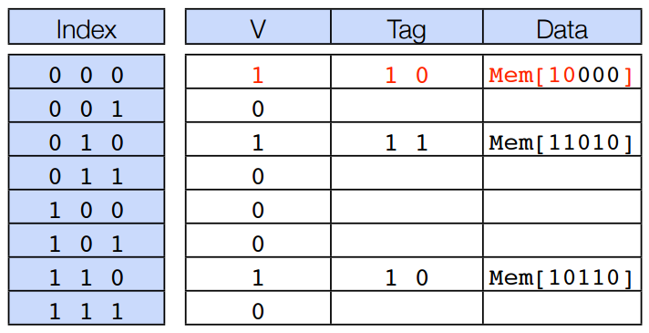
Accessing a cache-After handling miss of address 10000

Slide 28
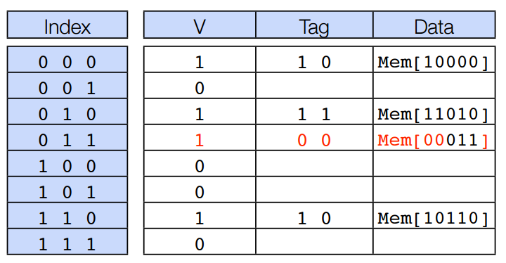
Accessing a cache-After handling miss of address 00011

Slide 29

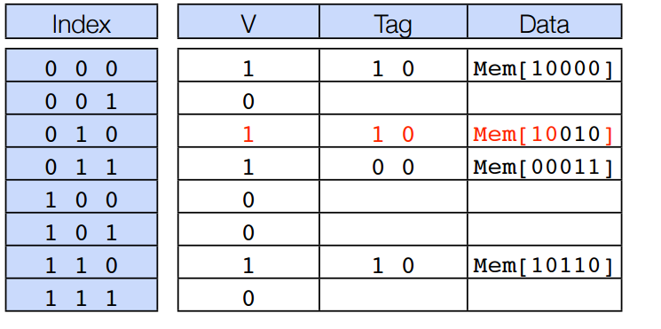
Accessing a cache-After handling miss of address 00011

Slide 30
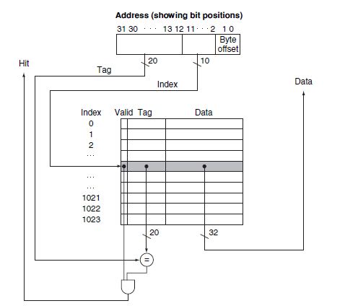
Referencing a Cache Block
A referenced address is divided into:
A tag field, which is used to compare with the value of the tag field of the cache
A cache index, which is used to select the block

Slide 31
Referencing a Cache Block
32-bit byte addresses
A direct-mapped cache
The cache size is 2^{n} blocks, so n bits are used for the index
The block size is 2^{m} words (2^{m+2} bytes), so m bits are used for the word within the block, and two bits are used for the byte part of the address the size of the tag field is
32 - (n + m + 2).

Slide 32
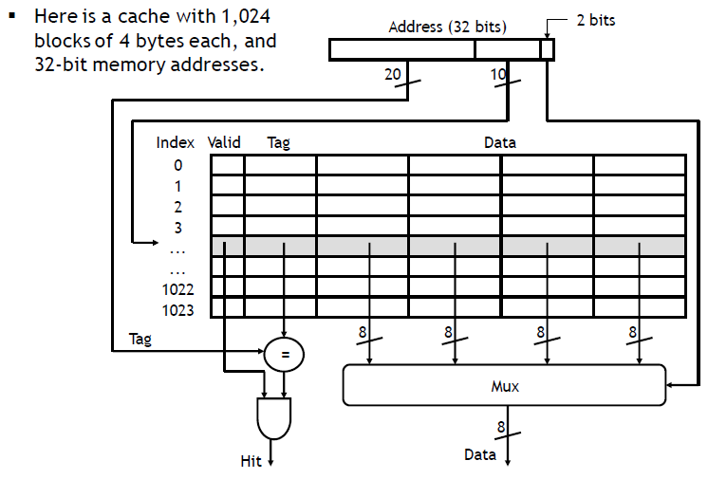
Referencing a Cache Block-Continue

Slide 33
Bits in a Cache
The total number of bits in a direct-mapped cache is
2^{n} × (block size + tag size + valid field size).
Since the block size is 2^{m} words (2^{m+5} bits), and we need 1 bit for the valid field, the number of bits in such a cache is
2^{n} × (2^{m} × 32 + (32 - n - m - 2) + 1) = 2^{n} × (2^{m} × 32 + 31 - n - m).
The cache size is 2^{n} blocks, so n bits are used for the index
The block size is 2^{m} words (2^{m+2} bytes), so m bits are used for the word within the block

Slide 34
Example
How many total bits are required for a direct-mapped cache with 16 Kbyte of data and 4-word blocks, assuming a 32-bit address?
Solution
We know that 16 KB is 4K (2¹²) words. With a block size of 4 words (2²), there are 1024 (2¹⁰) blocks.
Each block has 4 × 32 or 128 bits of data plus a tag, which is 32 – 10 – 2 – 2 bits, plus a valid bit.
Thus, the total cache size is
2¹⁰ × (4 × 32 + (32 - 10 - 2 - 2) + 1) = 2¹⁰ × 147 = 147 Kbits or 18.4 KB for a 16 KB cache.

Slide 35
Example
How many total bits are required for a direct-mapped cache with 64KByte of data and one-word blocks, assuming a 32-bit address?
Solution
We know that 64 KB is 16K (2¹⁴) words. With a block size of 4 words (2²), there are 4096 (2¹²) blocks.
Each block has 1 × 32 or 32 bits of data plus a tag, which is 32 – 12 – 2 – 2 bits, plus a valid bit.
Thus, the total cache size is
2¹⁴× (1 × 32 + (32 - 12 - 2 - 2) + 1) = 2¹⁴ × 49 = 784 Kbits or 98 KB for a 64 KB cache.

Slide 36

Example
For a direct-mapped cache design with a 32-bit address and byte-addressable memory, the following bits of the address are used to access the cache:
What is the cache line size (in words)? How many entries (cache lines) does the cache have? Cache lines are also called blocks.
Solution

Slide 37



Example
For a direct-mapped cache design with a 32-bit address and byte-addressable memory, the following bits of the address are used to access the cache:
What is the cache line size (in words)? How many entries (cache lines) does the cache have? Cache lines are also called blocks.
Solution

