Slide 1
Booth’s Multiplication Algorithm
CSE-413 Computer Architecture
Lecture 14

Slide 2
Booth’s Multiplication Algorithm
It employs both addition and subtraction.
It treats positive and negative operands uniformly.
No special actions are required for negative numbers.
It provides faster execution.

Slide 3
Booth’s Multiplication Algorithm
Step – 1:
Two adjacent bits x_{i}x_{i-1} are examined in each step.
If x_{i}x_{i-1} =01, then Y is added to the current partial product P_{i}.
If x_{i}x_{i-1} =10, then Y is subtracted from P_{i}.
If x_{i}x_{i-1} =00 or 11, then neither addition or subtraction is performed.
Step – 2:
Shift the product register right 1 bit.

Slide 4
Points to remember
When using Booth's Algorithm:
  You will need twice as many bits in your product as you have in your original two operands.
  The leftmost bit of your operands (both your multiplicand and multiplier) is a SIGN bit, and cannot be used as part of the value.

Slide 5
To Begin
Decide which operand will be the multiplier and which will be the multiplicand
Convert both operands to two's complement representation using X bits
  X must be at least one more bit than is required for the binary representation of the numerically larger operand
Begin with a product that consists of the multiplier with an additional X leading zero bits

Slide 6
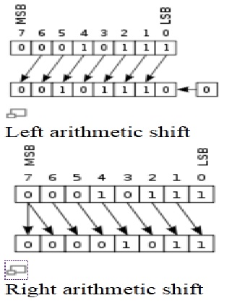
Left/Right Shift

Slide 7
Example
For our example, let's multiply (-5) x 2
  The numerically larger operand (5) would require 3 bits to represent in binary (101). So we must use AT LEAST 4 bits to represent the operands, to allow for the sign bit.
Let's use 5-bit 2's complement:
  -5 is 11011 (multiplier)
  2 is 0010 (multiplicand)

Slide 8
Beginning Product
The multiplier is:
11011
Add 5 leading zeros to the multiplier to get the beginning product:
00000 11011

Slide 9
Step 1 for each pass
Use the LSB (least significant bit) and the previous LSB to determine the arithmetic action.
  If it is the FIRST pass, use 0 as the previous LSB.
Possible arithmetic actions:
  00 → no arithmetic operation
  01 → add multiplicand to left half of product
  10 → subtract multiplicand from left half of product
  11 → no arithmetic operation

Slide 10
Step 2 for each pass
Perform an arithmetic right shift (ASR) on the entire product.
NOTE: For X-bit operands, Booth's algorithm requires X passes.

Slide 11
Example
Let's continue with our example of multiplying (-5) × 2
Remember:
  -5 is 11011 (multiplier)
  2 is 00010 (multiplicand)
And we added 5 leading zeros to the multiplier to get the beginning product:
00000 11011

Slide 12
Example Continued
Initial Product and previous LSB
00000 11011 0
(Note: Since this is the first pass, we use 0 for the previous LSB)
Pass 1, Step 1: Examine the last 2 bits
00000 11011 0
The last two bits are 10, so we need to:
subtract the multiplicand from left half of product

Slide 13
Example Pass 1 Continued
Pass 1, Step 1: Arithmetic action
(1) 00000 (left half of product)
-00010 (mulitplicand)
11110 (uses a phantom borrow)
Place result into left half of product
11110 11011 0

Slide 14
Example Pass 1 Continued
Pass 1, Step 2: ASR (arithmetic shift right)
  Before ASR
  11110 11011 0
  After ASR
  11111 01101 1
  (left-most bit was 1, so a 1 was shifted in on the left)
Pass 1 is complete.

Slide 15
Example: Pass 2
Current Product and previous LSB
11111 01101 1
Pass 2, Step 1: Examine the last 2 bits
11111 01101 1
The last two bits are 11, so we do NOT need to perform an arithmetic action --
just proceed to step 2.

Slide 16
Example: Pass 2 continued
Pass 2, Step 2: ASR (arithmetic shift right)
  Before ASR
  11111 01101 1
  After ASR
  11111 10110 1
  (left-most bit was 1, so a 1 was shifted in on the left)
Pass 2 is complete.

Slide 17
Example: Pass 3
Current Product and previous LSB
11111 10110 1
Pass 3, Step 1: Examine the last 2 bits
11111 10110 1
The last two bits are 01, so we need to:
add the multiplicand to the left half of the product

Slide 18
Example: Pass 3 continued
Pass 3, Step 1: Arithmetic action
(1) 11111 (left half of product)
+00010 (mulitplicand)
00001 (drop the leftmost carry)
Place result into left half of product
00001 10110 1

Slide 19
Example: Pass 3 continued
Pass 3, Step 2: ASR (arithmetic shift right)
  Before ASR
  00001 10110 1
  After ASR
  00000 11011 0
  (left-most bit was 0, so a 0 was shifted in on the left)
Pass 3 is complete.

Slide 20
Example: Pass 4
Current Product and previous LSB
00000 11011 0
Pass 4, Step 1: Examine the last 2 bits
00000 11011 0
The last two bits are 10, so we need to:
subtract the multiplicand from the left half of the product

Slide 21
Example: Pass 4 Continued
Pass 4, Step 1: Arithmetic action
(1) 00000 (left half of product)
-00010 (mulitplicand)
11110 (uses a phantom borrow)
Place result into left half of product
11110 11011 0

Slide 22
Example: Pass 4 Continued
Pass 4, Step 2: ASR (arithmetic shift right)
  Before ASR
  11110 11011 0
  After ASR
  11111 01101 1
  (left-most bit was 1, so a 1 was shifted in on the left)
Pass 4 is complete.

Slide 23
Example: Pass 5
Current Product and previous LSB
11111 01101 1
Pass 5, Step 1: Examine the last 2 bits
11111 01101 1
The last two bits are 11, so we do NOT need to perform an arithmetic action --
just proceed to step 2.

Slide 24
Example: Pass 5 continued
Pass 5, Step 2: ASR (arithmetic shift right)
  Before ASR
  11111 01101 1
  After ASR
  11111 10110 1
  (left-most bit was 1, so a 1 was shifted in on the left)
Pass 5 is complete.

Slide 25
Final Product
We have completed 5 passes on the 5-bit operands, so we are done.
Dropping the previous LSB, the resulting final product is:
11111 10110

Slide 26
Verification
To confirm we have the correct answer, convert the 2's complement final product back to decimal.
Final product: 11111 10110
Decimal value: -10
which is the CORRECT product of:
  (-5) × 2

Slide 27
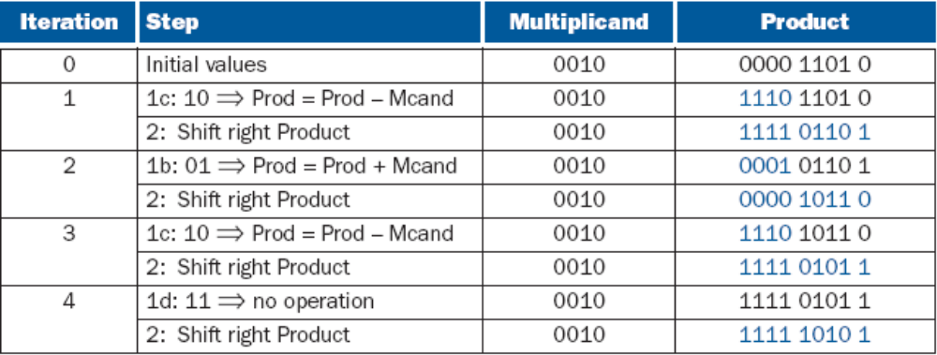
Example
2₁₀ ×-3₁₀ = 0010₂ × 1101₂

Slide 28
Division

Slide 29
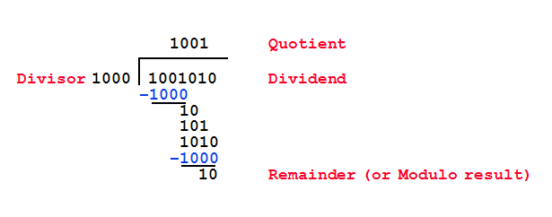
Divide: Paper and Pencil
See how big a number can be subtracted, creating quotient bit on each step
Binary → 1 × divisor or 0 × divisor
Dividend = Quotient × Divisor + Remainder

Slide 30
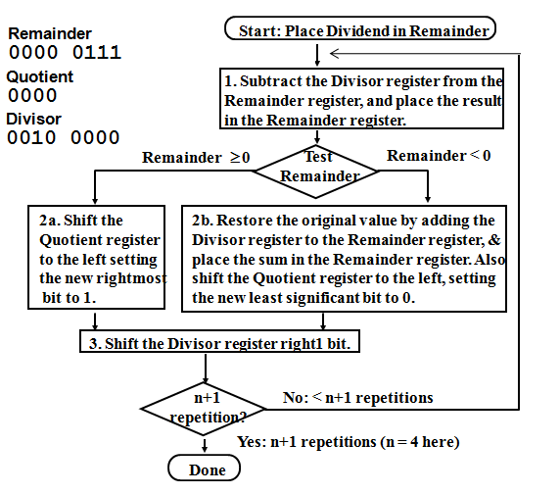
Restoring Division Algorithm

Slide 31
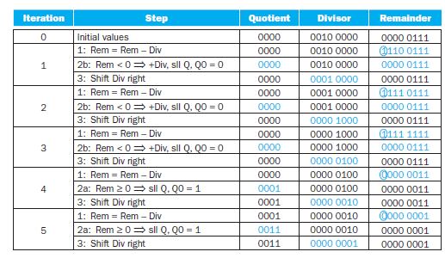
Division Example
Using a 4-bit version of the algorithm to save pages, let’s try dividing 7_{ten} by 2_{ten}, or 0000 0111_{two} by 0010_{two}.

Slide 32
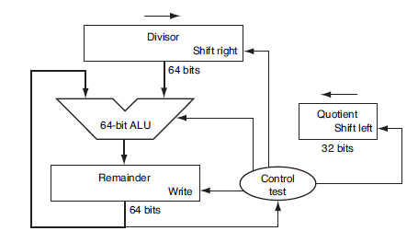
Hardware

Slide 33
Hardware
The Divisor register, ALU, and Remainder register are all 64 bits wide, with only the Quotient register being 32 bits.
The 32-bit divisor starts in the left half of the Divisor register and is shifted right 1 bit each iteration.
The remainder is initialized with the dividend.
Control decides when to shift the Divisor and Quotient registers and when to write the new value into the Remainder register.

