Slide 1
CSE-413
Computer Architecture
Lecture 9

Slide 2
Representing Instructions in the Computer

Slide 3
Introduction
Instructions are kept in the computer as a series of high and low electronic signals and may be represented as numbers.
Since registers are referred to by almost all instructions, there must be a convention to map register names into numbers.
In MIPS assembly language, registers $s0 to $s7 map onto registers 16 to 23, and registers $t0 to $t7 map onto registers 8 to 15.
Hence, $s0 means register 16, $s1 means register 17, $s2 means register 18, . . . , $t0 means register 8, $t1 means register 9, and so on.

Slide 4
Example
add $t0,$s1,$s2
The decimal representation is
Each of these segments of an instruction is called a field. The first and last fields (containing 0 and 32 in this case) in combination tell the MIPS computer that this instruction performs addition.
The second field gives the number of the register that is the first source operand of the addition operation (17 = $s1), and the third field gives the other source operand for the addition (18 = $s2).
The fourth field contains the number of the register that is to receive the sum (8 = $t0).
The fifth field is unused in this instruction, so it is set to 0.
Thus, this instruction adds register $s1 to register $s2 and places the sum in register $t0.

Slide 5
Continue
This instruction can also be represented as fields of binary numbers as opposed to decimal:
This layout of the instruction is called the instruction format.
As you can see from counting the number of bits, this MIPS instruction takes exactly 32 bits—the same size as a data word.
In keeping with our design principle that simplicity favors regularity, all MIPS instructions are 32 bits long.

Slide 6
Continue
To distinguish it from assembly language, we call the numeric version of instructions machine language and a sequence of such instructions machine code.
It would appear that you would now be reading and writing long, tedious strings of binary numbers.
We avoid that tedium by using a higher base than binary that converts easily into binary.
Since almost all computer data sizes are multiples of 4, hexadecimal (base 16) numbers are popular. Since base 16 is a power of 2, we can trivially convert by replacing each group of four binary digits by a single hexadecimal digit, and vice versa.

Slide 7
Continue
This layout of the instruction is called the instruction format.
As you can see from counting the number of bits, this MIPS instruction takes exactly 32 bits—the same size as a data word.
In keeping with our design principle that simplicity favors regularity, all MIPS instructions are 32 bits long.

Slide 8
Continue
To distinguish it from assembly language, we call the numeric version of instructions machine language and a sequence of such instructions machine code.
It would appear that you would now be reading and writing long, tedious strings of binary numbers.
We avoid that tedium by using a higher base than binary that converts easily into binary.
Since almost all computer data sizes are multiples of 4, hexadecimal (base 16) numbers are popular. Since base 16 is a power of 2, we can trivially convert by replacing each group of four binary digits by a single hexadecimal digit, and vice versa.

Slide 9
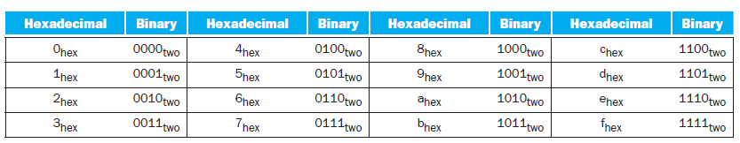
The hexadecimal-binary conversion table

Slide 10

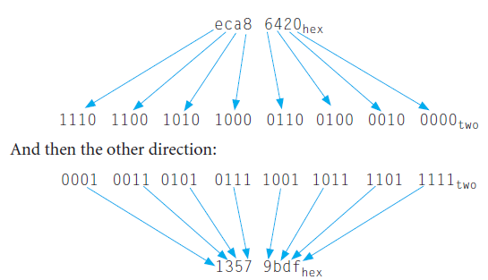
Example
Convert the following hexadecimal and binary numbers into the other base:

Slide 11

MIPS Fields
MIPS fields are given names to make them easier to discuss:
op: Basic operation of the instruction, traditionally called the opcode. The field that denotes the operation and format of an instruction.
rs: The first register source operand.
rt: The second register source operand.
rd: The register destination operand. It gets the result of the operation.
shamt: Shift amount. (Not used and hence the field contains zero in this section.)
funct: Function. This field, often called the function code, selects the specific variant of the operation in the op field.

Slide 12

Continue
The format previous slide is called R‑type (for register) or R-format.
A second type of instruction format is called I-type (for immediate) or I-format and is used by the immediate and data transfer instructions.
The fields of I-format are
The 16-bit address means a load word instruction can load any word within a region of ±2¹⁵ or 32,768 bytes (or 8192 words) of the address in the base register rs. Similarly, add immediate is limited to constants no larger than ±2¹⁵.

Slide 13
Example
lw $t0,32($s3)
Here, 19 (for $s3) is placed in the rs field, 8 (for $t0) is placed in the rt field, and 32 is placed in the address field.
Note that the meaning of the rt field has changed for this instruction: in a load word instruction, the rt field specifies the destination register, which receives the result of the load.

Slide 14
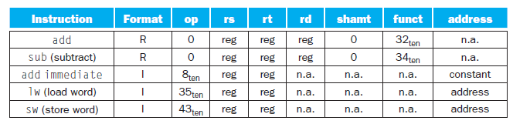
MIPS Instruction Encoding
Although multiple formats complicate the hardware, we can reduce the complexity by keeping the formats similar.
For example, the first three fields of the R-type and I-type formats are the same size and have the same names; the length of the fourth field in I‑type is equal to the sum of the lengths of the last three fields of R‑type.

Slide 15
MIPS Instruction Encoding-Continue
The formats are distinguished by the values in the first field: each format is assigned a distinct set of values in the first field (op) so that the hardware knows whether to treat the last half of the instruction as three fields (R-type) or as a single field (I-type).

Slide 16
MIPS Instruction Encoding-Continue
In the table above, “reg” means a register number between 0 and 31, “address” means a 16-bit address, and “n.a.” (not applicable) means this field does not appear in this format.
Note that add and sub instructions have the same value in the op field; the hardware uses the funct field to decide the variant of the operation: add (32) or subtract (34).

Slide 17
Example
If $t1 has the base of the array A and $s2 corresponds to h, the assignment statement A[300] = h + A[300]; is compiled into
lw $t0,1200($t1) # Temporary reg $t0 gets A[300]
add $t0,$s2,$t0 # Temporary reg $t0 gets h + A[300]
sw $t0,1200($t1) # Stores h + A[300] back into A[300]
What is the MIPS machine language code for these three instructions?

Slide 18
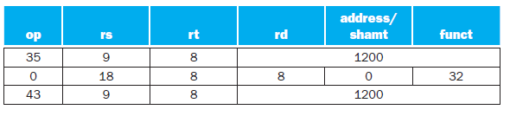

Solution
lw $t0,1200($t1) # Temporary reg $t0 gets A[300]
add $t0,$s2,$t0 # Temporary reg $t0 gets h + A[300]
sw $t0,1200($t1) # Stores h + A[300] back into A[300]

Slide 19
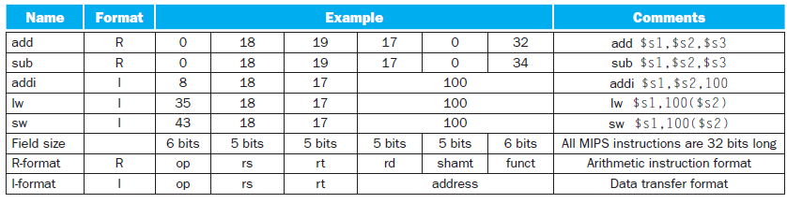
MIPS Machine Language

Slide 20
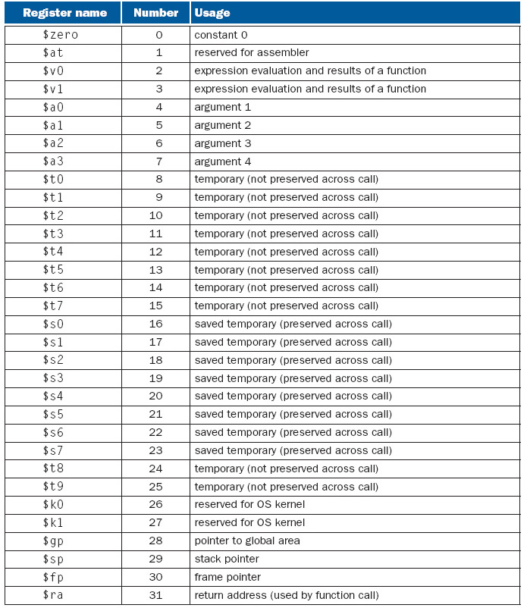
MIPS Registers

Slide 21
Stack Control

Slide 22
Stack Control
A stack is a sequence of storage locations that are accessible from only one end referred to as the top of the stack.
Two operations: Push and Pop.
Push or pop changes the position of the stack top by an amount that depends on the length of the operand pushed or popped.
A stack is controlled by an address register called the stack pointer SP. It contains the address of the new stack top.

Slide 23
Stack Control in Motorola 680X0
Motorola 680X0 has no explicit hardware for stack support. But its various addressing modes make it easy to treat any contiguous region of its external memory M as a stack.
Suppose the address register A2 of the 680X0 is designated as stack pointer and the stack grows toward the low addresses of M.
To push the content of D6 (data register) into the stack requires a single instruction MOVE.L D6, -(A2) which is equivalent to A2:=A2-4 and M(A2):=D6.
The pop instruction is MOVE.L (A2)+, D6 which is equivalent to D6:=M(A2) and A2:=A2+4

Slide 24
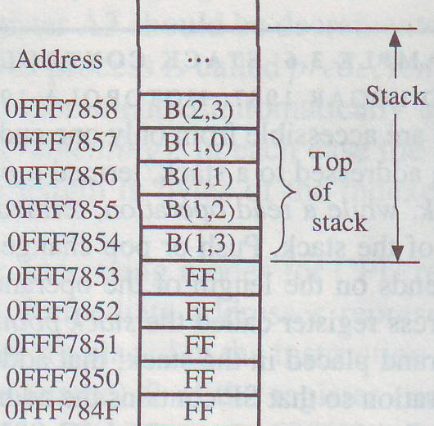
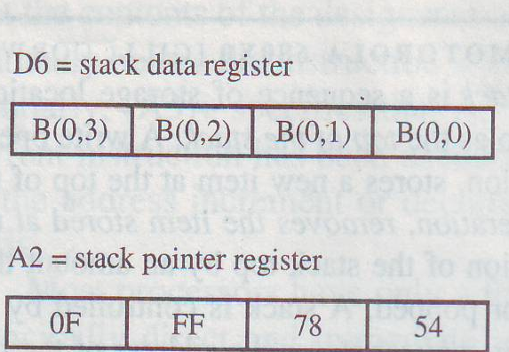
Stack Control in Motorola 680X0
Prior the execution of MOVE.L D6, -(A2)

Slide 25
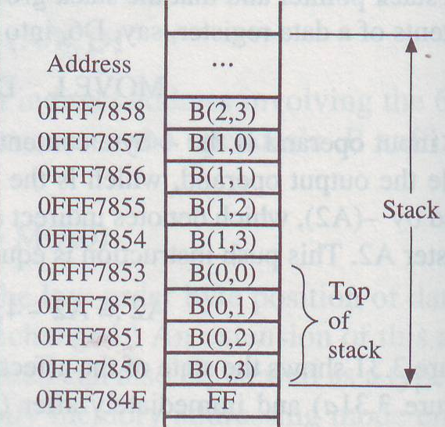
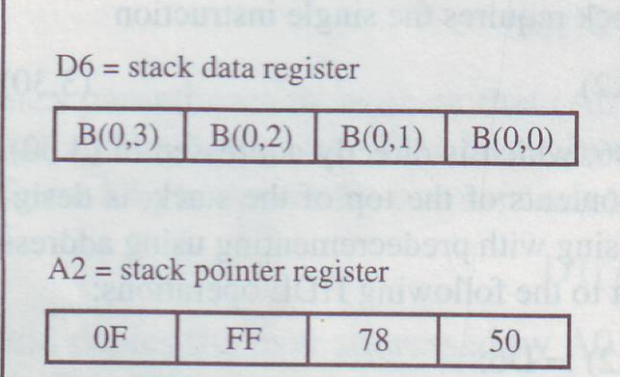
Stack Control in Motorola 680X0
After the execution of MOVE.L D6, -(A2)

Slide 26
Number of addresses
Three-address instruction:
ADD Z, X, Y
Z:= X+Y.
Two-address instruction:
ADD X, Y
X:= X+Y.
One-address instruction:
ADD X
AC:=AC+X.

Slide 27
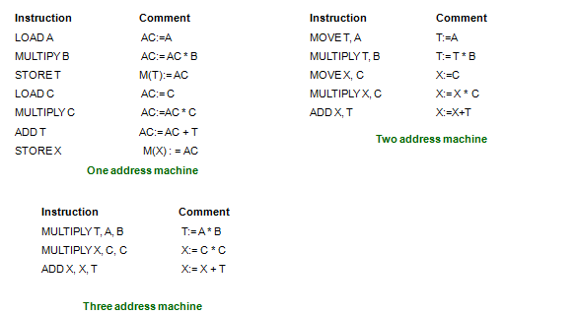
Number of addresses
Implement X:=A×B+C×C, where A, B, C and X are stored in the memory.

Slide 28

Accumulator Architecture
Instruction set:
  add A, sub A, mult A, div A, . . .
  load A, store A
Example: A*B - (A+B*C)
  load B
  mul C
  add A
  store D
  load A
  mul B
  sub D

Slide 29
Accumulator Architecture : Pros and Cons
Pros
  Very low hardware requirements
  Easy to design and understand
Cons
  Accumulator becomes the bottleneck
  Little ability for parallelism or pipelining
  High memory traffic

Slide 30
Zero Address Machine (Stack Based Architecture)
Addresses are eliminated by storing operands in a push-down stack.
All the operands are required to be in the top locations in the stack.
Stack pointer automatically keeps track of the stack top.
Push and pop operations are needed to transfer data to and from the stack.
For example, X+Y is invoked by ADD that causes the top two operands, which should be X and Y, to be removed from the stack and added. The resulting sum X+Y is then placed at the top of the stack.

Slide 31
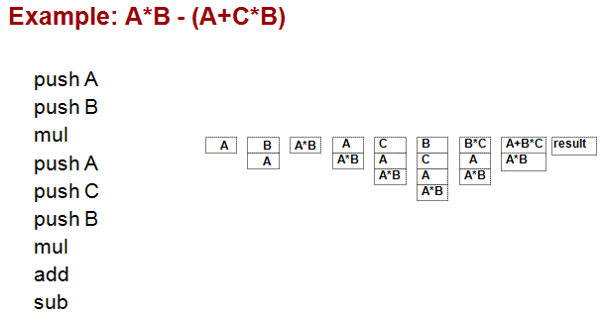
Stack Architectures

Slide 32
Stack Architecture: Pros and Cons
Pros
  - implicit operand addressing. Maintained by top of the stack.
  - Low hardware requirements.
Cons
  - Stack becomes the bottleneck.
  - Little ability for parallelism or pipelining.
  - Data is not always at the top of stack when need, so additional instructions like POP and SWAP are needed.

