Slide 1




rpabot
Record a task once. Replay it safely, row by row.
User guide for the team · version 0.2.0
REC
PLAY
EDIT
REPORT
Notes:
Welcome. This guide shows what rpabot does, how to use it step by step, and the habits that keep automated work safe.

Slide 2
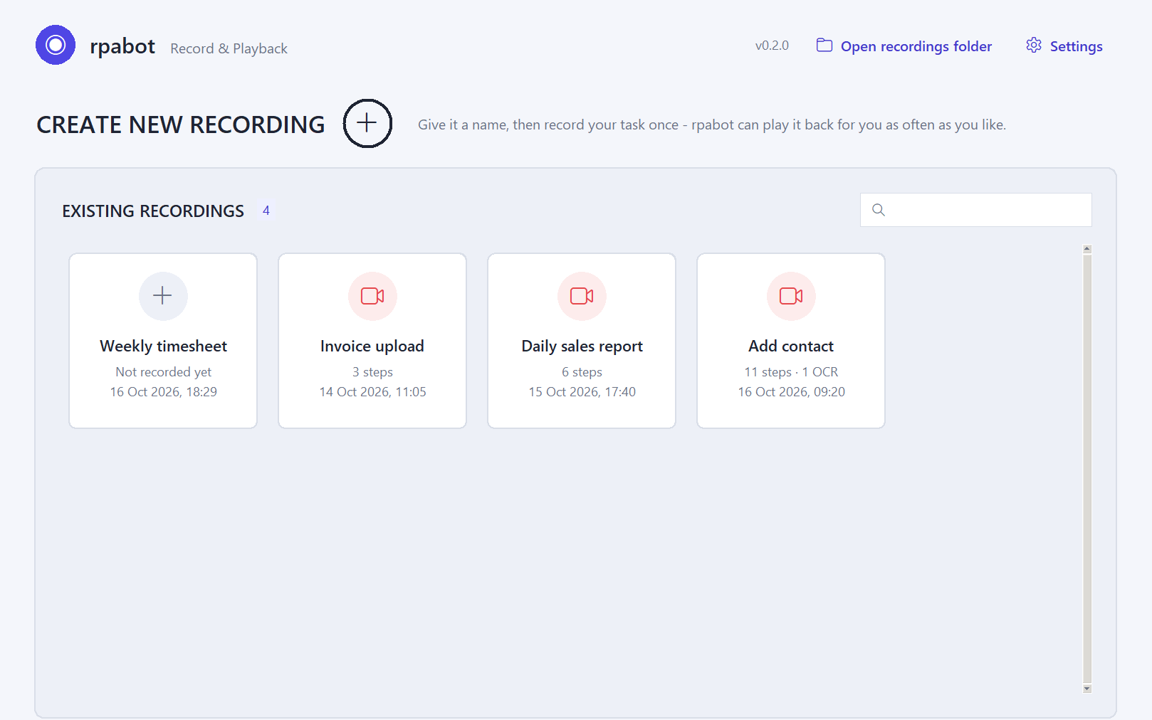

What rpabot does
OVERVIEW
Record once
Do the task one time. rpabot saves every click, typed text and key press as a step.
Play back, row by row
It repeats the steps with the real mouse and keyboard, once per row of an Excel or CSV file.
Check the screen (OCR)
It can read a message such as “No results found” and skip that row safely.
See exactly what it does
Every recording has a clear step list and a readable report.
The rpabot home page: all your recordings in one place
Notes:
rpabot records what you do on the computer once, then plays it back for you. It can repeat the task for every row of an Excel file, check the screen for messages, and show a readable report of every step.

Slide 3


When to use it, and when not
OVERVIEW
Good fit
Not a good fit
The same steps, repeated many times: data entry, uploads, forms
Values come from an Excel or CSV list
Screens and page layout stay the same every time
You can test it once and check the result
Each case needs a human decision
The page layout or window positions change often
Payments, deletions or anything you can't undo, unless tested and guarded by an OCR check
The PC will be locked or used by someone else while it plays
Rule of thumb: if the task could be written as a fixed checklist, rpabot can probably do it.
Notes:
Use rpabot for repetitive work on screens that stay the same. Do not use it where every case needs a decision, where the layout keeps changing, or for actions you cannot undo unless you have tested them and guarded them with a check.

Slide 4
The safe way to use rpabot: 10 steps
WORKFLOW
1
PREPARE
2
PREPARE
3
RECORD
4
REVIEW
5
PREPARE
Open the pages and the data you need
Arrange tabs and windows
Record the task once
Review and delete extra steps
Check tab, window, page and focus
6
PLAY
7
REVIEW
8
PLAY
9
PLAY
10
VERIFY
Test once with one row
Fix anything that went wrong
Play all rows when it is safe
Watch it; stop with F10 if needed
Check the results in the app
Most problems come from skipping step 5 (wrong page in front) or step 6 (no test run).
Notes:
This is the whole workflow on one page. Prepare, record, review, check that the right page is in front, test once, fix, then play everything, watch it, and verify the results.

Slide 5
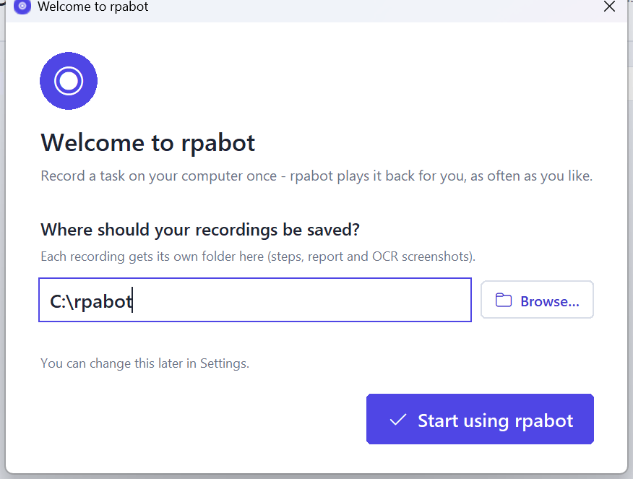
Install and first start
GETTING STARTED
1
Run the setup rpabot_setup_0.2.0.exe. If Windows SmartScreen warns: More info → Run anyway.
2
Choose who it is for “Only for me” needs no administrator rights.
3
Install folder Keep the suggested folder or pick another.
4
Recordings folder Where recordings are saved. Default C:\rpabot.
5
Shortcut and finish Desktop shortcut, Install, then Start rpabot now.
No folder chosen in setup? rpabot asks on the first start (right). Change it any time in Settings.
Notes:
Run the setup file. Choose to install only for you, which needs no admin rights. Pick where your recordings are saved; the default is C colon rpabot. If you skip that, rpabot asks on its first start, and you can change it later in Settings.

Slide 6
The home page
GETTING STARTED
4
5
1
Create new recording Name it, then record.
1
2
A recording Click to open it. Right-click: Play, Open folder.
3
2
3
Search Find a recording by name.
4
Recordings folder Opens it in File Explorer.
5
Settings Where recordings are saved.
Notes:
The home page lists your recordings as cards. Use the plus button to create a new one, click a card to open it, search by name, open the recordings folder, or change the folder in Settings.

Slide 7
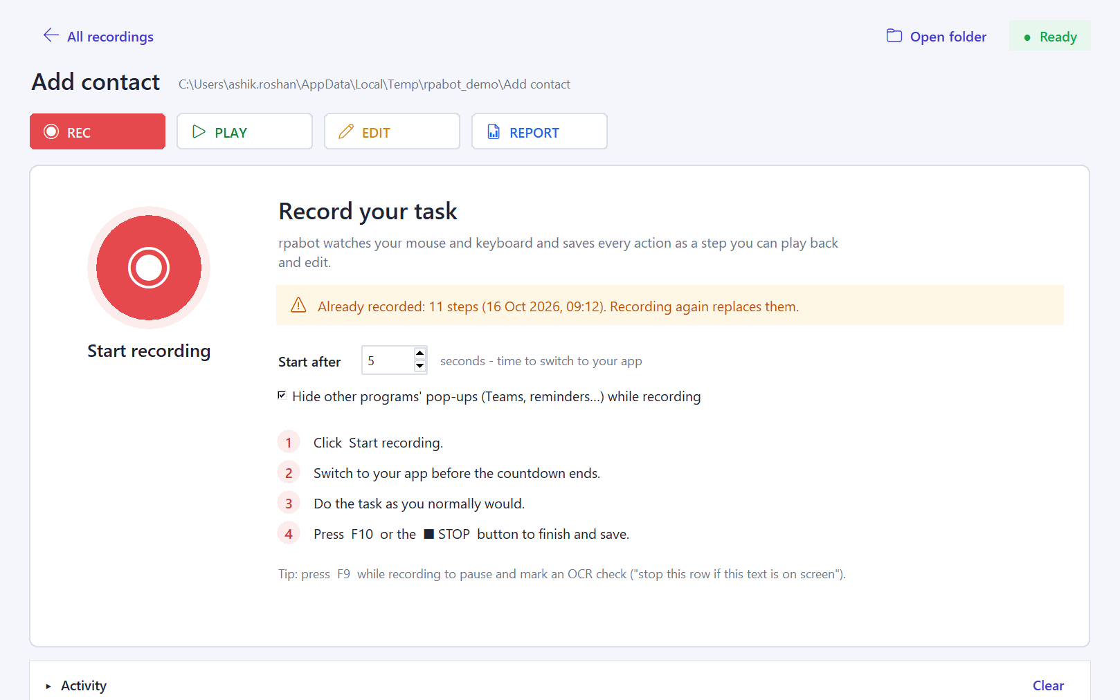
Inside a recording
GETTING STARTED
5
1
REC Record or re-record the task.
1
2
3
4
2
PLAY Run it, with data and options.
3
EDIT See and change the steps.
4
REPORT A readable page of all steps.
5
Status Ready, Starting, Recording, Playing.
6
Activity What rpabot is doing. Click to see the full log.
6
Notes:
Each recording has four sections: REC to record, PLAY to run it, EDIT to change the steps and REPORT for a readable overview. The status shows what is happening, and the Activity bar keeps a log.

Slide 8
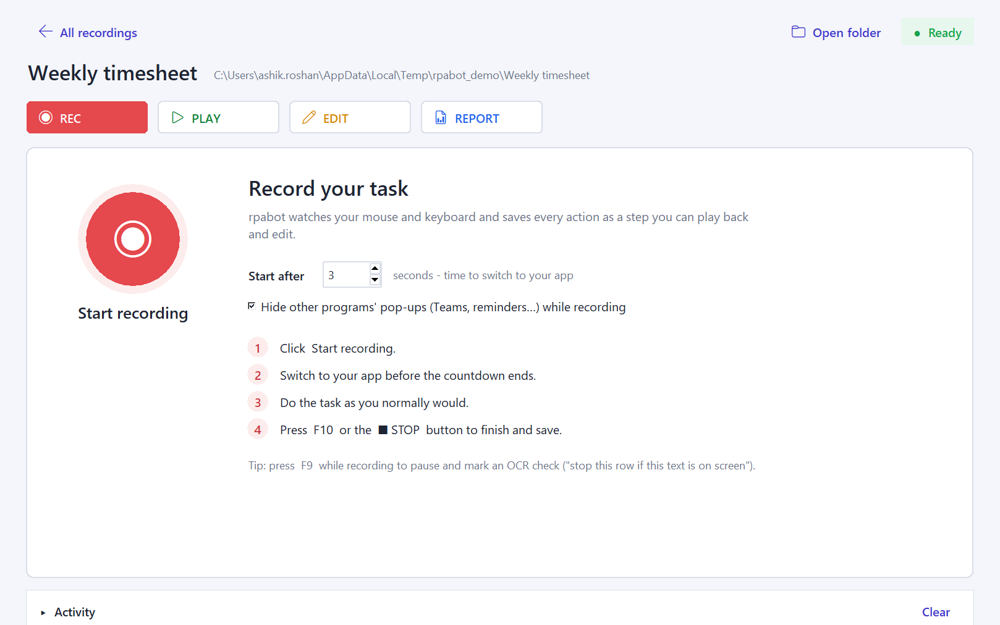

Record a task
RECORD
1
Prepare Open the page you start from: logged in, right tab, zoom 100%.
2
Start after Seconds to switch to your app before recording starts.
3
2
3
Start recording The window steps aside and a countdown begins.
4
Do the task once Calmly. Click into each field before typing.
5
Finish Press F10 or click ■ STOP. The steps are saved.
The STOP bar stays on top; its clicks are never recorded.
Notes:
Open the page you want to start from. Set the start delay, click Start recording, switch to your app, and do the task once, calmly. Click into each field before you type. Press F10 or the stop bar to finish.

Slide 9
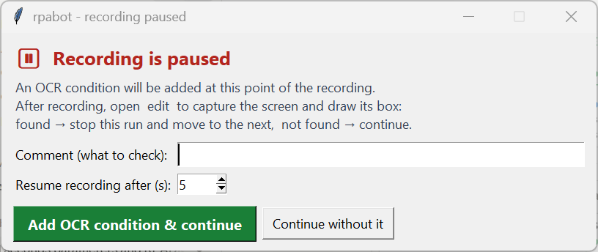
Mark a check while recording: F9
RECORD
Use F9 at the moment a message could appear
For example “already exists”, “No results found” or an error.
Recording pauses. Type what to check, then Add OCR condition & continue.
You get a few seconds to switch back to your app.
Nothing you do during the pause is recorded.
Finish the check later in the step editor: capture the screen, draw a box, type the text.
Tip: F9 and F10 are rpabot's own keys. They are never saved as steps.
Notes:
If a message can appear at some point, for example already exists or no results found, press F9 at that moment. Recording pauses and you add an OCR check. You finish it later in the step editor.

Slide 10
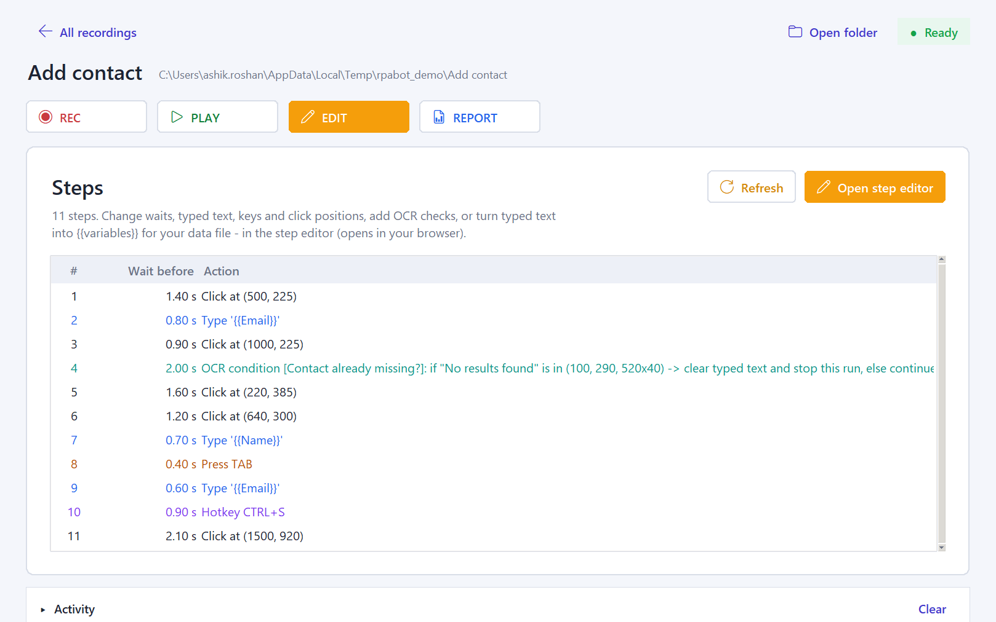
Review the steps
REVIEW AND EDIT
Colours in the list
Clicked / Hovered / Scrolled
Typed text
Key pressed
Shortcut (keys together)
OCR condition
Read it top to bottom, like a script.
Look for stray clicks and very long waits.
Double-click a row or Open step editor to change it.
Notes:
After recording, open EDIT. Read the steps from top to bottom like a script. Look for clicks you did not mean, and for long waits from thinking. Open the step editor to fix them.

Slide 11
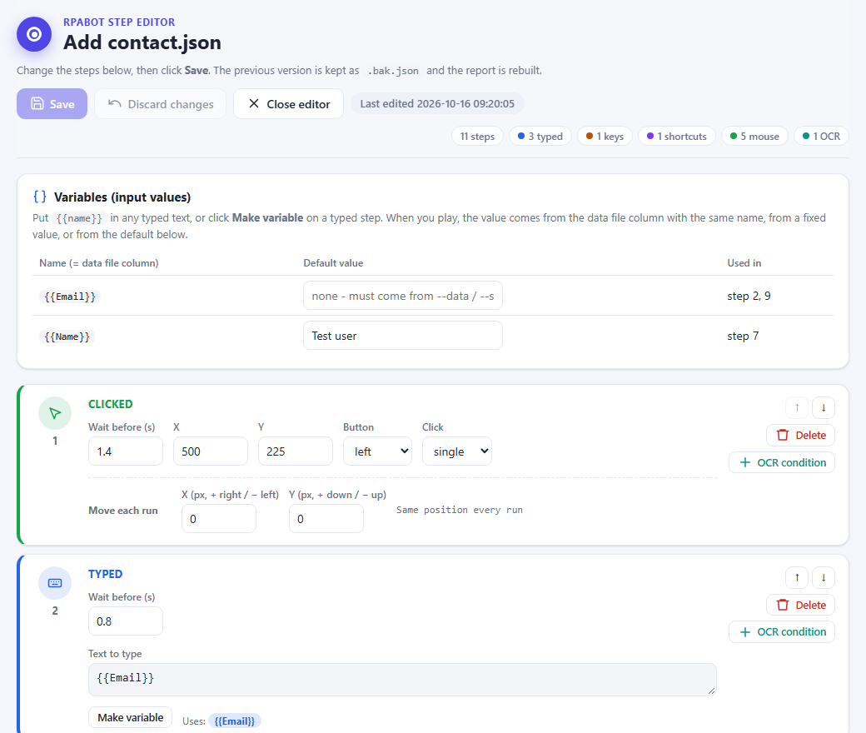


Step editor: change, delete, reorder
REVIEW AND EDIT
Change a step
Wait before, text to type, keys, X / Y of a click.
Delete or move
Delete removes a step; ↑ ↓ change the order.
Make variable
Turns typed text into {{Name}}, filled from Excel.
+ OCR condition
Adds a screen check after any step.
Save
Old version kept as .bak.json; report rebuilt.
To add new clicks or typing, record again.
Notes:
In the step editor you can change waits, typed text, keys and click positions, delete or reorder steps, turn typed text into a variable for your Excel file, and add OCR checks. Save keeps a backup.

Slide 12
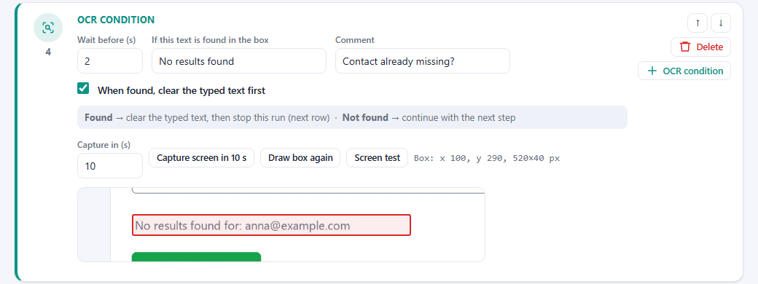
OCR checks: stop a row safely
REVIEW AND EDIT
1
Capture Set Capture in (s), click Capture screen, switch to the app showing the message.
2
Draw a box Drag a box around the message. It is read straight away.
3
Text to look for For example No results found. Upper and lower case don't matter.
4
Screen test, Save Check it reads the box, then save.
Found
Clear typed text
Stop this row, next row runs
Not found
Continue with the next step
Keep the app window in the same place and size as when you captured it.
Notes:
An OCR check reads a box on the screen. If the text is found, rpabot clears what it typed and stops that row, and the next row goes on. If it is not found, the steps simply continue.

Slide 13
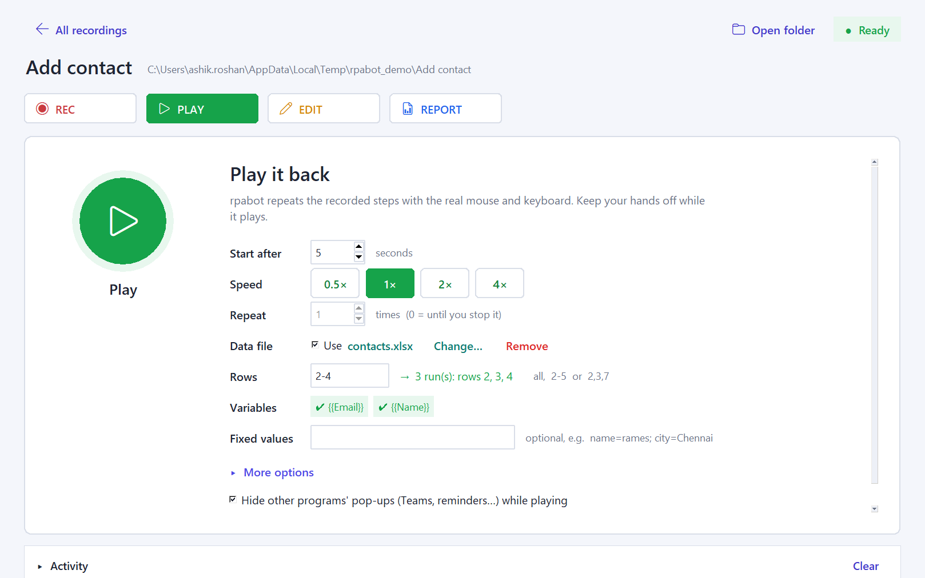
Play it back
PLAY
1
Start after Seconds before it starts.
2
Speed 0.5× to 4×. Test at 1×.
8
3
Repeat Without a data file. 0 = until stopped.
1
4
Data file Excel / CSV: one run per row.
2
3
4
5
Rows Which rows, e.g. 2-4. Checked as you type.
5
6
6
Variables Green = column found in the file.
7
7
Fixed values Same value for every run.
8
Play Window steps aside at the countdown.
Notes:
In PLAY, set the start delay and speed, pick your Excel file and the rows to run, and check that every variable is found. Then press Play. The window steps aside when the countdown begins.

Slide 14
Excel data and variables
PLAY
A
B
Step 2: Type {{Email}}
Run 1 types anna@example.com, run 2 bala@example.com, run 3 chitra@example.com.
1
Name
Email
2
Anna
anna@example.com
3
Bala
bala@example.com
Row 1 holds the column names. Every other row is one run.
A column named like the variable fills it: Email → {{Email}}.
Rows use Excel's row numbers: all, 2-5 or 2,3,7.
No column? The variable's default value is used (set in the step editor).
Fixed values (name=value) give every run the same value.
4
Chitra
chitra@example.com
5
Dev
dev@example.com
Rows 2-4 selected → 3 runs
Make a variable in the step editor: Make variable on a typed step.
Notes:
Your Excel file's first row holds the column names; every other row is one run. A column named Email fills the variable Email. Choose rows by their Excel numbers, for example 2 to 4 gives three runs.

Slide 15

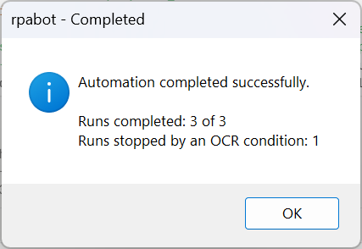
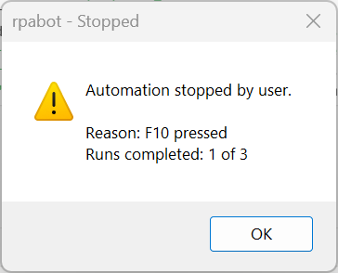



Stopping safely
PLAY
Press F10
Stops recording or playback. Held keys are released.
When playback ends, a pop-up tells you
Click ■ STOP
The floating bar; it moves away if a step clicks under it.
Mouse to the top-left corner
Playback only: a quick emergency stop.
Something unexpected? Stop first, then look.
Check what was already entered in the app before you play again.
Force stop (window)
Last resort. Recording is not saved.
Notes:
To stop, press F10 or click the stop bar. During playback you can also push the mouse into the top left corner. When it ends, a pop-up says completed or stopped. If anything looks wrong, stop first, then check.

Slide 16
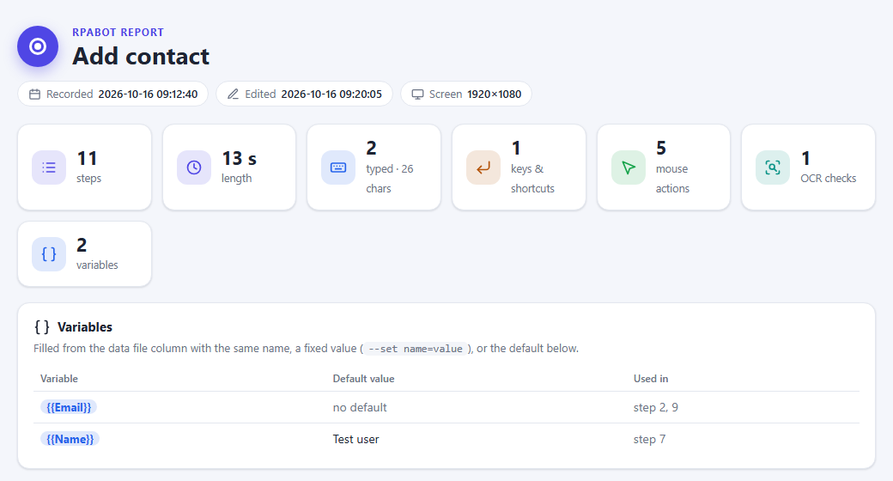
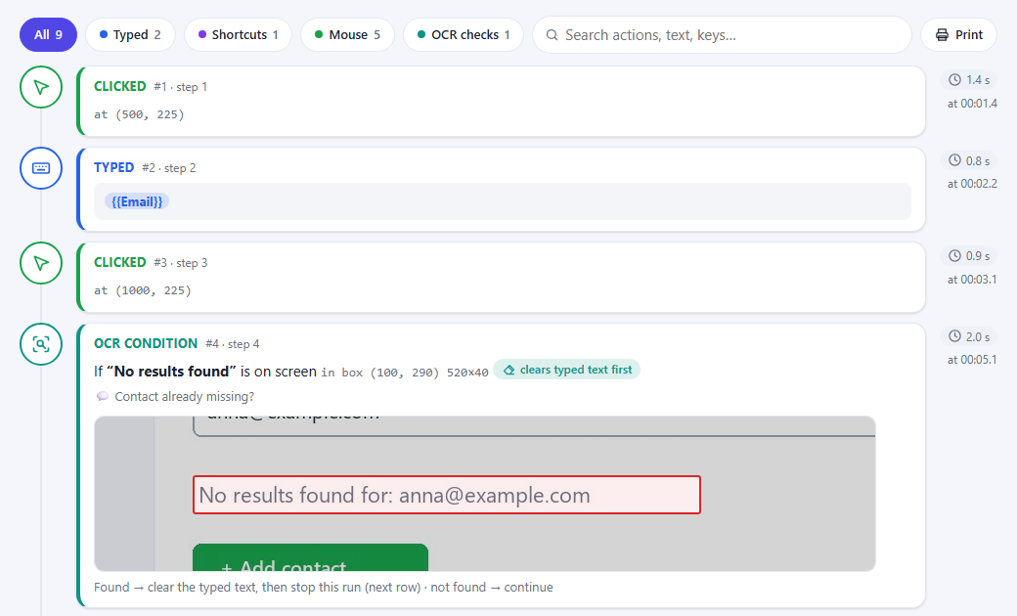
The report: what the recording does
REVIEW
Open it from REPORT → Open report. It opens in your browser.
Filter, search and print. Share it so a colleague can review.
OCR checks show their screenshot with the red box.
Notes:
The report is a readable page of every step, with filters, search and print. Share it so a colleague can check what the recording will do before it runs on real data.

Slide 17



Test once, then repeat
BEST PRACTICES
Test
Check
Fix
Run all
Verify
Rows: one row only, speed 1×. Watch it.
Look at the result in the app.
Correct steps in the editor.
Then play the remaining rows.
Confirm no duplicates or wrong records.
Prevent duplicates and wrong data
End the recording on the page where it started, so every run begins the same way.
Add an OCR check for “already exists” or error messages, with clear typed text on.
Never re-run rows that already worked. Set Rows to the remaining ones, e.g. 5-20.
Keep a copy of the data file and note which rows are done.
Notes:
Always test with a single row first, at normal speed, and watch it. Check the result in the app, fix the steps, and only then run the remaining rows. Never re-run rows that already worked.

Slide 18






Browser: tabs, windows and pages
BEST PRACTICES
Start page
Tabs
Window and zoom
Record from the exact page each run starts on, and finish back there.
New Ctrl+T · switch Ctrl+Tab or Ctrl+1–8 · close Ctrl+W · reopen Ctrl+Shift+T.
Keep the browser maximized and zoom at 100% (Ctrl+0), same screen and scaling.
Page loading
Pop-ups and prompts
Navigation
Wait until buttons show before clicking while recording; that wait is saved.
rpabot hides other programs' pop-ups. Clear cookie, password and permission prompts first; Do not disturb: Win+N.
During playback don't refresh, open links, scroll or switch tabs.
General good practice. Shortcuts shown for Edge and Chrome on Windows; others may differ.
Notes:
In the browser: start from the same page every time, keep the window maximized at one hundred percent zoom, wait for pages to load while recording, clear browser prompts before you start, and do not touch tabs during playback.

Slide 19


Coming back to the original workflow
BEST PRACTICES
1. Finish the side task
2. Close it
3. Return
4. Verify the page
5. Then play
in the other tab or app
Ctrl+W when done
to the original tab: click it or Ctrl+Tab
right record, empty fields, nothing half-typed
or play again
rpabot clicks screen positions. It does not know which tab is open.
If another tab or window is in front, the clicks and typing go there. Always confirm the active tab and page before you press Play.
Notes:
If you need to do something else in another tab, finish it, close that tab, return to the original tab, and check the page before you press play. rpabot clicks screen positions; it does not know which tab is open.

Slide 20


Mouse and keyboard
BEST PRACTICES
Mouse
Keyboard
Clicks are saved as screen positions: same screen, scaling and window place.
Single, double and right-clicks, drags and scrolls play back as you did them.
Resting the mouse (hover) is saved too, e.g. to open a menu.
Delete stray clicks in the editor. Use Move each run for targets that shift.
Typed text, Tab, Enter and shortcuts like Ctrl+S are saved.
Click into the field first, so the text goes to the right place, and clearing works.
Don't touch the mouse or keyboard while it plays.
F9 (pause) and F10 (stop) are never saved as steps.
Keep the same screen layout and browser window size for recording and playback.
Notes:
Clicks are saved as positions on the screen, so keep the same screen, scaling and window size. Click into a field before typing. And keep your hands off the mouse and keyboard while it plays.

Slide 21
Common mistakes and fixes
TROUBLESHOOTING
Problem
Why it happens
Fix
Prevent it
Plays in the wrong tab or window
Another tab or app was in front
Stop (F10); bring the right page to front
Check the active tab before Play; start from the start page
Repeats before checking the result
All rows run straight away
Stop; check the data in the app
Test with one row first (Rows: 2)
Extra or wrong steps
Stray clicks while recording
Delete them in the step editor
Record calmly; review EDIT after recording
Clicks happen too early
Page still loading
Raise Wait before on that step
Wait for pages while recording; play at 1×
Pop-up or changed layout
Dialog, banner, zoom or window size
Close it; zoom 100% (Ctrl+0); maximize
Do not disturb (Win+N); same window size
Duplicate or wrong data
Rows re-run; text left in a field
Correct the records by hand
Rows = only the remaining ones; OCR check + clear typed text
Notes:
The most common problems: playing in the wrong tab, running everything without a test, leaving stray steps, clicking before the page has loaded, unexpected pop-ups, and duplicate data. Each has a simple fix.

Slide 22
Quick-reference checklist
CHECKLIST
Before recording
Before playing
While playing
After playing
Start page open and logged in
Steps reviewed, extras deleted
Hands off mouse and keyboard
Read the finish pop-up
Browser maximized, zoom 100%
Right tab and window in front
Watch the first runs
Check the results in the app
Do not disturb on (Win+N)
Tested once with one row
Unexpected? Press F10
No duplicates or wrong records
Data file ready, columns named
Rows set correctly
Note the rows still to do
Notes:
Print this page and keep it next to you for the first few weeks.

Slide 23


Remember
Test once
Right page in front
F10 stops
Verify results
One row, 1× speed, watch it.
Check the tab and window before Play.
Stop first, then look.
No duplicates, no wrong records.
Workflow: prepare → record → review → check the page → test → play → verify
Questions? Ask in the team channel. Check a PC: rpabot.exe doctor
Notes:
To sum up: test once, make sure the right page is in front, stop with F10 if anything looks wrong, and always verify the results. Thanks for watching.

