Slide 1
Mini Project
IR Based Object Counter with LCD Display Using Arduino
Presented by:
Ashika R (312322106024)
Aiswarya A (312322106009)

Slide 2
Abstract
IR-based object counter using Arduino and IR sensors.
Counts objects as they interrupt an IR beam.
Low power, cost-effective, suitable for automation applications.
Automate object counting using IR sensor.
Display count in real-time on LCD.
Reduce human errors and increase efficiency.
Design a scalable and low-cost system.

Slide 3
Components Used
Arduino UNO
IR Infrared Sensor Module
16x2 LCD Display
I2C (TWI 1602) Module
Jumper Wires and Breadboard
Power Supply (USB or 9V battery)

Slide 4
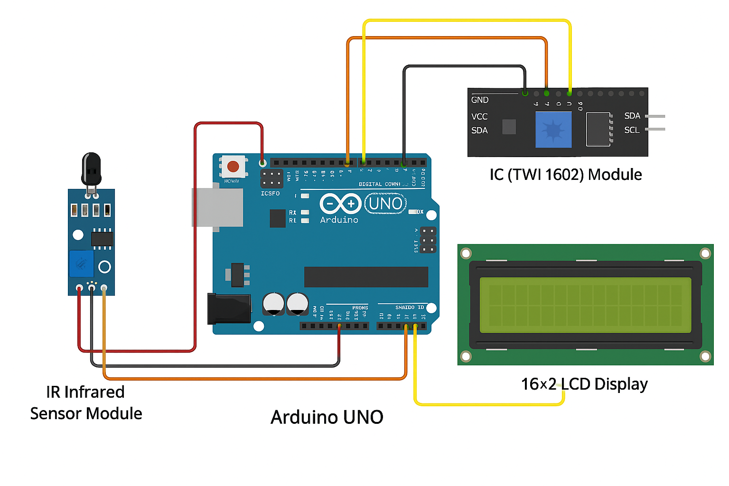

Slide 5
Working Principle
IR LED emits invisible beam, detected by photodiode.
Object interrupts beam -> signal sent to Arduino.
Arduino detects state change -> increments counter.
Count is displayed on LCD via I2C.

Slide 6
Arduino Code Overview
Detects beam interruption via digital input.
Flag variable to avoid multiple counts.
Count variable incremented on detection.
LCD updated with new count using I2C.

Slide 7
Applications
Product counting on conveyor belts.
People counting at events or buildings.
Inventory tracking in warehouses.
Educational electronics projects.

Slide 8
Advantages
Low cost and easy to assemble.
Real-time monitoring with LCD.
Reduces human error.
Compact and energy-efficient system.

Slide 9
Future Enhancements
Wireless data transmission (Wi-Fi, Bluetooth).
SD card logging for data history.
Touchscreen interface instead of LCD.
Advanced sensors (ultrasonic, vision, LiDAR).

Slide 10
Conclusion
IR-based counter automates object counting reliably.
Uses non-contact IR technology with real-time display.
Lays foundation for advanced automation systems.
Scalable, efficient, and low-cost design.

Slide 11
THANK YOU

