Slide 1
DIVERSITY & INCLUSION

Slide 2
Diversity & Inclusion Dashboard Report
Introduction
The Diversity & Inclusion dashboard, presented by PwC, provides a comprehensive overview of diversity and inclusion metrics within an organization, as represented by data on hiring, promotion, and leavers turnover rate for FY20. It breaks down the data by gender to offer insights into the gender distribution across different job levels of employment and performance ratings. . It provides insights into the executive gender balance, performance rating by gender, and employee distribution by age group for FY20 and FY21

Slide 3
Recommendations
Hiring: With 59% of hires being men, there is a need to explore strategies that encourage more gender
balance in recruitment processes. For example, PwC could implement a blind hiring policy, where candidates are evaluated based on their skills and qualifications rather than their names or backgrounds. PwC could also partner with organizations that promote women in STEM fields, such as Girls Who Code, to attract more female talent.
Promotion: While the number of women promoted is commendable, continuous efforts should be made to ensure equal opportunities for both genders. For instance, PwC could establish a mentorship program, where senior female leaders provide guidance and support to junior female employees. PwC could also conduct regular performance reviews and feedback sessions, where employees can voice their concerns and aspirations.

Slide 4
Leavers Turnover Rate: Implement retention strategies focusing on female employees as they have a higher turnover rate (11%) compared to male employees (9%). For example, PwC could offer flexible work arrangements, such as remote work or part-time options, to accommodate employees’ personal and professional needs. PwC could also create a culture of recognition and appreciation, where employees are rewarded for their contributions and achievements.
Gender Balance: There is a noticeable imbalance in the executive gender ratio, with males comprising 86.67%. Efforts should be intensified to attract and promote more female executives to achieve a balanced representation.
Performance Rating: Although both genders have almost equal average ratings, policies that ensure unbiased performance evaluations should be reinforced.
Age Group: The majority of employees are between 20-39 years old. Implement strategies to attract a diverse age group to enrich the organizational culture with varied experiences and perspectives.

Slide 5

Conclusion:
The organization has made strides in promoting diversity and inclusion but there is room for improvement especially in hiring practices and employee retention. There is gender parity in performance ratings, executive positions are predominantly held by males. The workforce is also majorly youthful; hence diversifying the age group should be a focus. Continuous efforts are essential to enhance diversity and inclusion across all facets of the organization.

Slide 6
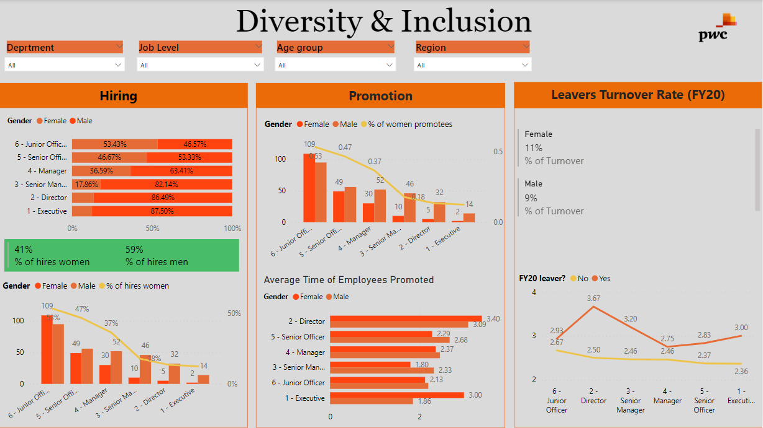

Slide 7
