Slide 1
Rockbuster Stealth Database Analysis
By: Ashika Patel

Slide 2
Project Overview
Rockbuster Stealth LLC
It is a movie rental company that used to have stores around the world. Facing stiff competition from streaming services such as Netflix and Amazon Prime, the Rockbuster Stealth management team is planning to use its existing movie licenses to launch an online video rental service in order to stay competitive.

Slide 3
Objectives & Key Questions
Film & Genre Analysis
Customer Analysis
Which movies contribute the most/least to revenue gain?
Where are customers with a high lifetime vallue based
01
02
03
04
05
Rental Analysis
Location Analysis
Spatial Analysis
What was the average rental duration for all videos?
Which countries are Rockbuster customers based in?
Do Sales figures vary between geographic regions?

Slide 4
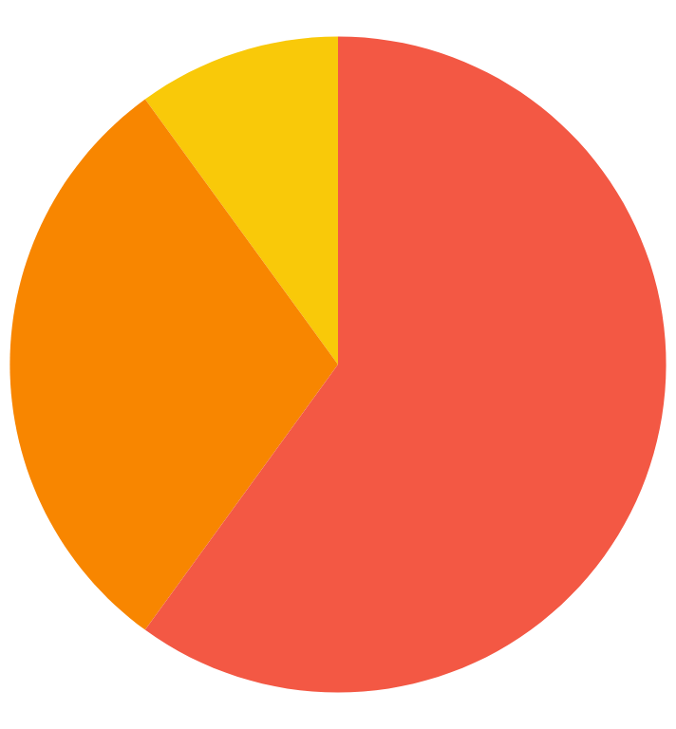
Company Overview
1000 Films
Films
$ 2.98
Rental Rate
PG-13
Avg Rating
4.95 Days
Rental Duration
Action!
599 Customers
Customers

Slide 5
Film Analysis
Top 5 Films
Bottom 5 Films
Title | Genre | Revenue
Telegraph Voyage | Music | $215.75
Zorro Arc | Comedy | $199.72
Wife Turn | Documentary | $198.73
Innocent Usual | Foreign | $191.74
Hustler Party | Comedy | $190.78
Title | Genre | Revenue
Rebel Airport | Music | $6.93
Freedom Cleopatry | Comedy | $5.95
Texas Watch | Horror | $5.94
Oklahoma Jumanji | New | $5.94
Duffel Apocalypse | Documentary | $5.94

Slide 6
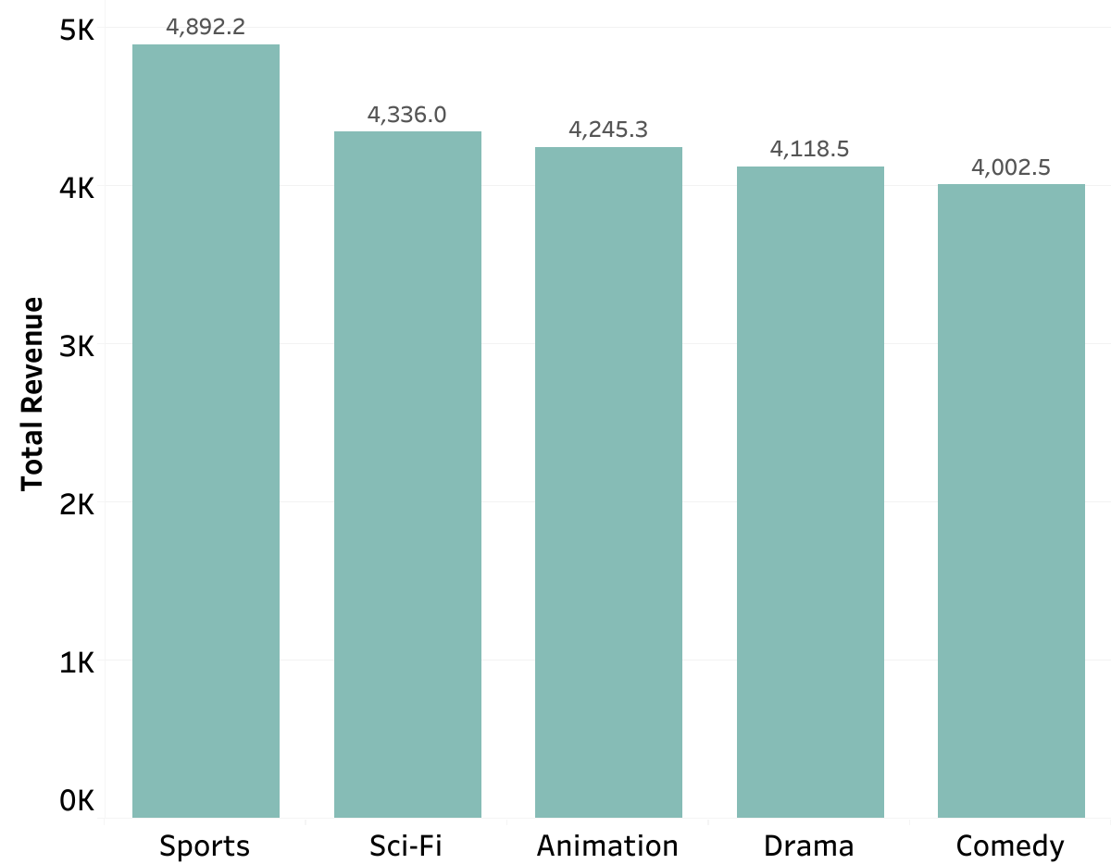
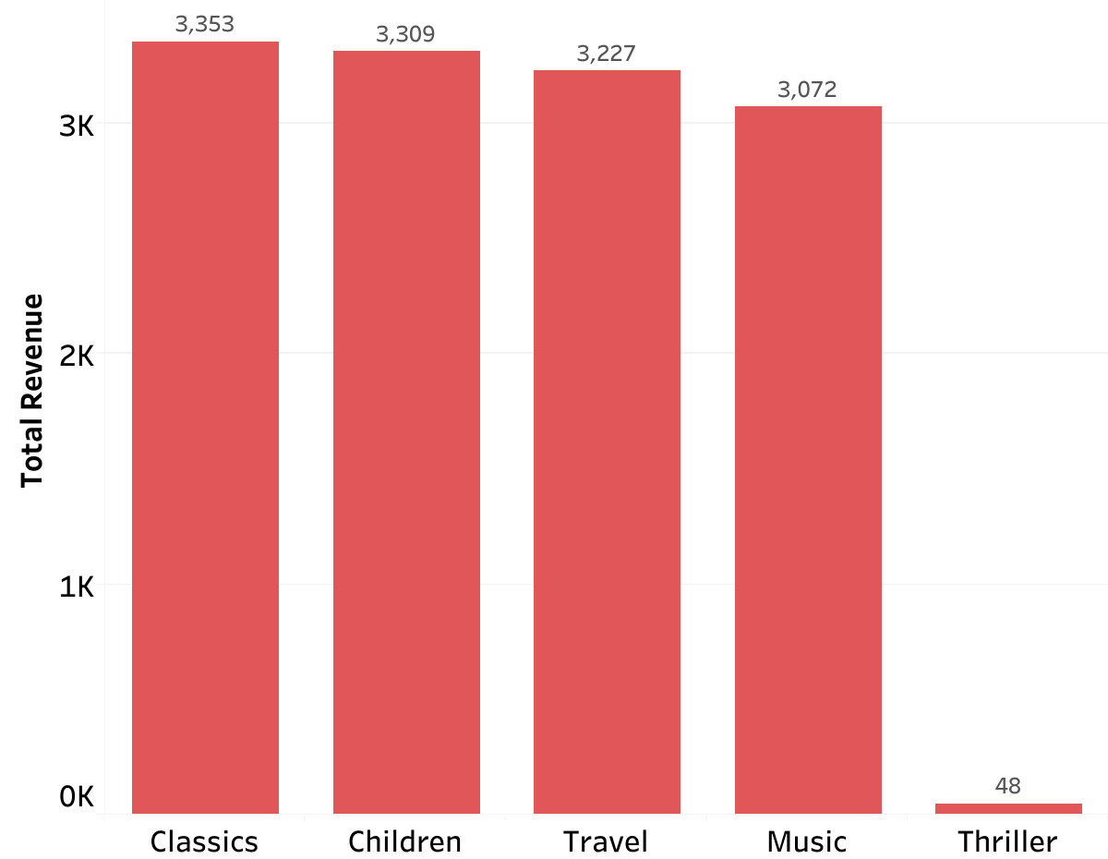
Genre Revenue Analysis
Top 5 Genres
Bottom 5 Genres
Top 5 genres make up more than 35% of total revenue.
The Thriller genre performs significantly lower than any other genre.

Slide 7
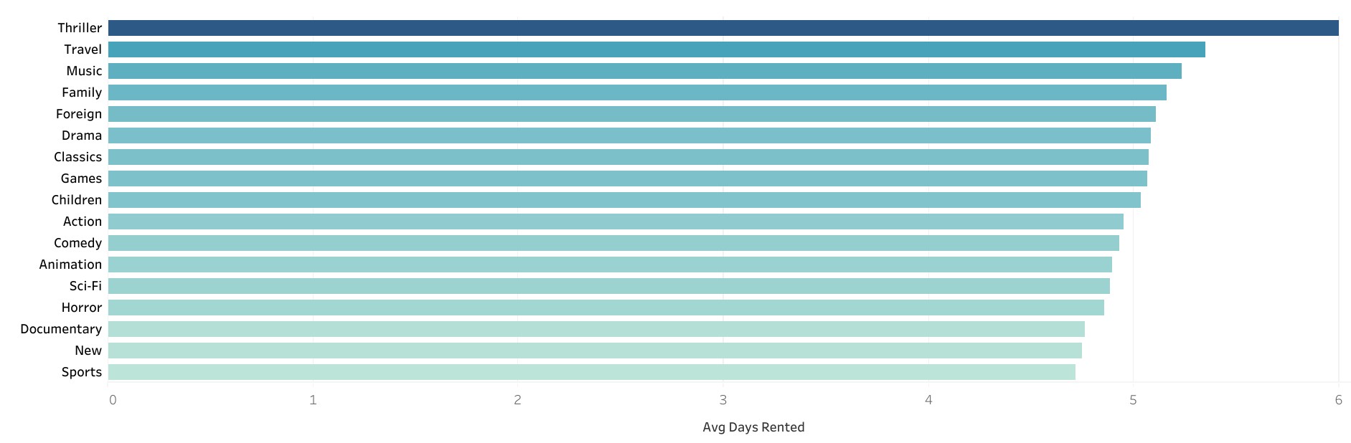
Rental Duration Analysis
The thriller genre has the longest rentals but least amount of revenue.
Rental duration is relatively consistent across genres
The average rental duration is 4.95 days.

Slide 8
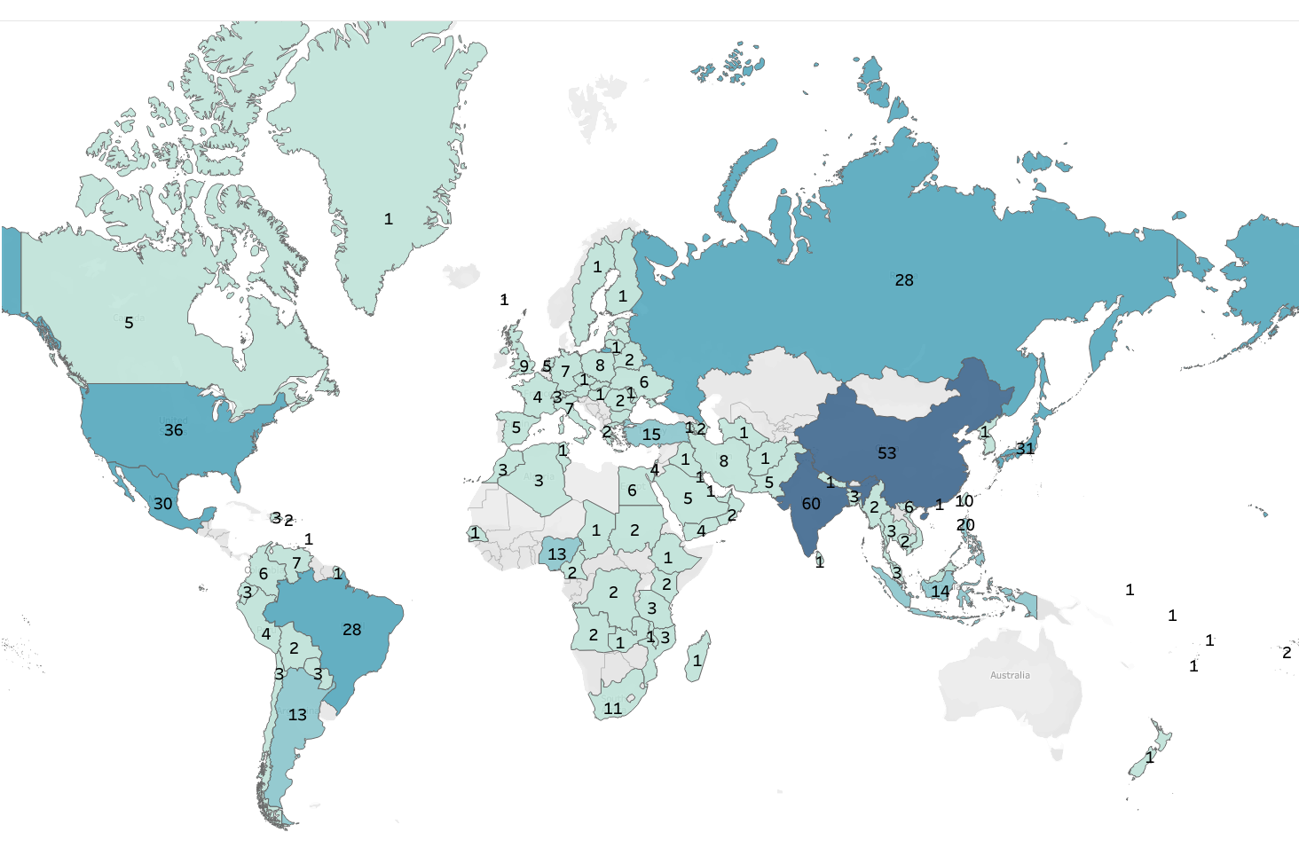

Location Analysis
Total Customer
There are a total of 599 customers worldwide in 109 countries
India
Has the most customers world wide
60 customers
China
05
Has the second highest customer count worldwide
53 customers
United States
05
Has the third most customers worldwide
36 customers
05

Slide 9
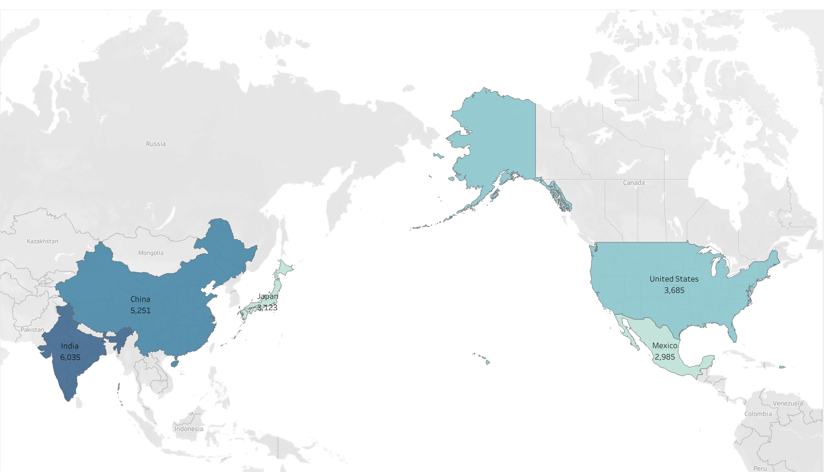

Spatial Analysis
Total Revenues
India
Has the highest revenue volume
$6,035
05
China
Has the second largest revenue total
$5,251
05
United States
Has the third highest revenue volume
$3,685
05

Slide 10
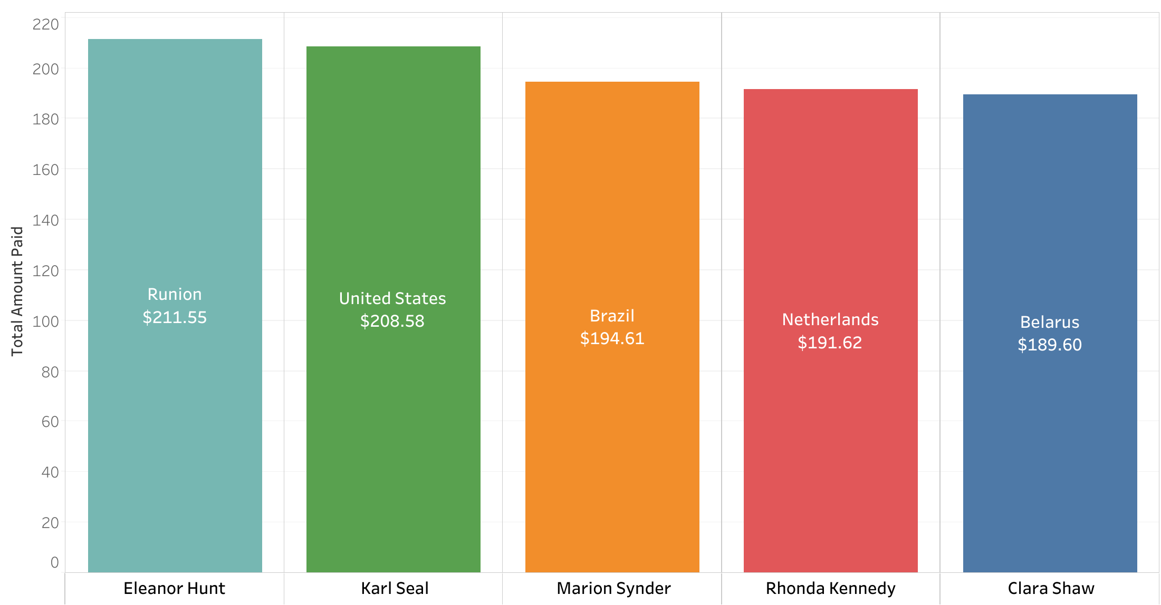
Customer Analysis
Top customer, Elentor Hunt, is not located in one of the 5 countries
Special FX
Film score
Only 1 of the top 5 countries for revenue is also a location for a top 5 customers

Slide 11
Recommendations & Suggestions
1
2
Engagement
Marketing
Create a reward program for customers with high rental volume and long-term plying accounts
Target geographical locations with high customer count to gain more customers
3
4
Film Collection
Social Media
Remaining movie licence should go to popular titles in the Sports, Sci-fi, Animation, Drama and Comedy genres
Create a platform where customers can interact with Rockbuster to win prizes and discounts

Slide 12
Questions?
Thank you!
Contact
ashikapatel90@gmail.com

