Slide 1
EMAIL SECURITY · QUICK OVERVIEW
SMTPS
Secure Simple Mail Transfer Protocol
How TLS protects email while it travels.
Notes:
SMTPS is SMTP with a secure TLS connection built in from the start. This short overview explains the connection, the handshake, the ports, and the limits of what it protects.

Slide 2


01 · THE BASIC IDEA
SMTP
TLS
The set of rules that moves email between clients and servers.
Encryption that protects the connection in transit from network eavesdropping.
SMTPS protects email while it travels
SMTP moves the message. TLS protects the connection carrying it.
Notes:
Start with the distinction. SMTP describes how email is transferred. SMTPS adds TLS to that connection, so the message and the credentials are protected while they cross the network.

Slide 3
02 · CONNECTION MODE
Implicit TLS starts secure from the first connection
There is no unencrypted SMTP phase before the secure session begins.
01
02
03
Open
Negotiate
Continue
Client opens a connection to the submission server.
TLS negotiation begins immediately.
After encryption is established, SMTP authentication and message transfer continue.
Notes:
Implicit TLS changes the order of events. The client connects to a TLS-enabled endpoint first. Only after that secure session exists does it authenticate and continue with SMTP.

Slide 4

03 · TRUSTED TUNNEL
The TLS handshake builds a trusted tunnel
Server Certificate
Cipher Negotiation
Encrypted Email Tunnel
Three checks turn an open connection into a protected session.
Notes:
The handshake is the trust-building step. The server presents its certificate, both sides agree on how to encrypt, and then the SMTP session runs inside that protected tunnel.

Slide 5
Port | Mode | What it usually means
465 | Implicit TLS | Secure submission from the first connection.
587 | STARTTLS | Submission that commonly upgrades an existing connection.
25 | Server-to-server SMTP | Mail transfer between servers, not the normal end-user submission port.
04 · PORTS
Port 465 is the usual SMTPS endpoint
Port numbers signal the connection mode, but provider documentation is the final authority.
Notes:
Port 465 is the usual endpoint for SMTPS. Port 587 is commonly used for submission with STARTTLS. Port 25 is primarily for server-to-server delivery, so it is not the normal choice for an email app sending a message.

Slide 6



05 · END-TO-END PATH
Follow the message through the mail flow
Send securely
Mail app connects to the submission server.
Relay onward
Submission server relays the message toward the recipient domain.
Store for access
Recipient server stores the message for later access.
The secure app-to-submission connection is one part of the wider mail flow.
Notes:
SMTPS protects the app's connection to the submission server. The submission server then relays the message toward the recipient domain, where the recipient server stores it for later access. The protection at one hop does not automatically describe every hop afterward.

Slide 7



06 · WHAT TLS DOES AND DOES NOT DO
SMTPS improves confidentiality, but not everything
It helps with
It cannot guarantee
It does not stop
It helps prevent network eavesdropping during the protected connection.
It does not guarantee the recipient's mailbox is secure.
It does not stop phishing, malware, or a compromised endpoint.
Notes:
Keep the scope precise. TLS is valuable for confidentiality on the protected connection. It does not secure the recipient's mailbox, identify every malicious message, or repair a compromised device.

Slide 8
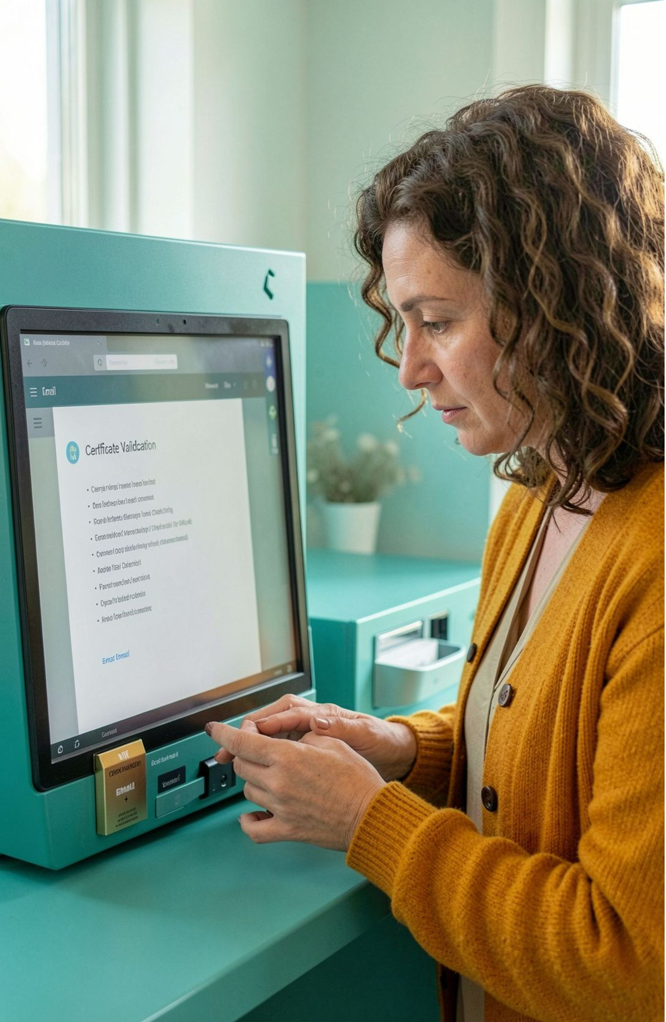



07 · PRACTICAL CHECKLIST
Use the right mode, port, and certificate
Choose implicit TLS on port 465 when the provider documents SMTPS.
Choose STARTTLS on port 587 when the provider documents submission upgrades.
Validate certificates and avoid falling back to plaintext.
Notes:
Close with the operational choices. Use port 465 for implicit TLS when the provider documents SMTPS. Use port 587 for STARTTLS when that is the documented submission mode. In both cases, validate the certificate and do not silently fall back to plaintext.

