Slide 1

Fatematuz Jahura 1830481 Mohammed Masum Hossain 1810691 Md Ashikur Rahman 1831110
CSE 216 Lab
Alcohol Detection with Engine Locking System

Slide 2
Introduction
This project is about alcohol detection with engine locking system for drunk driver.
Presents the design and implementation of an Alcohol Detection using the Arduino UNO as microcontroller.
The current scenario shows the road accidents are occurring because of drunk driving.
Alcohol detection with engine locking system will help to diminish road accident which happen because of drunk driving.
Arduino UNO R3, MQ2 sensor, DC motor, power supply, GPS, LCD Display, Buzzer will be used.
The project provides an efficient solution to control accidents due to drunk driving.

Slide 3
Methodology
This system will detect using Arduino uno whether the driver is drunk or not and will control the vehicle.
The system will continuously monitor level of alcohol concentration with MQ2 sensor and turn off the engine of vehicle if the alcohol concentration is above threshold level.
When alcohol will be detected, LCD display will show “Alcohol is detected”.
Buzzer will be automatically started.
GSM 900A module is worked for Sending message of vehicle’s absolute location.
GPS will track absolute location and show it in virtual terminal.

Slide 4
Procedure
Arduino Uno r3: In this process we used Arduino uno r3 as a microcontroller. Arduino uno R3 serves as the system's brain.
MQ2 sensor: To detect the presence of alcohol, MQ-2 sensor is used. Takes data from the environment and give this data to Arduino.
Buzzer: A buzzer is used as the warning system, and it sounds when alcohol is detected.
Dc Motor: We used a dc motor in the project to demonstrate whether the engine would turn off if alcohol is detected.

Slide 5
Procedure Continue…..
LCD display: To demonstrate whether alcohol is detected or not, we use an LCD monitor.
GPS: To get absolute location we used GPS and show it in virtual terminal.
GSM: Transmit a message and the location of a vehicle to the nearest police station using GSM.

Slide 6
Result
If driver takes alcohol during driving vehicle, then MQ2 sensor detect alcohol and locks the engine instantly.
Buzzer starts sound and LCD display shows that alcohol is detected
GPS tracks that location.
People in that vehicle can be aware of that situation by the help of LCD display.
Passengers can be safe from road accident.

Slide 7

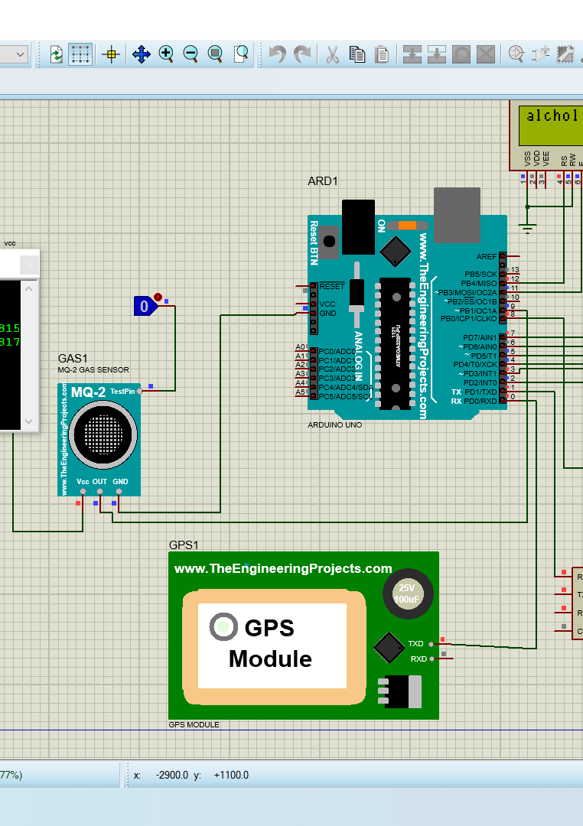
Discussion
Detect the presence of alcohol and stop the engine.
The calculation of percentage error
values increase or decrease
The microcontroller determine
The purpose of using Arduino UNO, LCD Display, Buzzer, GPS.

Slide 8
Conclusion and recommendation
A smart system for vehicles to reduce the number of accidents.
The aim of this project.
Device enhances.

Slide 9
Cout <<“Thank you ☺ << endl;

