Slide 1
Rainfall and water quality in India

Slide 2
Rainfall prediction and water quality
Aim-

Slide 3
India receives 80% of its annual rainfall during the southwest monsoon season of june to september.Rainfall over the country during this season shows a wind range of spatial variation due to orographic influences and preferential occurrence of rain system in certain regions.
source of all water on earth is not the river, is not the underground aquifer, is not the lake, well or stream. Rain is the source of all water.

Slide 4
INDIAN CLIMATIC ZONE
1)The climate of India comprises a wide range of weather conditions across a vast geographic scale and varied topography, making generalisations difficult.
2)India hosts six major climatic subtypes which is arid, semi-arid, tropical wet, tropical wet and dry, montane and Humid subtropical

Slide 5
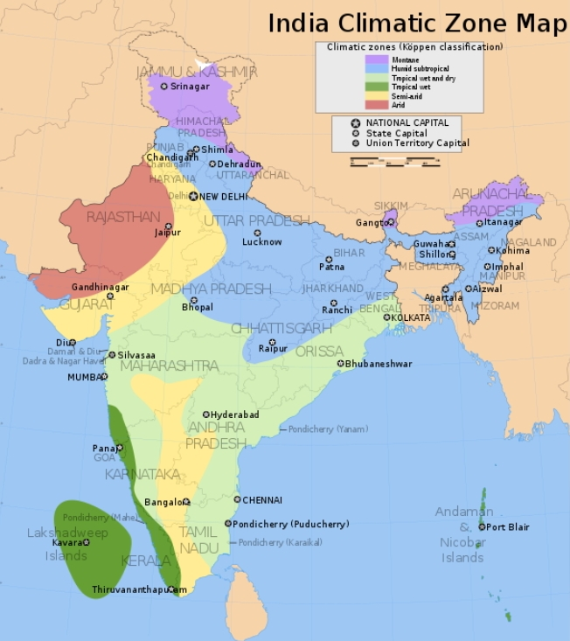
pH value is a good indicator of whether water is hard or soft. The pH of pure water is 7. In general, water with a pH lower than 7 is considered acidic, and with a pH greater than 7 is considered basic. The normal range for pH in surface water systems is 6.5 to 8.5, and the pH range for groundwater systems is between 6 to 8.5

Slide 6
Factor affected the amount of rainfall
✔ Latitude
✔ Temperature
✔ Moisture
✔ Air masses
✔ Pressure
✔ Mountain barriers
✔Differntial Heating

Slide 7
Water Quality:-
Water quality describes the condition of the water, including chemical, physical, and biological characteristics.
Poor water quality can pose a health risk for ecosystems

Slide 8
Water quality depend upon--
1)conductivity
2)pH of water
3)Dissolved Oxygen

Slide 9
Conductivity:-
Conductivity is the ability of water to conduct an electrical current, and the dissolved ions are the conductors.
The electrical conductivity of rain water is seen to decrease with an increase in rainfall amount.

Slide 10
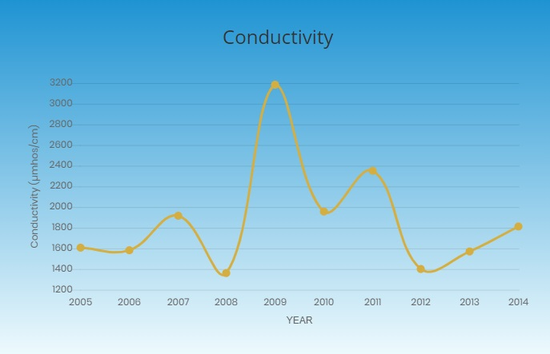

Slide 11
pH of water--
pH value is a good indicator of whether water is hard or soft. The pH of pure water is 7. In general, water with a pH lower than 7 is considered acidic, and with a pH greater than 7 is considered basic. The normal range for pH in surface water systems is 6.5 to 8.5, and the pH range for groundwater systems is between 6 to 8.5

Slide 12
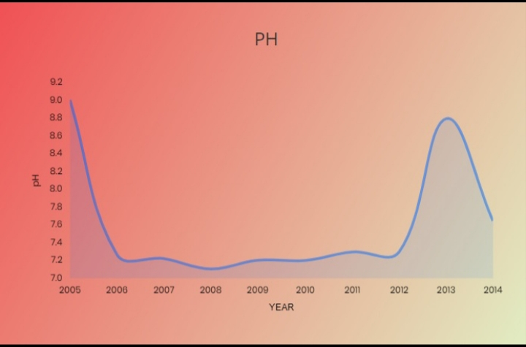

Slide 13
Dissolved Oxygen:-
Dissolved oxygen is the oxygen present in water available to aquatic organisms.
Waters with higher dissolved oxygen have ecosystems that are generally more diverse and stable.
The concentration of dissolved oxygen (DO) has decreased over the years due to pollution.

Slide 14
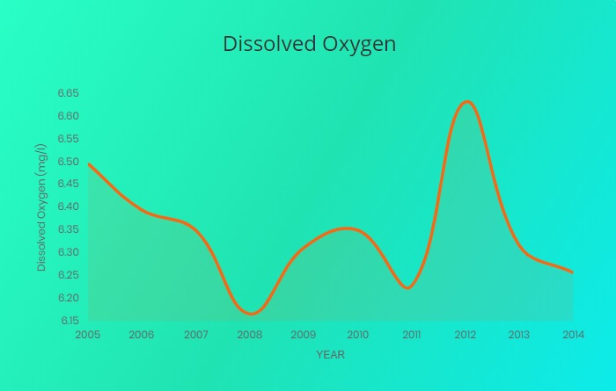

Slide 15
Django framework-
Django is written in python.
Django provide wide range of features and functionalities.
Django is open source and available for free online

Slide 16
Machine learning-
Linear regression-
In statistics, linear regression is a linear approach to modeling the relationship between a scalar response (or dependent variable) and one or more explanatory variables (or independent variables).

Slide 17
Programming language-
1)framework--Django
2)scripting language-Python,javascript
3)markup language - HTML
4)Style language - CSS

Slide 18
Reference--
https://www.kaggle.com/datasets https://data.gov.in/dataset-group-name/water-quality

Slide 19
Thank you....

