Slide 1
QA Individual IMS Project SoftwareMarch16
Ashill Pathak
https://github.com/Ashillqa/IMSprojectSoftwareMarch16

Slide 2
Introduction
Scope of the project and Specification
What I have learned during my QA journey
Initial plans
Technology used
CI pipeline, static analysis and nexus
Git hub
Demo
Sprint Review and Conclusion

Slide 3
Project scope and Specification
Kanban board (https://trello.com/b/jmwfhEsA/ims-project-softewaremarch2016)
GCP database minimum 3 tables
Fully functioning app (demo) – CRUD
Unit tests and applying sonarqube to improve coverage
Version control system – (https://github.com/Ashillqa/IMSprojectSoftwareMarch16)

Slide 4
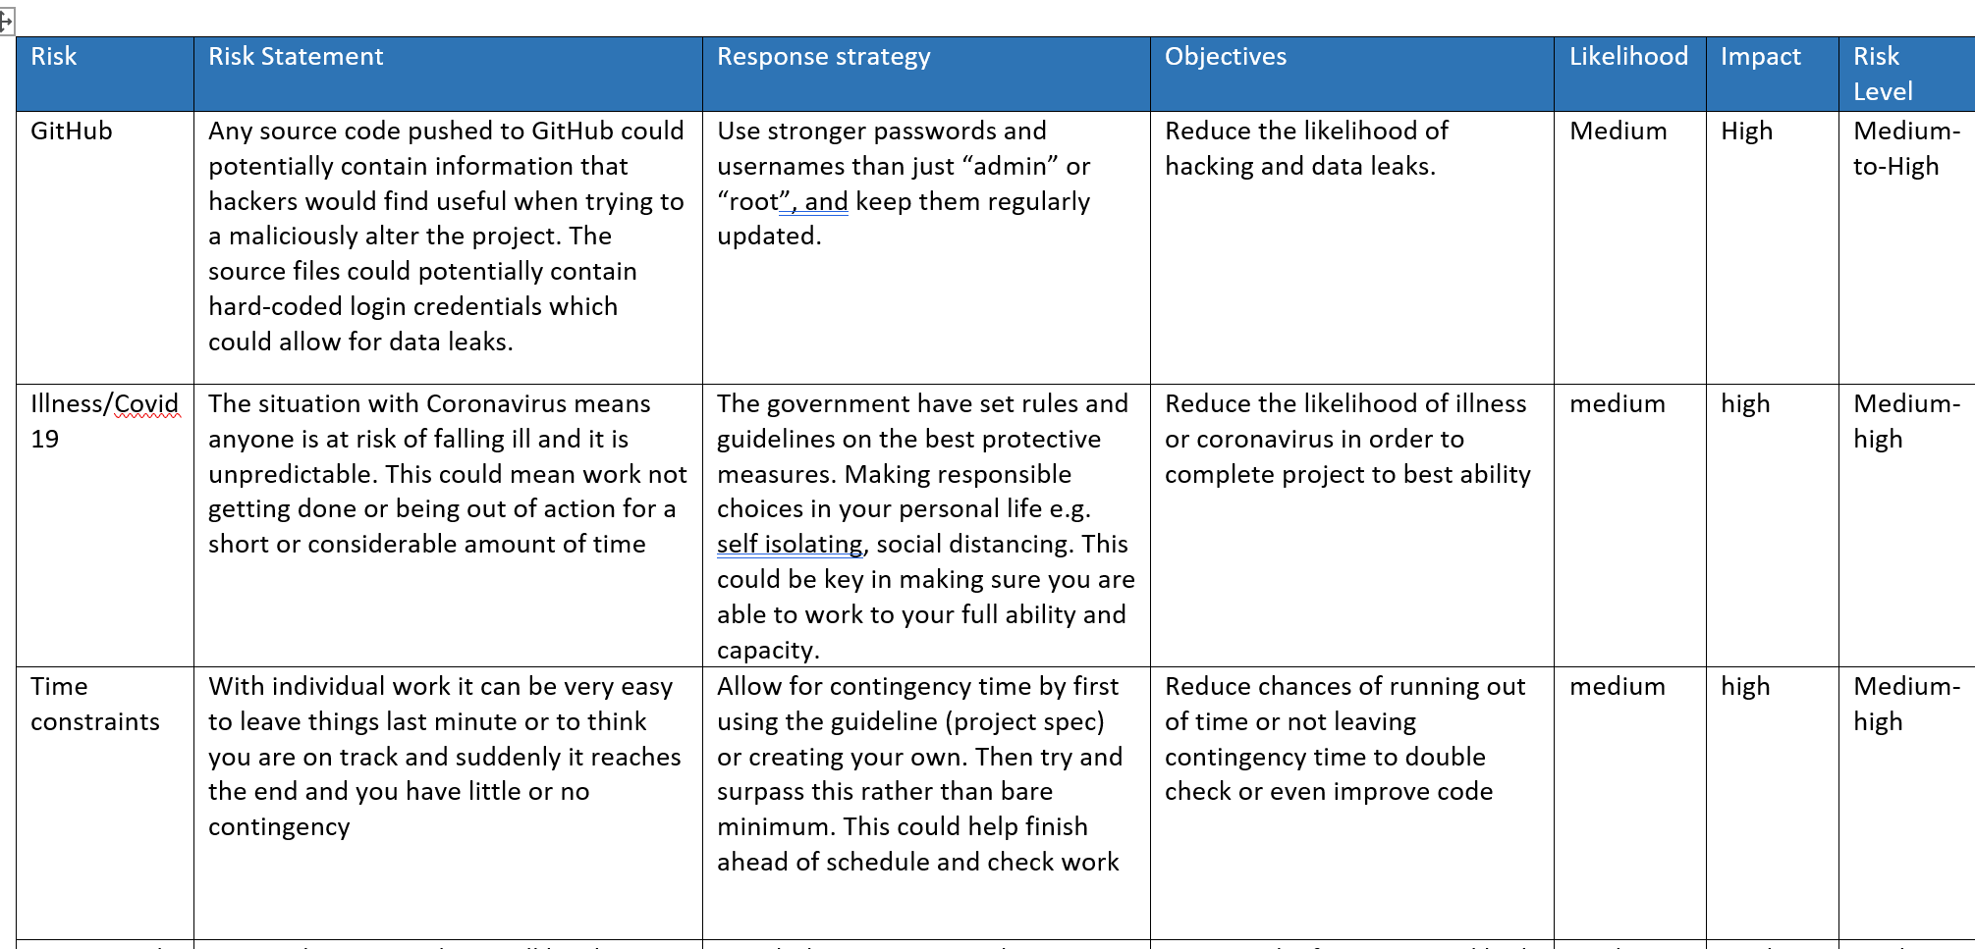
Risk Assessment

Slide 5
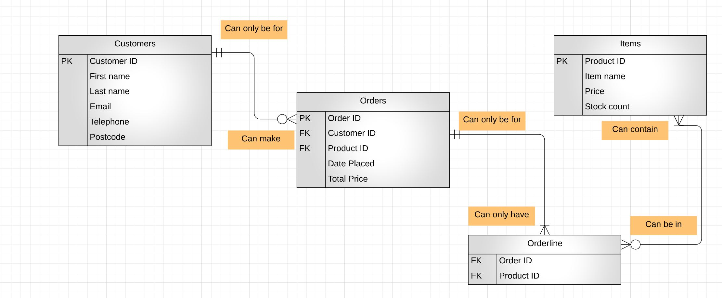
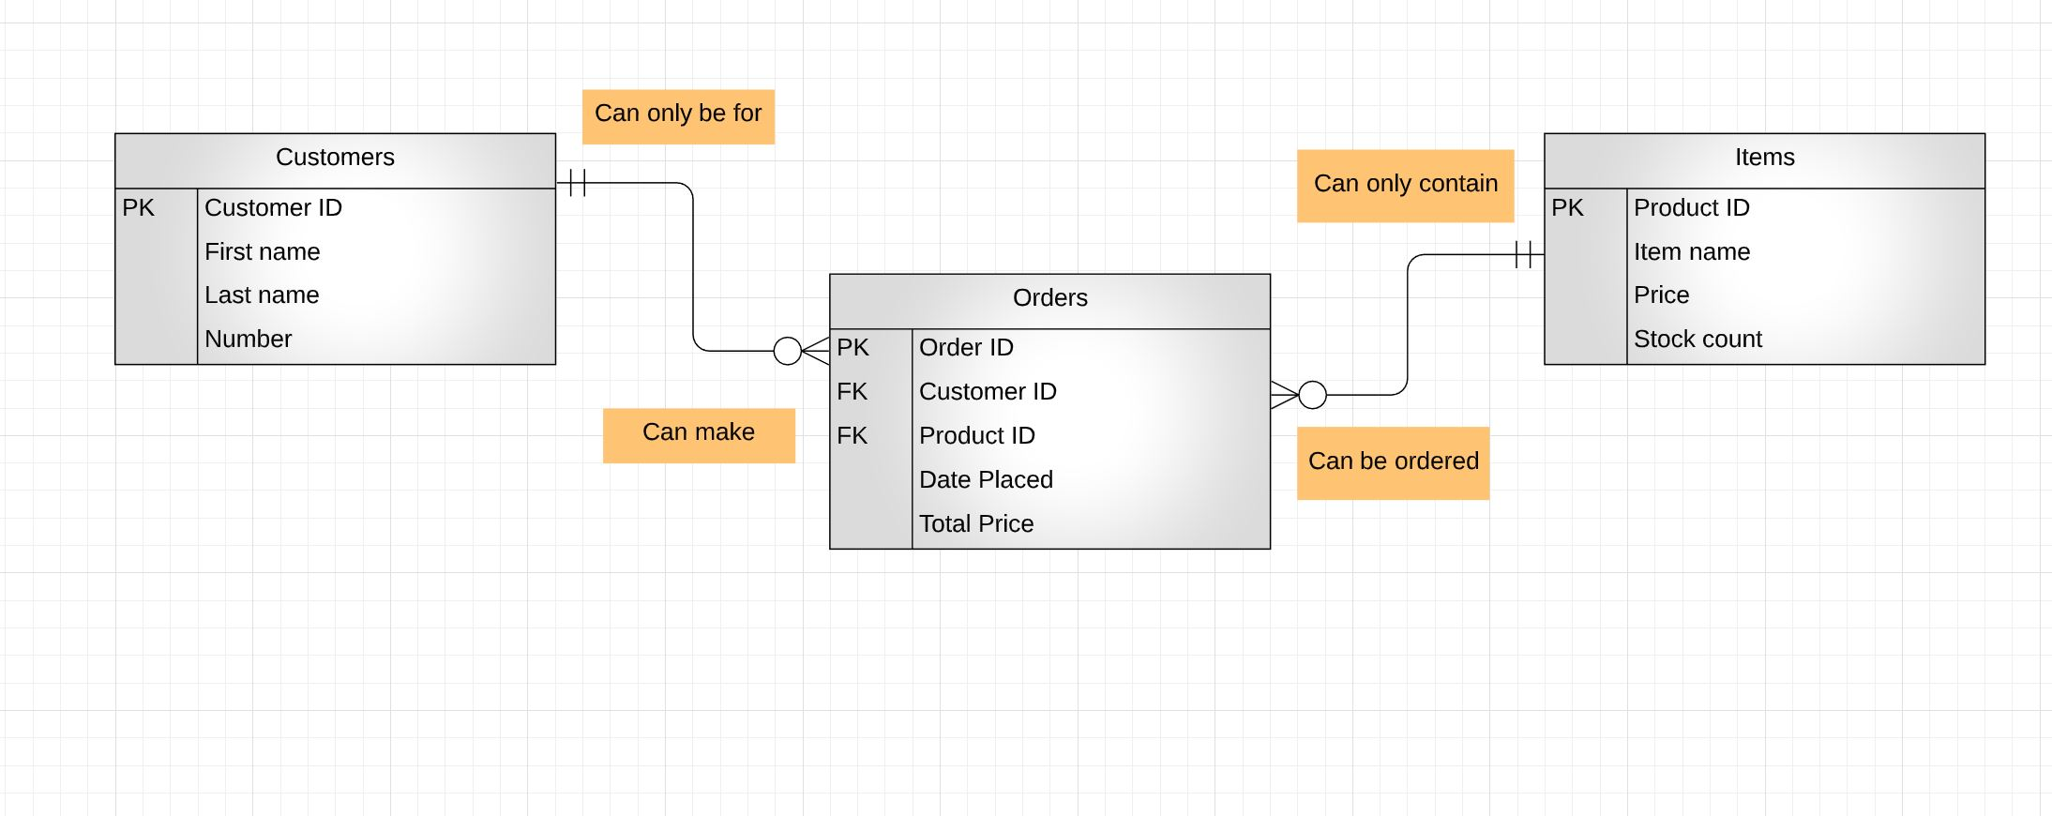
ERD Initial & Actual

Slide 6
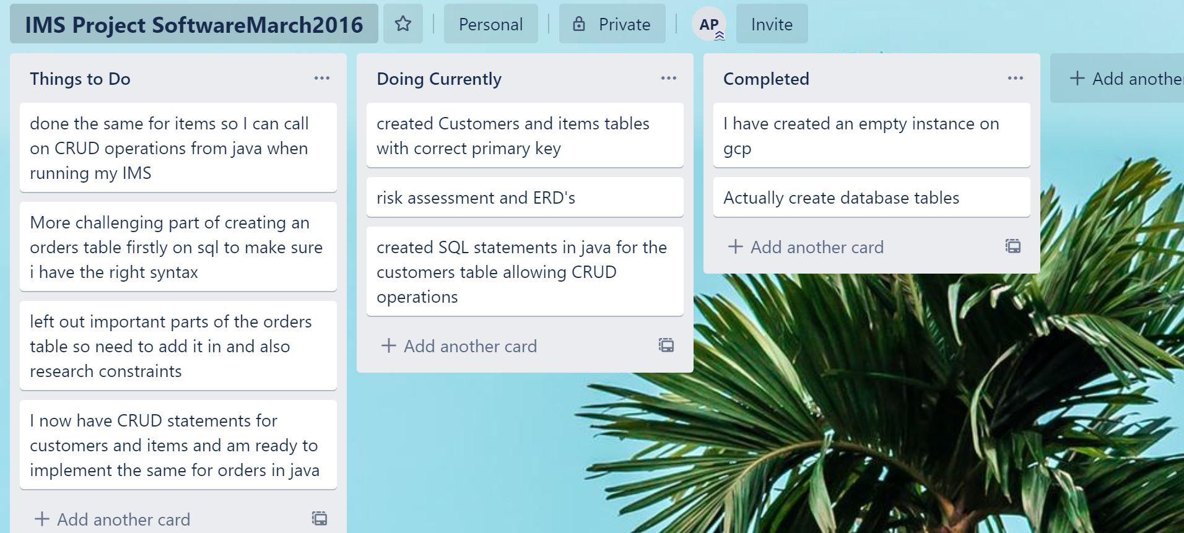
Kanban Board (Before)

Slide 7
Consultant Journey What have I learned so far
GitHub – cloning, add/commit/push, branching, merging etc
Java – OOP, Solid principles, JDBC, String manipulation, interfaces, inheritance, loops/conditional statements.
SQL – DDL & DML, GCP instances, setting up IP address for access
Networks and security
Continuous integration – Jenkins
SonarQube, Maven
JUnit Testing, Mockito (Spy & MockInjections)

Slide 8
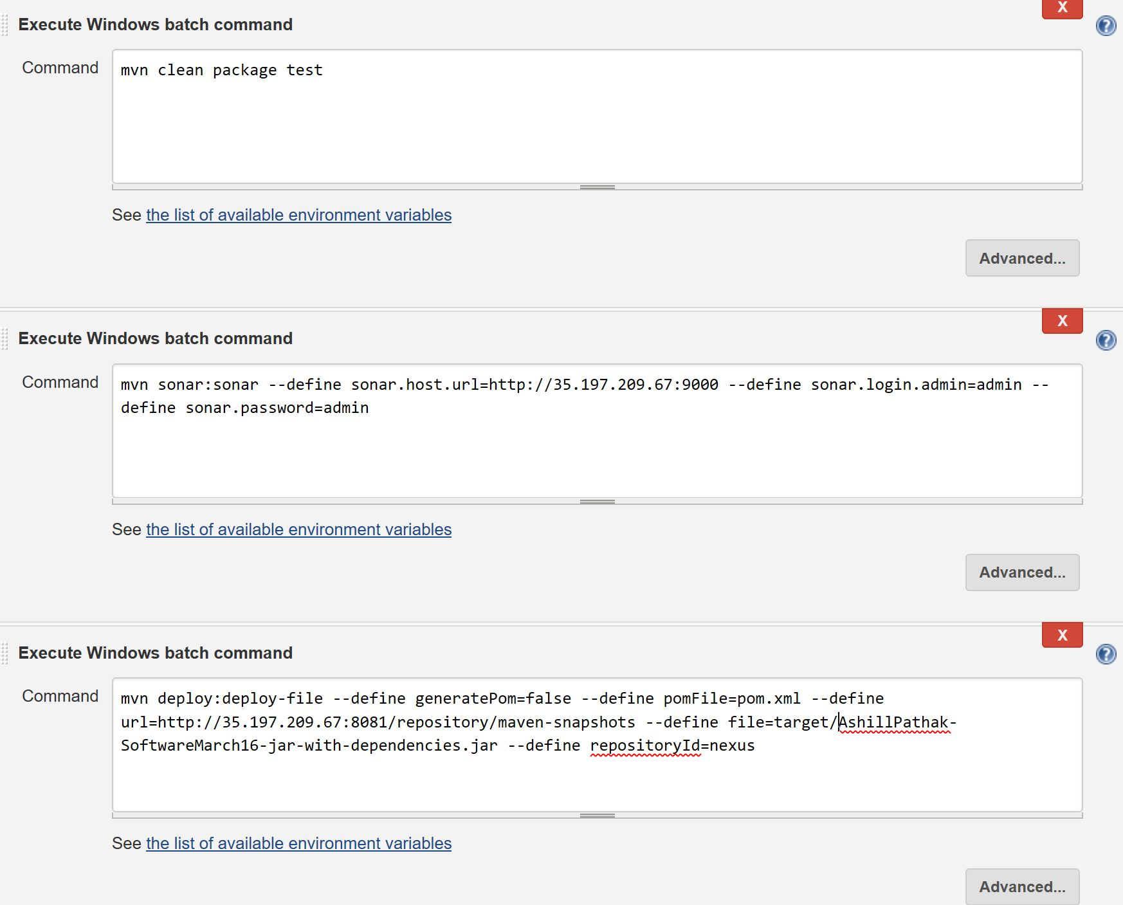
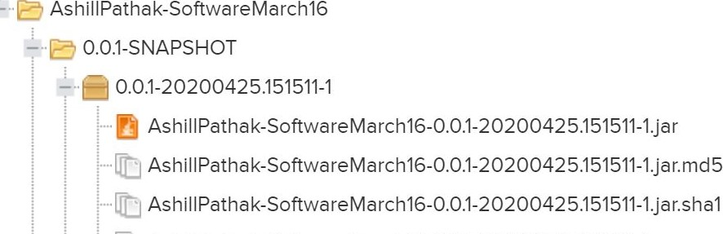
CI Setup

Slide 9
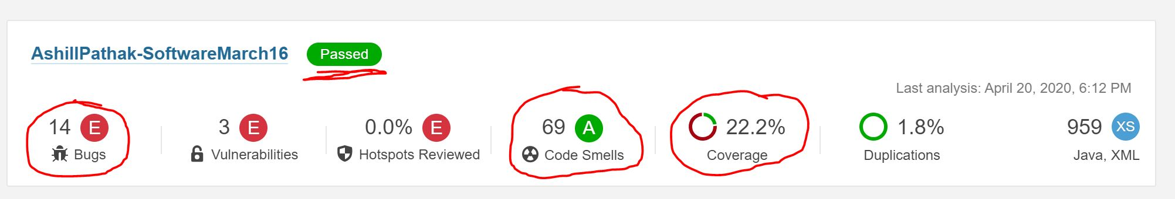
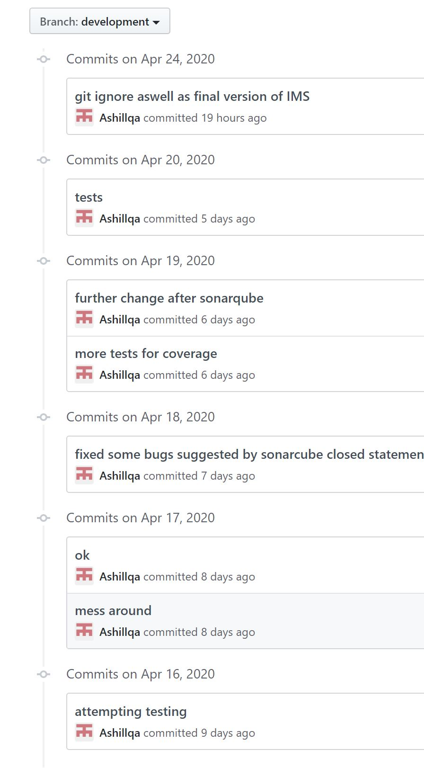
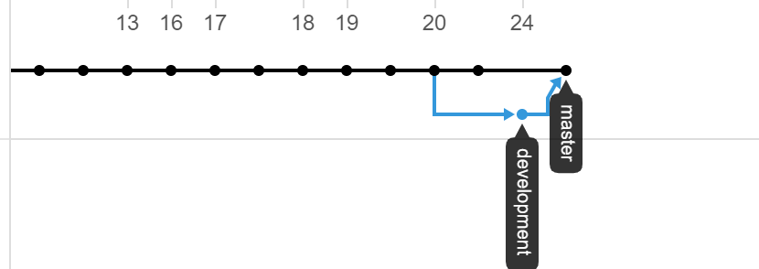
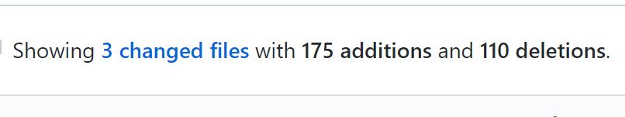
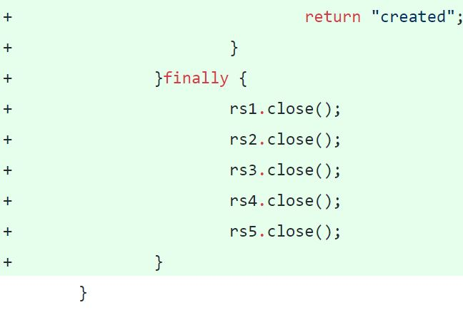
CI Setup Continued

Slide 10
Demo of IMS Application
Create, read update and delete a Customer
Create, read update and delete an Item
Create, read update and delete an Order
Extra Features (see screenshots last slide)
A customer can be in many orders but the items will not be repeated instead just update the quantity
When an order is created, updated or deleted the necessary change is reflected in the quantity count for items.

Slide 11
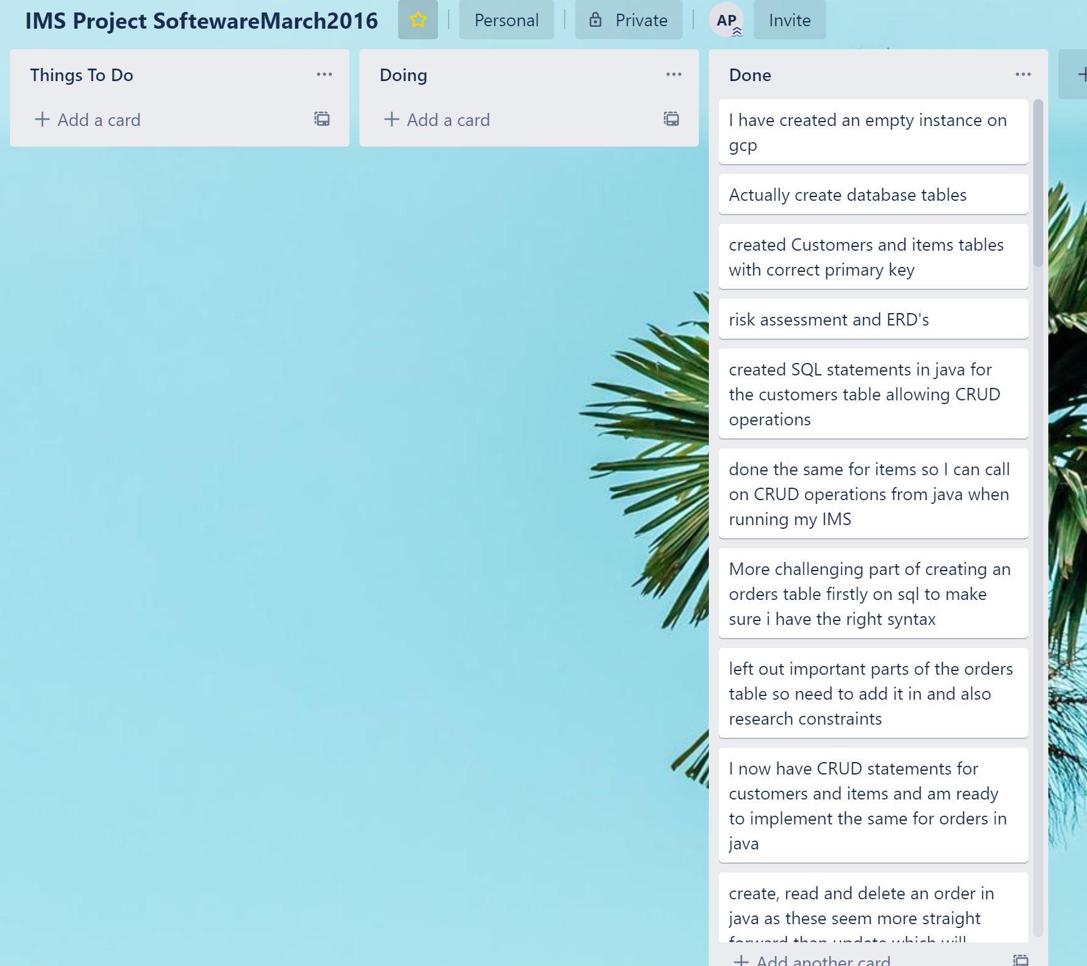
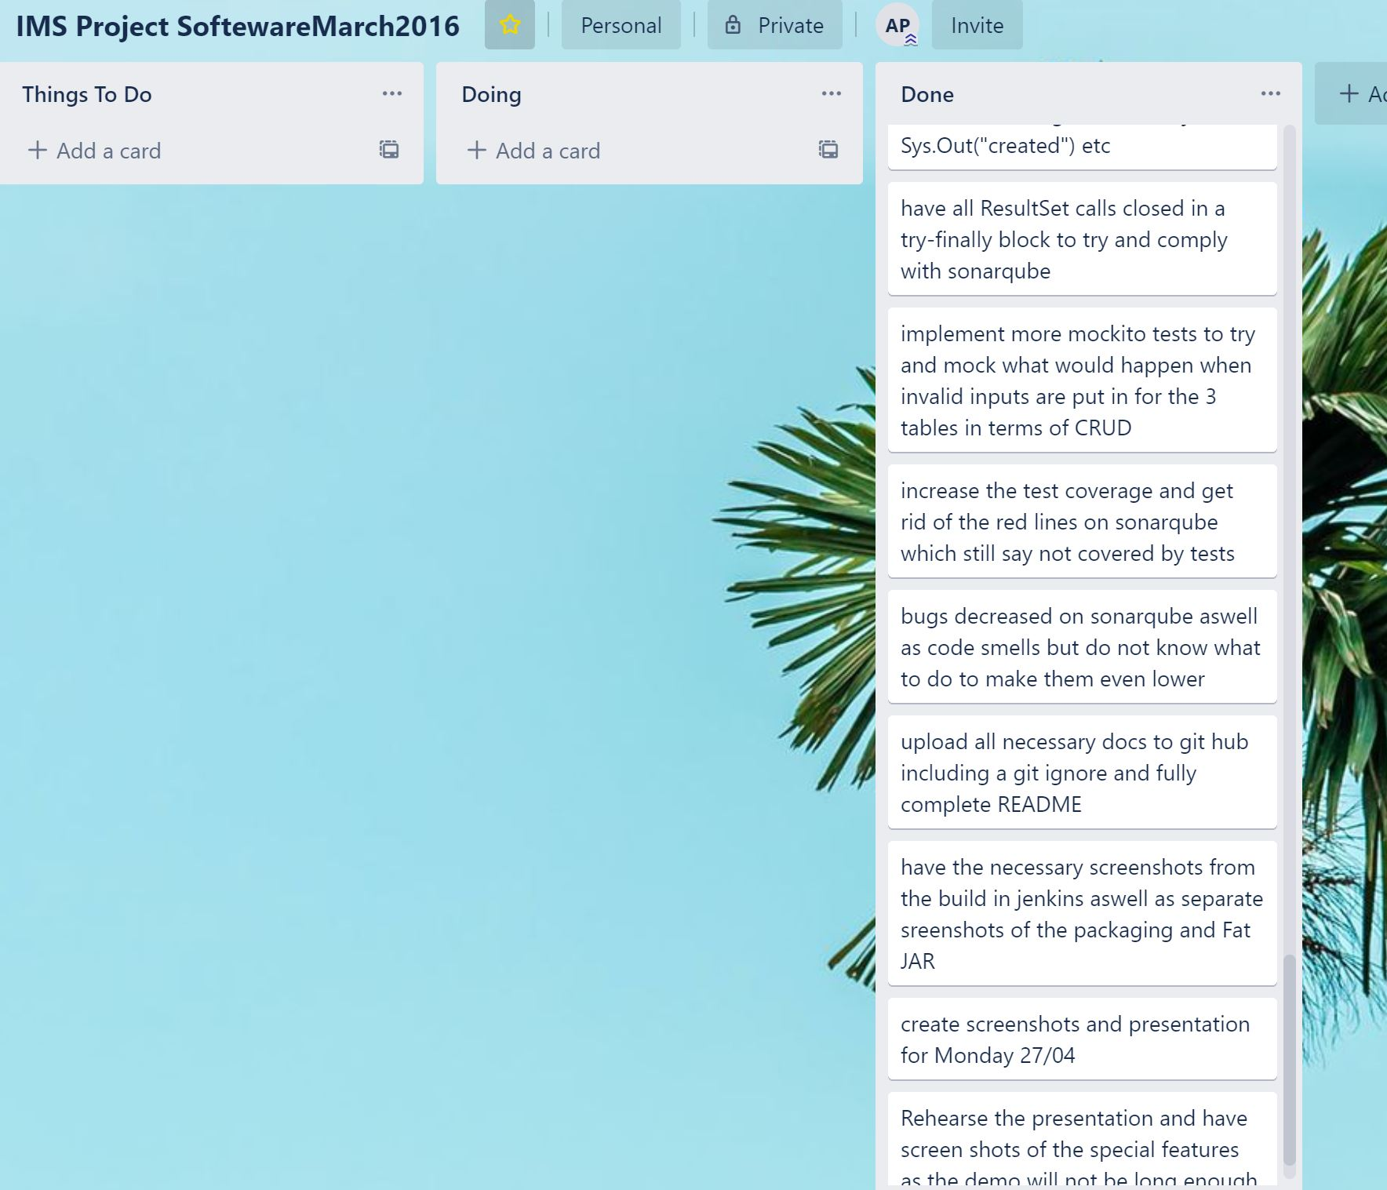
Sprint review

Slide 12
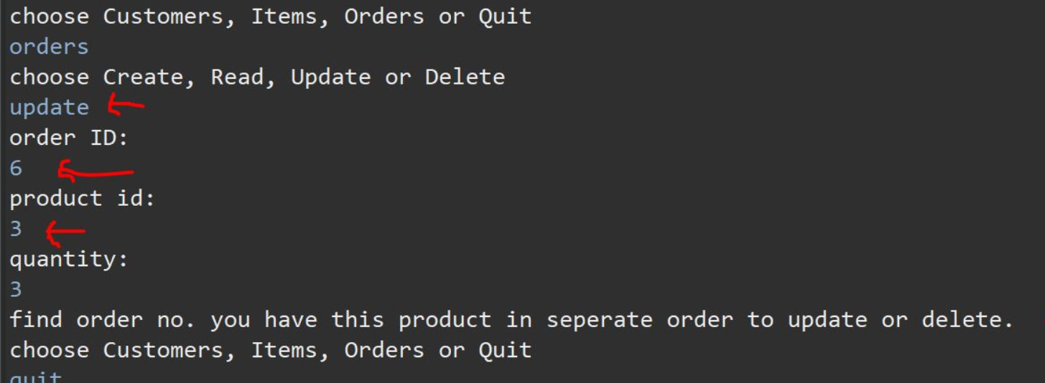
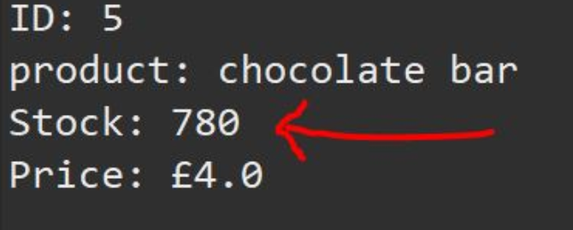
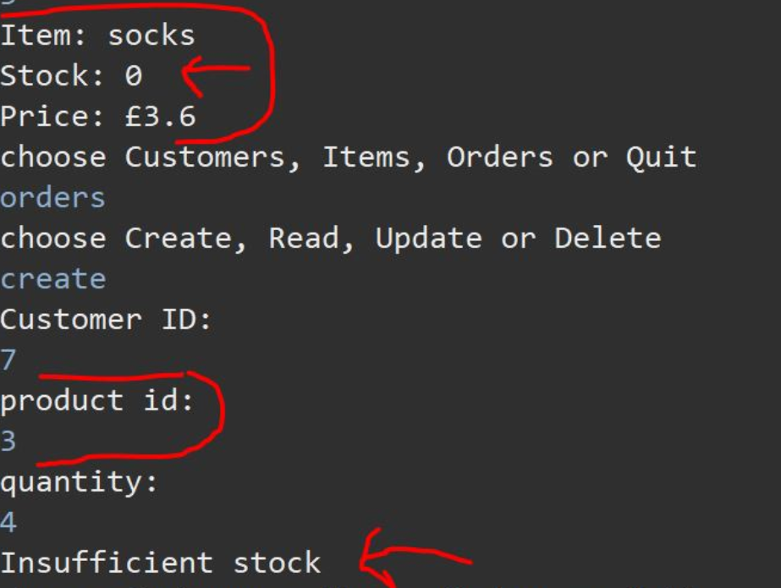
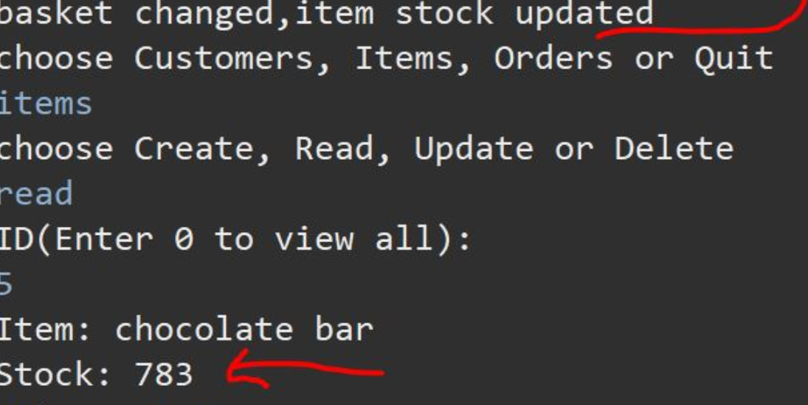
Conclusion
Overall a successful IMS with fully functioning crud applications as well as extra features such as the following:

Slide 13
Conclusion continued: Future improvements
Orderline was a challenge – difficult to implement and then in java even more so
Solution: extra research and practice on sql and then apply to java
Wanted to follow my own template made testing difficult struggled to increase coverage (managed 11 to 22%)
Solution: re-visit lecture/demo on testing and perhaps use a better template next time especially when one has been provided
Push far more regularly to git rather than big chunks of work as I ran more risk. Also brush up on branching and merging as I lost a big section of my network graph made it look like only branched out once

Slide 14
Thank you for listening any questions?

