Slide 1
QA Hobby Project SoftwareMarch16
Ashill Pathak
https://github.com/Ashillqa/SoftwareMarch16Project2
User Story
https://github.com/Ashillqa/SoftwareMarch16Project2/projects

Slide 2
Introduction
Scope of the project and Specification
What I have learned during my QA journey
Initial plans
Technology used
CI pipeline, static analysis and nexus
Git hub
Demo
Sprint Review and Conclusion

Slide 3
Project scope and Specification
Kanban board (https://trello.com/b/jmwfhEsA/ims-project-softewaremarch2016)
GCP database minimum 3 tables
Fully functioning app (demo) – CRUD
Unit tests and applying sonarqube to improve coverage
Version control system – (https://github.com/Ashillqa/IMSprojectSoftwareMarch16)

Slide 4
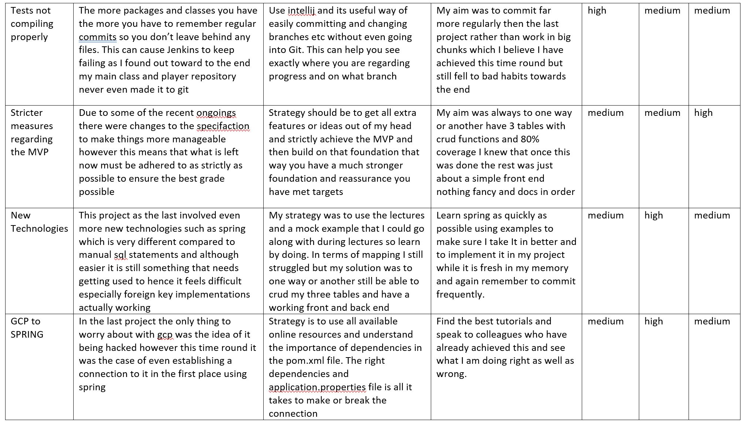
Risk Assessment

Slide 5
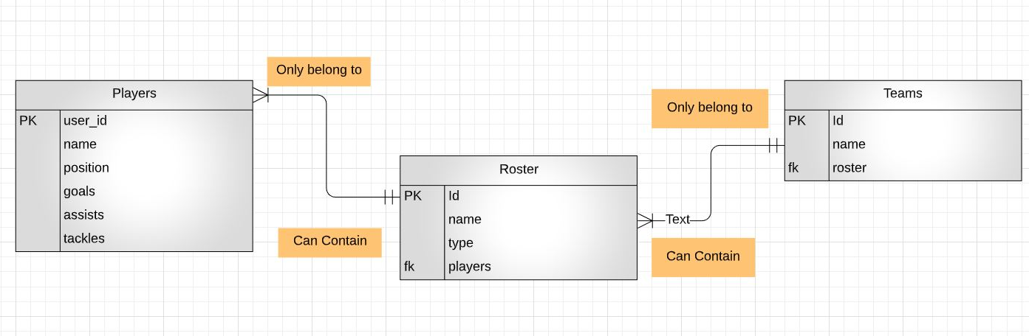
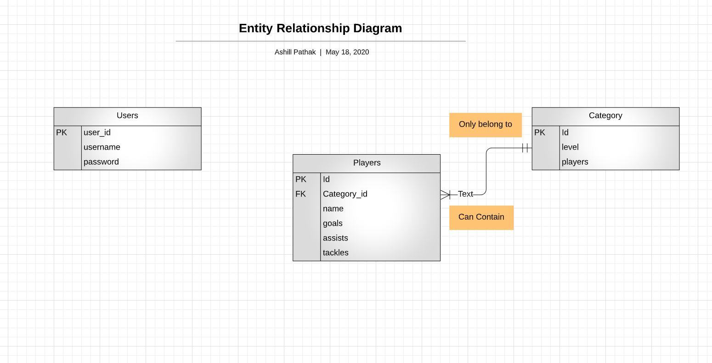
ERD Initial & Actual

Slide 6
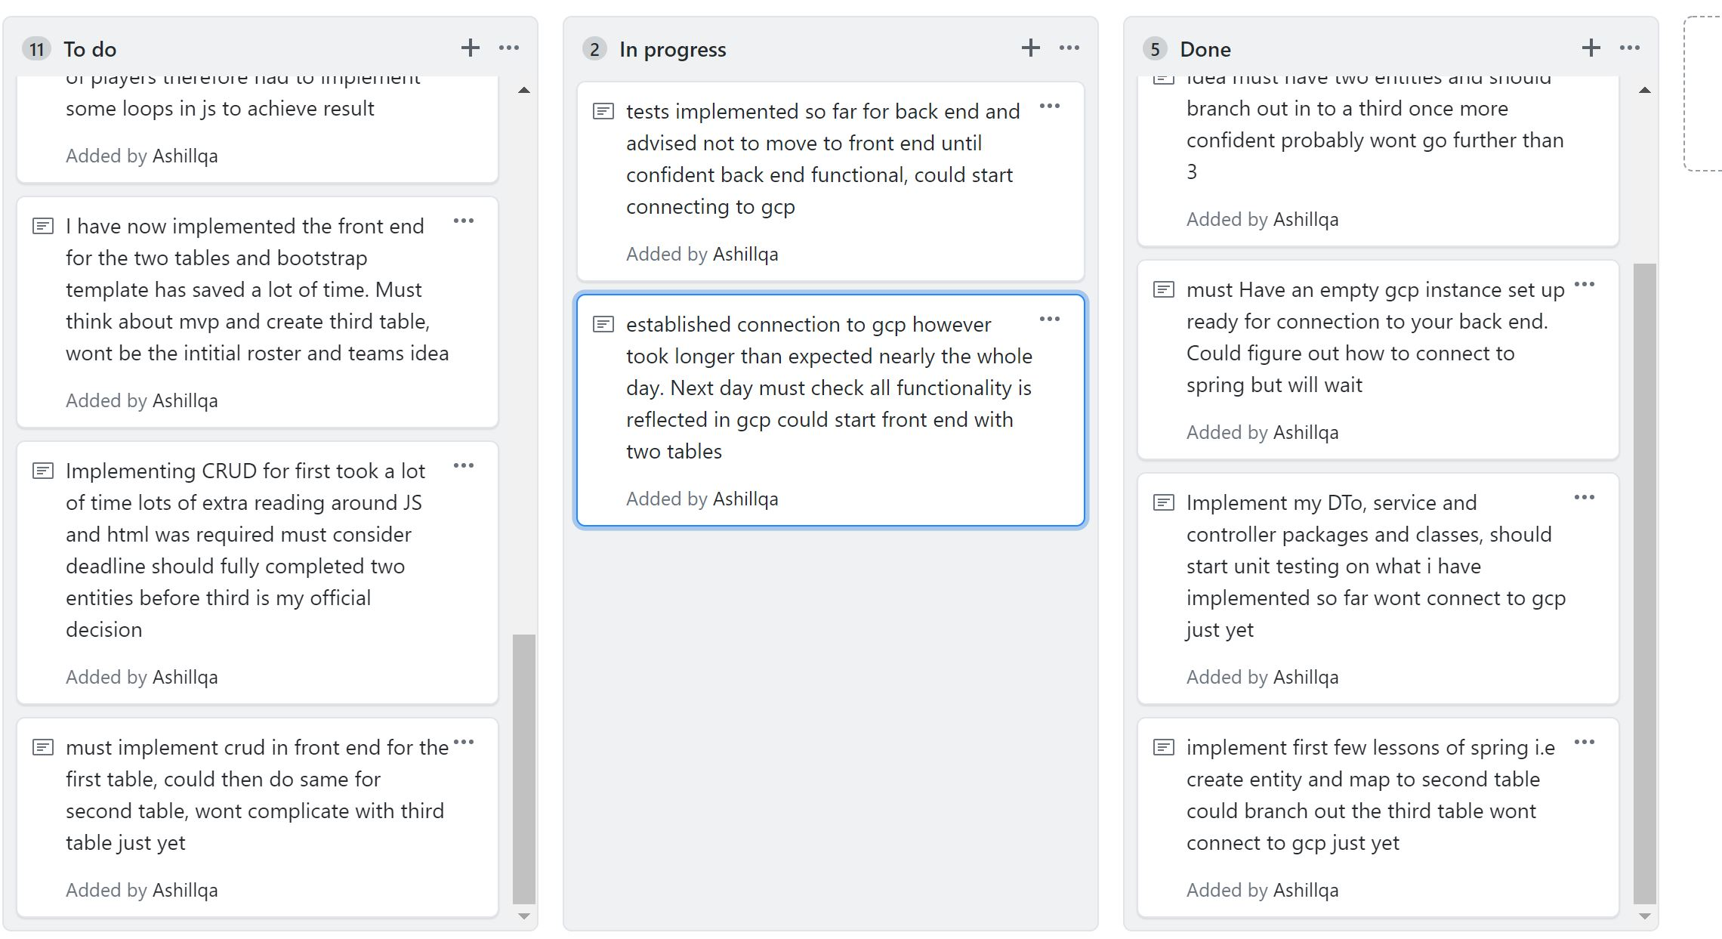
Kanban Board (Before)

Slide 7
Consultant Journey What have I learned so far
GitHub – cloning, add/commit/push, branching, merging etc
Java – OOP, Solid principles, JDBC, String manipulation, interfaces, inheritance, loops/conditional statements.
SQL – DDL & DML, GCP instances, setting up IP address for access
Networks and security
Continuous integration – Jenkins
SonarQube, Maven
JUnit Testing, Mockito (Spy & MockInjections)

Slide 8
Consultant Journey What have I learned so far
SpringBoot – Crud app, mapping, gcp, templates for html
Javascript, html5, CSS, Bootstrap, API calls, fetch, HTTPReq,JSON
Selenium front end testing, screenshots, extent reports, finding elements
JUnit Testing, Mockito (injectMocks), integration testing the project
Importance of testing

Slide 9
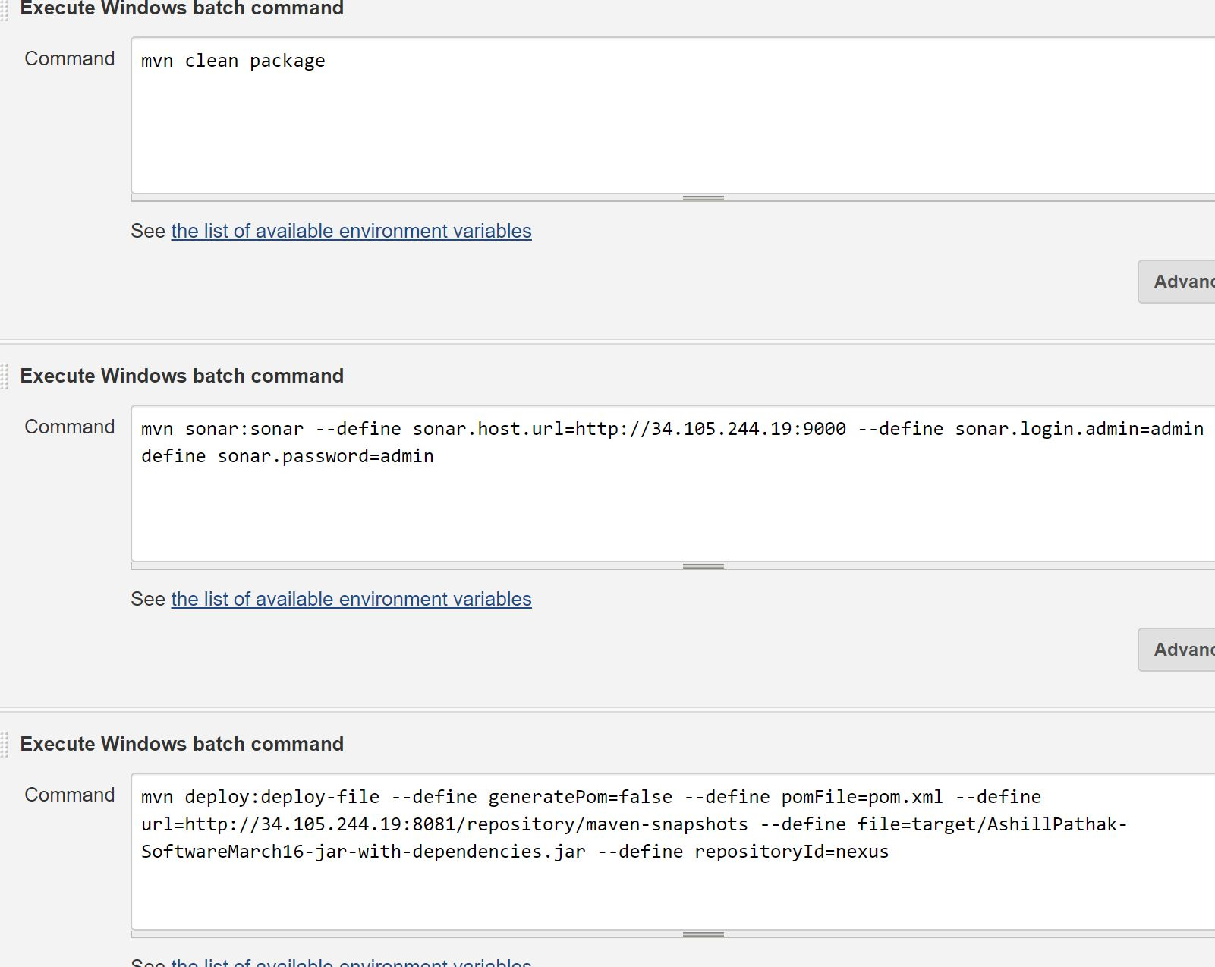
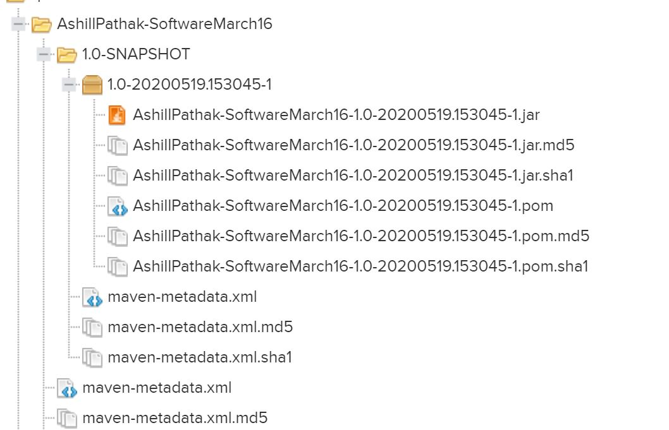
CI Setup

Slide 10
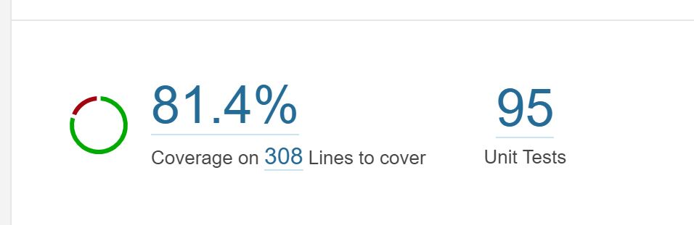
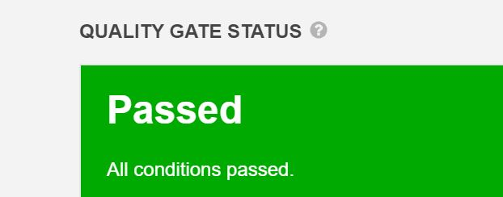

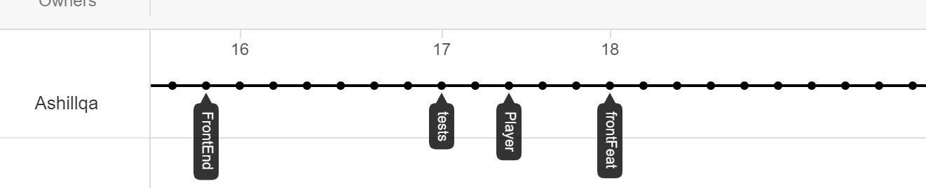
CI Setup Continued

Slide 11
Demo of Hobby Project - PlayerRate
Mock login and view account, update password
Create 4 players with same attributes and view category
Update attributes then view category effect
Delete a player and delete account

Slide 12
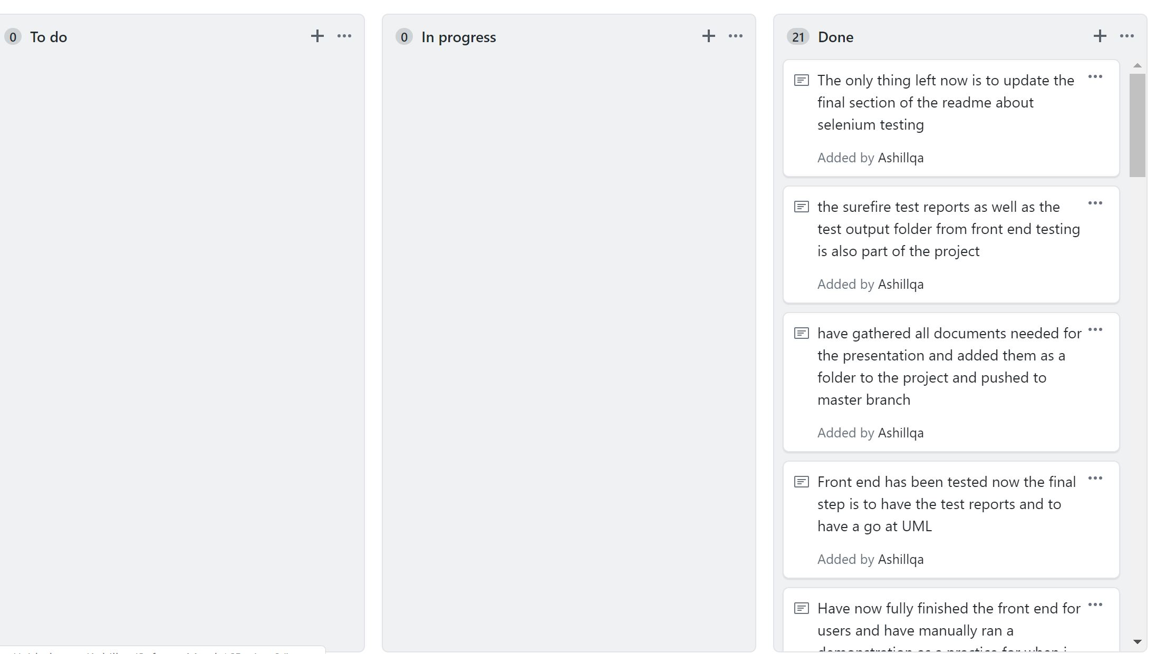
Sprint review

Slide 13
Conclusion
Overall a successful project in terms of meeting mvp requirements and being able to do what I wished for – create players and put them in a category based on their attributes which can ofcourse change as the season goes on. Also accounting for all/some attributes equal
Compared to the last project testing was significantly better from achieving only 22% last time to 81% this time according to SonarQube
Selenium testing also confirmed my front end functioned as I wanted it to.

Slide 14
Conclusion continued: Future improvements
Towards the end as work got closer to deadline started falling to bad habits of committing big loads of work rather than frequent regular
Would have been nice to get my head around the mapping in order to actually view the list of players in the category without having to implement it in the Javascript file
If the above had been implemented I could have stuck with the initial third table idea of having a team which takes in the category which is limited to 5 players
If I had decided earlier to do users could have possibly implemented spring security or atleast had a foreign key for users and players

Slide 15
Thank you for listening any questions?

