Slide 1
CPE 301 PID Control of DC Motor
Ashim Ghimire
L#2000124930
Email:ghimirea@unlv.nevada.edu

Slide 2
AIM & ACCOMPLISHMENT
AIM:
Control Motor speed by implementing PID
Set speed and display the current speed on the host
ACCOMPLISHMENT
PID implemented
Speed was set to 350 rpm

Slide 3
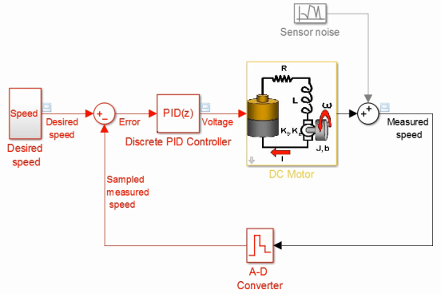
PID

Slide 4
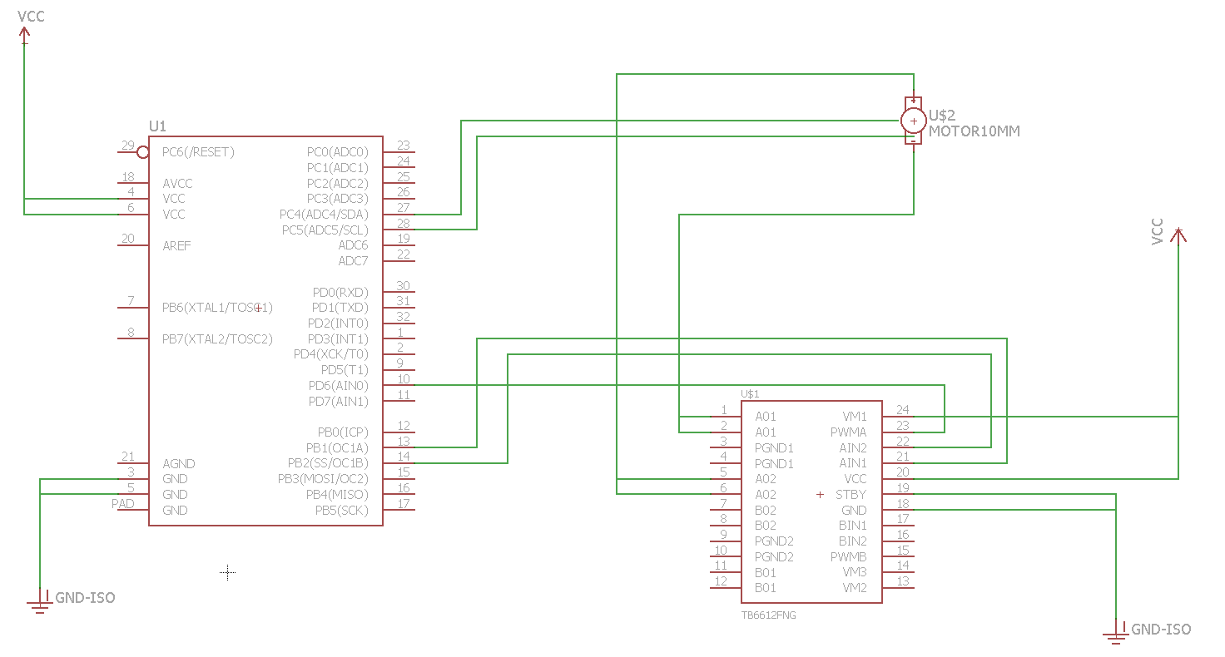
SCHEMATICS

Slide 5
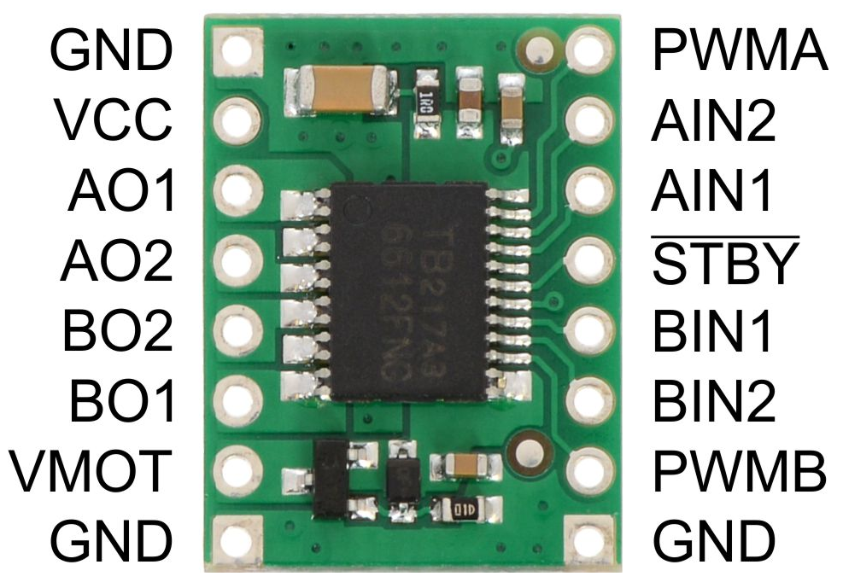
DESIGN STAGES
Components
AVR ATMEGA328p
TB6612FNG
DC MOTOR
POLOLU USB AVR PROGRAMMER
Interfaces
Atmega328p – TB6612FNG
TB6612FNG – DC motor
Encoder – Atmega328p
Atmega328p – Serial Terminal

Slide 6
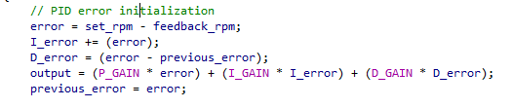
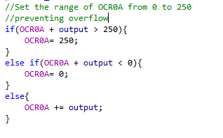
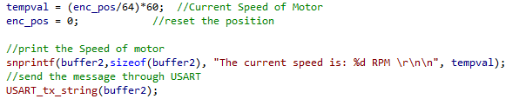
CODE:

Slide 7
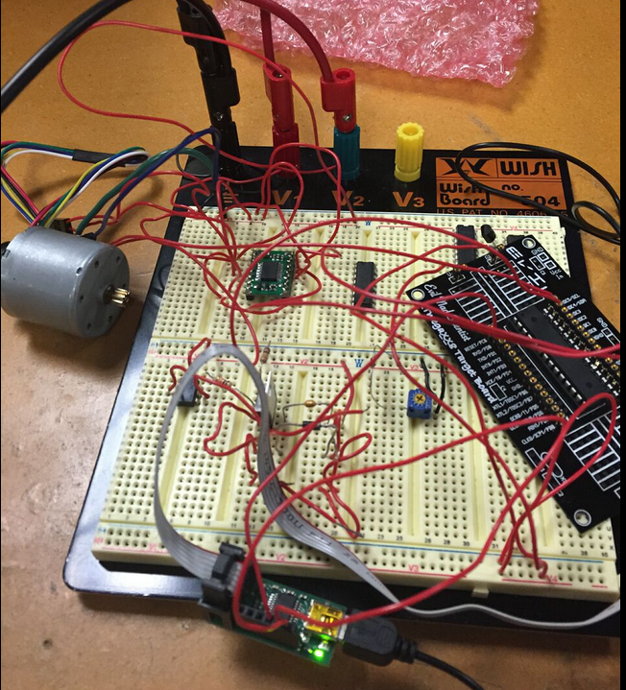
DEMO SNAPSHOT

Slide 8
DEMO VIDEO:
https://www.dropbox.com/s/lbbo6ug3rwd5xle/Video%20May%2012%2C%2012%2030%2038%20AM.mov?dl=0

