Slide 1
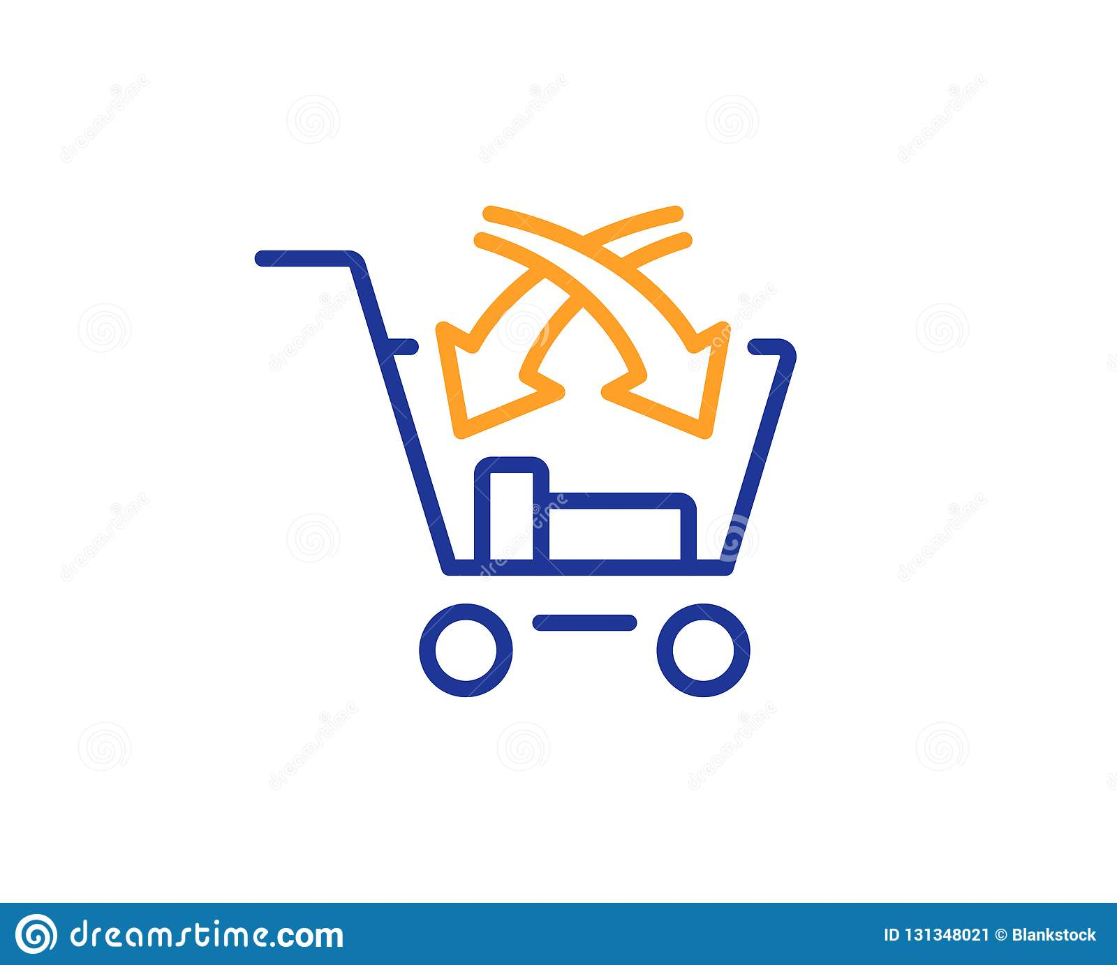
AFTER MARKET “ Cash Up by Cross-Selling”
Created By
Mohan Suresh
Dec 2020

Slide 2
What is Cross-selling ??
Cross-sell involves the sale of multiple products offered by a single product/service provider to a new or existing customer.
For Example,
You plan to purchase a mobile phone worth Rs 30,000 but the salesman offered you a charming deal of buying mobile phone with exclusive JBL headphones for Rs.40,000 only and you again got swayed away. (This is Cross-Selling)

Slide 3
Why and how to Cross-selling ??
Cross-selling is a core component of a customer centric relationship strategy and requires an integrated view of the customer.
Cross-selling has proved to be a defining strategy for profitable growth across multiple sectors.
How to plan the program
The success of a cross-sell program depends on enablers such as,
organizational commitment
well-defined business strategy
effective execution
regular monitoring
effective targeting strategy.

Slide 4
Benefits of Cross Selling
Cross Selling offers benefit to both the ends of marketing cycle i.e. customer and firm.
For the Firm
Builds customer equity
Differentiates from competition, enhances market position
Promotes diversification and innovation
Stimulates universe expansion and entry into new markets
Balances growth between new and existing customers, low and high margin products and segments
Enhance customer profitability
Discourages customer attrition, improves customer loyalty

Slide 5
Benefits of Cross Selling
2. For the Customer
Patronizes the brand
Broadens choices of product and services
Offers convenience through one-stop shopping, flexibility, consolidated bill and others
Increases customer satisfaction
Lowers price
Encourages better customer service from relationship marketing

Slide 6
Target Audience
Insurance companies
E-commerce
Financial and Banking services
E.g. Selling Vehicle insurance along with health insurance

Slide 7
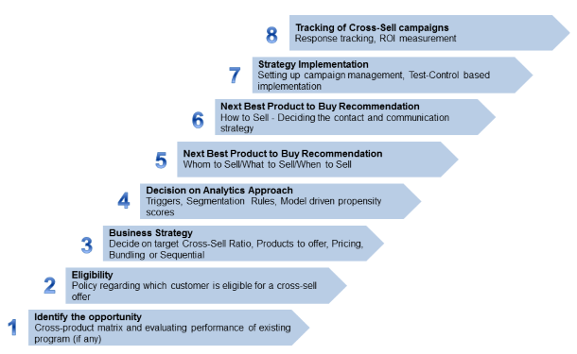
CROSS SELL PROCESS FLOW

Slide 8
PROBLEM STATMENT
Your client is an Insurance company that has provided Health Insurance to its customers now they need your help in building a model to predict whether the policyholders (customers) from past year will also be interested in Vehicle Insurance provided by the company.
An insurance policy is an arrangement by which a company undertakes to provide a guarantee of compensation for specified loss, damage, illness, or death in return for the payment of a specified premium. A premium is a sum of money that the customer needs to pay regularly to an insurance company for this guarantee.
For example, you may pay a premium of Rs. 5000 each year for a health insurance cover of Rs. 200,000/- so that if, God forbid, you fall ill and need to be hospitalized in that year, the insurance provider company will bear the cost of hospitalization etc. for upto Rs. 200,000. Now if you are wondering how can company bear such high hospitalization cost when it charges a premium of only Rs. 5000/-, that is where the concept of probabilities comes in picture. For example, like you, there may be 100 customers who would be paying a premium of Rs. 5000 every year, but only a few of them (say 2-3) would get hospitalized that year and not everyone. This way everyone shares the risk of everyone else. Just like medical insurance, there is vehicle insurance where every year customer needs to pay a premium of certain amount to insurance provider company so that in case of unfortunate accident by the vehicle, the insurance provider company will provide a compensation (called ‘sum assured’) to the customer.
Building a model to predict whether a customer would be interested in Vehicle Insurance is extremely helpful for the company because it can then accordingly plan its communication strategy to reach out to those customers and optimize its business model and revenue.
Now, in order to predict, whether the customer would be interested in Vehicle insurance, you have information about demographics (gender, age, region code type), Vehicles (Vehicle Age, Damage), Policy (Premium, sourcing channel) etc.

Slide 9
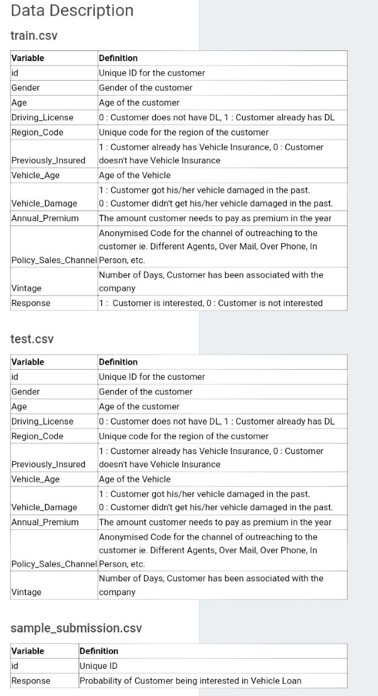

Slide 10
Hypothesis Generation
Are old customers more likely to subscribe to Vehicle Insurance compared to young customers ?
Are Male customers more interested in opting for the to Vehicle Insurance compared to female customers ?
Customers holding driving license are likely to entertain the request for Vehicle Insurance or not?
Does the region the customer belongs to tell us anything about their chances of subscribing ?
Customer with previous insurance live are interested in opting?
Are the customers with less age of vehicle is not more interested in subscribing?
Customer with damaged vehicles will opt or not?
Does the channel(email, Phone) via which the customer getting contacted have any impact on opting?
Does the number of days the customers have associated with the insurance company and their response to interest in vehicle insurance are correlated?

Slide 11
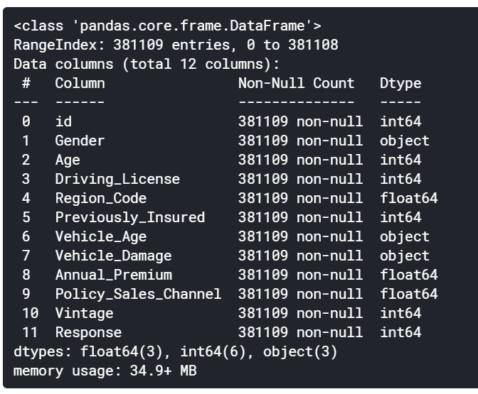
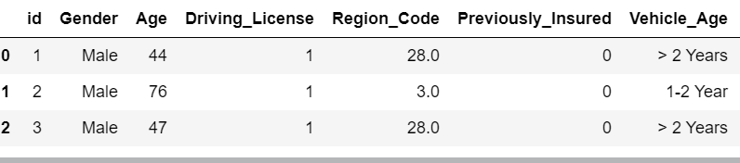
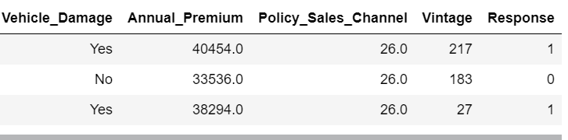
Raw Data

Slide 12

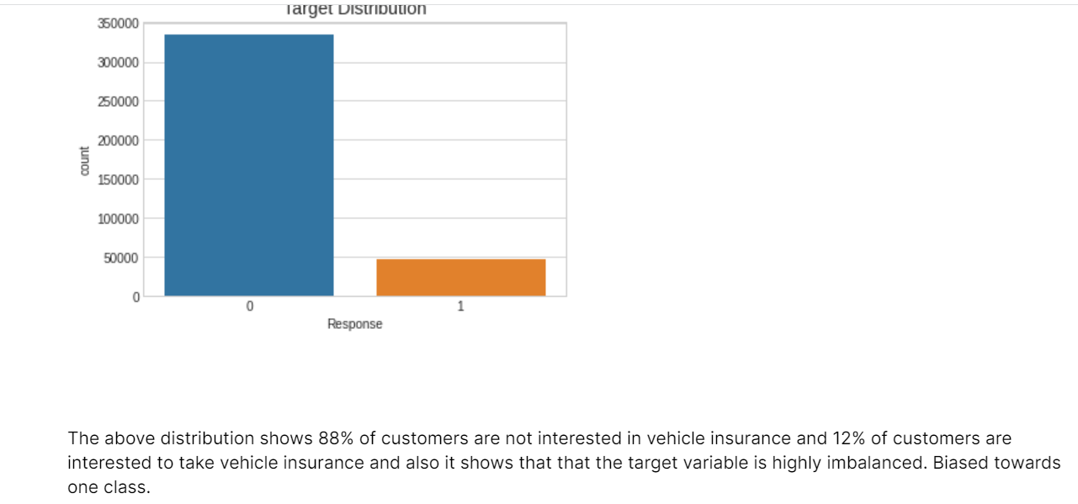
Distribution of input features and response
Output response
Where class 0 denotes Negative response and class 1 denotes positive
Visualizing the same target distribution using countplot

Slide 13
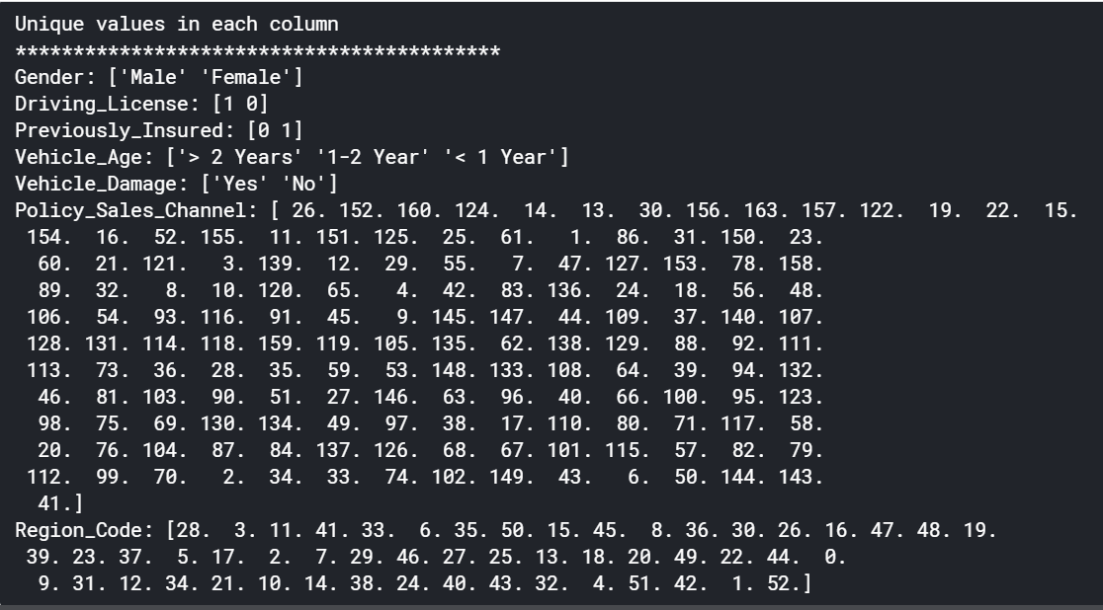
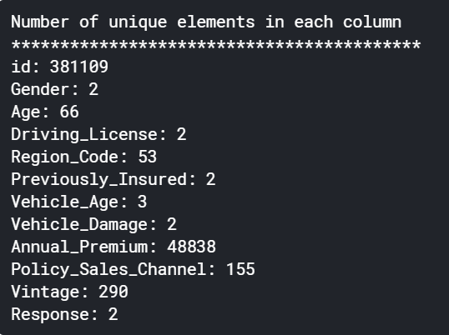
Distribution of input features and response

Slide 14
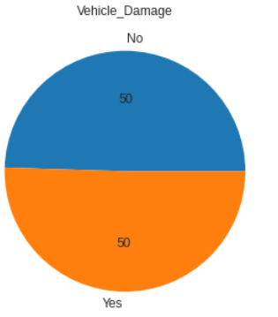
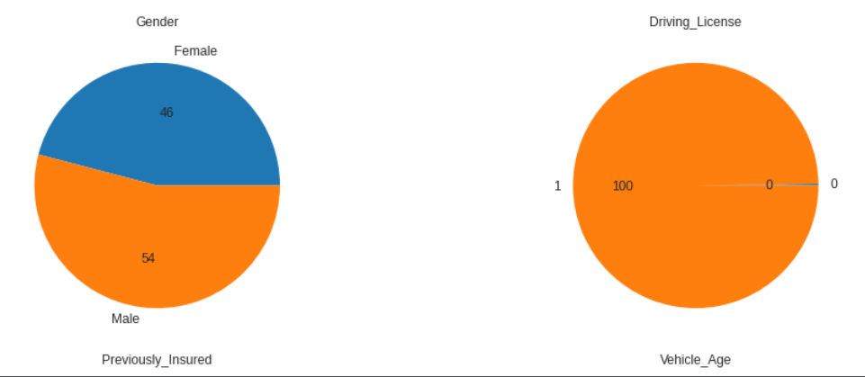
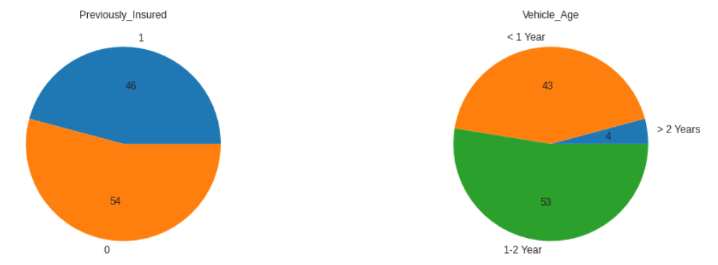
Distribution of input features and response
From the chart we can infer that the most of the features are balanced except Driving license. Let us look at the counts of each of the categories using countplots

Slide 15
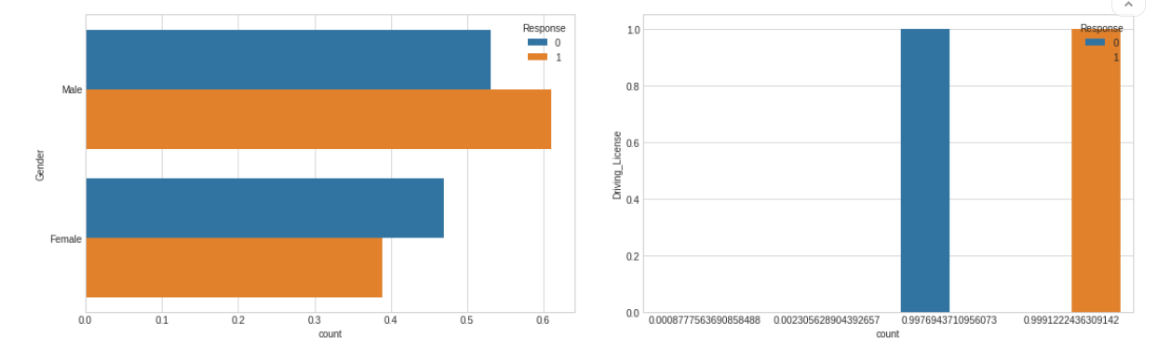
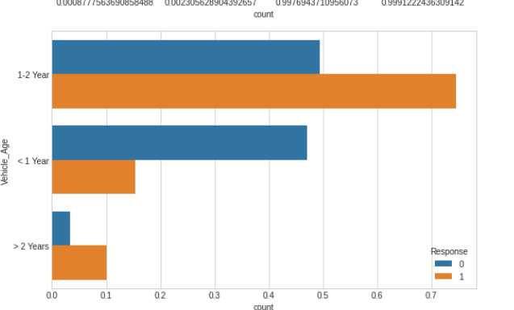
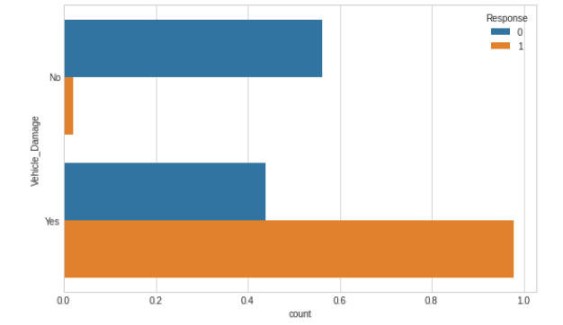
Distribution of input features and response

Slide 16
Key observation from the given datasets are,
Are Male customers more interested in opting for the to Vehicle Insurance compared to female customers ?
Yes the Male customers more interested in opting
2. Customers holding driving license are likely to entertain the request for Vehicle Insurance or not?
771 customers neither have a driving license and not-interested in to get vehicle insurance for their vehicle hence people with driving license are more likely to opt
3. Customer with previous insurance are interested in opting?
previously not insured customers are highly interested to get vehicle insurance and at the same time Previously insured customers are not interested to get vehicle insurance.
.

Slide 17
Key observation from the given datasets are,
4. Are the customers with less age of vehicle is not more interested in subscribing?
from the above chart, less than 1 year old vehicle owners are less likely get insurance for their vehicle.1 to 2 years old Vehicle customers are highly interested to get insurance for their vehicle. If the vehicle is getting old , the customer is less likely to renew/get insurance for their vehicle.
5. Customer with damaged vehicles will opt or not?
Yes, damaged vehicle owners are very likely to get insurance for their vehicles
.

Slide 18
Models Used
Random Forest
XGBRF
Logistic Regression
Extreme Gradient Boosting
Stacking Classifier

Slide 19
Model Evaluation
I have created a baseline model without doing much feature engineering and I was able to obtain the ROC score of 0.50
After setting up all the features, Four different models have been used for predicting the response of the customer on vehicle insurance.
RandomForest Classifier
Xgboost Classifier
XGBRF Classifier
Hyperparameter tuning was done using Bayesian optimization for each and every model
The final model used was StackingClassifier for predicting the output(Customer response).

Slide 20
Model Evaluation
I have created a baseline model without doing much feature engineering and I was able to obtain the ROC score of 0.50
After setting up all the features, Four different models have been used for predicting the response of the customer on vehicle insurance.
Hyperparameter tuning was done using Bayesian optimization for each and every model
The final model used was StackingClassifier for predicting the output(Customer response).
Model Name | ROC_AUC SCORE
Random Forest | 0.8560008242570467
XGBoosting Classifier | 0.8597330023933047
XGBRF Classifier | 0.84667705098257

Slide 21
Conclusion
Response is Biased towards one class.
female customers are less interested to get insurance for their vehicles.
Age distribution mean of interested and non-interested customers of vehicle insurance have only a small difference
people with driving license are more likely to opt
previously not insured customers are highly interested to get vehicle insurance and at the same time Previously insured customers are not interested to get vehicle insurance.
From the above chart, less than 1 year old vehicle owners are less likely get insurance for their vehicle.1 to 2 years old Vehicle customers are highly interested to get insurance for their vehicle. If the vehicle is getting old , the customer is less likely to renew/get insurance for their vehicle.
Damaged vehicle owners are very likely to get insurance for their vehicles.
From above inference customers contacted via the channel 28 are highly interested to get insurance for their vehicle
.

