Slide 1


Aug 02, 2026
AI-Assisted Health Risk Prediction
for Life Insurance Underwriting
Ashin Bhooshan Sahu
The University of Texas at Austin | MS-AI: AI in Healthcare | High-Risk Project

Slide 2
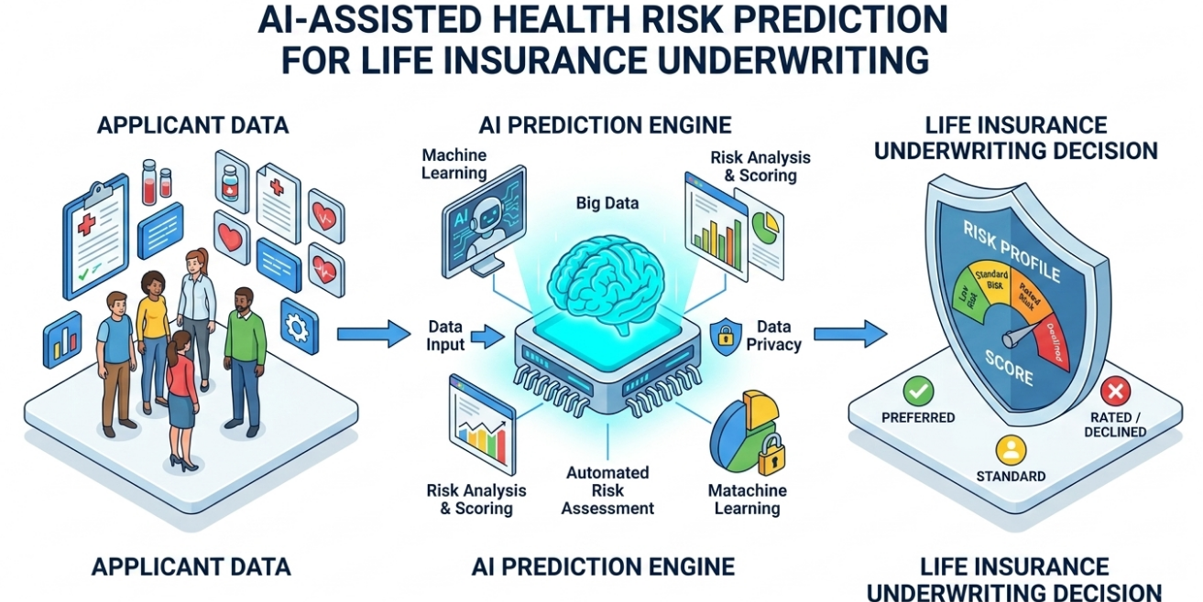
NHANES +
CDC mortality
Models (GLM,NN & XGBoost)
prediction
SHAP
explanation
RAG
grounding
Agentic LLM
report
Prediction, explanation and narrative kept as separate, auditable stages
Notes:
I am Ashin Sahu. This is my high-risk project for AI in Healthcare: an AI-assisted mortality risk pipeline for life insurance underwriting. I will cover the problem, method, results, a short demo, and future direction.

Slide 3
INTRODUCTION
Problem and Motivation
Life insurance underwriting is a healthcare risk problem
❤
Health data collected
Age, blood pressure, cholesterol, HbA1c,
kidney function, smoking, disease history
The core tension
Accuracy
ML captures non-linear interactions a GLM cannot
⚠
Risk must be estimated
What is this applicant's probability of
death within the policy horizon?
Transparency
A regulated decision must be explainable line by line
⚖
Decision must be explained
Regulators and applicants are entitled to
know WHY coverage was denied or priced up
This project asks: how much accuracy does transparency actually cost, and can an LLM bridge the gap by writing explainable narratives from a black-box model's output?
Accurate risk stratification keeps coverage both solvent and accessible
Notes:
Underwriting is really a healthcare risk problem, and getting it wrong hurts both ways: too low and the insurer is exposed, too high and people are priced out of coverage. The industry uses GLMs because they can be explained to a regulator. ML is more expressive but opaque, in a domain where people are entitled to an explanation. That tension is my starting point.

Slide 4
INTRODUCTION
Research Questions
Four questions, answered in order
RQ1
Can ML meaningfully beat a traditional GLM at mortality prediction on public health data?
RQ2
Can post-hoc explainability (SHAP) recover the interpretability underwriting requires?
RQ3
Can an agentic LLM turn model output into a faithful, readable underwriting narrative?
RQ4
Does retrieved clinical literature improve it, and should retrieval be a fixed stage or a skippable tool?
Design constraint throughout: the LLM explains, it never predicts. The mortality probability comes only from XGBoost.
Notes:
Four questions: can ML beat a GLM; can SHAP restore interpretability; can an LLM agent write a faithful narrative; and does retrieval grounding improve it. One constraint holds throughout, and it is the key design decision: the language model explains, it never predicts.

Slide 5
RELATED WORK
Related Work
Four strands, and where this project departs
Strand | What prior work established | What I add
ML on NHANES Weng 2017 | Boosted trees and deep nets reach AUROC high-0.80s to low-0.90s; age and kidney markers dominate | Same-footing GLM vs tree vs neural net in one pipeline
Explainable AI Lundberg 2017, 2020 | SHAP gives global importance and per-patient local attribution | SHAP output feeds an LLM instead of a plot for a human
Interpretability Rudin 2019 | For high-stakes decisions, prefer interpretable models over explaining a black box | Empirical test: transparency costs minimal AUROC here
Agents and RAG Yao 2023, Lewis 2020 | ReAct interleaves reasoning with tool calls; RAG grounds generation in retrieved text | Retrieval as a pipeline stage, not an optional tool
10 references in the report, all peer-reviewed venues or official statistical sources
Notes:
Four strands. Weng showed ML helps cardiovascular risk prediction. Lundberg gave us SHAP. Rudin argues that black-box models should not be used in high-stakes decisions. My project addresses this concern by translating model explanations into human-readable reports, improving transparency while keeping humans in the decision-making loop. ReAct and RAG give the agent architecture. My contribution is the last column.

Slide 6
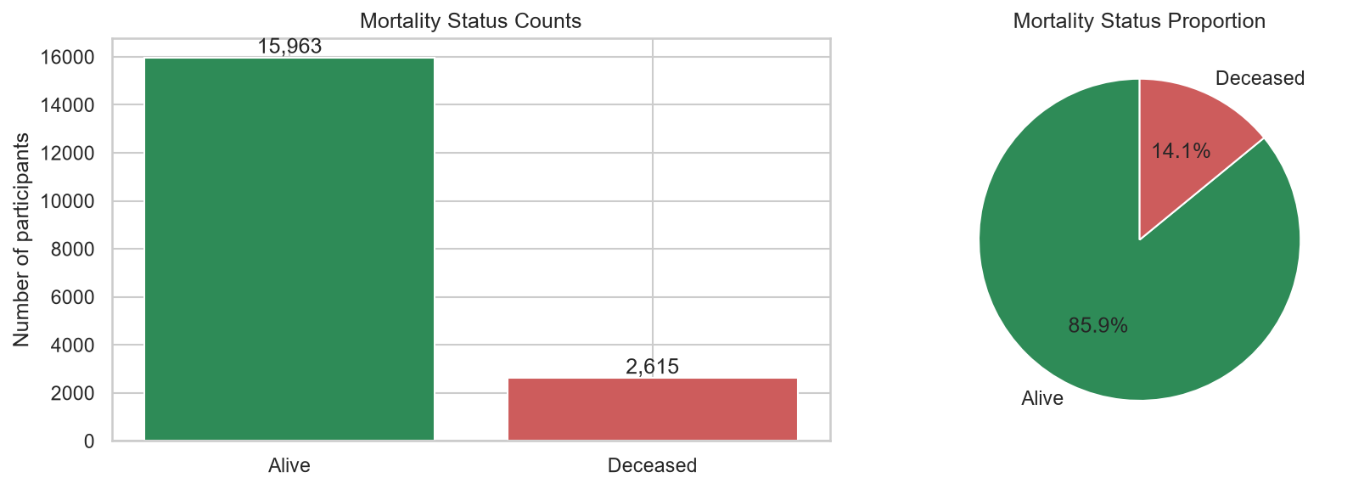
METHOD
Dataset and Tools
Public, documented, fully reproducible
• NHANES 2007-08, 2009-10, 2011-12 linked to the CDC public-use Linked Mortality File, follow-up to 31 Dec 2019.
– Older cycles on purpose: 7-12 years of follow-up yields enough observed deaths to learn from
• Joined on SEQN; mortality-eligible adults, age 18+.
• Stratified 80/20 split: 14,862 train / 3,716 test.
• Local stack only: scikit-learn, XGBoost, PyTorch, SHAP, LangGraph, Ollama (nomic-embed-text, Qwen 2.5 7B), ChromaDB, Gradio. No external API.
18,578
adults
84
features
14%
mortality rate
100%
runs offline
Class imbalance (14% deceased) drove every training choice: class weighting and PR-AUC early stopping
Notes:
Three NHANES cycles linked to the CDC mortality file. I chose older cycles on purpose: against the fixed 2019 cutoff they give seven to twelve years of follow-up, so enough observed deaths to learn from. Eighteen and a half thousand adults, eighty-four features, fourteen percent mortality, and that imbalance on the right drove every training choice. Everything runs locally, including the language model.

Slide 7
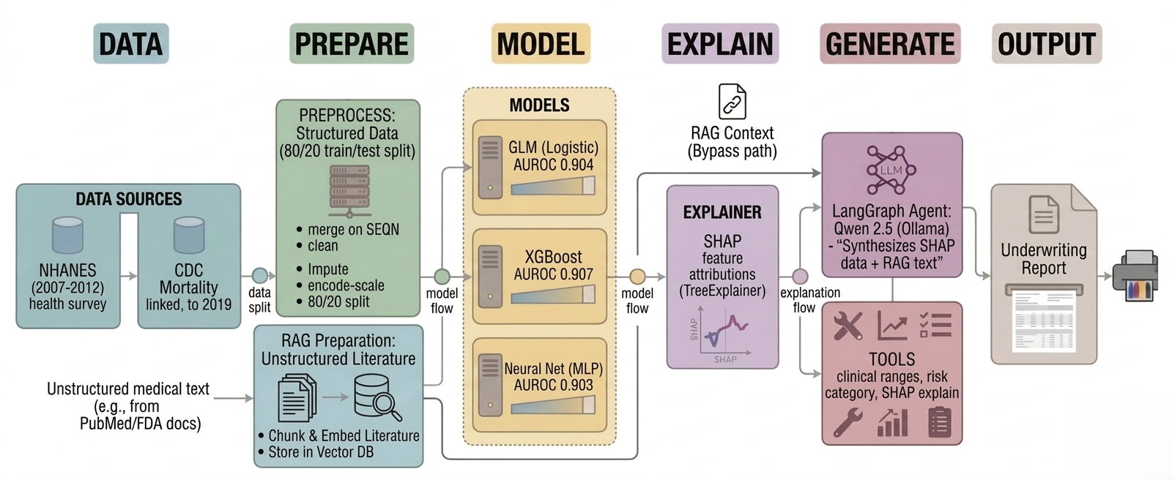
METHOD
End-to-End Architecture
Prediction, explanation and narrative are separate stages by design
Collect Data
Feature Extraction, engineering and RAG indexing
Train GLM, NN, & XGBoost models and predict
SHAP Explanation and Retrieved literature
Agentic orchestration and tool calls
Generate Human readable Under writing report
Notes:
The whole pipeline. Data is merged on SEQN, cleaned, and split before any transformer is fitted, so there is no leakage. The medical literatures are chunked and index for RAG. Three models train on identical features; SHAP explains the best one. Then the interesting part: the SHAP attributions do double duty. They go to the LLM agent, and they also become the search queries that pull grounding literature from a vector store. The agent has three clinical tools backed by an auditable JSON of published thresholds, and it never touches the prediction.

Slide 8
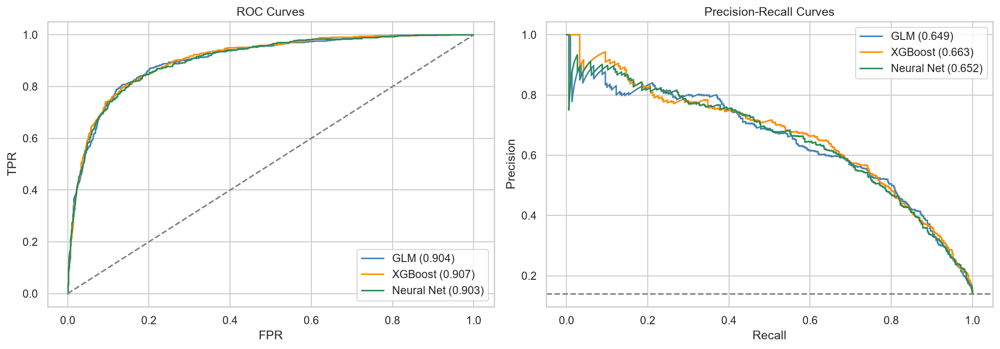
RESULTS
Interpretable Models Stayed Competitive
Held-out test set, n = 3,716
Model | AUROC | PR-AUC | F1
XGBoost (best) | 0.907 | 0.663 | 0.613
GLM - Logistic Regression | 0.904 | 0.649 | 0.579
Neural Network (MLP) | 0.903 | 0.653 | 0.560
+0.003
XGBoost AUROC gain over the GLM
0.907
best AUROC achieved
• XGBoost wins every metric, by a little margin. It may matter more when add more non liner features
• The neural net gave no advantage on tabular clinical data.
ROC and precision-recall curves overlap closely: the three models are near-indistinguishable on this data
Notes:
First result, and clearer than I expected. XGBoost wins every metric, albeit by a small margin of AUROC over the interpretable GLM. The ROC and PR curves nearly overlap, but the consistent lead suggests that some predictive signal is captured by the more expressive model. The neural network offered no additional benefit on this tabular dataset. Importantly, the project shows that high-performing black-box models do not have to remain opaque. By combining XGBoost with SHAP explanations and LLM-generated underwriting reports, the model's reasoning can be translated into a transparent, human-readable form for review. In that sense, the results challenge Rudin's claim that black-box models should be avoided entirely in high-stakes settings, demonstrating instead that strong predictive performance and meaningful transparency can coexist when appropriate explanation and human oversight are built into the workflow.

Slide 9
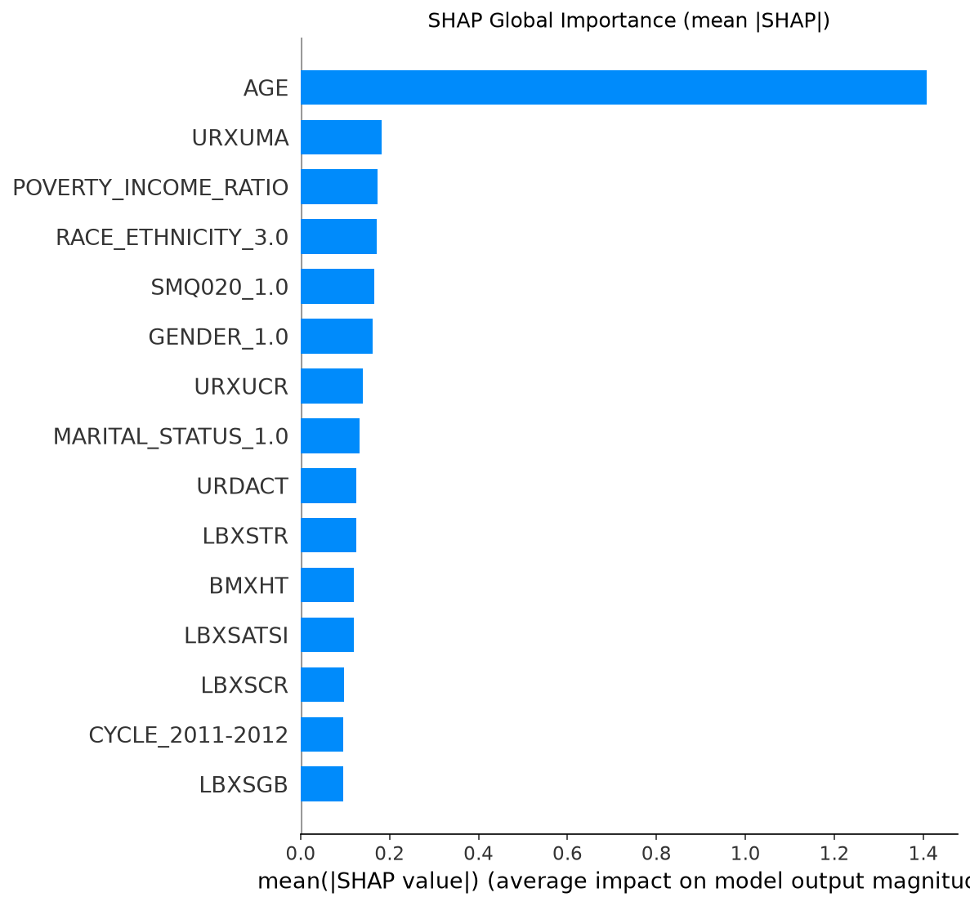
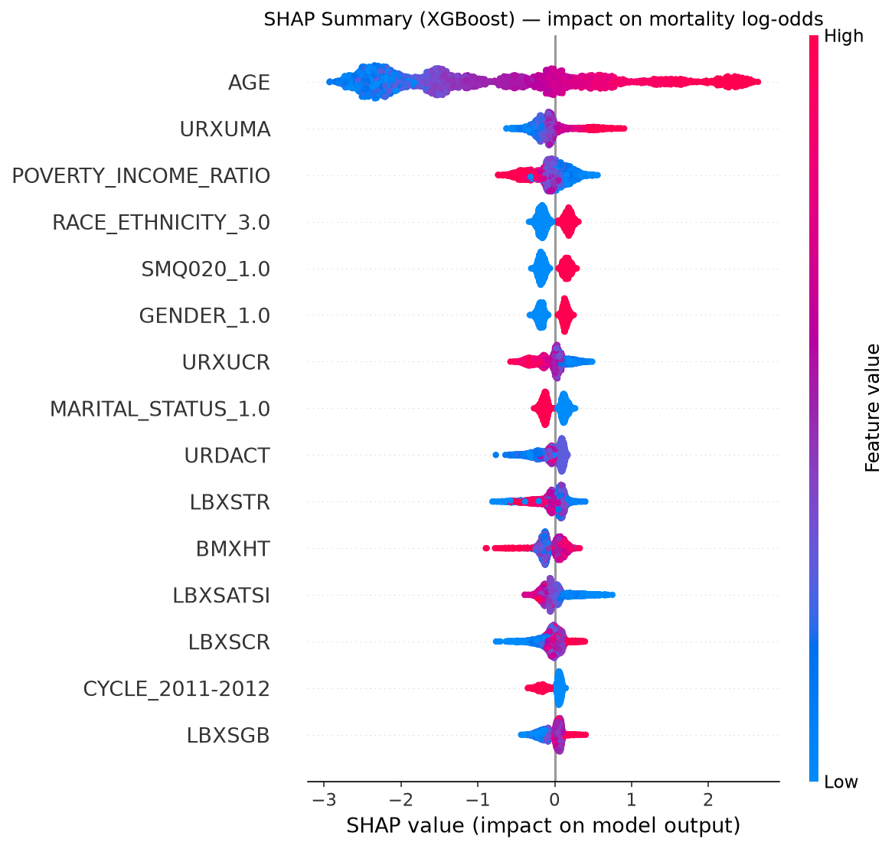
RESULTS
SHAP Recovers the Interpretability
Cross-checked against the GLM coefficients
Feature | β | Odds ratio
Age | +1.47 | 4.33
Race/ethnicity | +0.53 | 1.70
BMI | –0.45 | 0.64
CHF (yes) | +0.38 | 1.46
Marital status | –0.39 | 0.68
• Age dominates: mean |SHAP| = 1.41, several times any other feature. The GLM agrees: β = +1.47, odds x4.3 per SD (see table).
• Both methods rank the same leading drivers: clinically sensible structure, not artifacts.
• BMI carries a NEGATIVE coefficient (–0.45): reverse causality, since illness causes weight loss. Exactly what a human must review.
GLM top-5 coefficients (standardized)
Notes:
Second result. SHAP says age dominates and the GLM independently agrees, which suggests the model learned real clinical structure rather than artifacts. The beeswarm on the right adds direction, per applicant. The table on the right shows the actual GLM coefficients, and also the negative BMI coefficient which is reverse causality. A naive reading would be badly wrong, which is exactly why a human must review attributions.

Slide 10
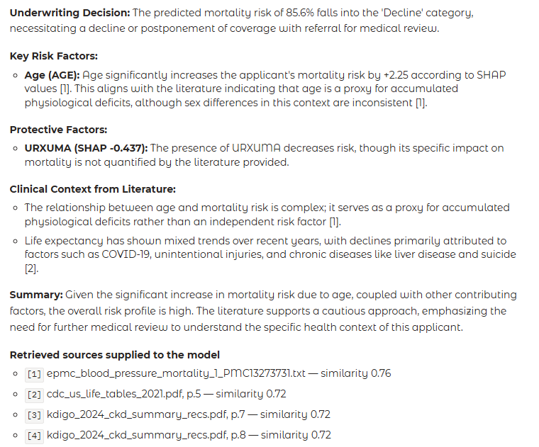
RESULTS
Agentic Reporting, and What RAG Adds
Same agent, same 3 tools, same SHAP input -- only retrieval differs
Sample Report
Metric | Tools only | Tools + RAG
Passages injected per report | 0 | 4
Distinct citations per report | 0.0 | 3.0
Retrieval similarity (cosine) | n/a | 0.715
Report length (words) | 179 | 242
Names the top SHAP driver | 8 / 8 | 8 / 8
SHAP drivers
clinical search queries
ChromaDB cosine search
top-4 passages into the prompt
• Knowledge base: 50 documents (ADA, ACC/AHA, KDIGO, WHO, CDC life tables and 42 open-access papers) into 5,593 embedded chunks.
• Faithfulness did not deteriorate: both variants cite the model's own top driver in all 8 cases.
• KEY POINT: retrieval runs BEFORE the LLM, not as a tool it may skip, so grounding is guaranteed rather than probabilistic.
• Caveat: citation density measures coverage, not correctness.
Notes:
Third result. Two reporting variants, same agent and same three tools, so retrieval is the only difference. RAG moved reports from zero citations to three each, from a fifty-document base of guidelines and open-access papers. Crucially faithfulness did not deteriorate: both variants still name the model's own top driver in all eight cases. The design point is where retrieval sits. I run it before the model is called, not as a tool the agent can decline. In a regulated workflow you cannot let a model decide whether today's report needs evidence.

Slide 11
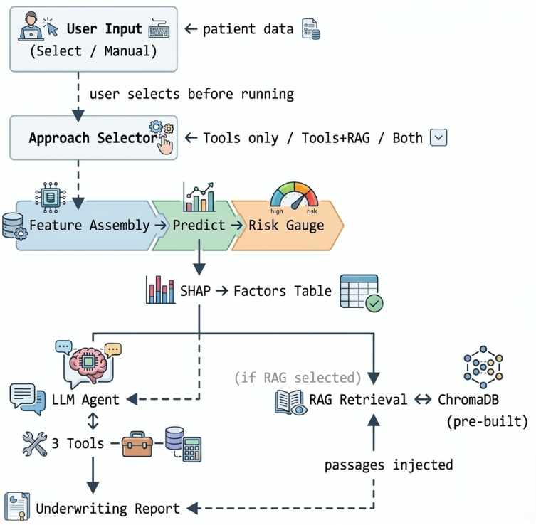
DEMO
Demo App
Gradio app running the full pipeline on one applicant
Risk score
probability plus underwriting category
SHAP factors
direction and magnitude per feature
Approach switch
Tools only / Tools + RAG / Both
RAG panel
queries, passages, pages, cosine scores
Activity log
every stage and tool call, live
The underwriter can see exactly which passages the narrative was written against
Notes:
This slide presents the Gradio-based demo application for the underwriting assistant. The user takes applicant data or manually enters, generates a mortality risk prediction, selects the approach tools only / Tools + Rag / Both, explains the prediction with SHAP factors, optionally grounds the explanation with retrieved clinical literature, and produces a transparent underwriting report. The interface displays the risk score, underwriting category, SHAP explanations, retrieval results, and execution log in one place. Users can switch between reporting approaches and inspect the exact clinical passages used for grounding. By exposing the prediction, explanation, retrieval, and report-generation steps, the application provides an auditable workflow where underwriters can understand both the model's reasoning and the evidence supporting the final narrative.

Slide 12
FUTURE DIRECTIONS
What I Would Do Differently, and Where This Goes Next
If I redo the project
Future directions
• Model time-to-event, not a binary label. Collapsing follow-up months threw away my most informative signal: the biggest missed opportunity.
• Build the knowledge corpus first. Evaluate retrieval quality before generating reports.
• Treat the context window as a design parameter. An oversized RAG prompt silently stalled the model server.
• Faithfulness was operationalized after looking at the generated report. Define report quality metrics before generation and validate them on a larger, hand-labeled sample and sample 50 applicants rather than 8.
• Survival modelling (Cox / discrete-time) so risk becomes a horizon-specific curve, which is how policies are actually priced.
• Calibration and fairness auditing by subgroup. Race, sex and socioeconomic status are among the drivers, so this is an ethical prerequisite.
• Traditional vs agentic RAG head to head: how often would an agent skip retrieval, and at what cost?
• Expert adjudication of whether each citation supports its claim.
• Human evaluation with practicing underwriters.
Notes:
This slide summarizes what I would improve if I repeated the project, and where the work can go next. The biggest change would be to model time-to-event instead of using a simple binary mortality label, because follow-up time contains important risk information. I would also define report-quality and faithfulness metrics before generating reports, test retrieval quality earlier, and evaluate on a larger sample. Future work would focus on survival modeling, calibration and fairness auditing, stronger citation validation, and evaluation with practicing underwriters.

Slide 13
CONCLUSION
Conclusion
0.907
XGBoost AUROC
+0.003
gain over the GLM
8 / 8
faithful reports
3.0
citations per report
• A fully local, reproducible pipeline: prediction, SHAP, agentic narrative, retrieval grounding and a demo interface.
• On this dataset the GLM held its own; XGBoost/NN, comparable here, gain relevance once more nonlinear features are introduced.
• Separating prediction from explanation kept narratives faithful to the model rather than to the language model’s parametric memory.
• Main transferable lesson: grounding is an architectural property. WHERE the retrieval decision sits determines whether it can be guaranteed.
• Everything runs offline on one machine, so no patient data leaves it if run for more real sensitive patient data and features.
Thank you. Report, code, notebooks and demo are included with the submission.
Notes:
To conclude, this project demonstrates a fully local and reproducible underwriting pipeline that combines mortality risk prediction, SHAP-based explainability, retrieval-grounded evidence, and agentic report generation. XGBoost achieved the best predictive performance, while SHAP and LLM-generated narratives made its decisions easier to interpret and review. The key takeaway is that transparency and performance do not have to be mutually exclusive, and that grounding should be treated as an architectural design choice. By separating prediction, explanation, and evidence retrieval into distinct stages, the system provides a more transparent and auditable workflow for high-stakes decision making. Thank you.

Slide 14
Live Demo

