Slide 1

CauseInfer: Automatic and Distributed Performance Diagnosis with Hierarchical Causality Graph in Large Distributed Systems
Xi’an Jiaotong University
Pengfei Chen, Yong Qi, Pengfei Zheng, Di Hou
Slides Author: Pengfei Chen
Presented by: Lei Yang
2014-05-01
Contact author: chenpengfei@outlook.com

Slide 2
Apologize
Dear fellows:
Due to the Visa Problem, I can’t attend the conference to present my work. It is a pity for me to lose this great opportunity to communicate with so many excellent researchers face to face. Hence I authorize PhD Lei Yang to present my work on behalf of me. Sorry for that! If you have any problems, please feel free to contact me, my email:
chenpengfei@outlook.com
Pengfei Chen

Slide 3
Outline
1
Introduction
3
Problem formulation
4
System design
5
System evaluation
6
Conclusion

Slide 4

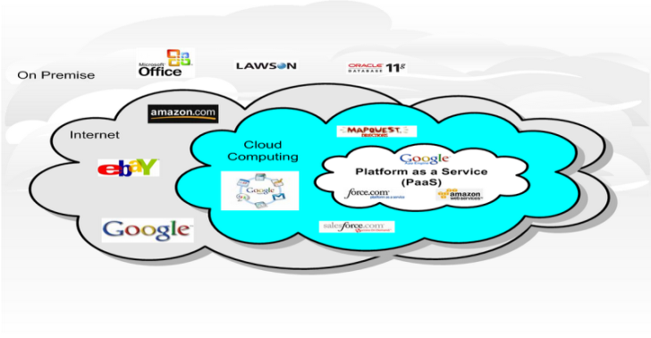
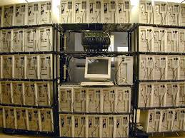
Introduction
Performance and availability problems are commonplace in modern distributed systems: data center、cloud、cluster …
Fault
Failure
Performance anomaly
Cloud
Cluster
Data Center

Slide 5
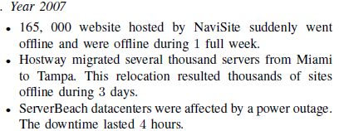

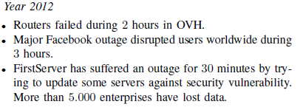

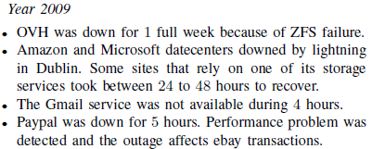
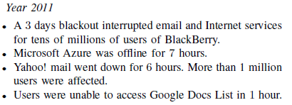
Introduction
Real cases and real cost
Notes:
Some real failure events in modern cloud platform

Slide 6
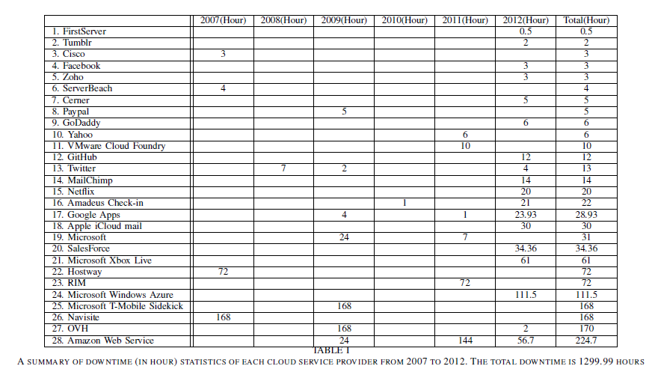
Introduction
Christophe C´erin, et al. “Downtime statistics of current cloud solutions”
Real cases and real cost
Downtime statistics of several famous cloud platform

Slide 7
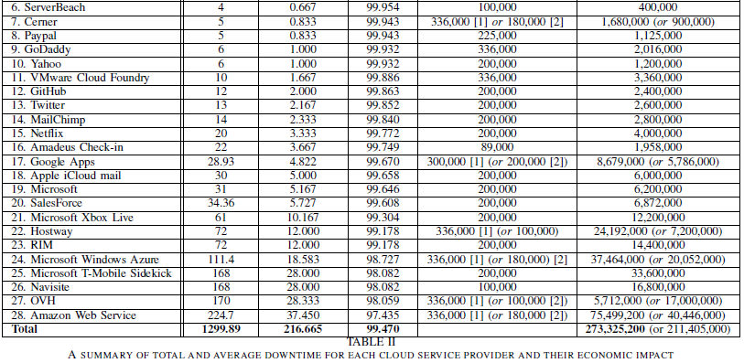
Introduction
Christophe C´erin, et al. “Downtime statistics of current cloud solutions”
Real cases and real cost
Downtime and economic impact

Slide 8
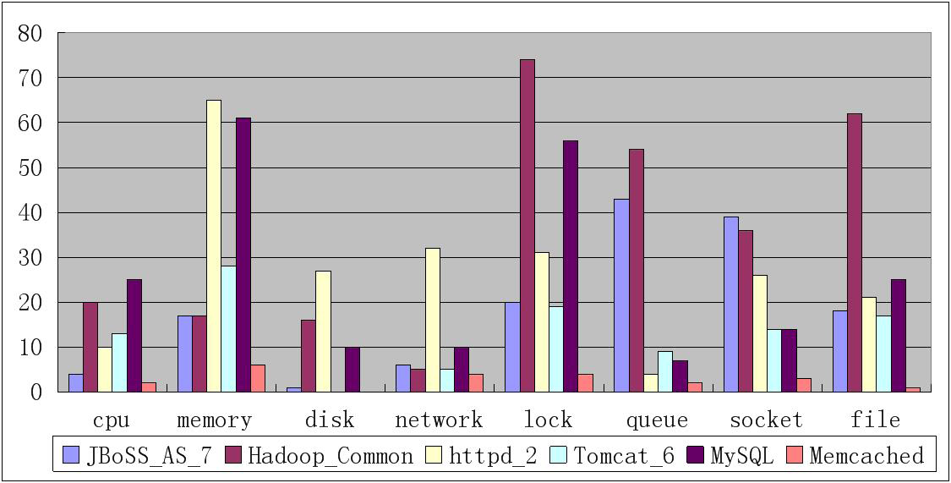
Introduction
Root causes of performance or availability problems
Causes from runtime environment: VM dynamical management (e.g. CPU\Memory preservation)、CPU hog、Memory hog、configuration changes 、workload changes、software update、…
Causes from application per se：memory leak、lock contention、data corruption、thread leak、…
Bug statistics from several popular open source software

Slide 9
Introduction
Goal
Pinpoint the real causes without manual diagnosis!!!.
Requirements
Real time
Accurate
Fine granularity
Low overhead
Automatic
Challenges
Complex dependence relationships amongst software components and runtime parameters.
Large cardinality of potential root causes.
Our solution
Explicitly construct the dependence (causality) relationships amongst software and runtime parameters with causal graph model, then infer the root causes on the graph.

Slide 10
Introduction
Weaknesses of previous works
Log-based method
Hard to work on line!
Trace-based method
The overhead is too high due to the code instrumentation!
Signature-based method
Need labeled data in order to employ supervised learning model!
Dependency graph-based method
Coarse granularity!
Our contributions
Introduce a new change point detection method
A light-weighted service dependency construction method
A new causality graph construction method
An efficient prototype CauseInfer

Slide 11
Problem Formulation
Formulation
The performance diagnosis problem is formulated as a inference problem.
The whole software system is abstracted as a two layered hierarchical graph: Service dependence graph and system metric causal graph, the cause inference is conducted on the graph.
Performance diagnosis
Inference
Anomaly
Fault
Anomaly
Failure
CPU
Memory
Why?
Disk queue
Configuration

Slide 12
Problem Formulation
Service dependence graph
Definition: service A depends on service B, that is A → B, if service A requires service B to satisfy certain requests from its clients. For standard 3-tier system:
However anomaly propagates along the opposite direction.
Metric causal graph
Definition: A is a cause of B if change of metric A can cause change of metric B, that is A→B. A collection of metrics can be constructed as a DAG.
Application service
Web service
Database service
Locate causes at service or node granularity
Application service
B
C
Locate causes at metric granularity (real causes)
A
E
D
Notes:
Software services are deployed in different nodes (VM instance or physical machine). In each node the a metric causal graph is constructed.

Slide 13
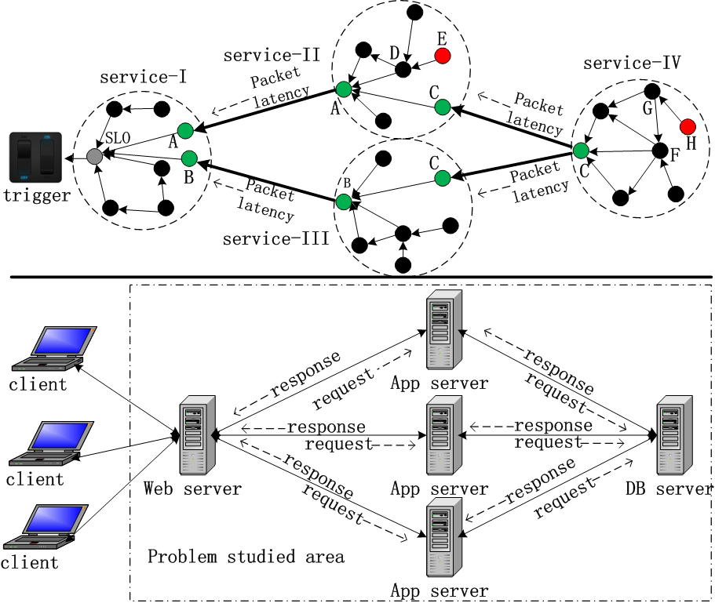
Problem Formulation
A case
Service –I
Service –II
Inference path:
SLO
A
A
D
E
Notes:
We assume metric E on service II node is the root cause. When a SLO violation
of service I is detected, the cause inference is triggered. After
a cause inference in service I node, we locate the performance
anomaly at metric A indicating the SLO violation of service II.
Therefore the cause inference on service II node is triggered
and executed according to the metric causality graph stored on
this node. Finally, we find the root cause, metric E. The whole
inference path is: SLO->A->D->E. It should be noticed
that the inference result may contain multiple metrics due to
the statistical error. Hence a root cause ranking procedure is
necessary to decrease the false positive and select the most
probable root causes.

Slide 14
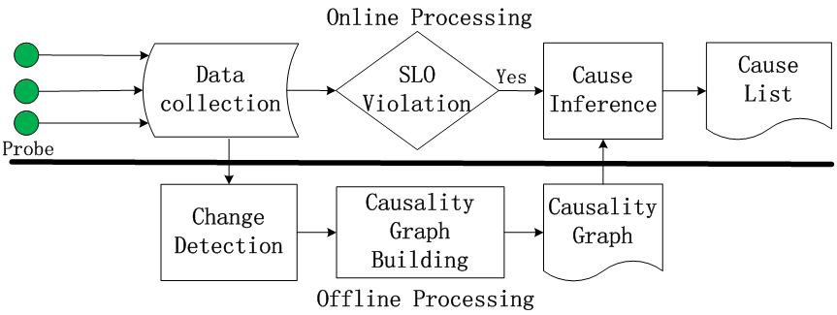
System design
Framework
Notes:
CauseInfer system mainly contains two procedures: an offline
causality graph building procedure and an online cause inference
procedure. The online procedure consists of two modules:
data collection and cause inference. The data collection module
collects the runtime performance metrics from multiple data
sources. The cause inference module is in charge of traversing
and ranking the root causes according to the causality graph
generated by the causality graph builder. The offline procedure
contains two modules:change point detection module and
causality graph building module. The change point detection
module converts every metric to a binary data series using a
Bayesian change point detection. The causality graph building
module uses the binarized metrics to construct a two layered
hierarchical causality graph.

Slide 15
System design
Data collection
This module collects multiple data sources across different software stacks including: Application、Process、OS
To provide a unified SLA of different applications (e.g. Hadoop, Tomcat, Httpd)， a new metric TCP_LATENCE is proposed.
Data Collection
Data Collection
Application
Application
Operating System
Operating System
Hardware
TCP latency
Hardware
Last inbound packet t1
Service-A
Service-A
First outbound packet t2
TCP_LATENCE = t2-t1

Slide 16

System design
Change Point detection
Change point is necessary:
The requirements of “Cause-Effect” notion.
Additional advantage:
Transfer the original data series with different scales to a unified {0,1} binary data.
BCP (Bayesian Change Point) method is introduced.
Basic idea:
Given a sequence of observations: the aim is to find a partition: , where indicates a change occurs at position i + 1, else
The score to determine whether the point at position i is a change is defined as:
Notes:
According to Pearl’s cause-effect notion, if two variables
have causal relationship, the changes of one variable will
cause the changes of the other. So before causality graph
building, we first identify the changes in the time series.

Slide 17
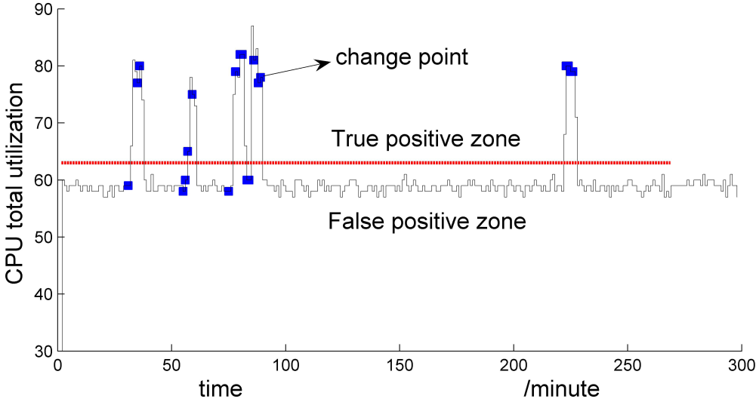
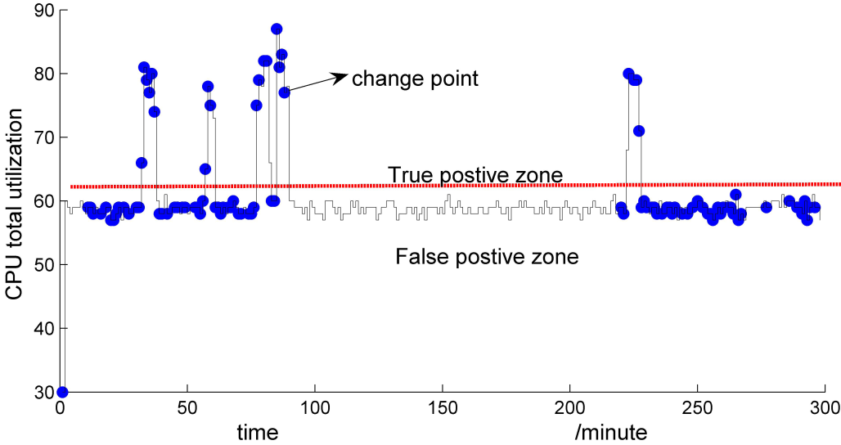
System design
Change Point detection
Comparison between CUSUM and BCP:
BCP
CUSUM

Slide 18
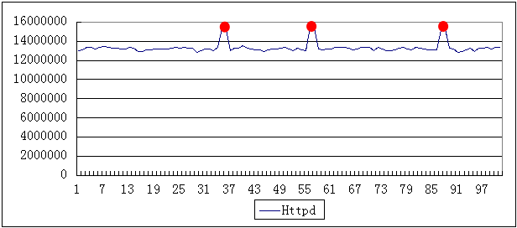
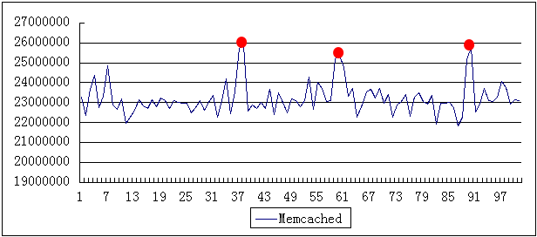
System design
Causality graph building
Causality: Given two variables X and Y, we say X is a cause of Y if the changes of X can affect the distribution of Y but not vice versa, denoted by X→ Y, all the causal relationships of a collective variables are encoded by a DAG.
Service dependency graph
Oracle : The traffic delay between dependent services often exhibits “typical” spikes that reflect the underlying delay for using or providing these services.

Slide 19
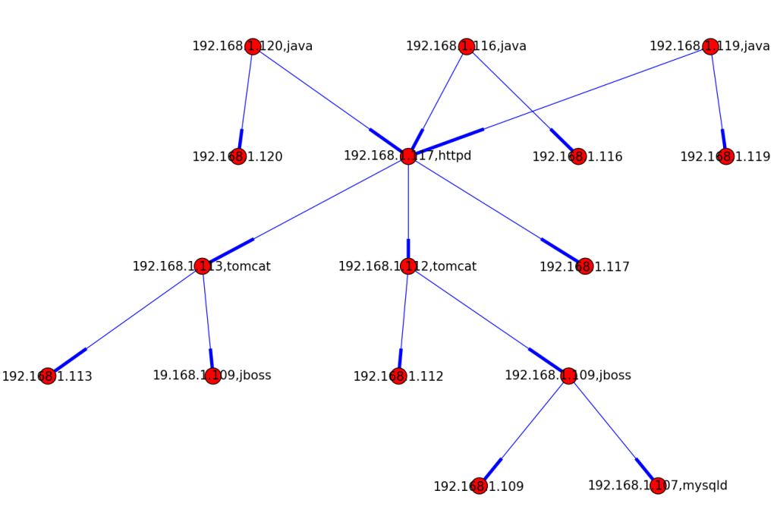
System design
Causality graph building
Service dependency graph
1. construct the skeleton of the dependence graph
service identification: two-tuple (ip, service_name)
a. Employ netstat to construct the skeleton: for example
tcp 192.168.1.107:5901 192.168.1.107:43878 ESTABLISHED
tcp 192.168.1.107:43878 192.168.1.107:5901 ESTABLISHED
tcp 192.168.1.107:5904 192.168.1.107:45973 ESTABLISHED
tcp 192.168.1.107:33235 192.168.1.107:5902 ESTABLISHED
…
b. Transfer the port no. to the service name by querying port information
5901 → qemu-kvm, 43878→Python, 80→Httpd, 8090→Tomcat
One example

Slide 20
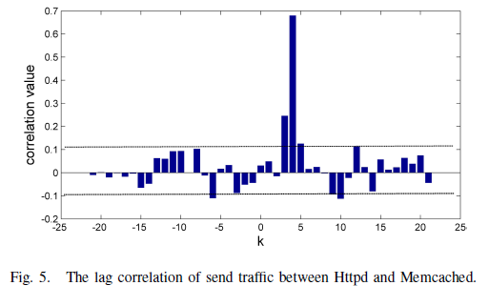


System design
Causality graph building
Service dependency graph
2. Orientate the dependence direction
Observation: The packets sent by the server change with the ones sent by the client.
System tool: systemTap to intercept the network transmission of specific services
Mathematical tool: lag correlation to determine the direction
Our objective is to find a best k which maximize namely

Slide 21
System design
Metric Causality Graph
correlation ≠ causality
causality → correlation, but not vise versa
In causal relationships, variable X only depends on pa(X), while in correlation relationships, variable X may relevant to any other variables.
For example:
Y is a cause of Z, and Independence(X,Z|Y), but if
• P(X=1) = 0.5
• P(Y=1|X=1) = 1 P(Y=0|X=0) = 1
• P(Z=1|Y=1) =1 P(Z=0|Y=0) = 1
Knowing Z automatically tells us the value of X, so conditioning on Y makes no difference. X and Z appear not independent.
The “lucky” distribution may bias the causality!
X
Y
Z

Slide 22

System design
Metric Causality Graph
Two assumptions:
Causal Markov condition and faithfulness
Causal Markov condition:
This assumption decomposes the causal graph into some smaller independence relationships.
Under this assumption, the skeleton (undirected graph) is constructed.
Faithfulness:
The faithfulness assumption guarantees that the independence relationships among the variables in V are exactly those represented by G by means of the D-separation criterion.
Notes:
Causal Markov condition says nothing about whether there are additional independence relationships, while the faithfulness tells us the set of independence relations derived from Causal Markov is the exact set of independence relations

Slide 23

System design
Metric Causality Graph
Based PC-algorithm, two methods: conservative and aggressive algorithm are proposed.
PC-algorithm
1.Construct the skeleton of Causal graph (Undirected graph) with pair-wise independence condition test.
2. Orientate the graph according to several rules.
Causal graph skeleton construction
Given a set of variables, G2 metric is used to test the independence of variable X and Y given Z. G2 is cross entropy based metric, defined as:
and it follows chi-square distribution, hence via chi-square test the independence relationship is determined.
The skeleton construction procedure is:
(to be continued)
Notes:
Due to the statistical error, causal relationships may be wrong.

Slide 24
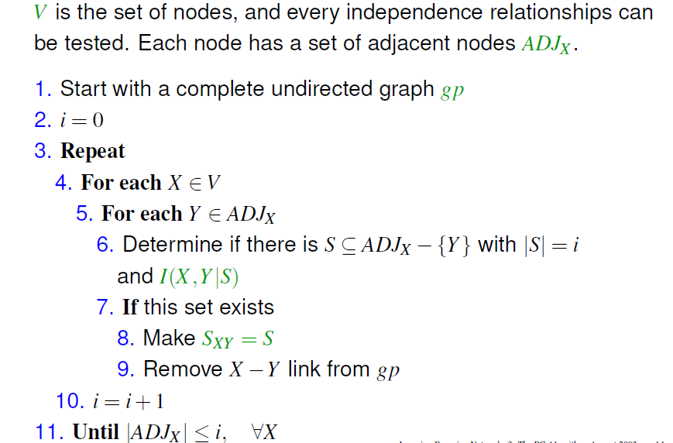
System design
Notes:
SXY is used to orientate the graph direction

Slide 25
System design
Causal graph skeleton
Example:
Given 5 variables: A, B, C, D, E
A
B
A
B
C
D
D
C
E
E
Complete undirected graph
Real hidden causal graph

Slide 26
System design
Causal graph skeleton
Example:
Given 5 variables: A, B, C, D, E
A
B
A
B
Yes
C
D
D
C
E
i=0
E
Complete undirected graph
Real hidden causal graph

Slide 27
System design
Causal graph skeleton
Example:
Given 5 variables: A, B, C, D, E
A
B
A
B
Yes
C
D
D
C
SAB=∅
E
i=0
E
Complete undirected graph
Real hidden causal graph

Slide 28
System design
Causal graph skeleton
Example:
Given 5 variables: A, B, C, D, E
A
B
A
B
Yes
C
D
D
C
SAB=∅
SAD=∅
E
i=0
E
Complete undirected graph
Real hidden causal graph

Slide 29
System design
Causal graph skeleton
Example:
Given 5 variables: A, B, C, D, E
A
B
A
B
No
C
D
D
C
SAB=∅
SAD=∅
E
i=0
E
Complete undirected graph
Real hidden causal graph

Slide 30
System design
Causal graph skeleton
Example:
Given 5 variables: A, B, C, D, E
A
B
A
B
No
C
D
D
C
SAB=∅
SAD=∅
E
i=0
E
Complete undirected graph
Real hidden causal graph

Slide 31
System design
Causal graph skeleton
Example:
Given 5 variables: A, B, C, D, E
A
B
A
B
No
C
D
D
C
SAB=∅
SAD=∅
E
i=0
E
Complete undirected graph
Real hidden causal graph

Slide 32
System design
Causal graph skeleton
Example:
Given 5 variables: A, B, C, D, E
A
B
A
B
No
C
D
D
C
SAB=∅
SAD=∅
E
i=0
E
Complete undirected graph
Real hidden causal graph

Slide 33
System design
Causal graph skeleton
Example:
Given 5 variables: A, B, C, D, E
A
B
A
B
No
C
D
D
C
SAB=∅
SAD=∅
E
i=0
E
Complete undirected graph
Real hidden causal graph

Slide 34
System design
Causal graph skeleton
Example:
Given 5 variables: A, B, C, D, E
A
B
A
B
No
C
D
D
C
SAB=∅
SAD=∅
E
i=0
E
Complete undirected graph
Real hidden causal graph

Slide 35
System design
Causal graph skeleton
Example:
Given 5 variables: A, B, C, D, E
A
B
A
B
No
C
D
D
C
SAB=∅
SAD=∅
E
i=0
E
Complete undirected graph
Real hidden causal graph

Slide 36
System design
Causal graph skeleton
Example:
Given 5 variables: A, B, C, D, E
A
B
A
B
No
C
D
D
C
SAB=∅
SAD=∅
E
i=0
E
Complete undirected graph
Real hidden causal graph

Slide 37
System design
Causal graph skeleton
Example:
Given 5 variables: A, B, C, D, E
A
B
A
B
No
C
D
D
C
SAB=∅
SAD=∅
E
i=0
E
Complete undirected graph
Real hidden causal graph

Slide 38
System design
Causal graph skeleton
Example:
Given 5 variables: A, B, C, D, E
A
B
A
B
No
C
D
D
C
SAB=∅
SAD=∅
E
i=1
E
Complete undirected graph
Real hidden causal graph

Slide 39
System design
Causal graph skeleton
Example:
Given 5 variables: A, B, C, D, E
A
B
A
B
Yes
C
D
D
C
SAB=∅
SAD=∅
E
i=1
E
Complete undirected graph
Real hidden causal graph

Slide 40
System design
Causal graph skeleton
Example:
Given 5 variables: A, B, C, D, E
A
B
A
B
Yes
C
D
D
C
SAB=∅
SAD=∅
E
i=1
SCD={B}
E
Complete undirected graph
Real hidden causal graph

Slide 41
System design
Causal graph skeleton
Example:
Given 5 variables: A, B, C, D, E
A
B
A
B
Yes
C
D
D
C
SAB=∅
SAD=∅
E
i=2
SCD={B}
E
Complete undirected graph
Real hidden causal graph

Slide 42
System design
Causal graph skeleton
Example:
Given 5 variables: A, B, C, D, E
A
B
A
B
Yes
C
D
D
C
SAB=∅
SAD=∅
E
i=2
SCD={B}
E
SAE={C,D}
Complete undirected graph
Real hidden causal graph

Slide 43
System design
Causal graph skeleton
Example:
Given 5 variables: A, B, C, D, E
A
B
A
B
Yes
C
D
D
C
SAB=∅
SAD=∅
E
i=2
SCD={B}
E
SAE={C,D}
Complete undirected graph
Real hidden causal graph

Slide 44
System design
Causal graph skeleton
Example:
Given 5 variables: A, B, C, D, E
A
B
A
B
Yes
C
D
D
C
SAB=∅
SAD=∅
E
i=2
SCD={B}
E
SAE={C,D}
Complete undirected graph
Real hidden causal graph
SBE={C,D}

Slide 45
System design
Causal graph skeleton
Example:
Given 5 variables: A, B, C, D, E
A
B
A
B
Stop, because i=3 > ADJx
C
D
D
C
SAB=∅
SAD=∅
E
i=3
SCD={B}
E
SAE={C,D}
Complete undirected graph
Real hidden causal graph
SBE={C,D}

Slide 46
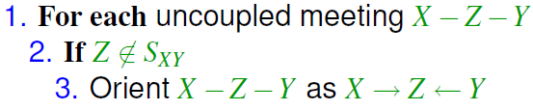
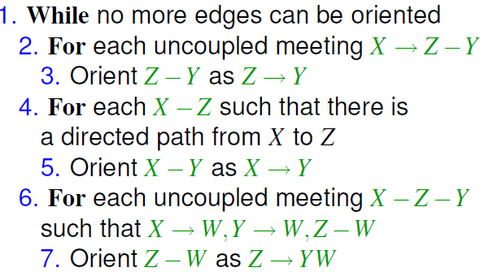
System design
Graph orientation
a. Orientate the head-to-head links: X—Y—Z
b. More rules to orientate the graph

Slide 47
System design
Finally, we got the causal graph!
A
B
A
B
counterintuitive
C
D
D
C
E
E
Got from PC-algorithm
Real hidden causal graph
Notes:
However the DAG may contain multiple isolated
Sub-graphs, counterintuitive causal relations and bidirectional
links due to the lacking of evidence, statistical errors or non-causal
relations at all.

Slide 48
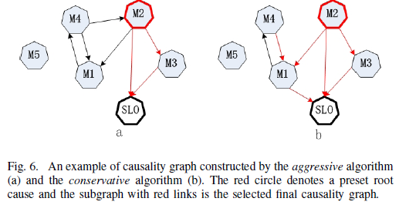
System design
Aggressive algorithm
Use no prior knowledge to build the causality graph.
1. Build the causal graph based on PC-algorithm (A rough graph)
2. Select a maximum subgraph from the DAG using the following conditions:
a. TCP LATENCY metric as the final effect metric has no descendants;
b. The final effect metric is reachable from every path in the graph.
c. There are no parentsfor the preset root cause metrics;
d. For a bidirectional link, we select one direction randomly
Notes:
For example, M5 is isolated, the causal
relation M4 → M2 is counterintuitive and the causal relation
between M1 and M4 is bidirectional in Figure 6 (a).

Slide 49
System design
Conservative algorithm
Preset several root causes according to prior knowledge. Workload, configuration parameters, … as the root causes.
Cause inference
1. Detect SLO anomaly using CUSUM.
2. Traverse the causal graph in a DFS way along the opposite direction.
3. Determine whether the current metric is abnormal using CUSUM.
4. Output the metric if there are no descendants for an abnormal node or no violations in all of its descendants.
Notes:
The procedure of conservative algorithm is the same as the
aggressive one except the initialization. We initialize some
directions in the graph before executing PC-algorithm. Compared with the aggressive algorithm,
the conservative one can capture more causal relations and
reduce the counterintuitive causal relations. For example, the
causal relation M1→SLO, lost by the aggressive algorithm
is captured by the conservative algorithm and simultaneously
the counterintuitive causal relation M4 → M2 is eliminated in
Figure 8(b).

Slide 50

System design
For example:
5. Use the z-score based method to rank the root causes.
abnormal
A
B
Search path:
SLO
D
B
C
B
abnormal
D
C
output
B
B
SLO
root cause
abnormal

Slide 51

Evaluation
Platform
Hardware: 5 physical machine virtualized into 20 VMs
Software: TPC-W and Olio benchmark
Methodology
Inject faults caused by the runtime environment changes:
CpuHog, MemLeak, DiskHog, NetworkJam, Overload, ConfChanges
Inject faults caused by software bugs:
CpuBug, MemBug
Evaluation criterion
precision and recall

Slide 52
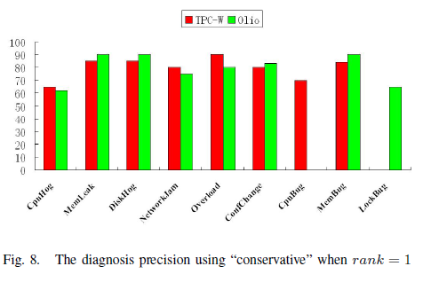
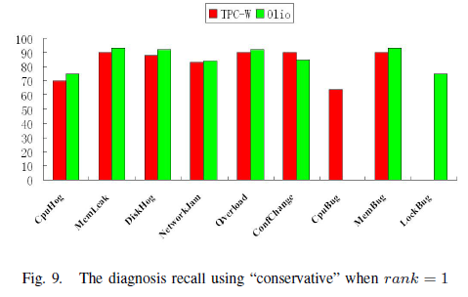
Evaluation
Effectiveness Evaluation

Slide 53
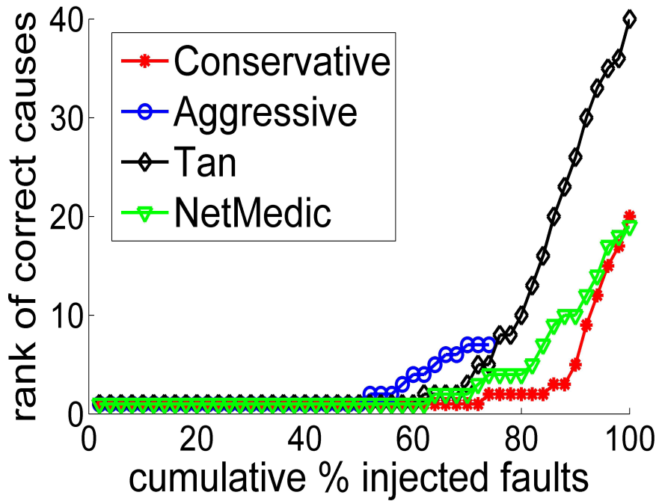
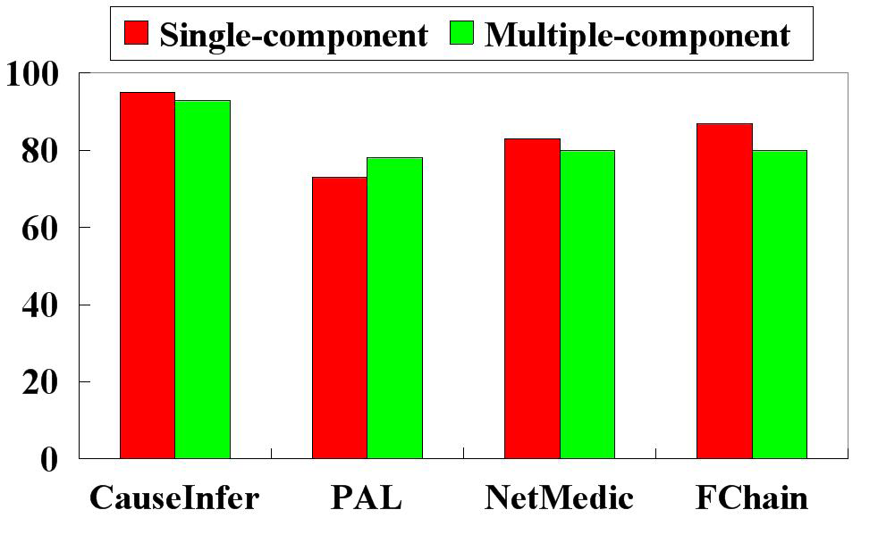
Evaluation
Comparison
We compare causeInfer with TAN, NetMedic, PAL and FChain.
Metric level diagnosis (single fault)
Node level diagnosis

Slide 54
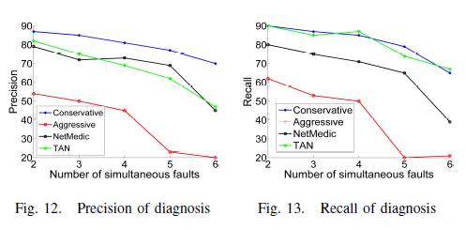
Evaluation
Comparison
Multiple faults injection

Slide 55
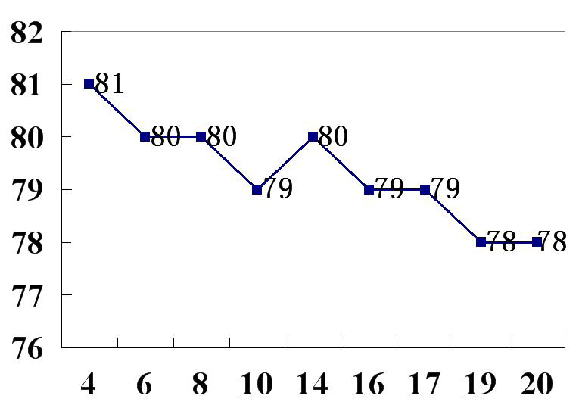
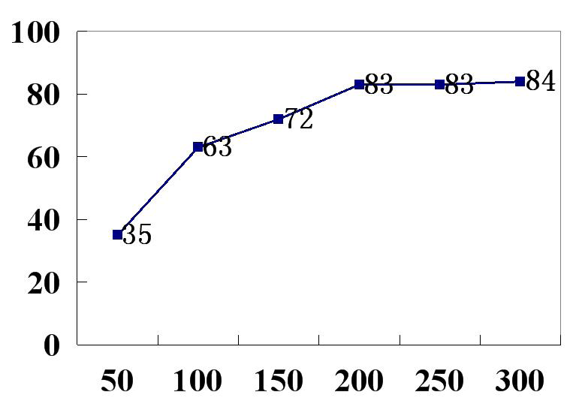
Evaluation
Scalability & Sensibility
scalability
sensibility
Notes:
scalability: CauseInfer works in a distributed manner. Most
of the computation is done locally and the data exchange
between hosts is very small only including the SLO information
and the send traffic of a specific service. Therefore our system
is easy to scale up no matter adding new services or machines
in a large distributed system. To test the scalability of our
system, we deploy more services such as Memcached and
Tomcat. From Figure 14 we can see our system has only three
percent degradation in precision from 4 services to 20 services
showing a good scalability.
scalability:CauseInfer works in a distributed manner. Most
of the computation is done locally and the data exchange
between hosts is very small only including the SLO information
and the send traffic of a specific service. Therefore our system
is easy to scale up no matter adding new services or machines
in a large distributed system. To test the scalability of our
system, we deploy more services such as Memcached and
Tomcat. From Figure 14 we can see our system has only three
percent degradation in precision from 4 services to 20 services
showing a good scalability. causality graph obtained by our method. But when the data
length reaches 200, the causality graph becomes stable and the
precision doesn’t change significantly. That’s the reason why
we choose 200 in this paper.

Slide 56
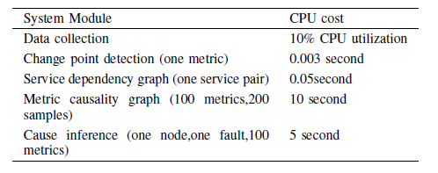
Evaluation
Overhead

Slide 57
Conclusion
Causality analysis bring some new insights to detailed performance diagnosis indeed. We will deploy our system in a real production system.
Thank you very much !
Q & A

