Slide 1

InvarNet-X : A Comprehensive Invariant based Approach for Performance Diagnosis in Big Data Platform
Pengfei Chen
Xi’an Jiaotong university
2014-9-2

Slide 2

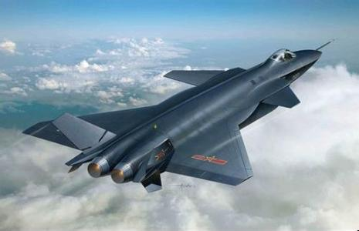





Background
National Defense
Health
Science
Education
Government
Business

Slide 3
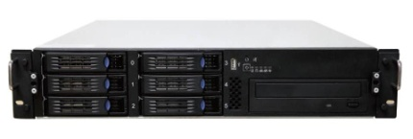
Background
Master
Anomaly
Error
Failure
Slave-1
Slave-2
Slave-3
QoS
System Crash
Long tail
Notes:
Impact on the real-time

Slide 4
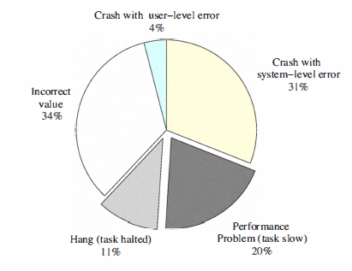
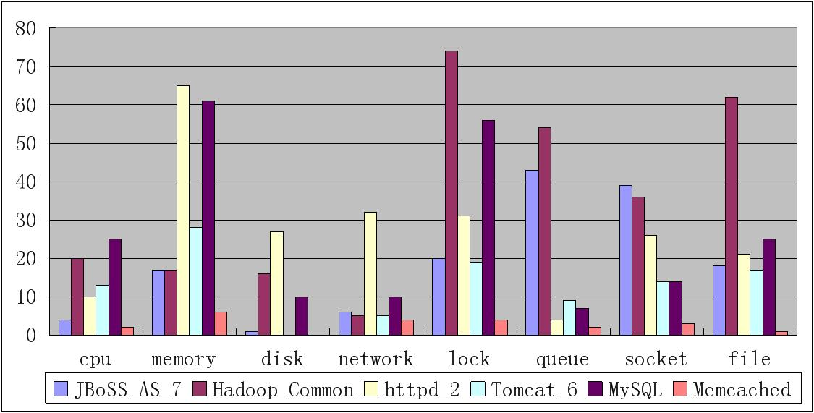
Background
Tan, J., Pan, X., et.al.: Kahuna: Problem diagnosis
for mapreduce-based cloud computing environments. ( NOMS, 2010)
31%
Problems (Hadoop)
Root causes

Slide 5
Related work
 | Granularity | Instrumentation | Work mode | Method | Supervised
Kahuna(NOMS) | LOC | No | Offline | Log-based | No
X-trace(NSDI) | Function | Yes | Online | Trace | No
Pinpoint(DSN) | Function | Yes | Online | Trace | No
CloudPD(DSN) | Component | No | Online | Signature | Yes
Fingerprint(EuroSys) | Node | No | Online | Signature | Yes
Fchain(ICDCS) | Node(VM) | No | Online | Graph | No
Netmedic(Sigcomm) | Component | No | Online | Graph | No
InvarNet-X | Root cause | No | Online | Signature | Yes

Slide 6

Goal
Which node
Node
Which metric
Metric
What’re the causes
Root cause
Goal: InvarNet-X is to pinpoint the root causes for those problems whose causes are recurrent and investigated and provide some hints for the unknown problems on the fly.

Slide 7
Challenges
QoS
Long running
Xeon, Atom, SSD, HDD, …
Workload
variation
Batch VS Interactive
Heterogeneity

Slide 8
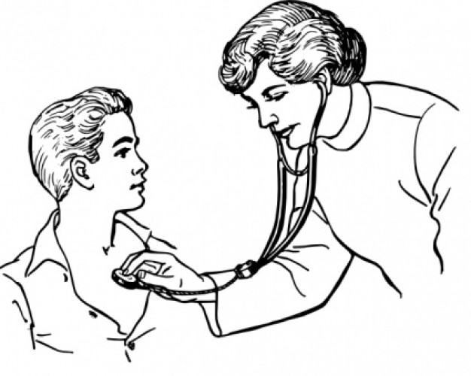
Motivation
Temperature
Fever
Density
Canner
Cold
Color
……
Alzheimer
……
Symptoms
Diseases
Signature database
The diseases have distinct behaviors from the perspective of some observable symptoms.

Slide 9
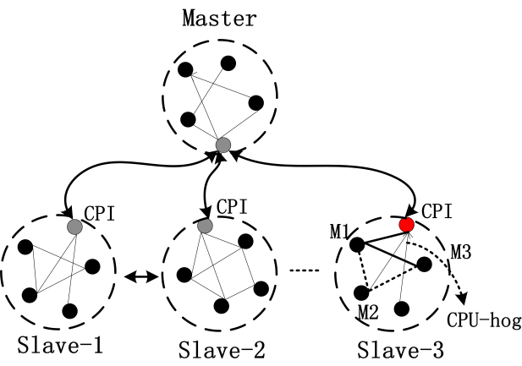
Solution Framework
Symptoms-->Signature base-->Root causes
（Supervised）
Performance
Diagnosis
Pattern
Recognition
1
Construct the Invariants in the normal running
2
Construct the Signature database
3
Infer the root causes on the fly
Invariants: the invariant statistical correlation between two variables
Building models for each type of workloads on each node

Slide 10
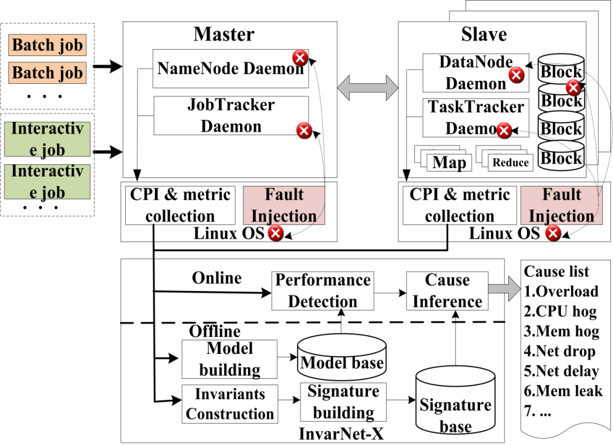
Solution Framework
The architecture of InvarNet-X

Slide 11

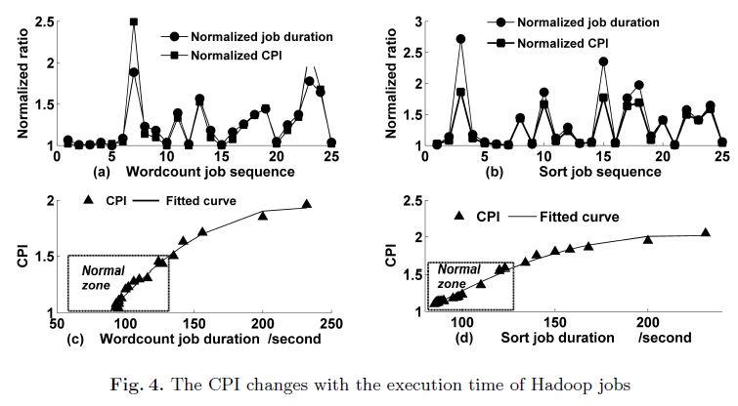
CPI as a KPI
CPI (Cycle Per Instruction) as a KPI

Slide 12

Anomaly detection
Belief:
The dynamics of CPI metric could be described by ARIMA model and the violation of the ARIMA model implies anomaly.
ARIMA model:
ARIMA(p,d,q), p-order of ‘AR’, q-order of ‘MA’, d-difference order
ARIMA(p,q):
Training ARIMA:
Five-tuple: (p,d,q, ip, type)

Slide 13
Anomaly detection
Basic idea:
(X(1), X(2), X(3), …, X(p)
ARIMA(p,d,q)
X’(p+1)
Define: ξ= |X(p+1)-X’(p+1)|
X(p+1) denotes the observed value
If ξ exceeds a threshold or steps out of the normal range, an anomaly occurs.
Test 1
Test 2
Test N
(X(1), X(2), X(3), …,X(n)
(X(1), X(2), X(3), …,X(n)
(X(1), X(2), X(3), …,X(n)
ξ(1)
ξ(2)
ξ(n/L)
ξ(1)
ξ(2)
ξ(n/L)
ξ(1)
ξ(2)
ξ(n/L)
R={ξ(1), ξ(2), …}

Slide 14
Anomaly detection
Methods:
——Max-Min
Use max(R) as the upper bar, min(R) as the lower bar. If ξ > max(R) or ξ < min(R), an anomaly occurs
——95th-percentile
Use the 95th percentile of R as threshold, namely, if ξ > 95th (R), an anomaly occurs.
——β-max
Use β*max(R) as the threshold where β is an fluctuation factor which is used to cover the unobserved value escaped from the test. We set β = 1.2 here.

Slide 15
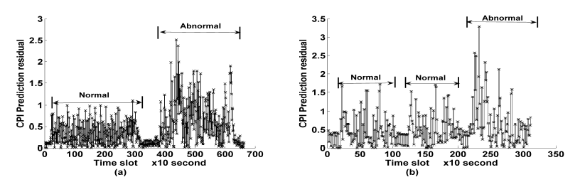
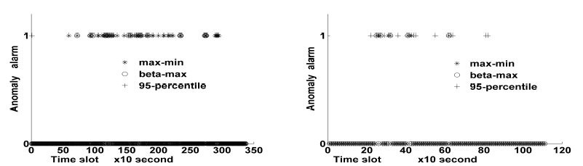
Anomaly detection
CPI data
Detection result

Slide 16
Invariants construction
MIC (Maximal Information Coefficient):
？
Reshef, D. N., Reshef, Y. A., Finucane, H. K., Grossman, S. R., McVean, G., Turnbaugh, P. J.,Sabeti, P. C.: Detecting novel associations in large data sets. Science, 2011
Variable A
Variable B
A novel method to detect functional & non-functional dependence
——Functional relationships: MIC ~= R^2
——Range: 0 (statistical independence) - 1 (no noise)
——For linear relationships: MIC ~= (Pearson correlation coefficient)

Slide 17
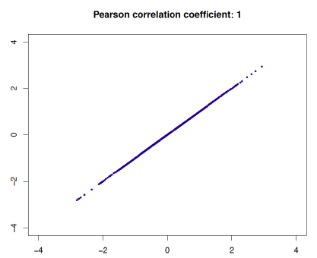
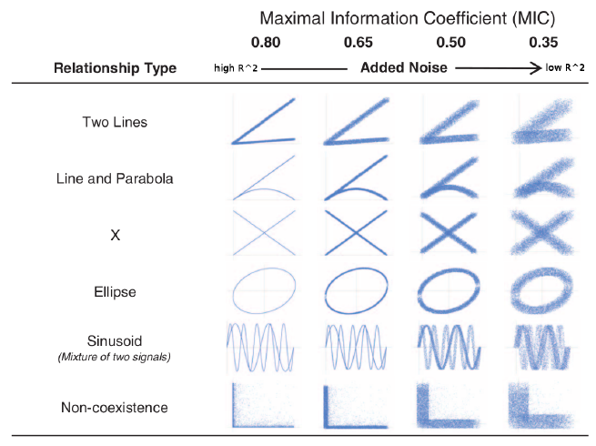
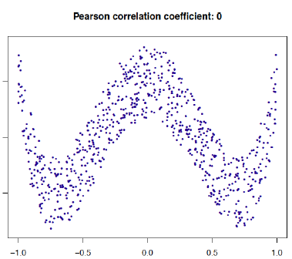
Invariants construction
MIC (Maximal Information Coefficient):

Slide 18
Invariants construction
Basic idea of MIC:
If a relationship exists between two variables, then a grid can be drawn on the scatter plot of the two variables that partitions the data to encapsulate that relationship
Critical points:
—— Score of the partition
Mutual Information
—— Find the best number of partitions (a.k.a. grid resolution)
—— Find the best placement of the partitions
Reshef, D. N., Reshef, Y. A., Finucane, H. K., Grossman, S. R., McVean, G., Turnbaugh, P. J.,Sabeti, P. C.: Detecting novel associations in large data sets. Science, 2011

Slide 19
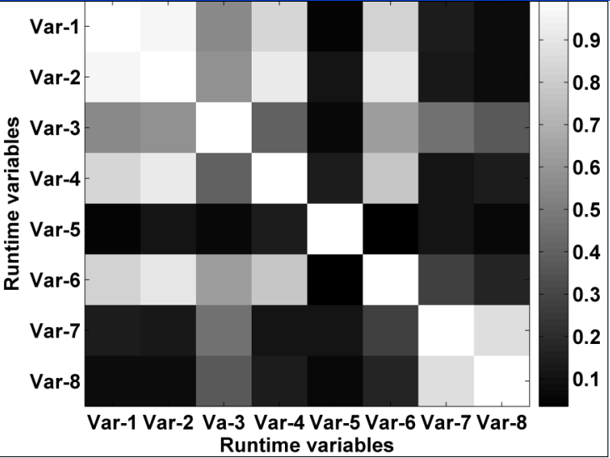
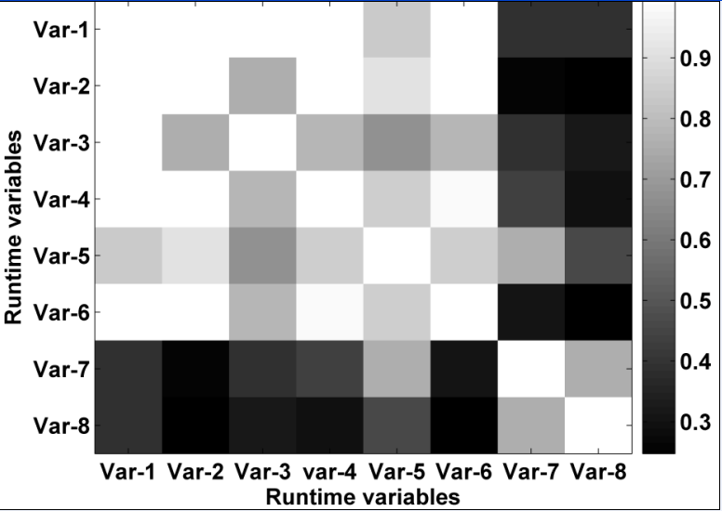
Invariants Construction
MIC VS Pearson correlation coefficient
Pearson
MIC
Pearson correlation coefficient between MEM PyageFault and MEM Cached is 0.02 but the MIC score is 0.87

Slide 20
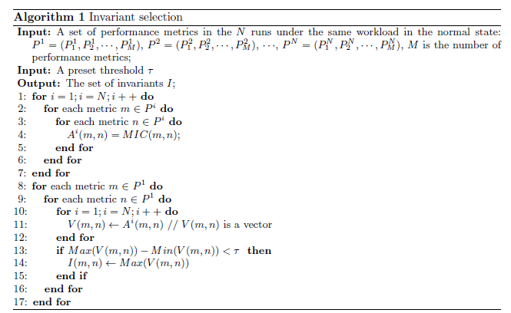
Invariants Construction
Invariants selection
A
B
A
B
C
D
C
D
Test 1
Test N
A
B
C
D
Invariants
Three-tuple: (I, ip, type) denotes Invariants

Slide 21
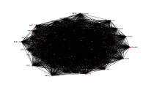
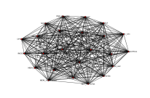
Invariants Construction
Before selection
After selection
Notes:
26 variables are included.

Slide 22
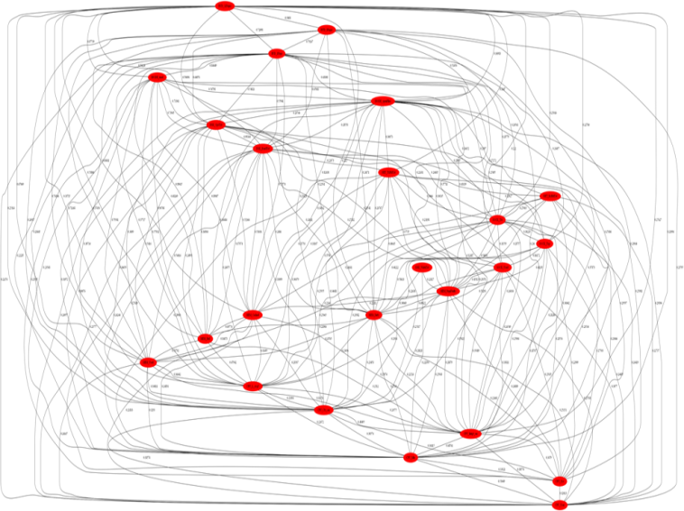
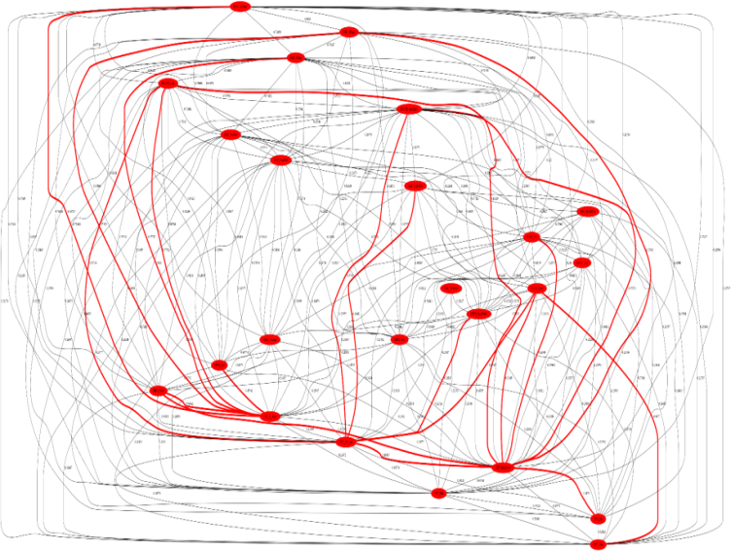
Signature building
Normal running
CPU hog injection
(1,0,1, … , 1,0,0) → CPU hog
(1,0,0, … , 1,1,0) → Memory hog
(0,0,1, … , 1,0,1) → Misconfiguration
Signature database
(0,0,0, … , 1,0,0) → Network jam

Slide 23
Root cause inference
1. Calculate the MIC scores in the current abnormal situations
2. Compare the MIC scores with the Invariants under the same workload
V=(0,1,0,1,1,…,0)
3. List the top k root causes who have the smallest similarity score with the given violation binary tuple.
S=(0,1,1,1,0,…,1), a signature
Similarity score: D=Hamming(V,S)

Slide 24

Evaluation
Methodology:
• Software stack：Hadoop, Mahout, Hive , MySQL, BigDataBench
• Workload：Batch type （e.g. Wordcount），Interactive type（e.g. TPC-DS）
• Hardware： Five server machines hosting the benchmark. Each physical machine is configured with two 4-core Xeon 2.1 GHZ CPU processors, 16GB memory, a 1TB hard disk and a gigabit NIC.
• Fault reproduction：Inject faults\errors\failures from Hadoop issue trackers or other papers.
Overload
CPU-hog
RPC-hang
Disk-hog
HADOOP-9703
Block receiver exception

Slide 25
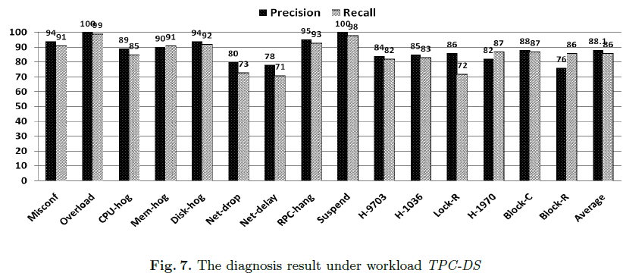
Evaluation
Result:

Slide 26
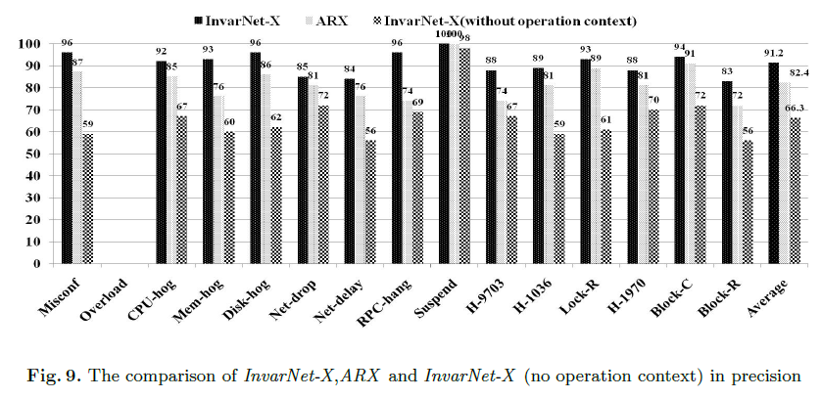
Evaluation
Comparison:

Slide 27
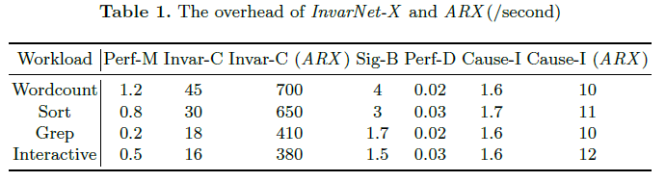
Overhead

Slide 28

Thank You!

