Slide 1
Implications for construction quality and sustainability
Group 03

Slide 2
Introduction
In this project we analyze how different concrete mix components influence construction quality and sustainability.
It focus on these materials like,
Cement: Binds the mix
Fly Ash & Blast Furnace Slag: Enhance durability & sustainability
Water: Essential for hydration, controlled for strength
Superplasticizer: Improves workability without extra water
Aggregates: Provide structural bulk
Age: Strength increases with curing time
Our Goal is Optimize mix proportions & curing periods to Maximize compressive strength

Slide 3
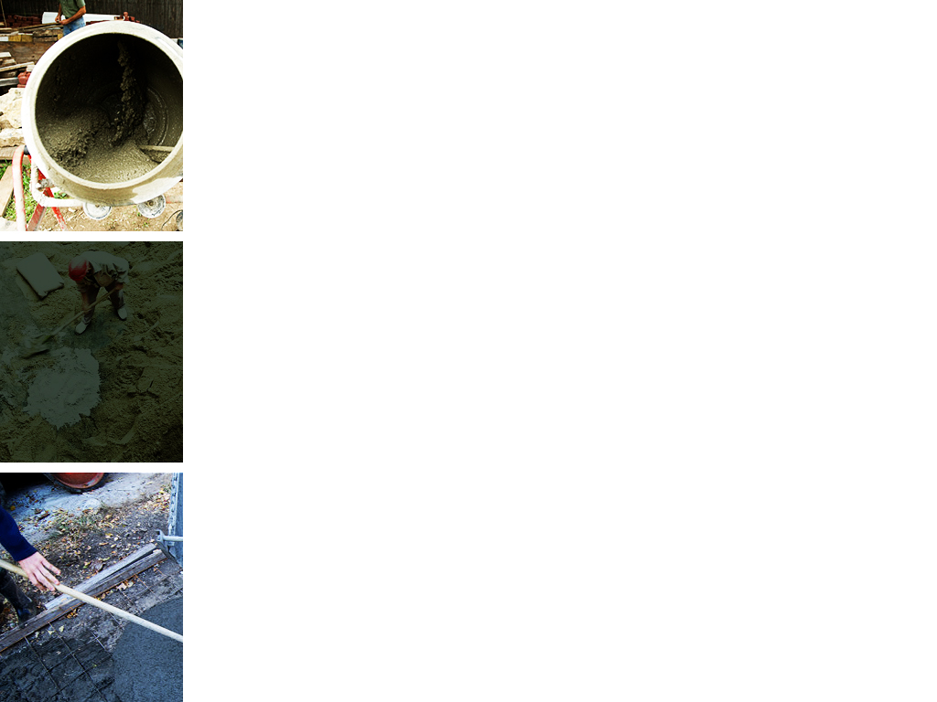
Problem Statement
Our project focuses on evaluating the strength of cement used in construction by analyzing datasets from previous studies.
These tests will help determine how well the cement withstands stress and strain, providing key insights into its performance.
The goal is to ensure the cement meets industry standards and identify any potential weaknesses.
The findings will contribute to improving the quality and durability of construction projects.

Slide 4
Significance of the study
This research addresses two major concerns in modern construction; the need for strong materials and sustainable building practices. While concrete strength has been studied extensively, this study uniquely explores how materials like Fly Ash and Blast Furnace Slag can reduce environmental impact while enhancing long-term strength.
The study also shows how sustainable materials can replace traditional ones without sacrificing performance, supporting eco-friendly construction methods.

Slide 5
Objectives
To analyze the influence of Cement, Fly Ash, Blast Furnace Slag, Water, Superplasticizer, Coarse Aggregate, and Fine Aggregate on the compressive strength of concrete.
To examine how the age of concrete (measured in days) affects its compressive strength.
To identify optimal mix proportions that maximize compressive strength while ensuring sustainability.
To provide recommendations for concrete mix designs that can be applied in the construction industry to improve quality and sustainability.

Slide 6
Methodology

Slide 7
DESIGN
This study employs a quantitative research design to analyze the implications of various concrete mix components on construction quality and sustainability.
The primary focus is on understanding how the proportions of different materials and the age of the concrete influence its compressive strength, which is a critical measure of construction quality.

Slide 8
DATA
The study will use a dataset containing records of different concrete mixtures with varying proportions of components and their respective compressive strengths.
Independent Variables:
▪ Cement (kg in a m³ mixture) ▪ Blast Furnace Slag (kg in a m³ mixture) ▪ Fly Ash (kg in a m³ mixture) ▪ Water (kg in a m³ mixture) ▪ Superplasticizer (kg in a m³ mixture) ▪ Coarse Aggregate (kg in a m³ mixture)
▪ Fine Aggregate (kg in a m³ mixture) ▪ Age (days)
Dependent Variable:
Concrete Compressive Strength (MPa)

Slide 9
ANALYSIS
1.Descriptive Analysis
• Summary statistics (mean, median, mode, standard deviation, etc.)
•Distribution plots for each variable (histograms, box plots, etc.)
2.Univariate Analysis
• Plotting histograms and density plots
• Identifying any outliers or anomalies
3.Multiple Linear Regression Analysis
• Fitting the full model
• Checking the overall model fit (R², Adjusted R², etc.)
• Analyzing the significance of individual predictors using p-values

Slide 10
4.Subset Selection
To improve the model variable selection techniques will be employed. This includes:
Forward stepwise selection
Comparing the models using criteria such as AIC, BIC, and Adjusted R²
Select the better model
5.Check the Leverage points in the better model and remove them for more accurate dataset.
6.Model Diagnostics
Plot the Residuals vs Fitted
Q-Q plot
Scale Location plot
Residuals vs Leverage plot

Slide 11
Results & Discussion

Slide 12
Descriptive Analysis….
This is the Descriptive analysis of the whole dataset.
Variable | Mean | Median | Max | Min | 1st Quantile | 3rd Quantile | St. Deviation
Cement | 281.2 | 272.9 | 540.0 | 102.0 | 192.4 | 350.0 | 104.51
Blast furnace slag | 73.9 | 22.0 | 359.4 | 0.0 | 0.0 | 142.9 | 86.28
Fly ash | 54.19 | 0.0 | 200.1 | 0.0 | 0.0 | 118.3 | 63.99
Water | 181.6 | 185.0 | 247.0 | 121.8 | 164.9 | 192.0 | 21.35
Superplasticizer | 6.21 | 6.4 | 32.2 | 0.0 | 0.0 | 10.2 | 5.97
Coarse aggregate | 972.9 | 968.0 | 1145.0 | 801.0 | 932.0 | 1029.4 | 77.75
Fine aggregate | 773.6 | 779.5 | 992.6 | 594.0 | 731.0 | 824.0 | 80.18
Age (day) | 45.6 | 28.0 | 365.0 | 1.0 | 7.0 | 56.0 | 63.17
Concrete compressive strength | 35.82 | 34.45 | 82.6 | 2.33 | 23.71 | 46.13 | 16.71

Slide 13
We then remove outliers using the function, resulting in a cleaned dataset without any outliers.

Slide 14
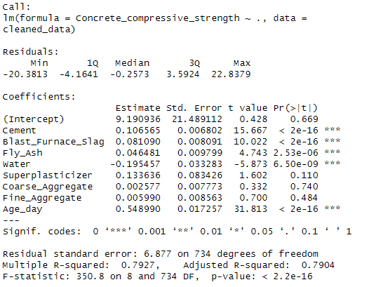
Then we get the results for full model.

Slide 15
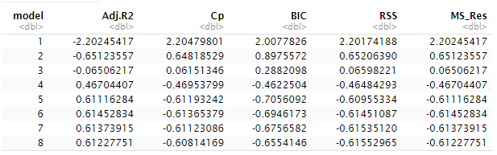
Model selection….
We are using the forward stepwise selection method for model selection in this dataset.
• There are two methods to find the better model.
1) Formal model :.
Using the values of above criteria, the better model should have maximum value for adjusted R^2 and minimum values for Cp, BIC, RSS and MS_Res.
Therefore according to the above values 5th model is the better model.

Slide 16
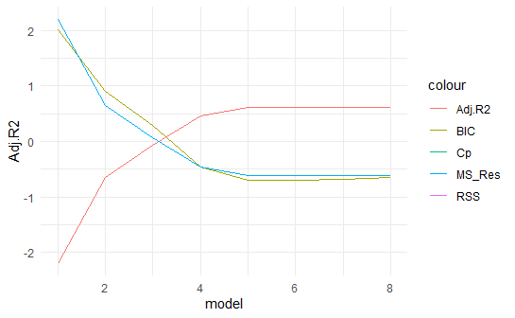
2) Graphical method:
According to the plot, 5th model has maximum value for adjusted R^2 and minimum values for Cp, BIC, RSS and MS_Res.
Therefore 5th model seems a better model.

Slide 17
Then we remove the leverage points using hat_values.
We check for multicollinearity in these variables (using vif values).
If 𝑉𝐼𝐹𝑗 < 5 then there is no problem with multicollinearity.

Slide 18
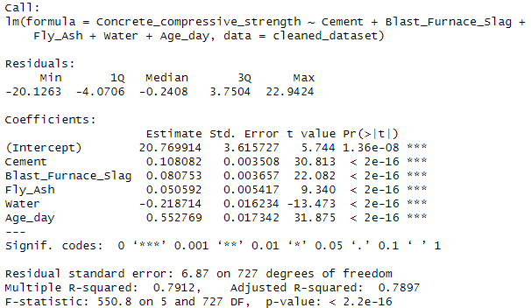
Better model summary
An adjusted R-Squared of 78.97% indicates that the model still explains a substantial amount of variance in Concrete Compressive Strength consider the number of predictors.
p-value: 2.2e-16 < 0.05
We have sufficient evidence to reject the null hypothesis. Concluding that at least one of the predictors in the model significantly contributes to explaining the variability the variability in Concrete Compressive Strength.

Slide 19
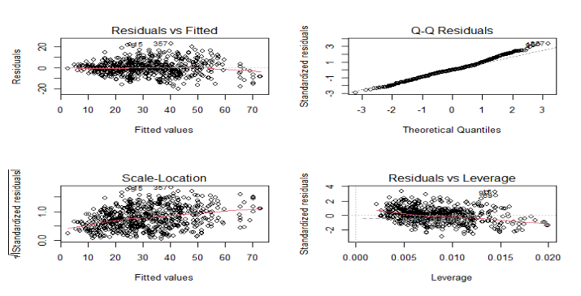
Model diagnostics….

Slide 20
Conclusion
This study reveals the key factors affecting concrete compressive strength, emphasizing the importance of controlling cement content, curing time, and incorporating materials like fly ash and blast furnace slag for sustainable construction. Cement and curing age are found to be the most critical factors, while careful water management is essential to avoid negative effects.
From a sustainability perspective, the use of fly ash and blast furnace slag offers a durable and eco-friendly alternative, enhancing concrete longevity while reducing environmental impact.

Slide 21
References
http://www.kaggle.com
https://archive.ics.uci.edu/
Introduction to Linear Regression Analysis

Slide 22
Group Details
PS/2020/018 – W.D.Sandamali
PS/2020/110 – D.D.A.K.Indeewari
PS/2020/130 – H.P.I.Sewwandi
PS/2020/132 – H.A.H.Dimalsha
PS/2020/135 – W.T.N.Perera
PS/2020/238 – D.W.P.S.Gunathilaka
PS/2020/302 – E.H.A.Thathsarani
PS/2020/318 – M.R.Surandi

Slide 23
Individual Contribution
Task Completed | PS/2020/018 | PS/2020/110 | PS/2020/130 | PS/2020/132 | PS/2020/135 | PS/2020/238 | PS/2020/302 | PS/2020/318
Data Collecting & Cleaning
Introduction with problem statement
Descriptive Analysis
Regression Analysis with residual Analysis
Results, Discussion & conclusions
Accuracy checking
Progress reports creating
Final Report Creating

Slide 24
Thank you!!

