Slide 1

DualPlay
The Ultimate Air Hockey Experience

Slide 2
Content
Problem Definition
Aims and Objectives
Proposed Solution and Significance
Design
Technology
Components
Progress
Literature Review
Work Plan
References

Slide 3

Problem Definition
No human interaction in traditional computer gaming
Issues on social dynamics and physical health
Traditional physical games require the presence of another player

Slide 4
Aims and Objectives
AIM
Create an interactive multiplayer table game that combines the excitement of air hockey with innovative features
OBJECTIVES
Design and build the game with an autonomous gameplay mode
Ensure an enjoyable experience regardless of player availability
Enhance gameplay with visual cues and sound systems

Slide 5
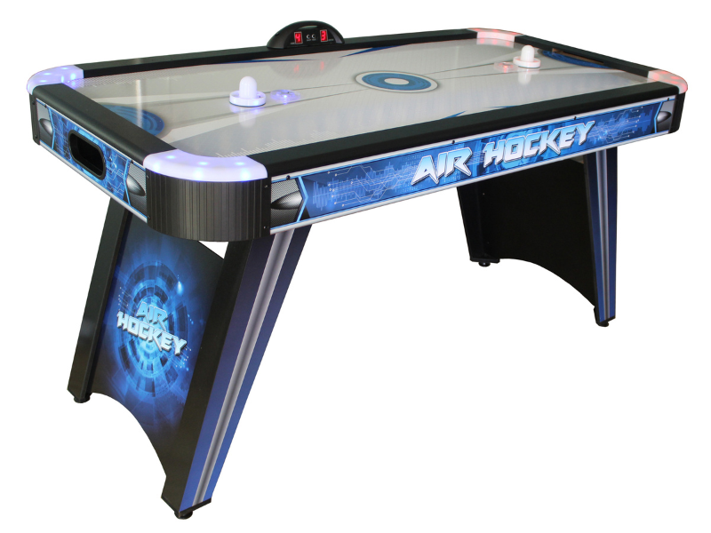
Proposed Solution and Significance
DualPlay – the air hockey game
Human player can play with another human as well as an autonomous opponent

Slide 6
Proposed Solution and Significance
Dynamically track the ball using computer vision
Human interaction for paddle manipulation through remote control

Slide 7
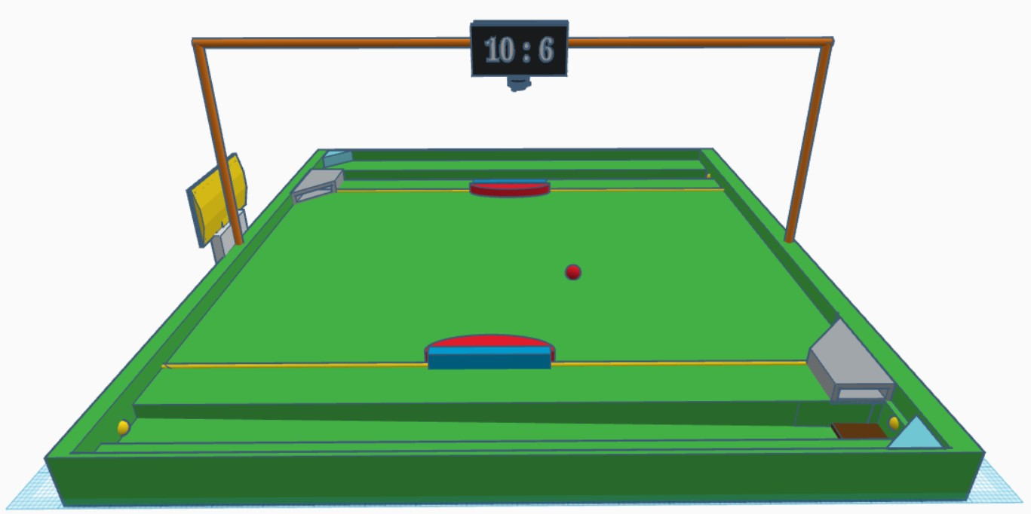
Design
Scores
Camera
50
cm
Paddle
Ball
50
cm
Hole
IR Break Beam Sensor
Ball Redeploy Mechanism

Slide 8
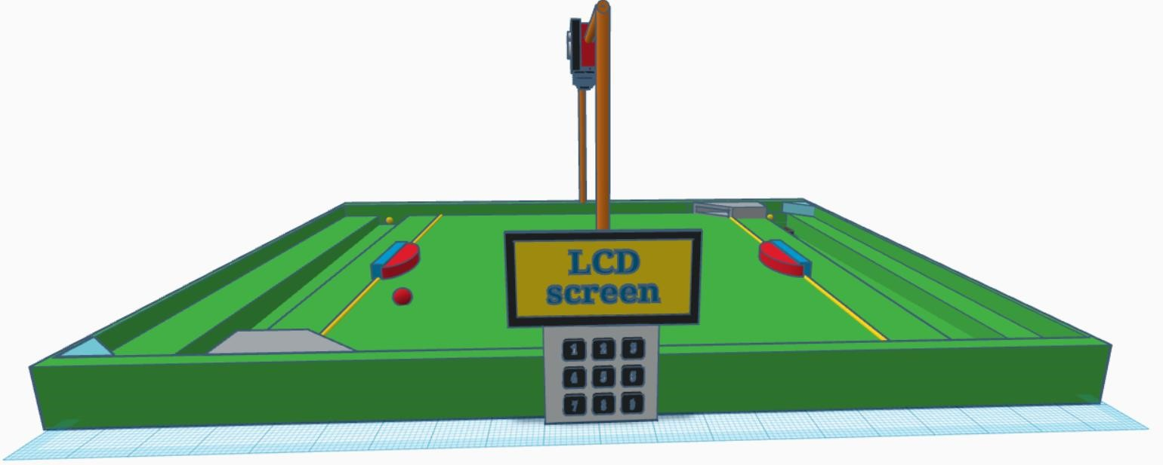
Design
Mode Selection LCD Screen
Keypad

Slide 9
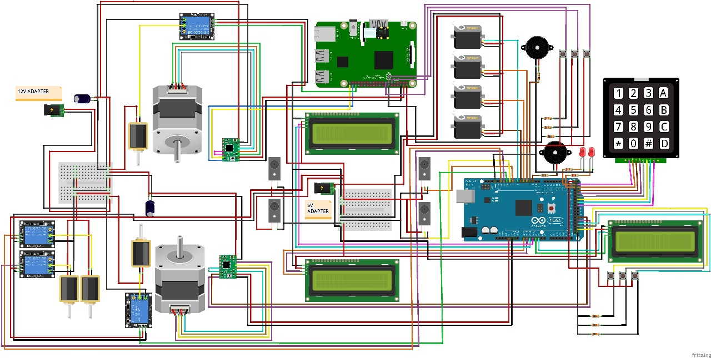

Slide 10
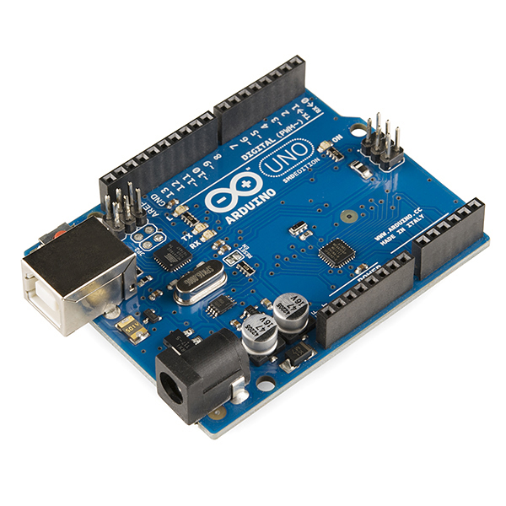
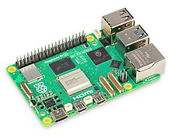
Technology
Computer vision (color recognition)
Raspberry Pi
Arduino Mega

Slide 11
Components
Raspberry Pi 3 Model B
Arduino Mega
Tactile Push Button
Servo Motor Plastic Wheel MG90
Servo Motor Plastic Wheel SG90
4x3 Matrix Array Keypad Switch Module
LCD Display
I2C Serial Interface Board Module Port
Camera Module v1.3 5MP for Raspberry Pi
NEMA 17 Stepper
A4988 Stepper Motor Driver
30 Teeth Timing Pulley
Brown GT2 6mm Timing Belt
IR Break Beam Sensor 5mm LED
Solenoid switch
2020 t slot aluminum extrusion
Linear system paddle and supporters
Relay Module
Active Piezo Buzzer
12V 20A SMPS Power Supply Metal Casing

Slide 12
Progress
Python program to track the playing ball using color tracking(Computer Vision).
Solenoid control for manual player using Raspberry Pi and Arduino(ball striking mechanism).
Implement LCD screen and keypad for game setup.
Establish connection between Raspberry Pi and Arduino.
Implement linear actuator for moving paddle.
Implement goal detector using IR break beam sensors.

Slide 13
Literature Review
Traditional Air Hockey game requires two or more players, but DualPlay can be played only by one player with an intelligent (AI) opponent.
DualPlay cheers up the winner using inbuilt game methodologies, such as score count, buzzer sounds, choosable difficulties.

Slide 14
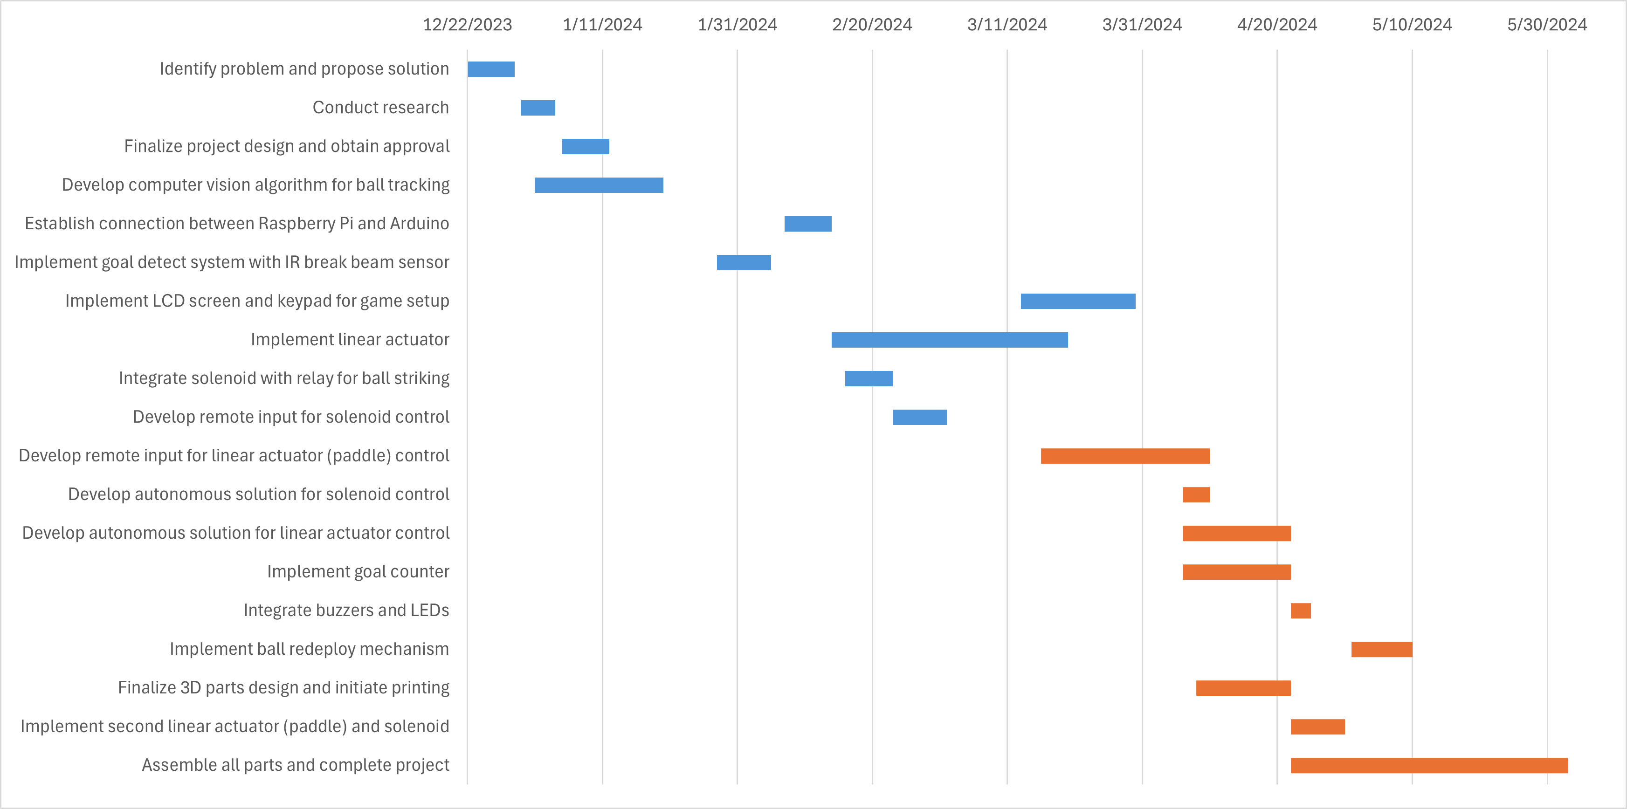
Work Plan

Slide 15
References
"merriam-webster," 2 2 2024 : https://www.merriam-webster.com/dictionary/air%20hockey.
"open builds part store," 10 1 2024 : https://openbuildspartstore.com/v-slot-nema-17-linear-actuator-bundle-belt-driven/.
A. TEAM, "arduino.cc," : https://blog.arduino.cc/2018/10/29/linear-movement-with-arduino-and-3d-printing
Felipe, "Computer vision engineer," : https://www.youtube.com/watch?v=eDIj5LuIL4A .
"Mechanical Design Masters," : https://youtu.be/ve9M8d6KfdI?si=8PxCvQbe-xPVnI0p.
"OpenCV," : https://docs.opencv.org/3.4/df/d9d/tutorial_py_colorspaces.html.
"OpenCV," : https://docs.opencv.org/3.4/da/d97/tutorial_threshold_inRange.html.
"OpenCV," : https://docs.opencv.org/4.x/d3/d05/tutorial_py_table_of_contents_contours.html.

