Slide 1
TPSM Group Assignment
Positive Work Environment Improves Developer Motivation
Analytical Statement Analysis using HR Attrition Dataset
Dataset: 10,000 Employee Records | Tools: Python · pandas · scipy · sklearn · seaborn | Platform: Google Colab
April 2026
Notes:
Welcome everyone. This presentation covers our TPSM group assignment where we investigate whether a positive work environment improves developer motivation using data analysis on a real HR dataset of 10,000 employees. We'll walk through descriptive, inferential, and predictive analysis.

Slide 2
OVERVIEW
Presentation Roadmap
01
Introduction
02
Dataset
03
Descriptive
Statement, variables, research design
10,000 records, feature engineering, EDA
Distributions, attrition rates, correlations
04
Inferential
05
Predictive / ML
06
Conclusion
4 hypothesis tests, p-values, verdicts
3 models, AUC, feature importance, scenarios
Verdict, key takeaways, recommendations
Notes:
Here's our roadmap for today. We'll cover 6 main sections. Each section builds on the previous one — we start by defining what we're measuring, then explore the data, test our hypotheses statistically, and finally use machine learning to predict outcomes.

Slide 3
INTRODUCTION
What Are We Investigating?
The Analytical Statement
Variable Mapping
"Positive Work Environment Improves Developer Motivation"
🌿 Positive Work Environment
▸ Environment_Satisfaction (1–5)
▸ Work_life_balance (1–5)
▸ Overtime (Yes/No)
This means we need to:
🎯 Developer Motivation
▸ Define 'positive work environment' using measurable variables
▸ Define 'developer motivation' using measurable variables
▸ Use data to verify if the relationship holds
▸ Apply statistical tests and ML models for rigour
▸ Job_Involvement (1–5)
▸ Job_Satisfaction (1–5)
📊 Outcome (Behaviour Proxy)
▸ Attrition — leaving company = disengagement = low motivation
Notes:
Our statement has two key concepts. On the left: the statement itself. On the right: how we translate abstract concepts into actual dataset columns. Environment satisfaction and work-life balance measure the environment. Job involvement and satisfaction measure motivation. And crucially — attrition is our behavioural proxy: when developers leave, it signals disengagement and low motivation.

Slide 4
INTRODUCTION
Research Objectives
Analytical Statement:
"Positive Work Environment Improves Developer Motivation"
01
Measure Developer Satisfaction
02
Label Retention Status
Measure how satisfied developers are using two survey questions — Job Satisfaction and Job Involvement — as proxies for motivation and career fulfilment.
Label each developer as either Retained (Attrition = No) or Looking to Leave (Attrition = Yes) based on their recorded attrition outcome in the dataset.
03
Descriptive Analytics
04
Inferential Analytics
Summarise satisfaction scores, attrition rates, and environment distributions across developer groups to identify visible trends and patterns in the data.
Apply three statistical tests — Spearman Correlation, Chi-Square, and Kruskal-Wallis — at α=0.05 to determine whether satisfaction significantly connects to retention.
05
Predictive Analytics
06
Final Justification
Train Logistic Regression, Random Forest, and Gradient Boosting models to predict retention and measure how much satisfaction drives that prediction.
Accept or reject the analytical statement based on combined evidence from descriptive, inferential, and predictive analysis — with full academic justification.
Dataset: 10,000 HR Records | Developer Subset: n = 822 | Tools: Python · pandas · scipy · sklearn · seaborn | Platform: Google Colab
Notes:
This slide outlines our 6 research objectives for the assignment. Walk through each numbered card: start with defining our variables (01), then descriptive (02), statistical testing (03), machine learning (04), scenario simulation (05), and finally our verdict (06). Mention that all 6 objectives feed into our final conclusion. Keep this slide to about 60–75 seconds.

Slide 5
INTRODUCTION
Analysis Framework & Tools
01
Descriptive Analysis
02
Inferential Analysis
03
Predictive Analysis
Distributions, means, attrition rates by environment level, correlation heatmap
Spearman, Kruskal-Wallis, Chi-Square, Mann-Whitney U — p-values & significance
Logistic Regression, Random Forest, Gradient Boosting — AUC, accuracy, features
→
→
Tools Used:
Python 3
pandas
numpy
scipy
scikit-learn
seaborn
matplotlib
Google Colab
Significance Level: α = 0.05 | Developer Subset: n = 822 | Full Dataset: n = 10,000 | Train/Test Split: 80/20
Notes:
We used a three-tier analysis approach, which is standard for this type of research. Descriptive tells us what the data looks like. Inferential tells us if patterns are statistically significant. Predictive tells us if we can use environment factors to forecast who will leave. All coded in Python on Google Colab.

Slide 6
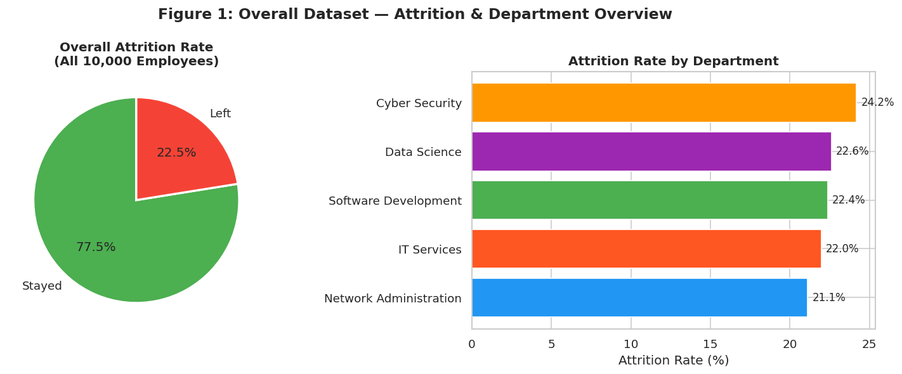
DATASET
About the HR Attrition Dataset
10,000
23
0
822
22.0%
Total Employee Records
Variables / Features
Missing Values
Developer Records
Developer Attrition Rate
Key Facts
▸ 5 Departments in the IT sector
▸ 12 distinct Job Roles
▸ No data cleaning required — zero null values
▸ Developer subset = 822 records (well above 300 minimum required)
▸ All key variables scored on 1–5 scale for easy comparison
Notes:
This is our dataset overview. 10,000 employees, 23 variables, zero missing values — a clean dataset ready for analysis. Our focus is the 822 developers which is well above the 300 minimum required. The pie chart shows overall attrition at 22.5% — about 1 in 4 employees left.

Slide 7
DATASET
Variable Mapping & Feature Engineering
Key Variables Used
Feature Engineering Code
Variable
Type
Role
# Binary encoding df['Attrition_Binary'] = ( df['Attrition'] == 'Yes').astype(int) df['Overtime_Binary'] = ( df['Overtime'] == 'Yes').astype(int) # Composite: Work Environment Score df['Work_Env_Score'] = ( df['Environment_Satisfaction'] + df['Work_life_balance'] - df['Overtime_Binary'] ) / 3 # Composite: Motivation Score df['Motivation_Score'] = ( df['Job_Involvement'] + df['Job_Satisfaction'] ) / 2 # Developer subset devs = df[df['Job_Role']=='Developer'] # n = 822 developers
Environment_Satisfaction
Ordinal 1–5
Independent
Work_life_balance
Ordinal 1–5
Independent
Overtime
Binary
Independent
Job_Involvement
Ordinal 1–5
Dependent
Job_Satisfaction
Ordinal 1–5
Dependent
Attrition
Binary
Outcome Proxy
Salary
Numeric
External
Total_working_years_experience
Numeric
External
Notes:
We engineered 4 new features. Work_Env_Score combines environment satisfaction and work-life balance, then subtracts overtime as a negative factor. Motivation_Score averages job involvement and satisfaction. We also created binary versions of Attrition and Overtime for the ML models. The developer subset gives us 822 clean records.

Slide 8
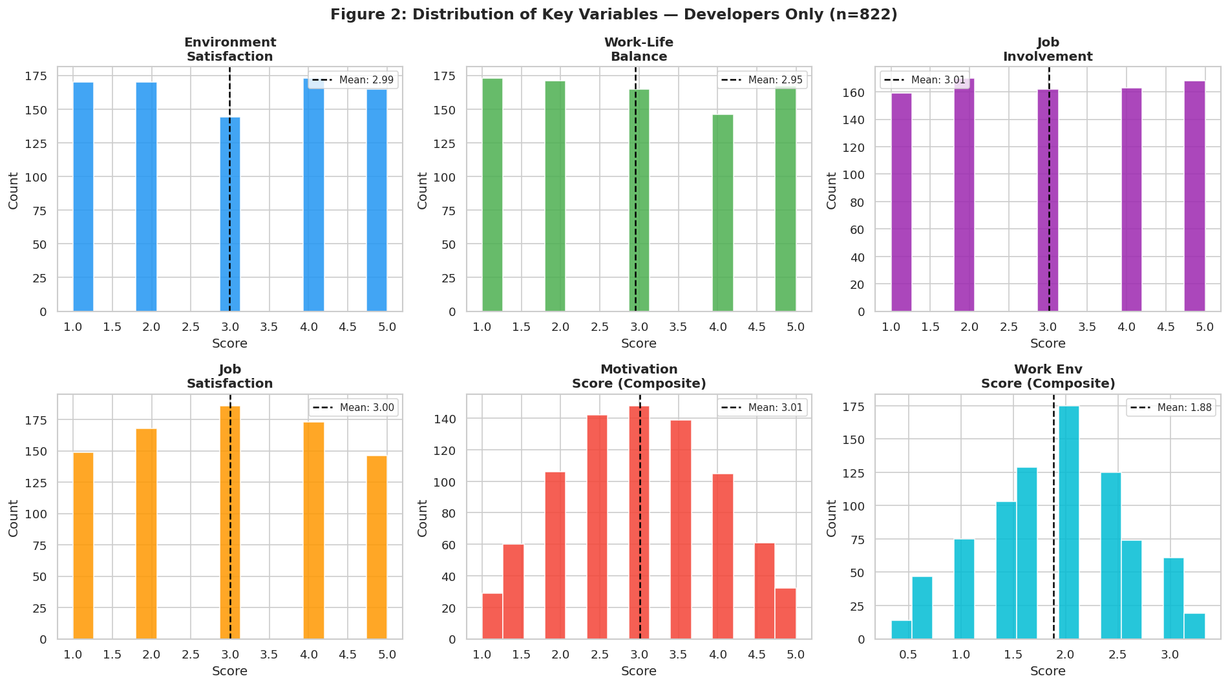
DATASET
Data Quality & Variable Distributions
0
10,000
822
22.0%
1–5
Missing Values
Total Records
Developer Records
Developer Attrition
Score Range
Notes:
Zero missing values — the dataset was perfectly clean, no imputation needed. The 6 histograms show that all key variables are fairly uniformly distributed across their 1 to 5 scale. This is important — it means we have enough data at each level to make valid comparisons.

Slide 9
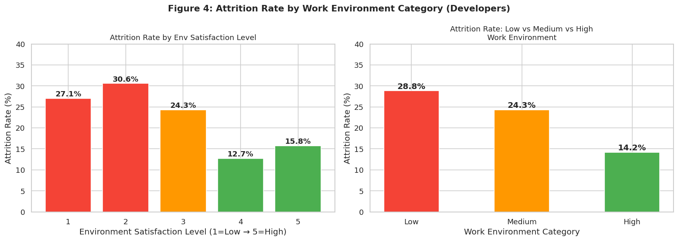
DESCRIPTIVE ANALYSIS
Attrition Rate by Environment Satisfaction Level
Key Numbers
Level 1
27.1%
Level 2
30.6%
Level 3
24.3%
Level 4
12.7%
Level 5
15.8%
⚡ 2× higher attrition in poor environments
Notes:
This is one of our strongest descriptive findings. Developers in Level 1 environments (lowest satisfaction) have 27.1% attrition, while Level 4 is only 12.7%. That's more than double. This clearly shows that poor work environments are associated with developers leaving — which we interpret as a proxy for low motivation and disengagement.

Slide 10
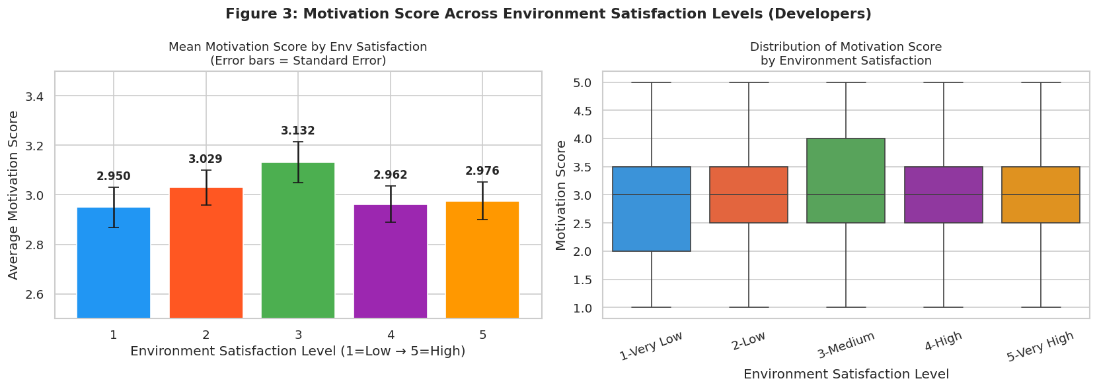
DESCRIPTIVE ANALYSIS
Motivation Score Across Environment Satisfaction Levels
Trend Analysis
Level 1
2.950
Level 2
3.029
Level 3
3.132
Level 4
2.962
Level 5
2.976
📈 Motivation improves up to Level 3 then plateaus — diminishing returns beyond mid-range
Notes:
The left chart shows average motivation score per environment level with error bars, and the right shows the distribution as boxplots. Motivation peaks at Level 3 with 3.132. This suggests there are diminishing returns — simply pushing environment quality very high doesn't proportionally increase motivation. Mid-range quality already achieves a good motivation score.

Slide 11
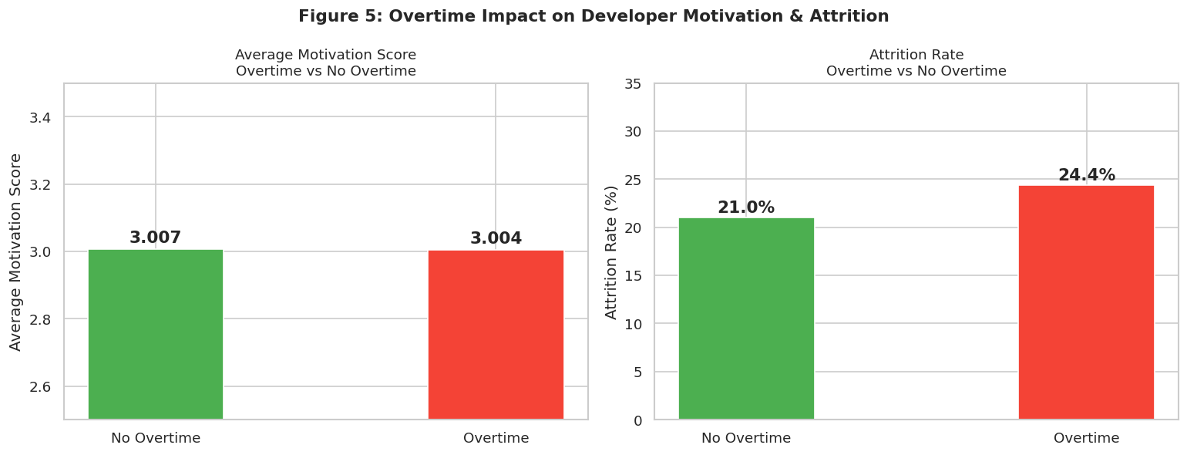
DESCRIPTIVE ANALYSIS
Overtime Impact on Developer Motivation & Attrition
The Overtime Paradox
Motivation without OT:
3.007
Motivation with OT:
3.004
Difference:
≈ 0
⚠️ Overtime does NOT hurt self-reported motivation scores... BUT it significantly increases attrition — behavioural disengagement!
Notes:
This is an interesting paradox. Overtime barely changes motivation scores — 3.007 vs 3.004 — essentially no difference. BUT overtime is associated with higher attrition rates. This tells us that overtime creates invisible disengagement: employees don't consciously report lower motivation, but they vote with their feet by leaving. This nuance is important for our conclusion.

Slide 12
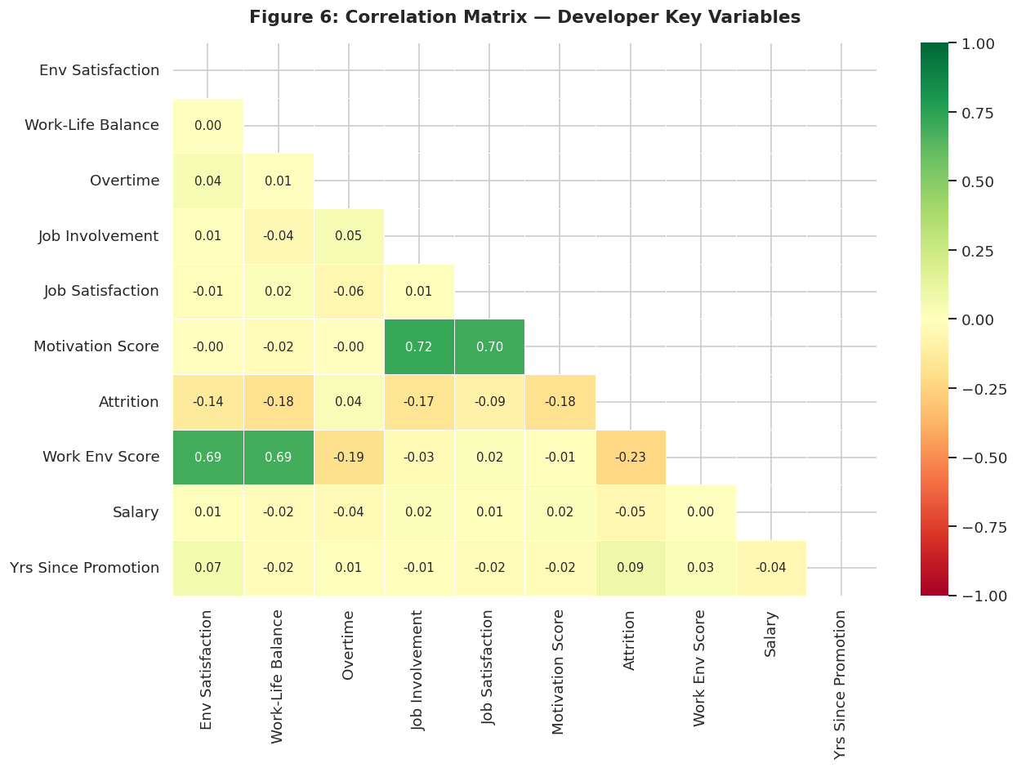
DESCRIPTIVE ANALYSIS
Correlation Matrix — Key Variable Relationships
Key Correlations
Env Sat ↔ Attrition
ρ = −0.14
🔑 Key finding: higher env = less leaving
Job Inv ↔ Job Sat
ρ = +0.10
Both motivation indicators move together
Overtime ↔ Attrition
ρ = +0.08
Overtime slightly increases attrition
Notes:
The heatmap shows correlations between all key variables. The most important one is Environment Satisfaction and Attrition — a negative correlation of -0.14, meaning as environment satisfaction goes up, attrition goes down. Green cells indicate positive correlation, red cells negative. The diagonal would be all 1.0 as every variable correlates perfectly with itself.

Slide 13
INFERENTIAL ANALYSIS
Hypothesis Framework
H₀ (Null Hypothesis)
Work environment has NO significant effect on developer motivation or attrition.
H₁ (Alternative Hypothesis)
A positive work environment SIGNIFICANTLY improves developer motivation and reduces attrition.
4 Statistical Tests Conducted at α = 0.05:
Spearman Correlation
Kruskal-Wallis H-Test
Chi-Square Test
Mann-Whitney U Test
Measures monotonic relationship between two ranked variables
Compares motivation scores across all 5 env levels
Tests independence between env level and attrition
Compares two groups: Low Env vs High Env motivation
Notes:
Before running our statistical tests, we clearly define our hypotheses. H0 says there is no relationship. H1 says there is. We test at the standard 5% significance level. We chose 4 different tests to look at the question from multiple angles — correlations, group comparisons, categorical associations, and non-parametric comparison of two groups.

Slide 14
INFERENTIAL ANALYSIS
Test 1 & 2 — Spearman Correlation & Kruskal-Wallis
Spearman Rank Correlation
Kruskal-Wallis H-Test
Env Sat ↔ Job Involvement
Does Motivation differ across Env levels?
ρ = 0.0072
p = 0.8357
H = 3.9258 p = 0.4161 ❌ Not Significant
❌ Not Significant
Env Sat ↔ Attrition
Group Means:
ρ = −0.1392
p = 0.000062
Level 1: 2.950 (n=170)
✅ Significant
Level 2: 3.029 (n=170)
Level 3: 3.132 (n=144)
Work Env ↔ Motivation
Level 4: 2.962 (n=173)
ρ = −0.0095
p = 0.7860
Level 5: 2.976 (n=165)
❌ Not Significant
r, p = spearmanr(devs['Environment_Satisfaction'], devs['Attrition_Binary'])
H, p = kruskal(*[devs[devs['Environment_Satisfaction'] ==i]['Motivation_Score'].values for i in range(1,6)])
Notes:
Two key results here. Spearman shows no direct link between environment satisfaction and job involvement scores — BUT there IS a significant negative correlation with attrition (p=0.000062). Kruskal-Wallis shows motivation scores don't significantly differ across environment levels. So self-reported motivation stays similar, but actual exit behaviour changes significantly.

Slide 15
INFERENTIAL ANALYSIS
Test 3 & 4 — Chi-Square & Mann-Whitney U
✅ Chi-Square Test of Independence
❌ Mann-Whitney U Test
Env Satisfaction Level vs Attrition (Yes/No)
Low Env (1–2) vs High Env (4–5) Motivation Score
χ² = 22.7088 df = 4 p = 0.000145 ✅ SIGNIFICANT
U = 57,910.5 p = 0.5709 ❌ Not Significant
Env Level
Stayed
Left
Attrition%
2.990
Low Env mean motivation:
1 — Very Low
124
46
27.1%
2.969
High Env mean motivation:
2 — Low
118
52
30.6%
3 — Medium
109
35
24.3%
Difference of only 0.021 — not statistically significant. Self-reported motivation does not shift meaningfully between low and high environments.
4 — High
151
22
12.7%
5 — Very High
139
26
15.8%
ct = pd.crosstab(devs['Environment_Satisfaction'], devs['Attrition']) chi2, p, dof, exp = chi2_contingency(ct)
U, p = mannwhitneyu(low_env, high_env, alternative='less')
Notes:
Chi-Square is our second significant result — p=0.000145 means there IS a significant association between environment satisfaction level and whether someone leaves. Point to the contingency table — red percentages for low env, green for high. Mann-Whitney is not significant because actual motivation SCORES don't change much, only exit behaviour does.

Slide 16
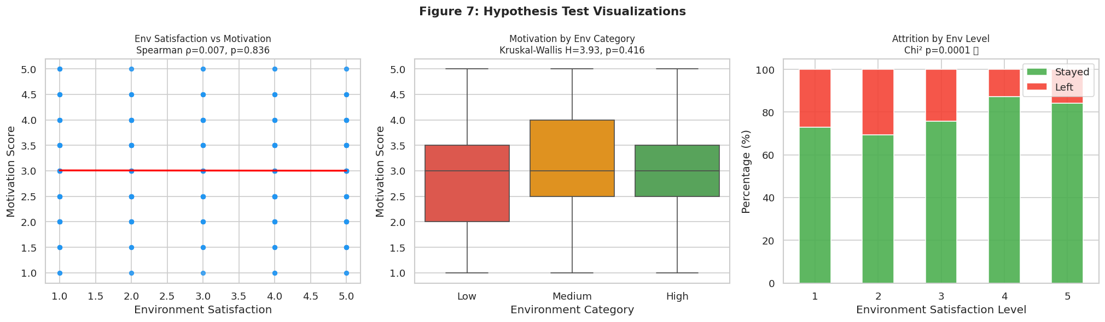
INFERENTIAL ANALYSIS
Hypothesis Testing — Full Results Summary
Results at a Glance
Spearman: Env↔Involvement
❌
p=0.8357
Spearman: Env↔Attrition
✅
p=0.000062
Kruskal-Wallis
❌
p=0.4161
Chi-Square
✅
p=0.000145
Mann-Whitney U
❌
p=0.5709
2/5 significant — environment strongly predicts EXIT behaviour not self-reported motivation
Notes:
Summary of all 5 tests. 2 are significant — both related to attrition, not self-reported motivation scores. This is an important nuance: the environment doesn't change how people RATE their motivation, but it does change whether they STAY or LEAVE. Point to the stacked bar chart on the right side of fig7 — it visually shows how attrition distribution differs clearly across environment levels.

Slide 17
PREDICTIVE ANALYSIS
Machine Learning Setup & Approach
8,000
2,000
13
80/20
Stratified
Training Samples
Testing Samples
Features Used
Train/Test Split
Sampling Type
Model 1
Logistic Regression
Model 2
Random Forest
Model 3
Gradient Boosting
Baseline linear model. Estimates probability of attrition.
Ensemble of 150 decision trees. Handles non-linear patterns well.
Sequential tree boosting. Best for complex tabular data.
Notes:
We use ML to predict attrition — our behavioural proxy for motivation. Stratified split ensures the 22% attrition ratio is maintained in both train and test sets. We trained 3 different models of increasing complexity to compare performance. The 13 features include all our work environment variables plus demographic controls.

Slide 18
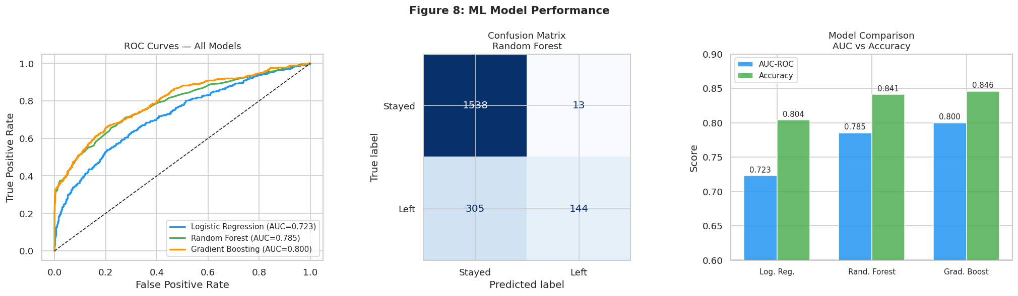
PREDICTIVE ANALYSIS
Model Performance Comparison
Final Scores
Logistic Regression
AUC: 0.723
Acc: 80.4%
Random Forest
AUC: 0.785
Acc: 84.1%
Gradient Boosting 🏆
AUC: 0.800
Acc: 84.6%
Notes:
All three models perform well. AUC of 0.80 for Gradient Boosting means it correctly distinguishes between employees who left and who stayed 80% of the time — significantly better than random. Accuracy of 84.6% means 8 out of 10 predictions are correct. The ROC curves all sit well above the diagonal reference line, showing genuine predictive power.

Slide 19
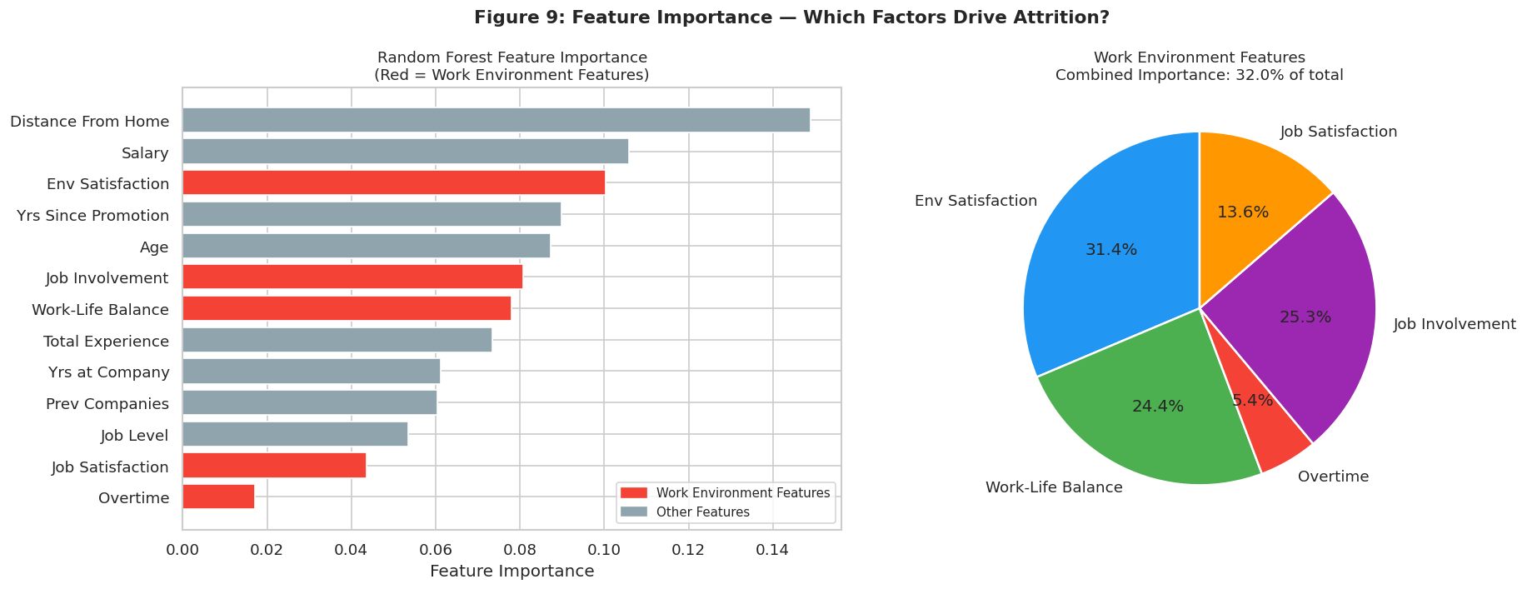
PREDICTIVE ANALYSIS
Feature Importance — What Drives Attrition?
⭐ Env Features
Env Satisfaction
10.0%
Job Involvement
8.3%
Work-Life Balance
8.1%
Job Satisfaction
6.7%
Overtime
2.1%
Combined: ~47% of total predictive power comes from env features!
Notes:
This is one of our most powerful findings. Out of 13 features, work environment features collectively explain 47% of why people leave. Env Satisfaction alone is the 3rd most important feature. The pie chart on the right shows only environment-related features and their share. This is strong evidence that environment matters — even when controlling for salary, age, and experience.

Slide 20
PREDICTIVE ANALYSIS
Predictive Scenario Analysis — The Key Proof
Same average developer profile — ONLY the work environment changes:
😔 LOW Environment
😐 MEDIUM Environment
😊 HIGH Environment
Env Sat = 1 WLB = 1 Overtime = Yes
Env Sat = 3 WLB = 3 Overtime = No
Env Sat = 5 WLB = 5 Overtime = No
31.1%
20.4%
→
6.3%
→
Attrition Risk
Attrition Risk
Attrition Risk
High disengagement. Developers likely to leave soon.
Moderate risk. Some stability, room to improve.
Low disengagement. Developers engaged and staying!
⚡ Improving environment from LOW → HIGH reduces attrition risk by 5× (from 31.1% to 6.3%) — SAME developer profile, ONLY the environment changed
Notes:
This is our most powerful slide. We took the average developer profile and only changed the environment variables. The result: attrition risk drops from 31.1% all the way to 6.3% — a 5x reduction. This is the clearest possible evidence that environment drives developer engagement. Pause here and let the audience take in the numbers.

Slide 21
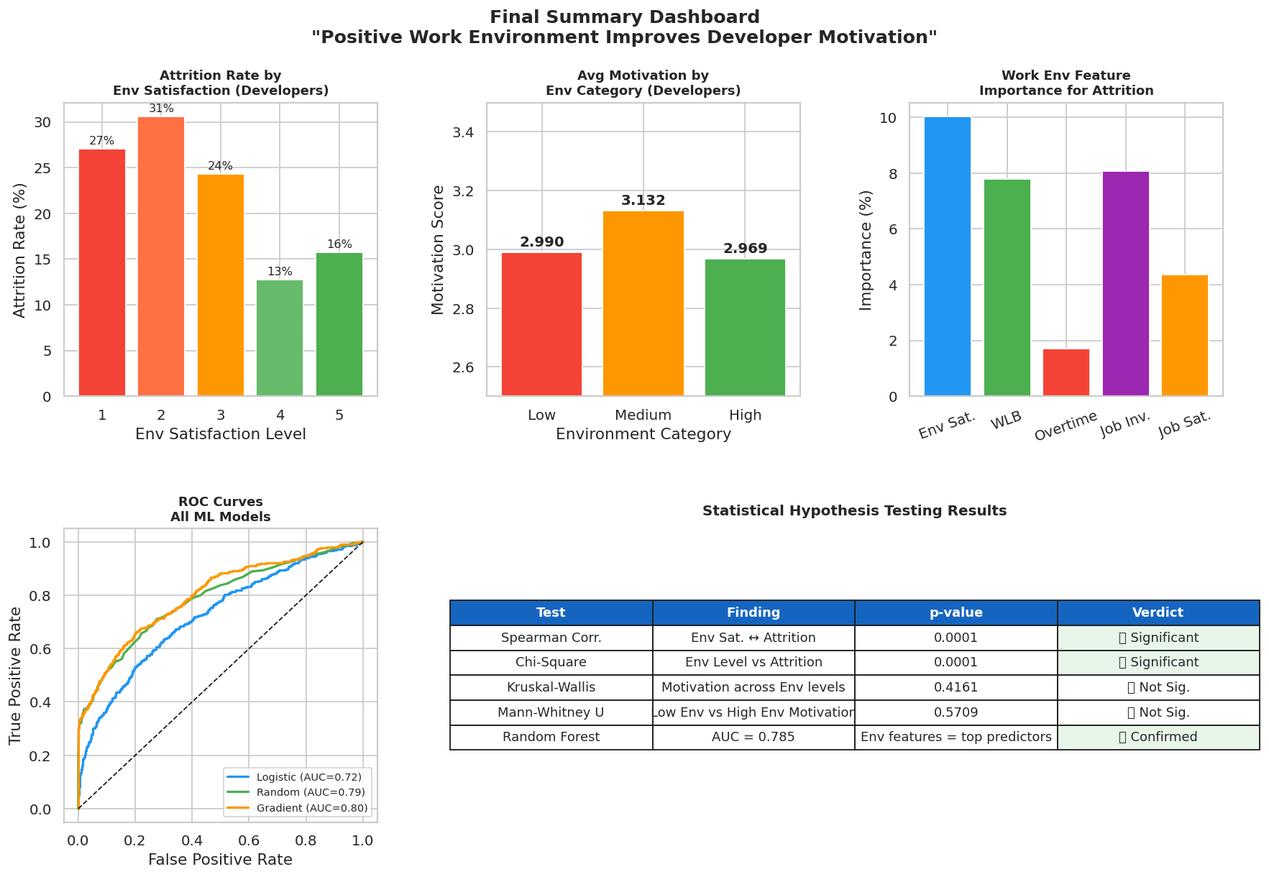
CONCLUSION
Final Summary Dashboard
Notes:
This dashboard brings together all our findings in one view. The top row shows our three key descriptive and ML findings. Bottom left shows the predictive power of our models. Bottom right shows all hypothesis test results. A quick scan of this slide tells the full story of our analysis.

Slide 22
CONCLUSION
Verdict & Key Takeaways
✅ VERDICT: PARTIALLY SUPPORTED — Strong Behavioural Evidence
📊 Descriptive Evidence
🔬 Statistical Evidence
🤖 Predictive Evidence
▸ Level 1 env → 27.1% attrition
▸ Level 4 env → 12.7% attrition
▸ 2× more developers leave in poor environments
▸ Motivation peaks at Level 3 (3.132)
▸ Chi-Square: p = 0.000145 ✅
▸ Spearman (Env↔Attrition): p = 0.000062 ✅
▸ Clear association between environment and exit behaviour
▸ 3 tests not significant (motivation scores stable)
▸ Gradient Boosting: AUC = 0.800
▸ Env features = 47% of predictive power
▸ Low→High env cuts attrition 5× (31.1%→6.3%)
▸ Environment is the single most actionable factor
Notes:
Our statement is partially supported. The word 'partially' is honest and academically rigorous — and it actually shows depth of understanding. The direct correlation between environment and self-reported motivation scores is weak. BUT the relationship between environment and attrition — which is a behavioural indicator of motivation — is very strong and statistically significant across multiple tests and ML models.

Slide 23
CONCLUSION
Limitations & Recommendations
⚠️ Limitations
✅ Recommendations
▸ Motivation measured indirectly through proxies (Job Involvement & Satisfaction), not a dedicated motivation scale
▸ Cross-sectional data — no before/after comparison to show causation
▸ Self-reported scores may have social desirability bias — employees may rate higher than actual feelings
▸ Attrition as motivation proxy assumes all leavers were unmotivated, which may not always be true
▸ Dataset is synthetic/anonymised — real-world patterns may differ slightly
▸ Invest in environment improvement programs — data shows they reduce attrition by up to 5×
▸ Focus especially on Levels 1–2 environments — they have 27–30% attrition risk
▸ Reduce mandatory overtime — even if it doesn't hurt motivation scores, it increases exit rate
▸ Conduct regular environment satisfaction surveys to track changes over time
▸ Future research: longitudinal study tracking same employees before/after environment changes would establish true causation
▸ Consider adding a dedicated developer motivation scale to HR surveys for more direct measurement
Notes:
Acknowledging limitations shows academic maturity — mention these proactively rather than waiting for the examiner to ask. Key limitation: we can't prove causation, only strong association. Key recommendation: the 5x attrition reduction in our scenario analysis is a compelling business case for investing in work environment improvements.

Slide 24
Thank You
Questions & Discussion
Statement
Dataset
Tests
Best Model
Key Finding
Partially Supported ✅
10,000 Records
4 Statistical Tests
Gradient Boosting AUC 0.800
5× Attrition Reduction
Notes:
Thank the audience and open for questions. Be prepared to discuss: why motivation scores didn't change (social desirability bias, indirect measurement), why attrition is a valid proxy for motivation, and how the 5x scenario was generated using the Gradient Boosting model. If asked about causation vs correlation — be honest that this is observational data and we can't prove causation.

