Slide 1
STUDENT PERFORMANCE PREDICTOR
TEAM MEMBERS:
Ashiq Mohamed A - 61782323102012
Gowdham Raj A - 61782323102045 Hariharan N - 61782323102047

Slide 2
INTRODUCTION
Student performance varies based on factors such as attendance, study hours, assignment scores, participation, and parental involvement.
Predicting academic outcomes helps teachers and institutions provide timely support and improve learning outcomes. This project applies Machine Learning techniques to predict student performance levels accurately.

Slide 3
Problem Statement
The challenge is to accurately predict a student’s academic performance using various academic and behavioral factors. Traditional evaluation methods often lack adaptability, making machine learning an effective approach.

Slide 4
OBJECTIVE
To build a predictive model that estimates student performance levels.
To analyze how factors like attendance, study hours, assignment scores, participation, and parental involvement affect academic outcomes.
To develop a Flask web application for real-time student performance prediction.

Slide 5
Methodology
Data Collection: Student dataset with features such as attendance percentage, assignment scores, participation level, study hours, quiz/test average, project scores, GPA, extra-curricular activities, and parental involvement.
Data Preprocessing: Label encoding and normalization applied to categorical and numerical features.
Model Training: Random Forest Regressor used for prediction.
Model Evaluation: Performance evaluated using accuracy, precision, recall, and F1-score.
Deployment: Flask-based web application developed for real-time student performance prediction.

Slide 6
Proposed Solution
The proposed solution leverages a Random Forest Classifier model trained on student performance data.
The model is integrated with a Flask web application, allowing users to input academic details and instantly predict the student’s performance level.

Slide 7
Existing Solution
Existing systems rely on manual evaluation or basic statistical methods to assess student performance.
They lack adaptability and fail to capture complex relationships between academic and behavioral factors.
Our model provides higher accuracy and reliability using ensemble learning techniques.

Slide 8
Tools and Technologies
Python
Flask (Web Framework)
Scikit-learn (Machine Learning)
Pandas and NumPy (Data Processing)
HTML, CSS (Frontend Design)
Visual Studio Code (Development Environment)

Slide 9
Output
The Flask web app allows users to input academic details and instantly view the predicted student performance level.
Example Output:
Predicted Performance: Medium

Slide 10
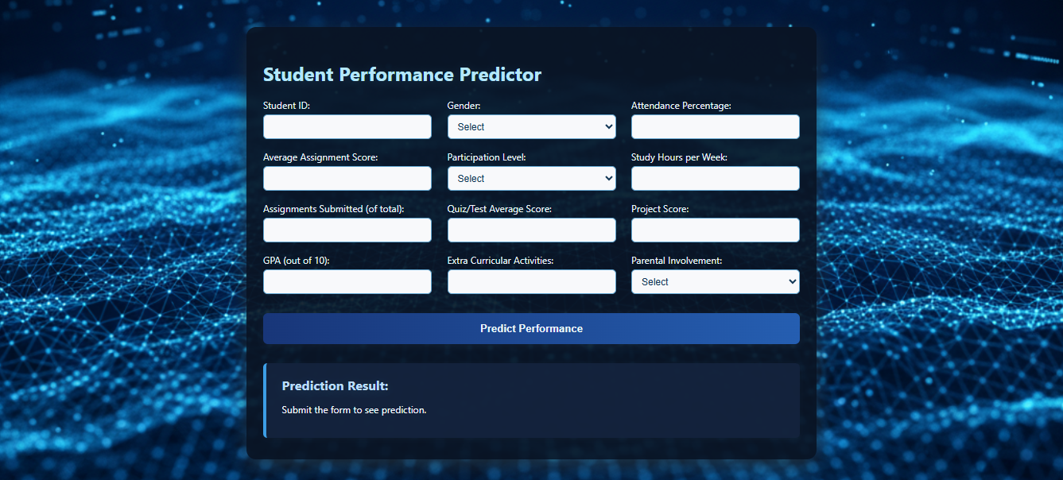
Output

Slide 11
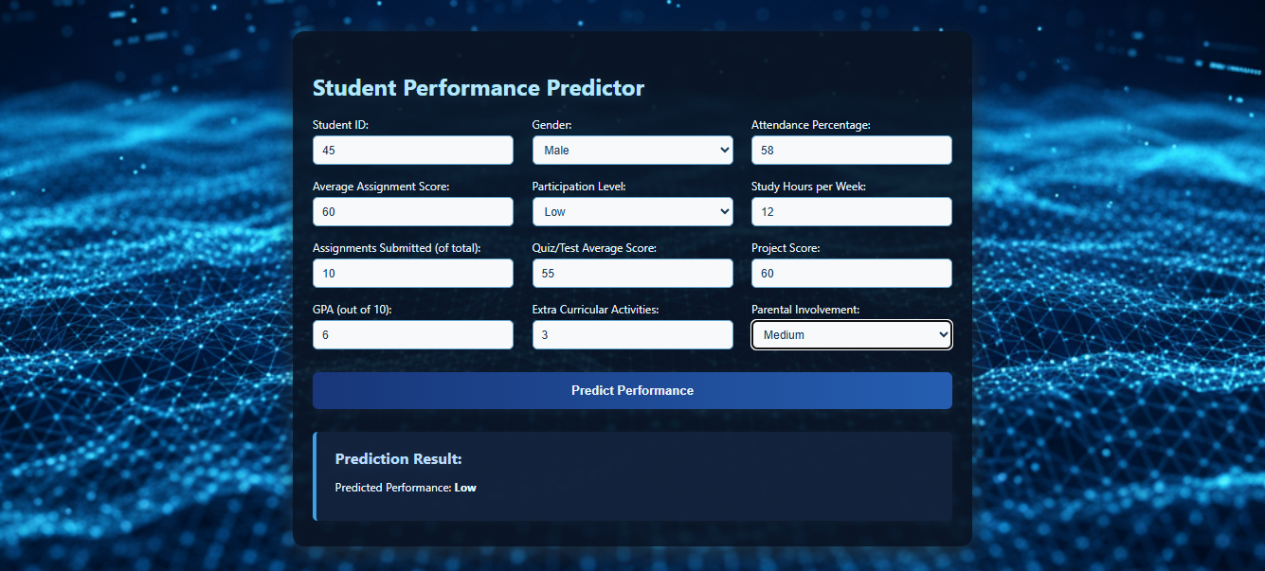
Output

Slide 12
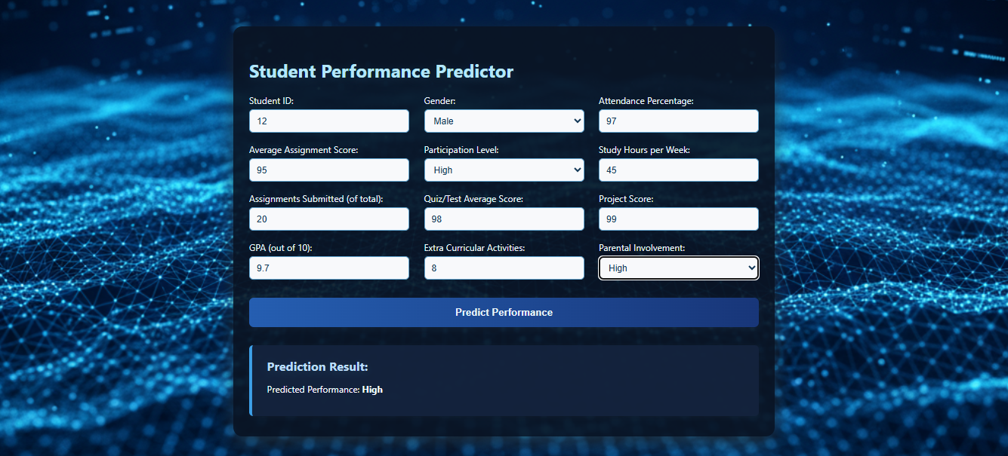
Output

Slide 13
Conclusion
The Student Performance Predictor effectively estimates academic outcomes using machine learning.
It helps teachers and institutions identify students at risk and understand the factors influencing performance.
Future enhancements can include deep learning techniques and larger, more diverse datasets for improved accuracy.

