Slide 1
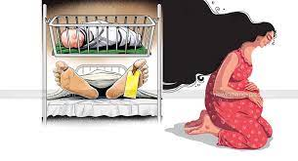
Maternal Mortality in Bangladesh: Progress, Challenges, and the Way Forward
Presenter Name:Samiha Islam Ahana
ID:2023-3-11-O47
Course Code & Name:PSS301[Mortality and Morbidity
Section:1

Slide 2
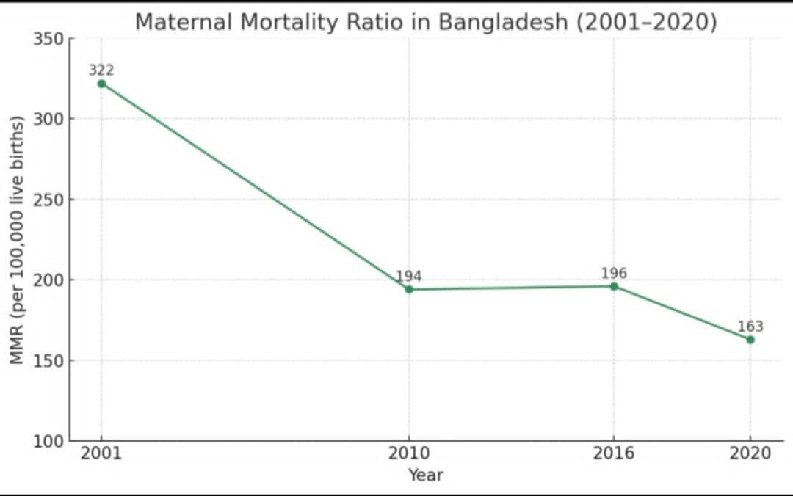
Background
Maternal mortality refers to the death of a woman during pregnancy, childbirth, or within 42 days after delivery. It is a key indicator of a country's healthcare system and women's health status.
Maternal mortality refers to the death of a woman during pregnancy, childbirth, or within 42 days after delivery. It is a key indicator of a country's healthcare system and women's health status.

Slide 3
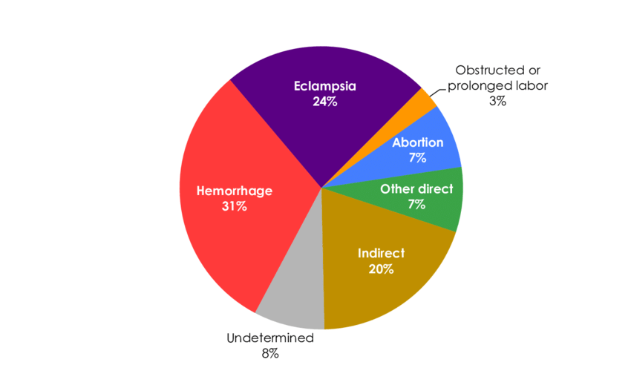
Maternal Mortality in Bangladesh
cause
Challenges
Way Forward
  Lack of Access to Skilled Maternal Care
  Limited Preventive Services and Early Diagnosis
  Socioeconomic and Healthcare System
  Healthcare Access Inequality
  Limited Emergency Care
  High Cesarean Dependency
  Strengthen Healthcare Services and Emergency Support
  Build Skilled Workforce and Community Awareness
  Support Poor Families and Increase Government Involvement
  1.Lack of access to
  Skilled Maternal care
  ​​
  2.Limited Preventive
  Services and Early
  Diagnosis​​
  3.Socioeconomic and Healthcare System Barriers
  Healthcare Access Inequality​
  Limited
  Emergency Care​
  High Cesarean
  Dependency
  Strengthen Healthcare Services and Emergency Support
  Build Skilled Workforce and Community
  Awareness​
  Support Poor Families and Increase Government Involvement
  Strengthen.

Slide 4

Conclusion:
.Strengthen healthcare in rural and low-income areas
.Ensure quick treatment for complications Promote awareness and preventive care
. Align with SDG targets to reduce maternal deaths
Maternal Mortality in Bangladesh

