Slide 1
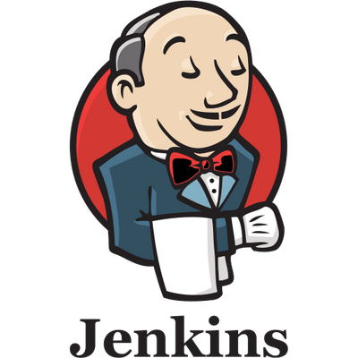

Slide 2
Using the CLI client
While the SSH-based CLI is fast and covers most needs, there may be situations where the CLI client distributed with Jenkins is a better fit. For example, the default transport for the CLI client is HTTP which means no additional ports need to be opened in a firewall for its use.
Downloading the client
The CLI client can be downloaded directly from a Jenkins master at the URL /jnlpJars/jenkins-cli.jar, in effect JENKINS_URL/jnlpJars/jenkins-cli.jar
While a CLI .jar can be used against different versions of Jenkins, should any compatibility issues arise during use, please re-download the latest .jar file from the Jenkins master.

Slide 3
Using the client
The general syntax for invoking the client is as follows:
java -jar jenkins-cli.jar [-s JENKINS_URL] [global options...] command [command options...] [arguments...]
The JENKINS_URL can be specified via the environment variable $JENKINS_URL. Summaries of other general options can be displayed by running the client with no arguments at all.
Client connection modes
There are three basic modes in which the 2.54+ / 2.46.2+ client may be used, selectable by global option: -http; -ssh; and -remoting.
HTTP connection mode
This is the default mode, though you may pass the -http option explicitly for clarity.
Authentication is preferably with an -auth option, which takes a username:apitoken argument. Get your API token from /me/configure:

Slide 4
java -jar jenkins-cli.jar [-s JENKINS_URL] -auth kohsuke:abc1234ffe4a command …
(Actual passwords are also accepted, but this is discouraged.)
You can also precede the argument with @ to load the same content from a file:
java -jar jenkins-cli.jar [-s JENKINS_URL] -auth @/home/kohsuke/.jenkins-cli command ...
Generally no special system configuration need be done to enable HTTP-based CLI connections. If you are running Jenkins behind an HTTP(S) reverse proxy, ensure it does not buffer request or response bodies.
SSH connection mode
Authentication is via SSH keypair. You must select the Jenkins user ID as well:
java -jar jenkins-cli.jar [-s JENKINS_URL] -ssh -user kohsuke command ...

Slide 5
In this mode, the client acts essentially like a native ssh command.
By default the client will try to connect to an SSH port on the same host as is used in the JENKINS_URL.
If Jenkins is behind an HTTP reverse proxy, this will not generally work, so run Jenkins with the system property -Dorg.jenkinsci.main.modules.sshd.SSHD.hostName=ACTUALHOST to define a hostname or IP address for the SSH endpoint.

Slide 6
Remoting connection mode
Authentication is preferably via SSH keypair. A login command and --username / --password command options are also available;
these are discouraged since they cannot work with a non-password-based security realm, certain command arguments will not be properly.
two transports available for this mode: over HTTP, or over a dedicated TCP socket. If the TCP port is enabled and seems to work, the client will use this transport. If the TCP port is disabled, or such a port is advertised but does not accept connections, the client will automatically fall back to the 173 less efficient HTTP transport.

Slide 7
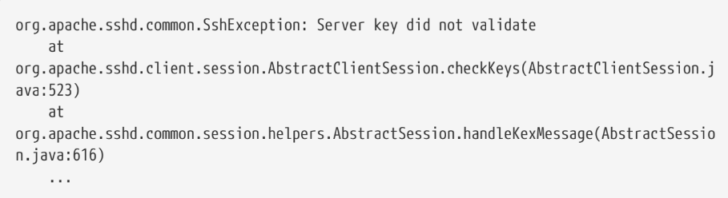
Common Problems with the Remoting-based client
There are a number of common problems that may be experienced when running the CLI client.
Operation timed out
Check that the HTTP or TCP port is opened if you are using a firewall on your server. You can configure its value in Jenkins configuration. By default it is set to use a random port.
Server key did not validate
You may get the error below and find a log entry just below that concerning mismatched keys:

Slide 8
UsernameNotFoundException
If your client displays a stacktrace that looks like:
To solve the problem, ensure your users exist in your configured security realm.

Slide 9
Troubleshooting logs
To get more information about the authentication process:
1. Go into Manage Jenkins > System Log > Add new log recorder.
2. Enter any name you want and click on Ok.
3. Click on Add
4. Type org.jenkinsci.main.modules.sshd.PublicKeyAuthenticatorImpl (or type PublicKeyAuth and
then select the full name)
5. Set the level to ALL.
6. Repeat the previous three steps for hudson.model.User
7. Click on Save

Slide 10
In-process Script Approval
Jenkins, and a number of plugins, allow users to execute Groovy scripts in Jenkins. These scripting
capabilities are provided by:
Script Console.
Jenkins Pipeline.
The plugin:email-ext[Extended Email plugin].
The plugin:groovy[Groovy plugin] - when using the "Execute system Groovy script" step.
The plugin:job-dsl[JobDSL plugin] as of version 1.60 and later.
To protect Jenkins from execution of malicious scripts, these plugins execute user-provided scripts in a Groovy Sandbox that limits what internal APIs are accessible.

Slide 11
Getting Started
The plugin:script-security[Script Security plugin] is installed automatically by the Post-install Setup Wizard, although initially no additional scripts or operations are approved for use.
Security for in-process scripting is provided by two different mechanisms: the Groovy Sandbox and Script Approval.
The first, the Groovy Sandbox, is enabled by default for Jenkins Pipeline allowing user-supplied Scripted and Declarative Pipeline to execute without prior Administrator intervention.
The second, Script Approval, allows Administrators to approve or deny unsandboxed scripts, or allow sandboxed scripts to execute additional methods.

Slide 12
Groovy Sandbox
To reduce manual interventions by Administrators, most scripts will run in a Groovy Sandbox by default, including all Jenkins Pipelines.
The sandbox only allows a subset of Groovy’s methods deemed sufficiently safe for "untrusted" access to be executed without prior approval.
Scripts using the Groovy Sandbox are all subject to the same restrictions, therefore a Pipeline authored by an Administrator is subject to the restrictions as one authorized by a non-administrative user.
The Pipeline will not execute until an Administrator approves the method signature via the In-process Script Approval page.
Disabling the Groovy Sandbox requires that the entire script must be reviewed and manually approved by an administrator.

Slide 13
Script Approval
Manual approval of entire scripts, or method signatures, by an administrator provides Administrators with additional flexibility to support more advanced usages of in-process scripting.
When the Groovy Sandbox is disabled, or a method outside of the built-in list is invoked, the Script Security plugin will check the Administrator-managed list of approved scripts and methods.
For scripts which wish to execute outside of the Groovy Sandbox, the Administrator must approve the entire script in the In-process Script Approval page:
For scripts which use the Groovy Sandbox, but wish to execute an currently unapproved method signature will also be halted by Jenkins, and require an Administrator to approve the specific method signature before the script is allowed to execute:

Slide 14
Approve assuming permissions check
Script approval provides three options: Approve, Deny, and "Approve assuming permissions check."
While the purpose of the first two are self-evident, the third requires some additional understanding of what internal data scripts are able to access and how permissions checks inside of Jenkins function.
Consider a script which accesses the method hudson.model.AbstractItem.getParent(), which by itself is harmless and will return an object containing either the folder or root item which contains the currently executing Pipeline or Job.
Following that method invocation, executing hudson.model.ItemGroup.getItems(), which will list items in the folder or root item, requires the Job/Read permission..
Instead, it is usually more desirable to click Approve assuming permissions check which will cause the Script Approval engine to allow the method signature assuming the user running the script has the permissions to execute the method, such as the Job/Read permission in this example.

Slide 15
System Administration
Backing-up/Restoring Jenkins
Having good backups of your Jenkins instance is critically important.
Backups are used for:
Disaster recovery.
Recovering an older configuration (an accidental configuration change may not be discovered for some time).
Recovering a file that is corrupted or was deleted accidentally.

Slide 16
Securing Jenkins
In the default configuration of Jenkins it does not perform any security checks. This means the ability of Jenkins to launch processes and access local files are available to anyone who can access Jenkins web UI and some more.
Securing Jenkins has two aspects to it.
Access control, which ensures users are authenticated when accessing Jenkins and their activities are authorized.
Protecting Jenkins against external threats

Slide 17
Access Control
You should lock down the access to Jenkins UI so that users are authenticated and appropriate set of permissions are given to them.
This setting is controlled mainly by two axes:
Security Realm, which determines users and their passwords, as well as what groups the users belong to.
Authorization Strategy, which determines who has access to what.
Quick and Simple Security --- if you are running Jenkins like java -jar jenkins.war and only need a very simple setup

Slide 18
Standard Security Setup --- discusses the most common setup of letting Jenkins run its own user database and do finer-grained access control
Apache frontend for security --- run Jenkins behind Apache and perform access control in Apache instead of Jenkins
Authenticating scripted clients --- if you need to programmatically access security-enabled Jenkins web UI, use BASIC auth
Matrix-based security --- Granting and denying finer-grained permissions

Slide 19
Protect users of Jenkins from other threats
There are additional security subsystems in Jenkins that protect Jenkins and users of Jenkins from indirect attacks.
The following features are off by default.
CSRF Protection --- prevent a remote attack against Jenkins running inside your firewall. This feature is off by default in Jenkins.
Security implication of building on master --- protect Jenkins master from malicious builds
Slave To Master Access Control --- protect Jenkins master from malicious build agents

Slide 20
The following features are ON by default.
Configuring Content Security Policy --- protect users of Jenkins from malicious builds
Markup formatting --- protect users of Jenkins from malicious users of Jenkins

Slide 21
Disabling Security
One may accidentally set up a security realm / authorization in such a way that you may no longer be able to reconfigure Jenkins.
When this happens, you can fix this by the following steps:
1. Stop Jenkins (the easiest way to do this is to stop the servlet container.)
2. Go to $JENKINS_HOME in the file system and find config.xml file.
3. Open this file in the editor.

Slide 22
4. Look for the <useSecurity>true</useSecurity> element in this file.
5. Replace true with false
6. Remove the elements authorizationStrategy and securityRealm
7. Start Jenkins
8. When Jenkins comes back, it will be in an unsecured mode where everyone gets full access to the system.

Slide 23


