Slide 1
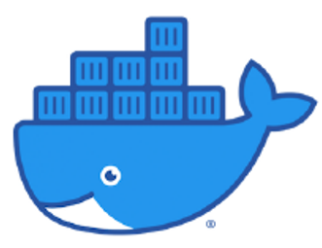
DOCKER

Slide 2
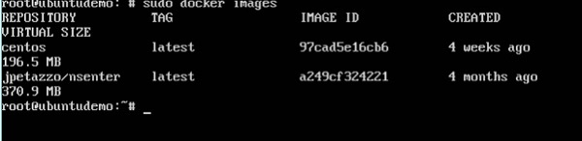
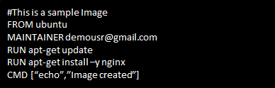
Docker File
Previously, we have seen the various Image files such as Centos which get downloaded from Docker hub from which you can spin up containers.
If we use the Docker images command, we can see the existing images in our system. From the screenshot, we can see that there are two images: centos and nsenter.
But Docker also gives you the capability to create your own Docker images, and it can be done with the help of Docker Files. A Docker File is a simple text file with instructions on how to build your images.
Steps to create the Dockerfile:
Step 1 − Create a file called Docker File and edit it using vim. The name of the file has to be "Dockerfile" with "D" as capital.
Step 2 − Build your Docker File using the following instructions.
Step 3 − Save the file.

Slide 3



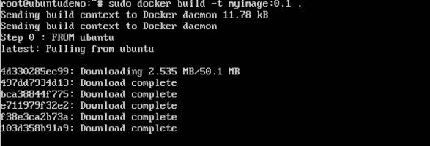
Building Docker Files
We created our Docker File in the last time. Now we will see how to build the Docker File. The Docker File can be built with the following command:
•This method allows the users to build their own Docker images.
Syntax:
Options:
• -t is to mention a tag to the image
• ImageName – This is the name you want to give to your image
• TagName – This is the tag you want to give to your image
• Dir – The directory where the Docker File is present.
•Example:
•Here, myimage is the name we are giving to the Image and 0.1 is the tag number we are giving to our image.
•Since the Docker File is in the present working directory, we used "." at the end of the command to signify the present working directory.
•Output:

Slide 4
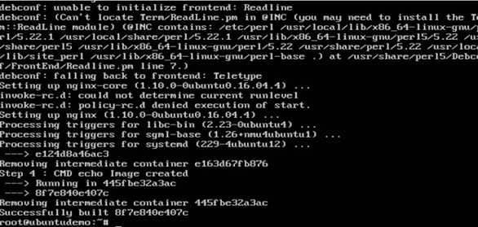
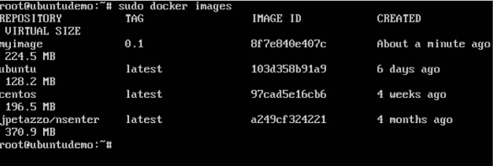
From the output, you will first see that the Ubuntu Image will be downloaded from Docker Hub, because there is no image available locally on the machine.
Finally, when the build is complete, all the necessary commands would have run on the image.
You will then see the successfully built message and the ID of the new Image. When you run the Docker images command, you would then be able to see your new image.
You can now build containers from your new Image.

Slide 5
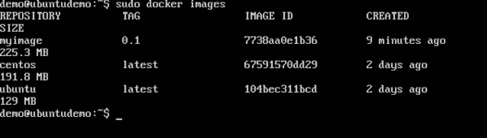
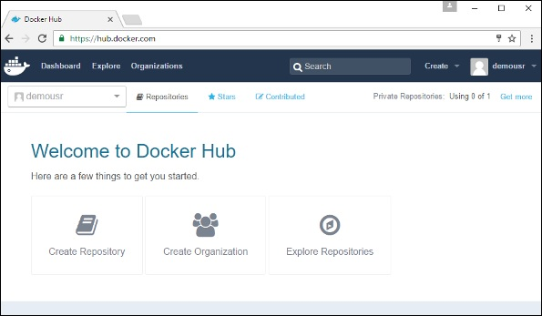
Public Repositories
Public repositories can be used to host Docker images which can be used by everyone else. An example is the images which are available in Docker Hub.
Most of the images such as Centos, Ubuntu, and Jenkins are all publicly available for all. We can also make our images available by publishing it to the public repository on Docker Hub.
For our example, we will use the myimage repository built in the "Building Docker Files" and upload that image to Docker Hub.
Let’s first review the images on our Docker host to see what we can push to the Docker registry.
Here, we have our myimage:0.1 image which was created as a part of the “Building Docker Files” .
Let’s use this to upload to the Docker public repository.
The steps to how to upload an image to public repository.
Step 1 − Log into Docker Hub and create your repository. This is the repository where your image will be stored. Go to https://hub.docker.com/ and log in with your credentials.

Slide 6
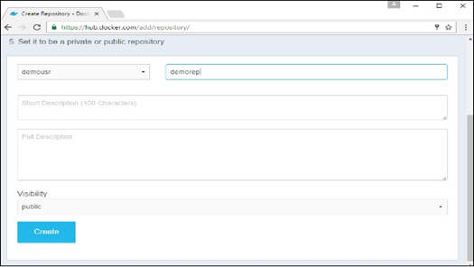
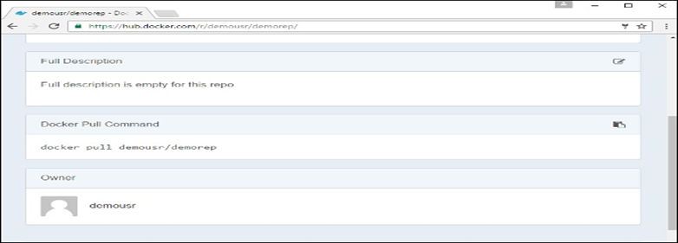
Step 2 − Click the button "Create Repository" on the above screen and create a repository with the name demorep. Make sure that the visibility of the repository is public.
Once the repository is created, make a note of the pull command which is attached to the repository.
The pull command which will be used in our repository is as follows −
docker pull demousr/demorep

Slide 7
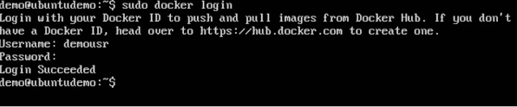
Step 3 − Now go back to the Docker Host. Here we need to tag our myimage to the new repository created in Docker Hub. We can do this via the Docker tag command.
Step 4 − Issue the Docker login command to login into the Docker Hub repository from the command prompt. The Docker login command will prompt you for the username and password to the Docker Hub repository.
Step 5 − Once the image has been tagged, it’s now time to push the image to the Docker Hub repository. We can do this via the Docker push command.

Slide 8

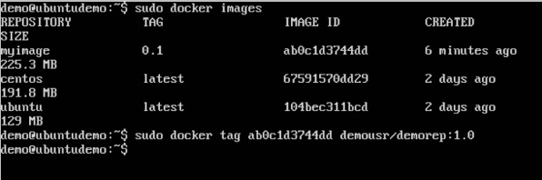
Docker tag:
•This method allows one to tag an image to the relevant repository.
Syntax:
Options:
•imageID − This is the ImageID which needs to be tagged to the repository.
•Repositoryname − This is the repository name to which the ImageID needs to be tagged to.
•Example:
•Output:
A sample output of the above example is given below.

Slide 9


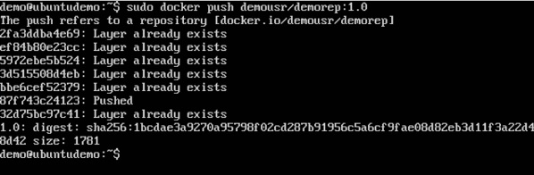
Docker push:
This method allows one to push images to the Docker Hub.
Syntax:
Options
Repositoryname − This is the repository name which needs to be pushed to the Docker Hub.
Return Value
The long ID of the repository pushed to Docker Hub.
Example:
Output:
•If you go back to the Docker Hub page and go to your repository, you will see the tag name in the repository.

Slide 10
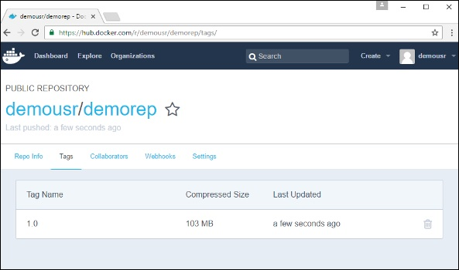
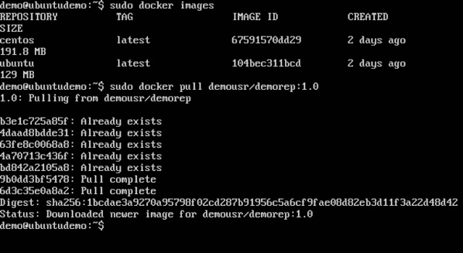
Now let’s try to pull the repository we uploaded onto our Docker host. Let’s first delete the images, myimage:0.1 and demousr/demorep:1.0, from the local Docker host. Let’s use the Docker pull command to pull the repository from the Docker Hub.
From the above screenshot, you can see that the Docker pull command has taken our new repository from the Docker Hub and placed it on our machine.

Slide 11
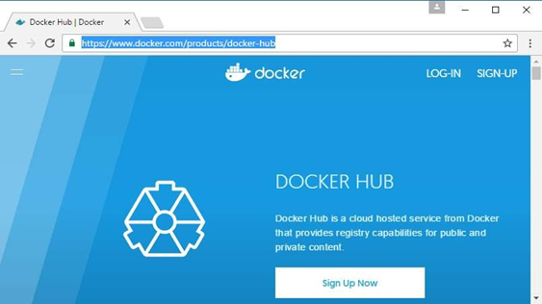
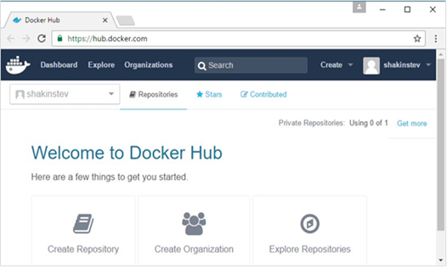
Docker – Managing Ports
In Docker, the containers themselves can have applications running on ports. When you run a container, if you want to access the application in the container via a port number, you need to map the port number of the container to the port number of the Docker host.
we are going to download the Jenkins container from Docker Hub. We are then going to map the Jenkins port number to the port number on the Docker host.
Step 1: First, you need to do a simple sign-up on Docker Hub
Step 2: Once you have signed up, you will be logged into Docker Hub.

Slide 12
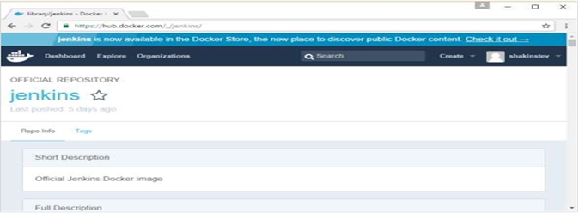
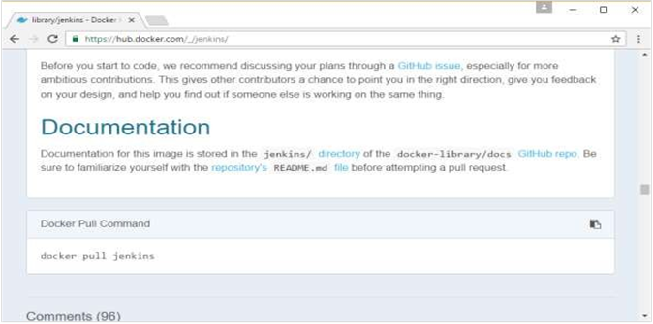
Step 3: Next, let’s browse and find the Jenkins image.
Step 4: If you scroll down on the same page, you can see the Docker pull command. This will be used to download the Jenkins Image onto the local Ubuntu server.

Slide 13
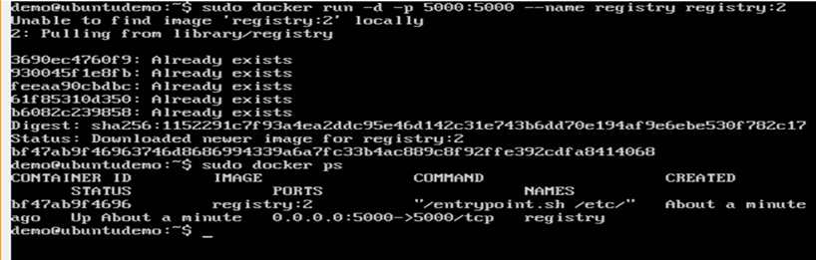
Step 5: Now go to the Ubuntu server and run the command:
Step 6: To understand what ports are exposed by the container, you should use the Docker inspect command to inspect the image.
Docker inspect
This method allows one to return low-level information on the container or image.
docker inspect Container/Image
Docker – Private Registries
You might have the need to have your own private repositories. You may not want to host the repositories on Docker Hub. For this, there is a repository container itself from Docker.
Step 1: Use the Docker run command to download the private registry. This can be done using the following command:
sudo docker run –d –p 5000:5000 –-name registry registry:2
Step 2: Let’s do a docker ps to see that the registry container is indeed running.

Slide 14

Step 3: Now let’s tag one of our existing images so that we can push it to our local repository. In our example, since we have the centos image available locally, we are going to tag it to our
private repository and add a tag name of centos.
sudo docker tag 67591570dd29 localhost:5000/centos
Step 4: Now let’s use the Docker push command to push the repository to our private repository
sudo docker push localhost:5000/centos
Here, we are pushing the centos image to the private repository hosted at
localhost:5000.
Step 5: Now let’s delete the local images we have for centos using the docker rmi
commands. We can then download the required centos image from our private repository.
Step 6: Now that we don’t have any centos images on our local machine, we can now use the following Docker pull command to pull the centos image from our private repository.
sudo docker pull localhost:5000/centos
Here, we are pulling the centos image to the private repository hosted at localhost:5000.

Slide 15
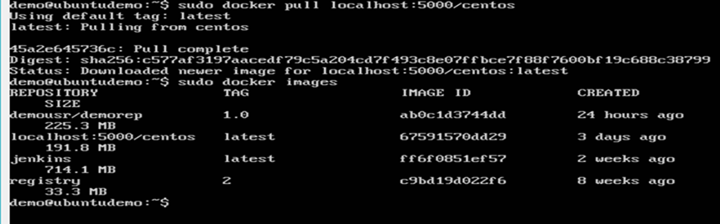
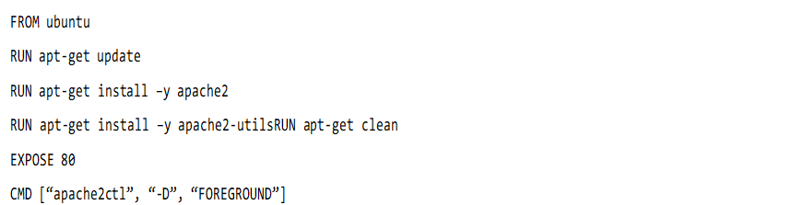
Docker – Building a Web Server Docker File
We have already learned how to use Docker File to build our own custom images. Now let’s see how we can build a web server image that can be used to build containers.
In our example, we are going to use the Apache Web Server on Ubuntu to build our image
Step 1: The first step is to build our Docker File. Let’s use vim and create a Docker File with the following information

Slide 16
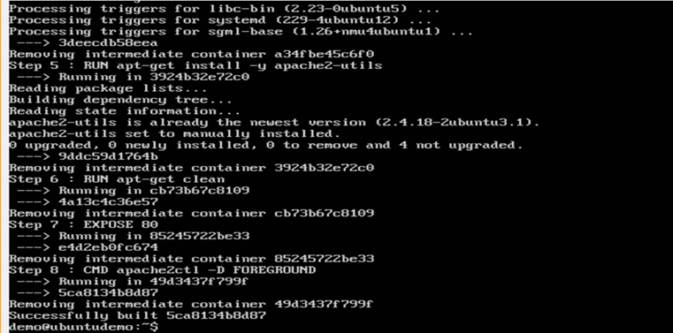
Step 2: Run the Docker build command to build the Docker file. It can be done using the following command:
We are tagging our image as mywebserver.
Step 3: Now that the web server file has been built, it’s now time to create a container from the image. We can do this with the Docker run command.

Slide 17
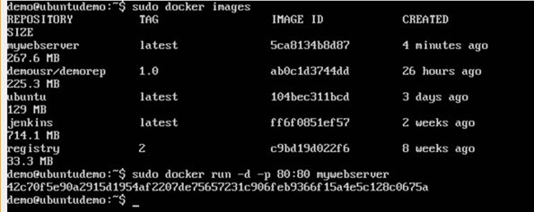
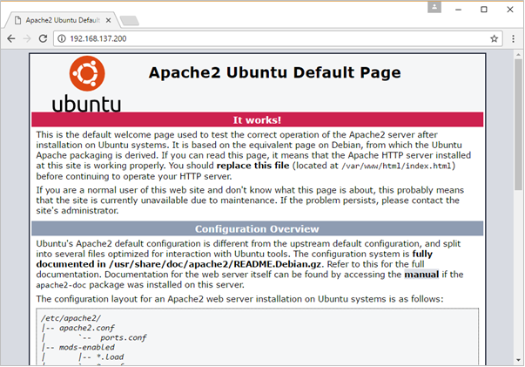
If you go to port 80 of the Docker host in your web browser, you will now see that Apache is up and running.

Slide 18
Docker Instruction Commands
Docker has a host of instruction commands. These are commands that are put in the Docker File.
CMD Instruction :
The command is used for executing at the runtime when the container is executed.
Syntax:
CMD command param1
ENTRYPOINT :
This command is used to execute the commands at the runtime for the docker container. This command is more flexible.
Syntax:
ENTRYPOINT command Param1
ENV :
This command is used to set the environment variables in the Docker Container.
Syntax:
ENV key value
Return value :
This command will execute accordingly.

Slide 19
WORKDIR :
This command is used to set the working directory of the docker container.
Syntax:
WORKDIR dirname
DOCKER-CONTAINER LINKING
Container linking allows multiple containers to link with each other. It is a better option than exposing ports.
Let's go step by step and learn how it works.
Step 1:
Download the Jenkins image using the PULL command.
sudo docker jenkins pull
Step 2:
Once the image is available, run the container by specifying the name to the container by using the --name option. This will now be our source container.
sudo docker run –name=jenkins –d jenkins_
Step 3:
Now, it's time to launch the destination container by linking it to our source container. For our destination container we will use standard Ubuntu image.
Sudo docker run –name=xxx –link=jenkins:alias-src –it ubuntu
Once executed the above command, when you give the "docker ps" you will see the both containers running.
Step 4:
Next we need to attach to the receiving container.

Slide 20
Sudo docker attach xxx
Once done with attaching the container run the ENV command. You will notice new variables for linking with the source container.
DOCKER STORAGE
Storage Drivers :
Docker has multiple storage drivers that allow one to work with the underlying storage devices.
TECHNOLOGY | STORAGE DRIVER
OverlayFS | overlay or overlay2
AUFS | aufs
Btrfs | brtfs
Device Manager | device manager
ZFS | zfs
VFS | vfs

Slide 21
Sudo docker info
This command displays the whole relative information of the docker. There we can find the storage driver that is used.
Changing the storage Drivers for a Container :
If you wanted to change to the storage driver used for a container, you can change it while launching the container. This can be done by using the "–volume-driiver" parameter while running the docker run command.
Sudo docker run –d –volume-driver=flocker –v l/home/demo:/var/jenkins_home –p
Data Volumes :
In docker we will have a separate volume that can be shared across containers. These are known as Data Volumes.
Features of Data Volumes:
They are Initialized when the container is created.
They can be shared and also reused among many container.
Any changes to the volume itself can be made directly.
They exist even after the container is deleted.
Creating a Volume :
A Volume can be created beforehand using the docker command.
Syntax :
docker volume create –name=volumename –opt options
Listing all the Volumes :
You can list out all the docker volumes on a docker host.
Syntax :
docker volume ls

Slide 22
THANK YOU

