Slide 1


LINUX

Slide 2
GREP Command and options
GREP: The 'grep' command stands for "global regular expression print". grep command filters the content of a file which makes our search easy.
Options of Grep:
Matching Multiple patterns (–e):
This option is used to grep the multiple matching patterns in the list.
Eg:
$ grep -e Tech -e Sales employee.txt
100 Thomas Manager Sales $5,000
200 Jason Developer Technology $5,500
300 Raj Sysadmin Technology $7,000
500 Randy Manager Sales $6,000

Slide 3
Adding Paterns to a file –f:
You can add different patterns to a single file.
Eg:
$ cat patterns.lst
Director
Chairman
$ grep -f patterns.lst emp.lst
9876|jai sharma |director |production |12/03/50|7000
2365|barun sengupta |director |personnel |11/05/47|7800
5423|n. k. gupta |chairman |admin |30/08/56|5400

Slide 4
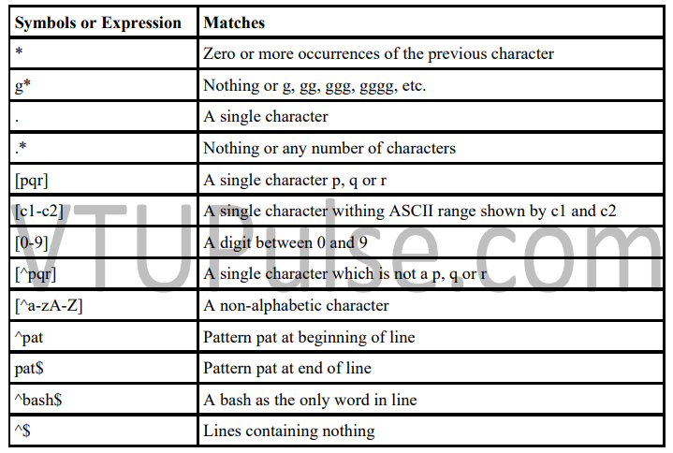
Basic Regular Expressions(BRE)
grep uses an expression of a different type to match a group of similar patterns. grep uses following set of meta-characters to design an expression that matches different patterns. If an expression uses any of these meta-characters, it is termed as Regular Expression (RE).

Slide 5
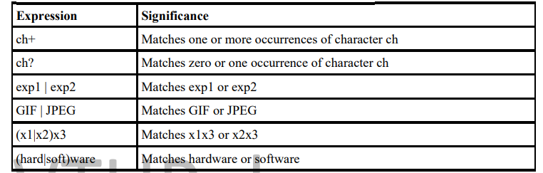
EXTENDED REGULAR EXPRESSION (ERE) AND egrep
ERE make it possible to match dissimilar patterns with a single expression. grep uses ERE characters with -E option. egrep is another alternative to use all the ERE characters without -E option. This ERE uses some additional characters set shown in below table

Slide 6
Shell Script
Shells are interactive which mean, they accept command as input from users and execute them. Some time we want to execute a bunch of commands routinely, so we have type in all commands each time in terminal.
As shell can also take commands as input from file we can write these commands in a file and can execute them in shell to avoid this repetitive work. These files are called Shell Scripts or Shell Programs.
Each Shell Script file should save with .sh file extension eg: sample.sh
Types of shells
Bourne shell − The $ character is the default prompt.
Bourne shell (sh)
Korn shell (ksh)
Bourne Again shell (bash)
POSIX shell (sh)

Slide 7
C shell − The % character is the default prompt.
C shell (csh)
TENEX/TOPS C shell (tcsh)
Every Shell Script begins with special interpreter line like –
#!/bin/sh or #!/bin/ksh or #!/bin/bash followed by commands.
Here #! is called Shebang which passes instruction to the program /bin/sh.
Example:
#!/bin/sh
#Sample Shell Script – sample.sh
echo “Today’s Date: ‘date’”
Execution:
$ chmod 777 sample.sh
$ sh sample.sh
Output:
Today’s Date: Thu Sep 22 12:10:20 IST 2022

Slide 8
READ: MAKING SCRIPT INTERACTIVE
The Script uses the read command which takes the input from the keyboard and assigns it as the value of the variable and finally prints it .
Example:
#!/bin/sh
#Sample Shell Script – sample.sh
echo “Enter your First Name:”
read fname
echo “Enter your Last Name:”
read lname
echo “Your First Name is: $fname”
echo “Your Last Name is: $lname”

Slide 9
Execution & Output:
$ chmod 777 sample.sh
$ sh sample.sh
Enter your First Name:
Henry
Enter your Last Name:
Ford
Your First Name is: Henry
Your Last Name is: Ford

Slide 10
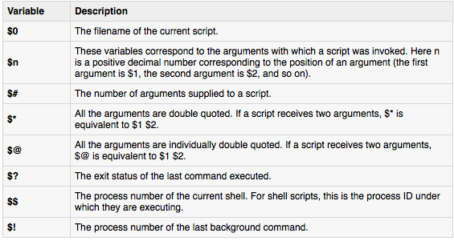
USING COMMAND LINE ARGUMENTS
Command line arguments (also known as positional parameters) are the arguments specified at the command prompt with a command or script to be executed. The locations at the command prompt of the arguments as well as the location of the command, or the script itself, are stored in corresponding variables. These variables are special shell variables.

Slide 11
Example:
#!/bin/sh
#Sample Shell Script – PositionalParameters.sh
echo "Script Name: $0"
echo "First Parameter of the script is $1"
echo "The second Parameter is $2"
echo "The complete list of arguments is $@"
echo "Total Number of Parameters: $#"
echo "The process ID is $$"
echo "Exit code for the script: $?“
Execution & Output:
./PositionalParameters.sh learning command line arguments
Script Name: ./ PositionalParameters.sh
First Parameter of the script is learning
The second Parameter is command
The complete list of arguments is learning command line arguments
Total Number of Parameters: 4
The process ID is 14974
Exit code for the script: 0

Slide 12
exit AND EXIT STATUS OF COMMAND
C program and shell scripts have a lot in common, and one of them is that they both use the same command ( or function in c ) to terminate a program. It has the name exit in the shell and exit( ) in C. The command is usually run with a numeric arguments:
exit 0 #Used when everything went fine
exit 1 #Used when something went wrong
The shell offers a variable $? and a command test that evaluates a command's exit status. The parameter $? stores the exit status of the last command. It has the value 0 if the command succeeds and a non-zero value if it fails. This parameter is set by exit's argument.
Examples:
$ grep director emp.lst >/dev/null; echo $?
0 #Success
$ grep director emp.lst >/dev/null; echo $?
1 #Failure – in finding pattern

Slide 13
THE LOGICAL OPERATORS && AND || - CONDITIONAL EXECUTION
The shell provides two operators that allow conditional execution – the && and | |.
Examples:
$ date && echo “Date Command Executed Successfully!”
Sun Jan 13 15:40:13 IST 2013
Date Command Executed Successfully!
$ grep 'director' emp.lst && echo “Pattern found in File!”
1234 | Henry Ford | director | Marketing | 12/12/12 | 25000
Pattern found in File!
$ grep 'manager' emp.lst | | echo “Pattern not-found in File!”
Pattern not-found in File!

Slide 14
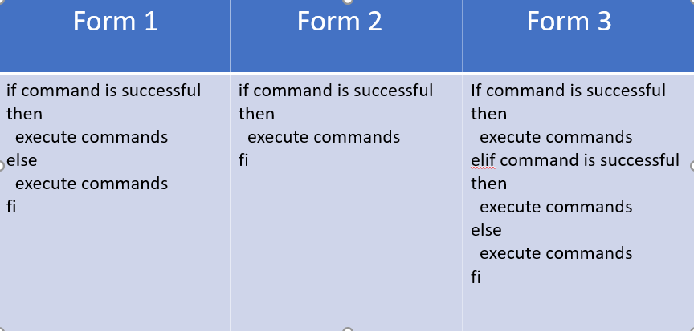
The if Conditional
The if statement makes two-way decisions depending on the fulfilment of a certain condition. In the shell, the statement uses the following forms-

Slide 15
Example:
#!/bin/sh
#Shell script to illustrate if conditional
if grep 'director' emp.lst >/dev/null
then
echo “Pattern found in File!”
else echo “Pattern not-found in File!”
fi

Slide 16
USING test AND [ ] TO EVALUATE EXPRESSIONS
When you use it to evaluate expressions, you need the test statement because the true or false values returned by expressions can't be directly handled by if.
The test uses certain operators to evaluate the condition on its right and returns either a true or false exit status, which is then used by if for making a decision.
Test works in three ways:
Compares two numbers
Compares two strings or a single one for a null value.
Checks a file's attributes
test doesn't display any output but simply sets the parameter

Slide 17
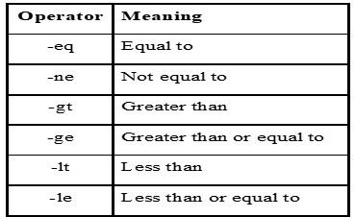
Numeric Comparison operators used by test
Examples:
$ x=5, y=7, z=7.2
$ test $x -eq $y; echo $?
1 # Not Equal
$ test $x -lt $y; echo $?
0 #True
$ test $y -eq $z
0 #True- 7.2 is equal to 7
The last example proves that numeric comparison is restricted to integers only. The [ ] is used as shorthand for the test.
Hence, the above example may be re-written as-
test $x -eq $y or [ $x -eq $y ] #Both are equivalent

Slide 18
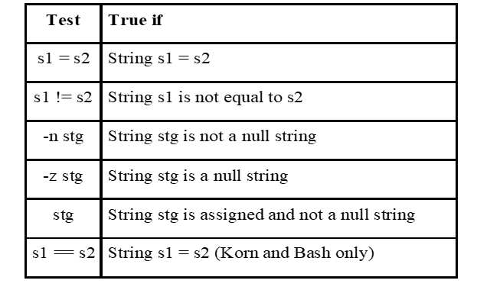
String Comparison
Test can be used to compare strings with yet another set of operators. The below table shows string tests used by test-
The below table shows the string test used by test:
Example:
#!bin/sh/
#Shell script to illustrate string comparison using test –strcmp.sh
If[$# -eq 0]; then
Echo “Enter your name:\c”,read name;
if [ -z $name ]; then
echo "You have not entered your name! "; exit 1;
else
echo "Your Name From Input line is : $name "; exit 1;
if
else
echo "Your Name From Command line is : $1 " ;

Slide 19
Execution and Output:
$ chmod 777 strcmp.sh
$ sh strcmp.sh Henry
Your Name From Command line is : Henry
$ sh strcmp.sh
Enter Your Name: Smith [Enter] Your Name From Input line is : Smith
$ sh strcmp.sh
Enter Your Name: [Enter]
You have not entered your name!
THE CASE CONDITIONAL
The case statement is similar to switch statement in C.
The statement matches an expression for more than one alternative, and permit multi-way branching.

Slide 20
The general syntax of the case statement is as follows:
Case expression in
Pattern1) command1;;
Pattern 2) command2;;
Pattern 3) command3;;
.. ………………………….
esac
Example:
#!/bin/sh
#Shell script to illustrate CASE conditional – menu.sh
echo "\t MENU\n 1. List of files\n 2. Today's Date\n 3. Users of System\n 4. Quit\n"; echo "Enter your option: \c";
read choice
case "$choice" in
1)ls -l ;;
2)date ;;
3)who ;;
4)exit ;;
*) echo "Invalid Option!" esac

Slide 21
Execution and Output:
$ chmod 777 menu.sh
$ sh menu.sh MENU
1.List of files
2.Today's Date
3.Users of System
4.Quit
expr: COMPUTATION AND STRING HANDLING
Shell does not have any computing features, but it rely on external expr command for that purpose.
This expr command combines two functions in one:
• Performs arithmetic operations on integers
• Manipulates strings
Computation
expr can perform the four arithmetic operations as well as the modulus (remainder) function.

Slide 22
Examples:
$ expr 3 + 5
8
$ x=8 y=4
$ expr $x + $y
12
$ expr $x - $y
4
$ expr $x \* $y #Asterisk has to be escaped to prevent from metacharacter
32
$ expr $x / $y
2
$ expr $x % $y
0
expr is often used with command substitution to assign a variable. For example, you can set a variable z to the sum of two numbers:
$ x=6 y=2; z=expr `$x + $y`
$ echo $z
8

Slide 23
String Handling
For manipulating strings, expr uses two expressions separated by a colon.
The string to be worked upon is placed on the left of the :, and RE is placed on its right. Depending on the composition of the expression, expr can perform three important string functions:
• Determine the length of the string
• Extract a substring
• Locate the position of a character in a string
Examples:
$ expr “abcdefghijkl” : '.*’
#Length of the string = number of characters
$ stg=2013
$ expr “$stg” : '..\(..\)’
#Extracts last two characters – as a substring
$stg=abcdefgh
$ expr “$stg” : '[^d]*d’
4 #Locate position of character d in stg

Slide 24
THANKYOU

