Slide 1

JAI JENKINS
DARSHAN K N
GOWTHAM
ADITYA
EASHAN

Slide 2
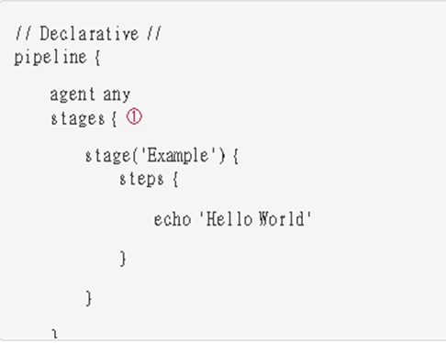
SECTIONS Sections in Declarative Pipeline typically contain one or more Directives or Steps.
STAGES
Containing a sequence of one or more [stage] directives, the stages section is where the bulk of the "work" described by a Pipeline will be located.
At a minimum it is recommended that stages contain at least one [stage] directive for each discrete part of the continuous delivery process, such as Build, Test, and Deploy
① The stages section will typically follow the directives such as agent, options, etc.
STAGES
Required | Yes
Parame ters | None
Allowed | Only once, inside the pipeline block.

Slide 3
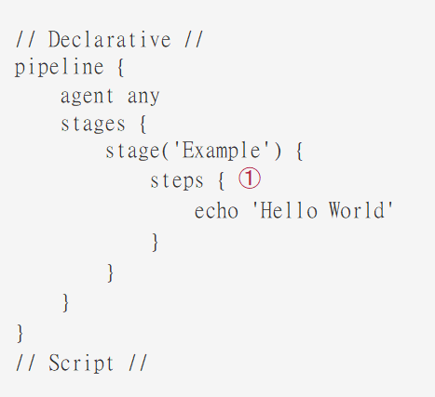
SECTIONS Sections in Declarative Pipeline typically contain one or more Directives or Steps.
STEPS
The steps section defines a series of one or more steps to be executed in a given stage directive.
① The steps section must contain one or more steps.
STEPS
Required | Yes
Parame ters | None
Allowed | Inside each stage block

Slide 4
Directives
environment
The environment directive specifies a sequence of key-value pairs which will be defined as environment variables for the all steps, or stage-specific steps, depending on where the environment directive is located within the Pipeline.
This directive supports a special helper method credentials() which can be used to access pre- defined Credentials by their identifier in the Jenkins environment.
For Credentials which are of type "Secret Text", the credentials() method will ensure that the environment variable specified contains the Secret Text contents.
For Credentials which are of type "Standard username and password", the environment variable specified will be set to username:password and two additional environment variables will be automatically be defined: MYVARNAME_USR and MYVARNAME_PSW respective.
environment
Required | No
Parame ters | None
Allowed | Inside the pipeline block or within stage directive.

Slide 5
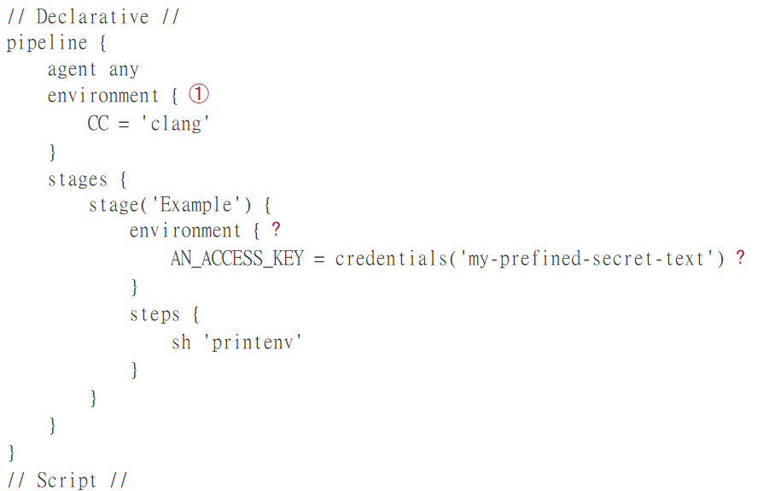
environment
ex:
① An environment directive used in the top-level pipeline block will apply to all steps within the Pipeline.
Ⓒ An environment directive defined within a stage will only apply the given environment variables to steps within the stage.
Ⓒ The environment block has a helper method credentials() defined which can be used to access pre-defined Credentials by their identifier in the Jenkins environment.

Slide 6
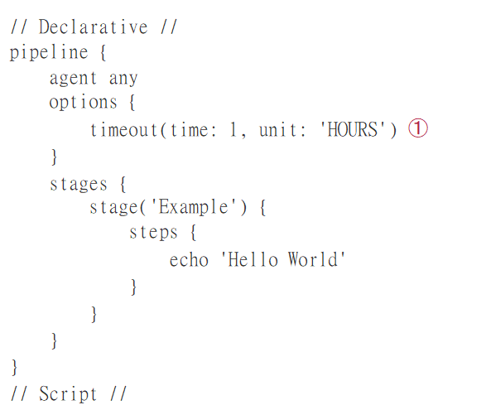
Directives
options
The options directive allows configuring Pipeline-specific options from within the Pipeline itself. Pipeline provides a number of these options, such as buildDiscarder, but they may also be provided by plugins, such as timestamps.
① Specifying a global execution timeout of one hour, after which Jenkins will abort the Pipeline run.
options
Required | No
Parame ters | None
Allowed | Only once inside the pipeline block..

Slide 7
Available options
buildDiscarder :
disableConcurrentBuilds :
overrideIndexTriggers :
skipDefaultCheckout :
skipStagesAfterUnstable :
Timeout :
Retry :
Timestamps :
Persist artifacts and console output for the specific number of recent Pipeline runs.
ex: options { buildDiscarder(logRotator(numToKeepStr: '1')) }
Disallow concurrent executions of the Pipeline. Can be useful for preventing simultaneous accesses to shared resources, etc. For example:
options { disableConcurrentBuilds() }
Allows overriding default treatment of branch indexing triggers. If branch indexing triggers are disabled at the multibranch or organization label,
options { overrideIndexTriggers(true) } will enable them for this job only.
Skip checking out code from source control by default in the agent directive. For example: options { skipDefaultCheckout() }
Skip stages once the build status has gone to UNSTABLE. For example:
options { skipStagesAfterUnstable() }
Set a timeout period for the Pipeline run, after which Jenkins should abort the Pipeline. For example: options { timeout(time: 1, unit: 'HOURS') }
On failure, retry the entire Pipeline the specified number of times. For example: options { retry(3) }
Prepend all console output generated by the Pipeline run with the time at which the line was emitted. For example: options { timestamps() }

Slide 8
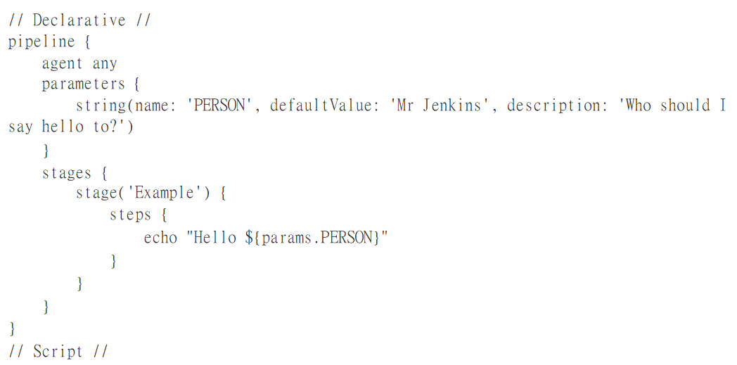
Directives
parameters
The parameters directive provides a list of parameters which a user should provide when triggering the Pipeline. The values for these user-specified parameters are made available to Pipeline steps via the params object, see the Example for its specific usage.
paramters
Required | No
Parame ters | None
Allowed | Only once inside the pipeline block..

Slide 9
Available parameters
string :
boolean Param :
A parameter of a string type, for example:
parameters { string(name: 'DEPLOY_ENV', defaultValue: 'staging', description: ‘’) }
A boolean parameter, for example:
parameters { booleanParam(name: 'DEBUG_BUILD', defaultValue: true, description: '') }

Slide 10
Trigger
The triggers directive defines the automated ways in which the Pipeline should be re-triggered.
For Pipelines which are integrated with a source such as GitHub
Accepts a cron-style string to define a regular interval at which the Pipeline should be retriggered.
Accepts a comma separated string of jobs and a threshold. When any job in the string finishes with the minimum threshold, the Pipeline will be re-triggered.
Required | No
Parameters | None
Allowed | Only once, inside the pipeline block.

Slide 11
stage
The stage directive goes in the stages section and should contain a [steps] section,
Required | At least one
Parameters | one mandatory parameter,
Allowed | inside the stages section.

Slide 12
tools
A section defining tools to auto-install and put on the path . This is ignored if agent none is specified.
Supported Tools:
Maven
Jdk
gradle
Required | No
Parameters | None
Allowed | Inside the pipeline block

Slide 13
Built-in Conditions
Branch:
Execute the stage when the branch being built matches the branch pattern given, for example: when { branch 'master' }.
Environment:
Execute the stage when the specified environment variable is set to the given value, for example: when { environment name: 'DEPLOY_TO', value: 'production' }

Slide 14
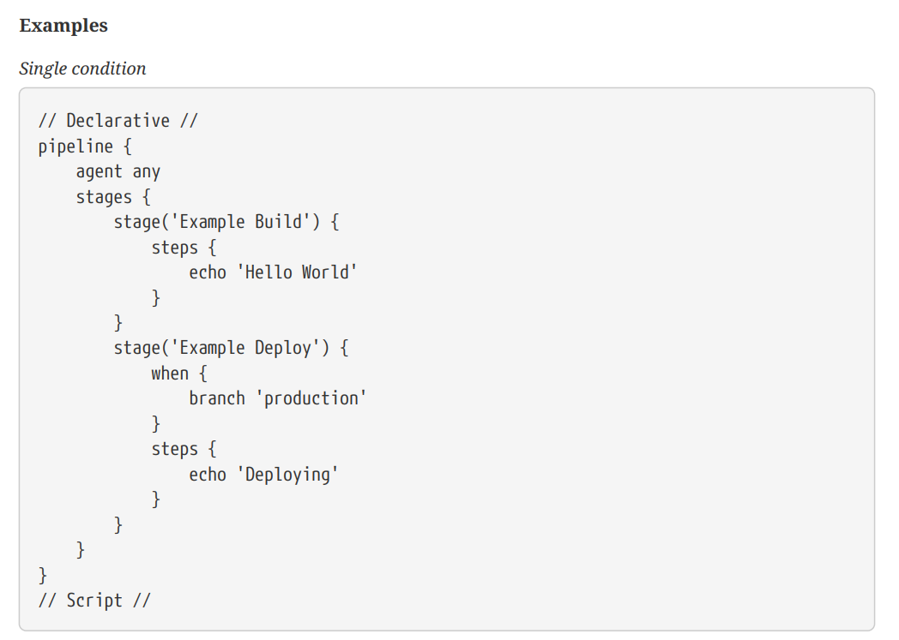
Built-in Conditions Single condition

Slide 15
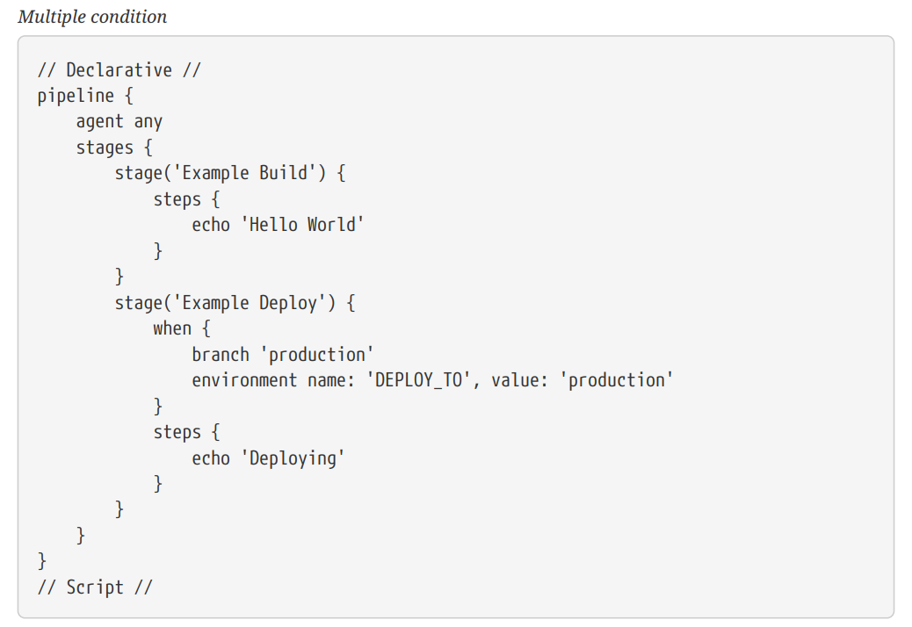
Built-in Conditions multiple condition

Slide 16
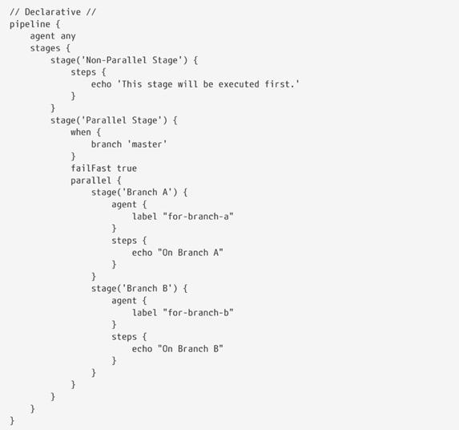
Parallel Stage
PARALLEL STAGE
Stages in Declarative Pipeline may declare a number of nested stages within them, which will be executed in parallel.
The nested stages cannot contain further parallel stages themselves, but otherwise behave the same as any other stage.

Slide 17
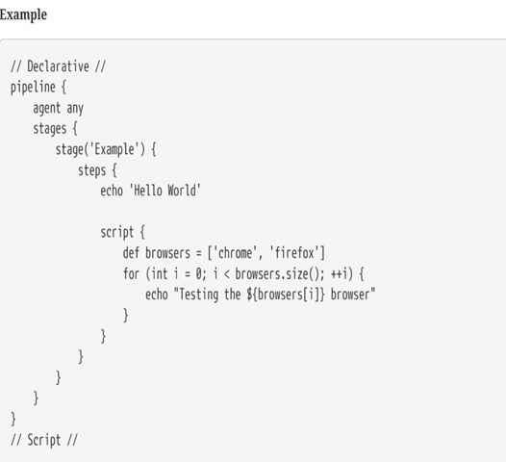
Steps
steps is Declarative Pipeline-specific syntax that describes the steps to be run in the stage.
Script
The script step takes a block of [scripted-pipeline] and executes that in the Declarative Pipeline.
Script blocks of non-trivial size and/or complexity should be moved into Shared Libraries instead.

Slide 18
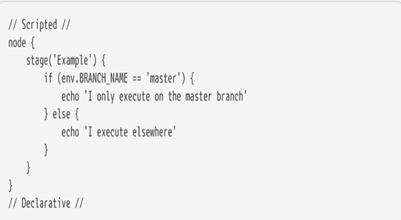
Scripted Pipeline
Scripted Pipeline is built on top of the underlying Pipeline sub-system.
Unlike Declarative, Scripted Pipeline is effectively a general purpose DSL built with Groovy.
Flow Control
Scripted Pipeline is serially executed from the top of a Jenkinsfile downwards, like most traditional scripts in Groovy or other languages.

Slide 19
Syntax Comparison
When Jenkins Pipeline was first created, Groovy was selected as the foundation. Jenkins has long shipped with an embedded Groovy engine to provide advanced scripting capabilities for admins and users alike.
As it is a fully featured programming environment, Scripted Pipeline offers a tremendous amount of flexibility and extensibility to Jenkins users.
The Groovy learning-curve isn’t typically desirable for all members of a given team, so Declarative Pipeline was created to offer a simpler and more opinionated syntax for authoring Jenkins Pipeline.

Slide 20
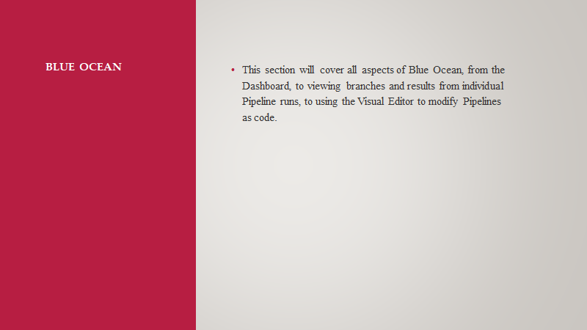

Slide 21
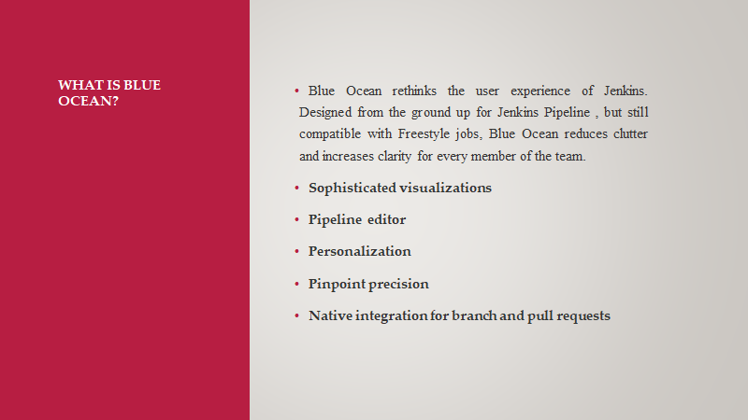

Slide 22
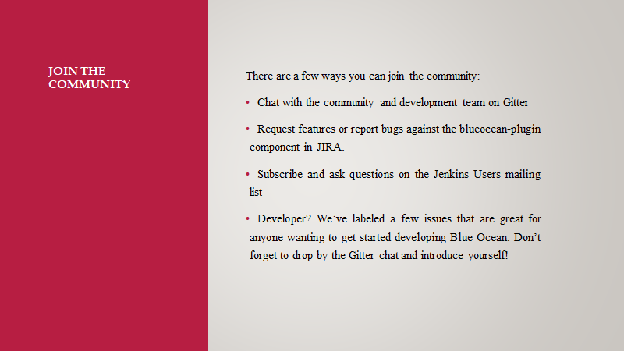

Slide 23
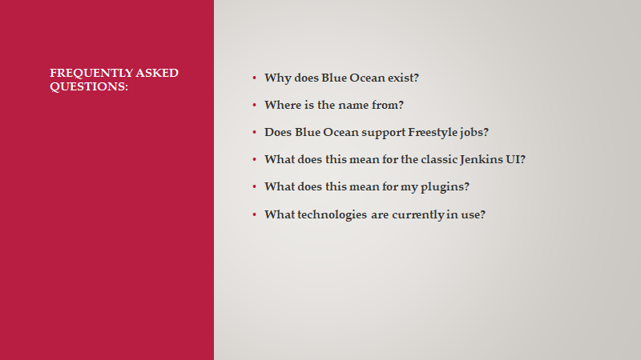

Slide 24
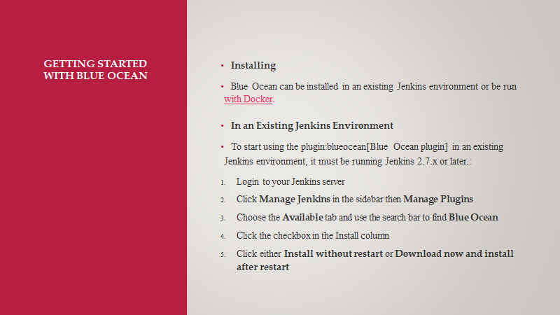

Slide 25

THANK YOU

