Slide 1
Jenkins

Slide 2

Navigation Bar
Blue Ocean uses a common Navigation bar at the top of most Blue Ocean views. It has 5 buttons :
Jenkins : Navigates to Dashboard (reload if already viewing it).
Pipelines : - Navigate to the Dashboard (do nothing if already viewing it)
Administration : Manage this Jenkins instance (using the Classic UI)
Switch to "Classic" UI : Switches to "Classic" Jenkins UI
Logout : Logout the current user and return to Jenkins login page

Slide 3
Switching to the "Classic" UI
Blue Ocean doesn't support some legacy and admin functions.
You can exit the Blue Ocean user experience by clicking on 'exit' icon (at the top of most pages).
Exiting from Blue Ocean will navigate to most relevant page in "Classic" UI.
Some links in Blue Ocean will also navigate to "Classic" UI like Administration.

Slide 4
Creating pipelines
It's very easy to create Pipelines in Jenkins using Blue Ocean.
Pipelines can be created from existing Jenkinsfile or from new Jenkinsfile created with Blue Ocean Pipeline Editor.
The workflow guides users throughout the process and the steps are very easy to understand.

Slide 5
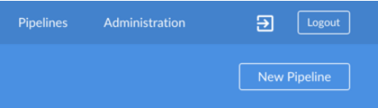
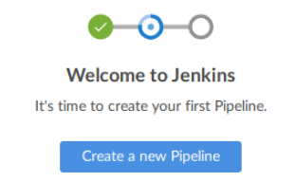
Starting Pipeline Creation
At the top of the Blue Ocean Dashboard, there is a "New Pipeline" button that will launch the Pipeline Creation workflow.
On a new Jenkin instance, if the Dashboard is empty, Blue Ocean will display a message to "Create a New Pipeline".

Slide 6
Creating a pipeline From a git repository
To create a Pipeline from a Git repository, select Git as the Source Control system.
Enter the URL for the Git Repository and select optionally select which credentials to use.
If desired credentials are not in dropdown, they can be added using the "Add" button.
Now click "Create Pipeline". Blue Ocean will look at all branches for the selected repository.
It will start a Pipeline run for each branch containing a Jenkinsfile.

Slide 7
Creating Pipelines from a gitHUB repository
To create a Pipeline from Github, select Github as the Source Control system.
If this is the first time Pipeline Creation has been run, Blue Ocean will ask for a Github Access Token
If the access token is not created already, click on the link and create selecting all appropriate permissions.
All repositories on Github are grouped by an user or organization, so when we create Pipelines Blue Ocean mirrors the same structure.

Slide 8
Creating Pipelines from a gitHUB repository
Blue Ocean offers two styles of Pipeline creation.
Single pipeline :
Selecting "New Pipeline" allows suer select and create for a single repository.
After selecting a repository Blue Ocean will scan all the branches and will create a pipeline for all branches containing Jenkinsfile in root folder.
If there are no Jenkinsfile in any branch, It will offer "Create a New Pipeline" for that repository.
Auto Discover Pipelines :
Selecting this scans all repositories belongs to the selected owner and will create a pipeline for each branch containing Jenkinsfile in the root folder.
This is useful for adding Pipelines for repositories in an organization, repositories that do not have Jenkinsfile are ignored.
Repositories that do not have a Jenkinsfile, use the "New Pipeline: option instead.

Slide 9
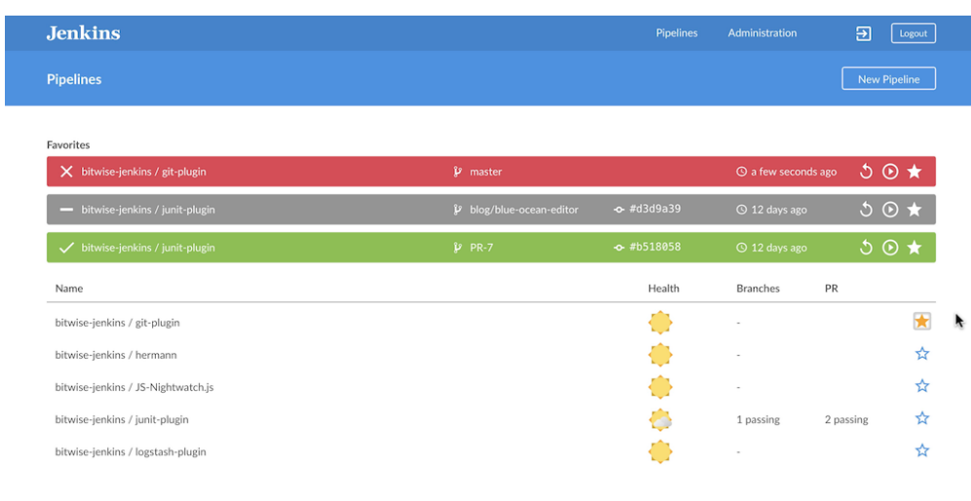
Dashboard
The Blue Ocean Dashboard shows an overview of all Pipelines on a Jenkins instance. The Dashboard is the default view shown when you open Blue Ocean. It consists of a Navigation bar at the top, a Favorites list, and a Pipelines list.

Slide 10
Navigation Bar
The Dashboard includes the standard navigation bar at the top, with a local navigation bar below that. The local navigation bar includes only one button:
• New Pipeline - Open the Pipeline Creation workflow

Slide 11
Favorites
The "Favorites" list is displayed above the regular Pipelines list.
The "Favorites" list shows the status and other key details about the latest Run for branches or pull requests that include items that are important to the current user.
Blue Ocean automatically adds branches or pull requests to this list when a they contain a Run that has changes authored by the current user.
Users can also manually remove items from their favorites by clicking on the solid star " " in this list.
Clicking on an item in the Favorites list will bring up the Pipeline Run Details for latest Run in that branch or pull request.

Slide 12
Pipelines
The "Piplines" list shows the overall state of each Pipeline in this Jenkins instance
It includes the health of the pipeline, counts of branches and pull requests that are passing or failing, and a star (either solid " " or outline " ") indicating whether the default branch for this Pipeline has been manually added to this user’s Favorites.
Clicking on the star will toggle whether the default branch for that Pipeline is shown in the "Favorites" list for this user.

Slide 13
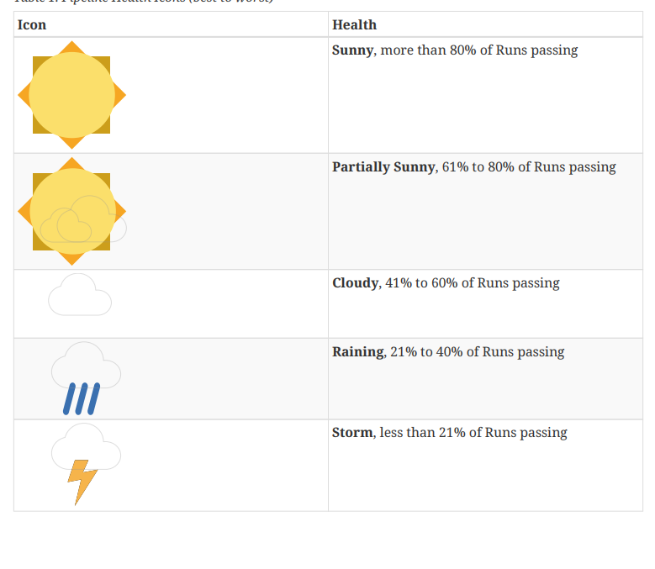
Health Icons
Blue Ocean represents the overall health of a Pipeline or Pipeline branch using weather icons.

Slide 14
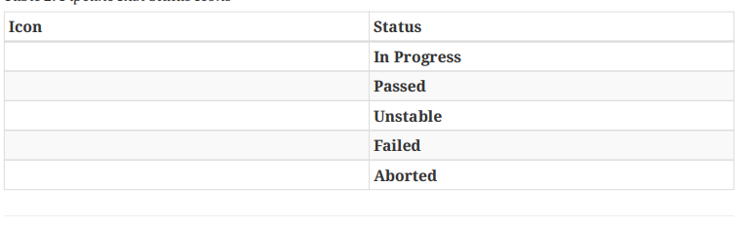
Pipeline Run Status
Blue Ocean represents Run Status using a consistent set of icons throughout.

Slide 15

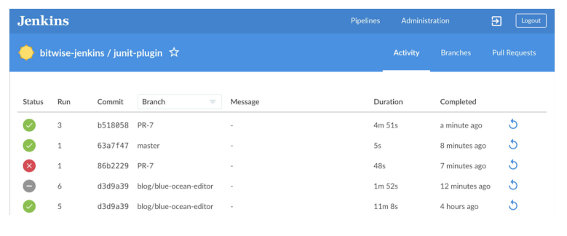
Activity View
The Blue Ocean Activity View shows the all activity related to one Pipeline

Slide 16
Navigation Bar
It includes:
Pipeline Name - Clicking on this displays the default activity tab
Favorites Toggle - Clicking the "Favorite" symbol (a star outline " ") adds a branch to the favorites list shown on the Dashboard’s "Favorites" list for this user.
Tabs (Activity, Branches, Pull Requests) - Clicking one of these will display that tab of the Activity View.

Slide 17
Activity
The "Activity" tab, shows a list of the latest completed or in-progress Runs.
Each line in the list shows the status of the Run, id number, commit information, duration, and when the run completed.
RUN- Show pipeline run details
STOP- Aborts the ‘in progress’ runs
RE-RUN- reruns the runs that have completed
To filter the run list we should filter from the branches dropdown from headers.
This Activity list does not allow runs to be edited or marked as favorites. Those actions can be done from the "branches" tab.

Slide 18
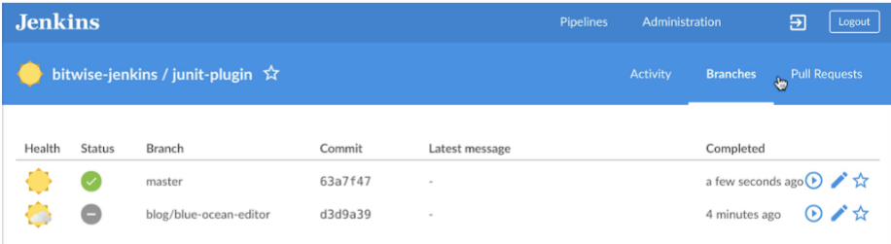
BRANCHES
The "Branches" tab shows a list of all branches that have a completed or in-progress Runs in the current Pipeline.
Displays overall health of the branch based on recent runs, status of the most recent run, id number, commit information, duration, and when the run completed.
BRANCH-list pipeline run details
PLAY – re runs the pipeline again
EDIT- Pipeline editor
STAR- add to favorites
STOP-aborts the inprogress runs

Slide 19
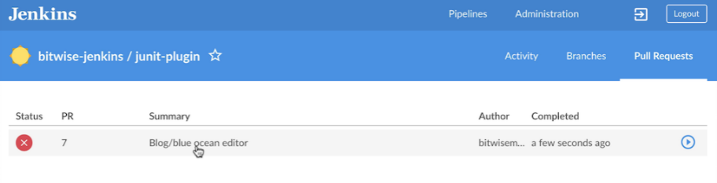
PULL REQUESTS
The "Pull Requests" tab shows a list of all Pull Requests for the current Pipeline that have acompleted or in-progress Run.
It shows the status of the most recent run, id number, commit information, duration, and when the run completed.
Pull request do not display "Health Icons" and cannot be edited or marked as favorites.
By default, when a Pull Request is closed, Jenkins will remove the Pipeline fromJenkins (to be cleaned up at a later date), and runs for that Pull Request will notlonger be accessible from Jenkins. That can be changed by changing theconfiguration of the underlying Multi-branch Pipeline job.

Slide 20
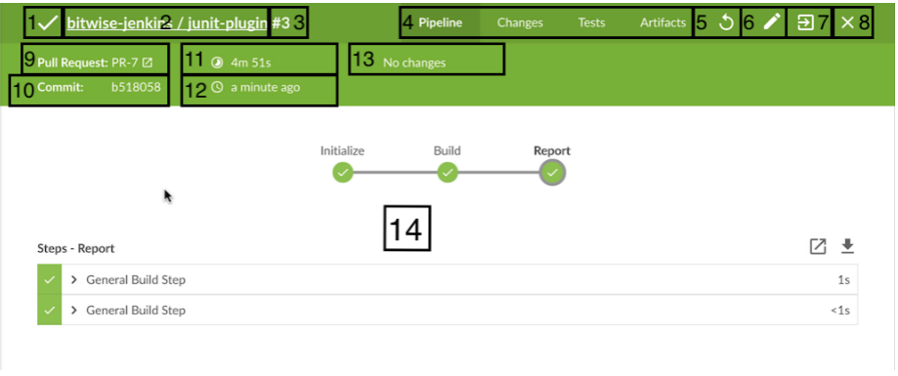
PIPELINE RUN DETAILS VIEW
Pipeline Run Status: Pipeline Run by changing the color of thetop menu bar to match the status: blue for "In progress", green for "Passed", yellow for "Unstable",red for "Failed", and gray for "Aborted".

Slide 21
Special Cases: Blue Ocean is optimized for working with Pipelines in Source Control, but it can display details for other kinds of projects as well. Blue Ocean offers the same tabs for all supported projects types, but those tabs may display different information.
Pipelines outside of Source Control: For Pipelines that are not based on Source Control, Blue Ocean still shows the "Commit Id", "Branch", and "Changes", but those fields are left blank. In this case, the top menu bar does not include the "Edit" option.
Freestyle Projects: For Freestyle projects, Blue Ocean still offers the same tabs, but the Pipeline tab only shows the console log output. The "Rerun" or "Edit" options are also not shown in the top menu bar.
Matrix projects: Matrix projects are not supported in Blue Ocean. Viewing a Matrix project will redirect to the"Classic UI" view for that project.

Slide 22
Pipeline run TaBS
Pipeline
Changes
Tests
Artifacts

Slide 23
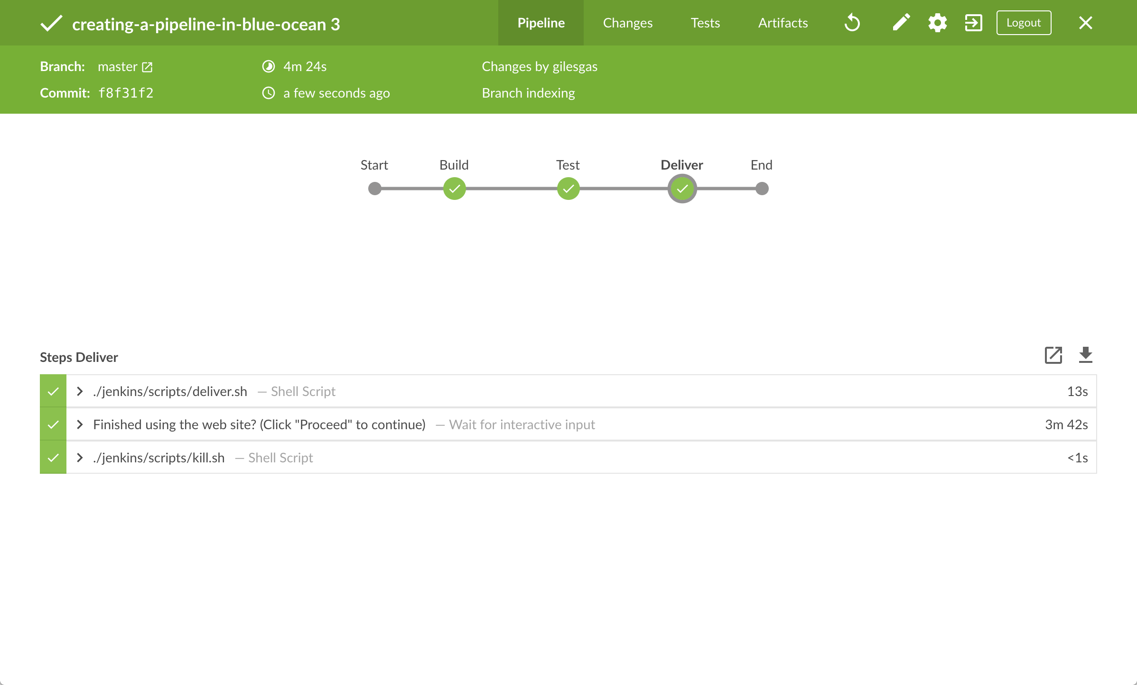
Pipeline
This is the default tab and gives an overall flow of this Pipeline Run. It shows each stage and parallel branch, the steps in those stages, and the console output from those steps.
The overview image shows a successful Pipeline run.
If a particular step during the run fails, this tab will automatically displayed showing the console log from the failed step. The image shows a failed Run.

Slide 24
CHANGES
The Changes tab displays the information of any changes made between the most recently completed and current runs. This includes the commit id for the change, change author, message, and date completed.

Slide 25
Tests
The Tests tab shows information about test results for this run. This tab only contains information of pipeline run tests
If all tests pass, this tab will report the total number of passing tests. If there are failures, the tab will display log details from the failures.
If all the test cases are passed then this tab is displayed

Slide 26
Artifacts
The "Artifacts" tabs show a list of any artifacts saved using the "Archive Artifacts" (archive) step. Clicking on a item in the list will download it.
The full output log from the Run can be downloaded from this list.

Slide 27
Pipeline Editor
The Blue Ocean Pipeline Editor is the simplest way for anyone to get started with creating Pipelines in Jenkins.
The editor allows users to create and edit Declarative Pipelines, add stages and parallelized tasks that can run at the same time, depending on their needs.
When finished, the editor saves the Pipeline to a source code repository as a Jenkinsfile.

Slide 28
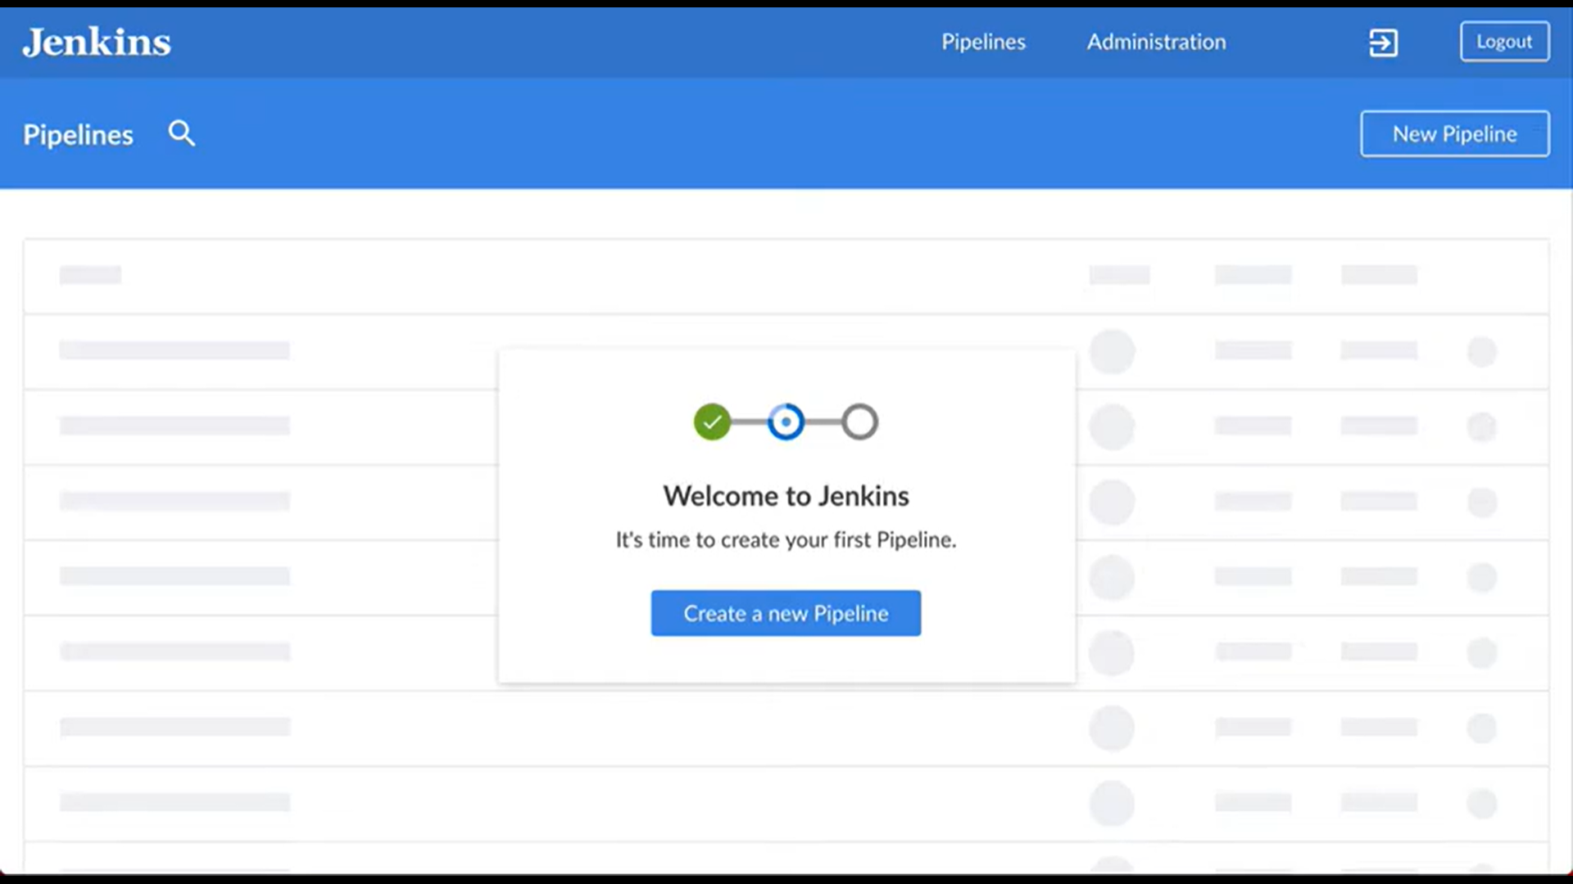
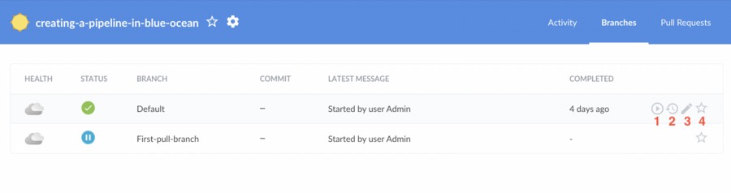
Starting the editor
To use the editor, a user must first create a Pipeline in Blue Ocean or have at least one existing Pipeline in Jenkins. If editing an existing Pipeline, the credentials for that Pipeline must allow pushing changes to the target repository.
The editor can be launched through the:
1.New Pipeline option from the Blue Ocean dashboard.
2.Branches tab within the Activity view.
3.Edit () in the Pipeline run details view.

Slide 29
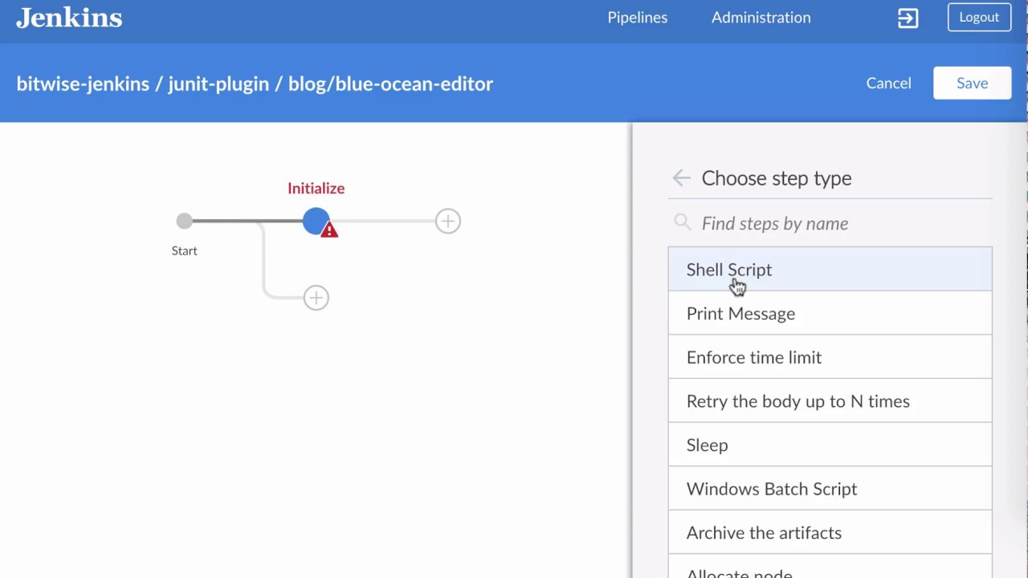
Navigation bar
The Pipeline Editor includes the standard navigation bar at the top, with a local navigation bar below that. The local navigation bar includes:
1.Pipeline Name
2. Cancel - Discard changes made to the pipeline.
3. Save - Open the Save Pipeline Dialog.

Slide 30
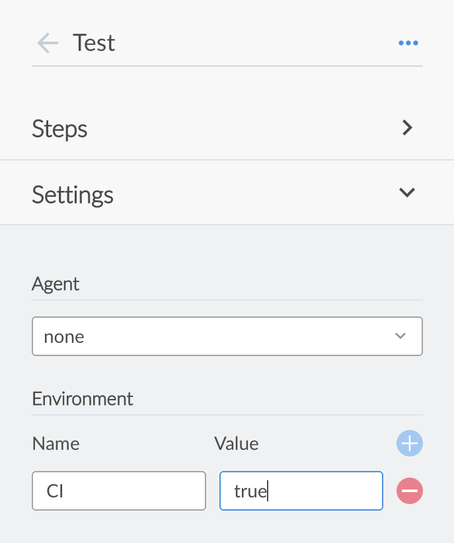
PIPELINE SETTINGS
By default, the pane on the right side of the editor displays the Pipeline Settings and there are two sections that are configurable.
1.AGENT
The Agent section controls which agent the Pipeline uses. This performs the same process as the agent directive.
2.ENVIRONMENT
The Environment section allows users to configure environment variables for the Pipeline. This is the same process as the environment directive.

Slide 31

Thank you

