Slide 1
Analysing and Building models for Predicting Attrition

Slide 2
Contributions (GROUP - 129)
Group No | Name | Student Email id | % Contribution
129 | Ashique Zzaman | 2021SC04612@wilp.bits-pilani.ac.in | Equal (100%)
129 | Mohan V | 2021SC04611@wilp.bits-pilani.ac.in | Equal (100%)
129 | Dharamkriti Kumar | 2021SC04613@wilp.bits-pilani.ac.in | Equal (100%)

Slide 3
Agenda

Slide 4
Agenda
Context
Exploratory analysis
Data Pre-processing
Feature engineering
Feature selection
Top features (Feature Importance)
Classification (using chosen models)
Compare performance of the classifiers
Conclusions/results (Important findings)

Slide 5
Context

Slide 6
Context
Attrition is the departure of employees from the organization for any reason (voluntary or involuntary), including resignation, termination, death or retirement
Employee attrition can be voluntary or involuntary reasons
Predicting attrition would help prevent and even plan replacement
Analysis could also help discover internal reasons that reduce employee productivity or even lead to exit
Objective: In the attached NoteBook our aim will be to analyze the datasets completely with respect to each feature and find the key features help root reason behind Attrition of Employees and also build a model

Slide 7
Approach
Exploratory analysis
Feature engineering and selection
Modelling to classification problem
Random Forest Classification
XGBoost
Hypertuning
Randomized Search CV
Comparison of models
Deriving Insights and Prediction

Slide 8
Exploratory Analysis

Slide 9
Observations – Initial Steps
The CSV file has features such as age, attrition, business travel, department (33 columns)
There are 2 columns with empty values (Date_of_termination, Unnamed: 32)
Employees left: 237; Employees remaining: 1233

Slide 10
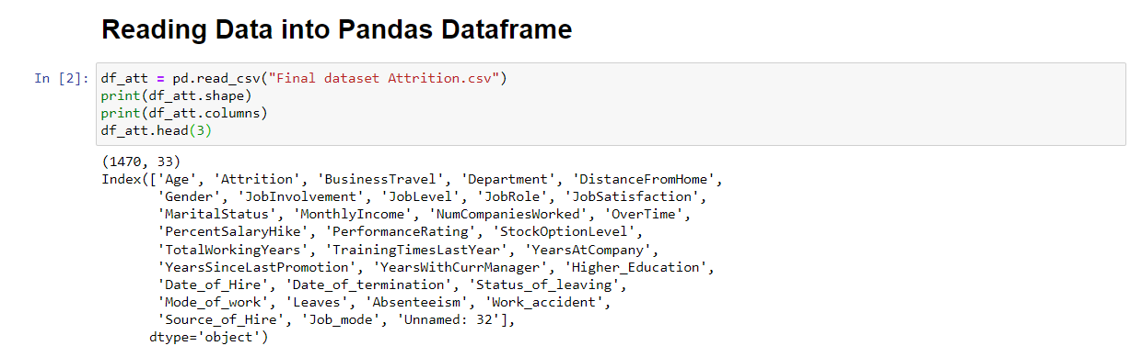
Observations – Data Load

Slide 11
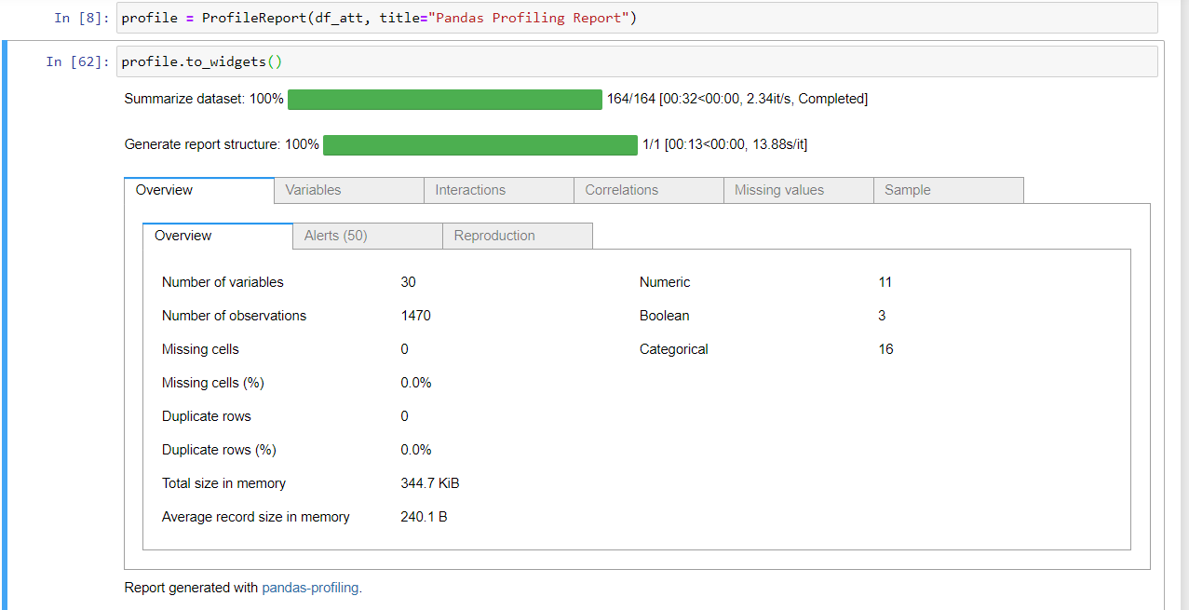
Observations - Profiling

Slide 12
Observations – Describing data
We only have int, string and float data types features. But the columns with float datatype are null fields, hence dropped the columns.
17 features are numerical and 14 features are categorical
Attrition in out target value which has no missing value. But, the quantity of data of emp having Attrition is less compared to employees which do not have Attrition.
It's very good that we are having a complete dataset, there is no any missing values in dataset.

Slide 13
Observations – EDA
The employees are more who travel very rare, and the number of Attrition of such employees are more
Employees working in R&D department are more
Males are more under Attrition then Females

Slide 14
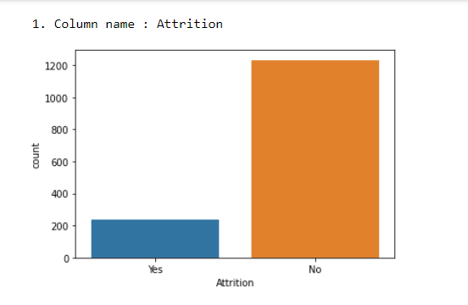
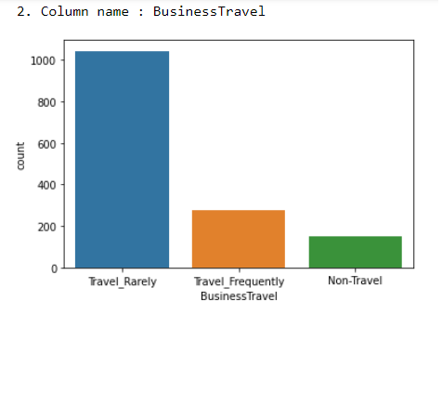
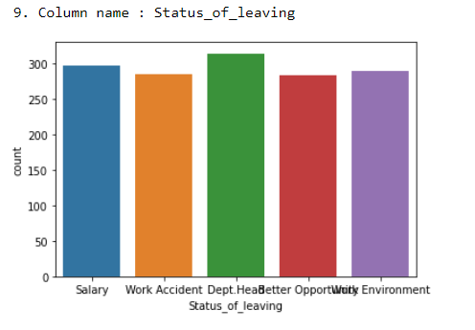
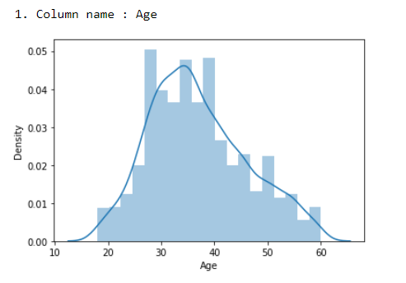
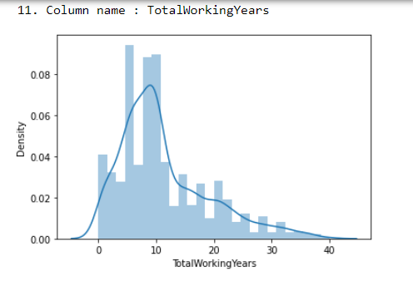
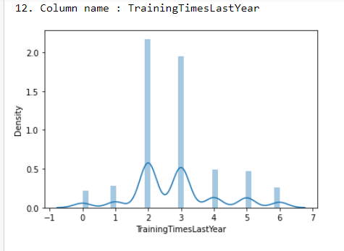
Observations – EDA (Univariate)

Slide 15
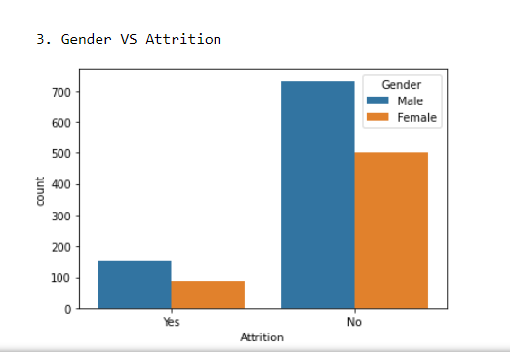
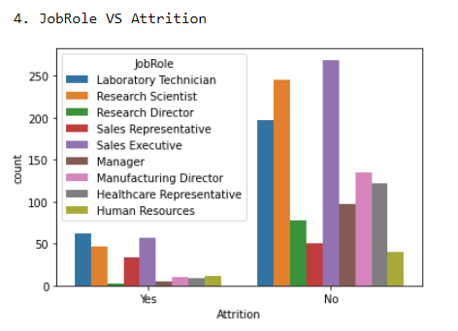
Observations – EDA (Bivariate)

Slide 16
Data Preprocessing

Slide 17
Data Preprocessing
Data checked for unique enumeration and non zero values
Data checked for relevant information for each field
There are 2 columns with empty values (Date_of_termination, Unnamed: 32), those are dropped. 1 column has high cardinality (Date_of_Hire) which is also dropped

Slide 18
Feature Engineering

Slide 19
Feature Engineering - Methods
EDA (Univariate analysis, Bivariate analysis)
Scaling numeric data
Encoding categorical data
Label Encoding
Solving Class Imbalance

Slide 20
Feature Engineering - Observations
Most employees are post grads, followed by grads
There are more male employees
Most employees are married
Most of the workforce in sales, R&D and lab technicians
More employees work from home
Few employees work overtime

Slide 21
Feature Selection

Slide 22
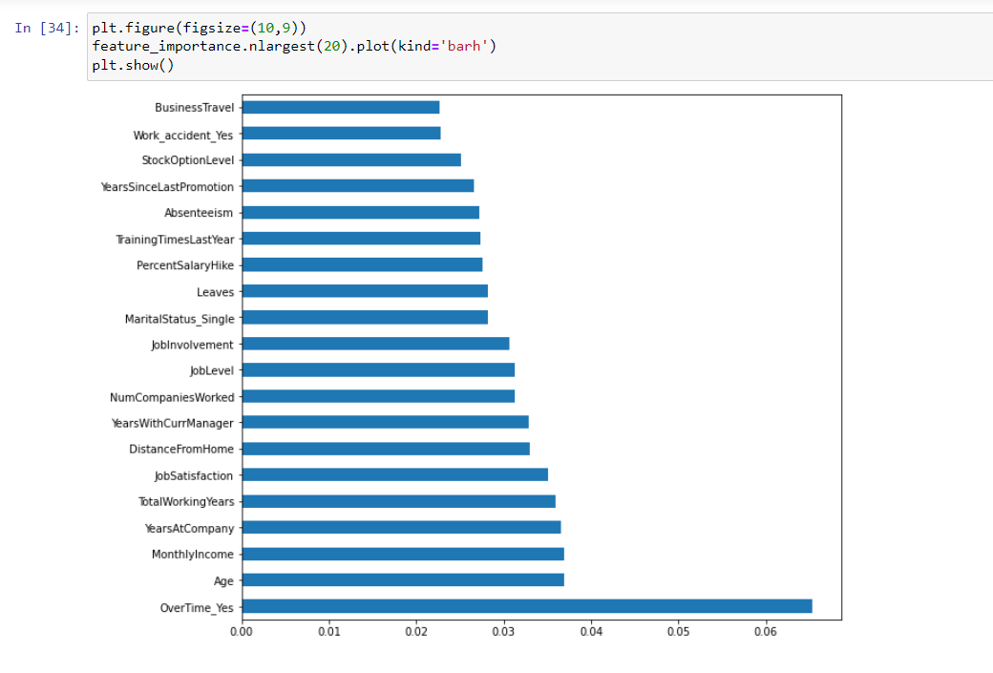
Feature Importance

Slide 23
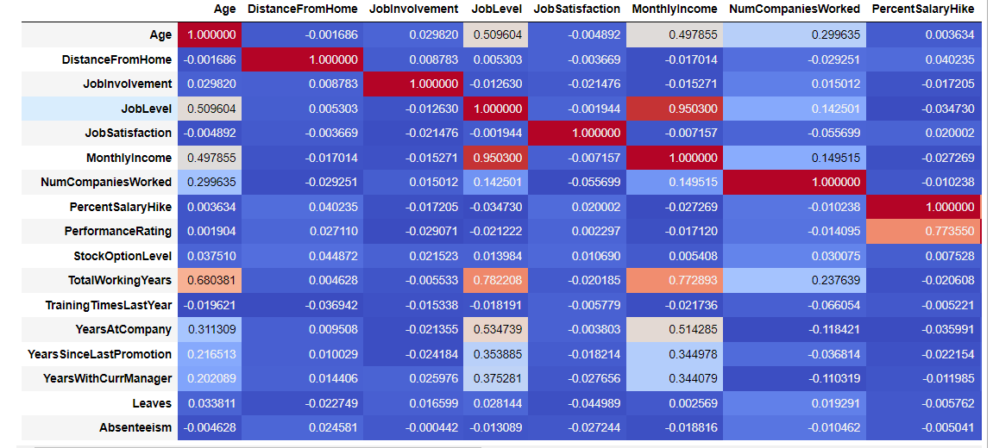
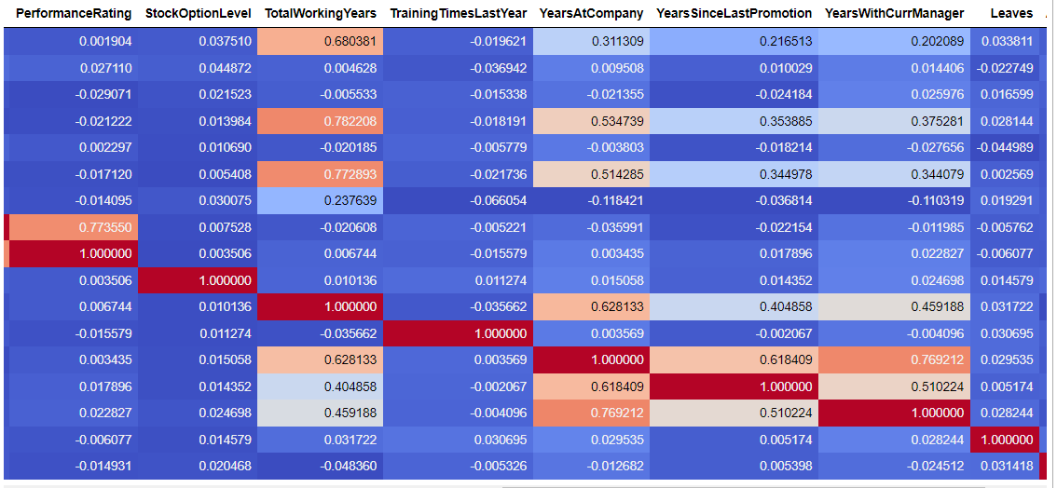
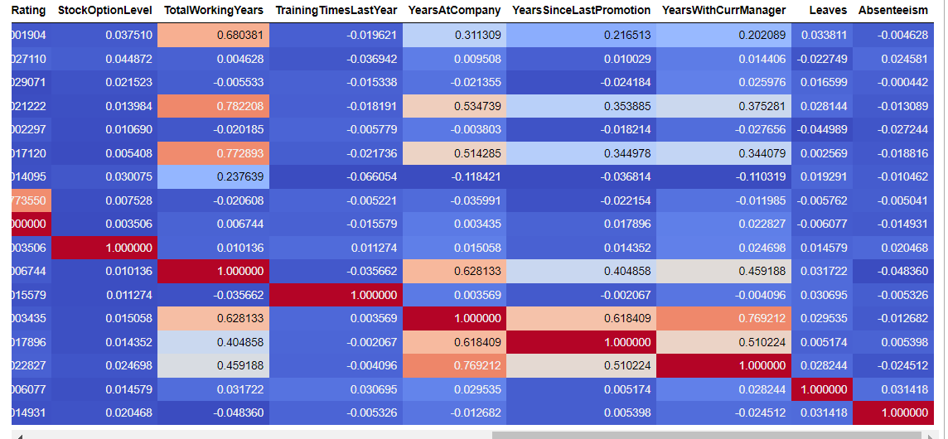
Correlation

Slide 24
Classification (models)

Slide 25
Modelling to classification problem
Random Forest Classifier
XGBoost Classifier
SVC
K Neighbors Classifier
Decision Tree Classifier
Hyperparameter tuning – Random Forest Classifier
Hyperparameter tuning – XgBoost Classifier
Randomized Search CV – Classifier

Slide 26
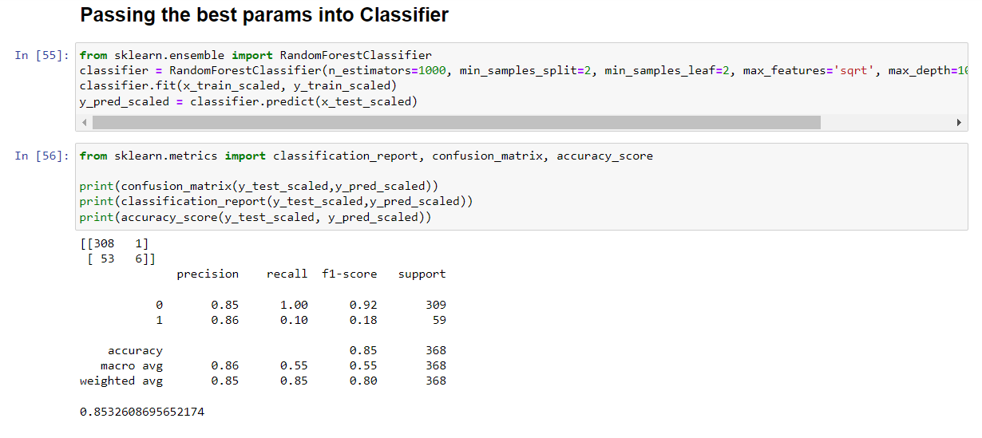
Random Forest Classification (Hyperparameter tuning)

Slide 27
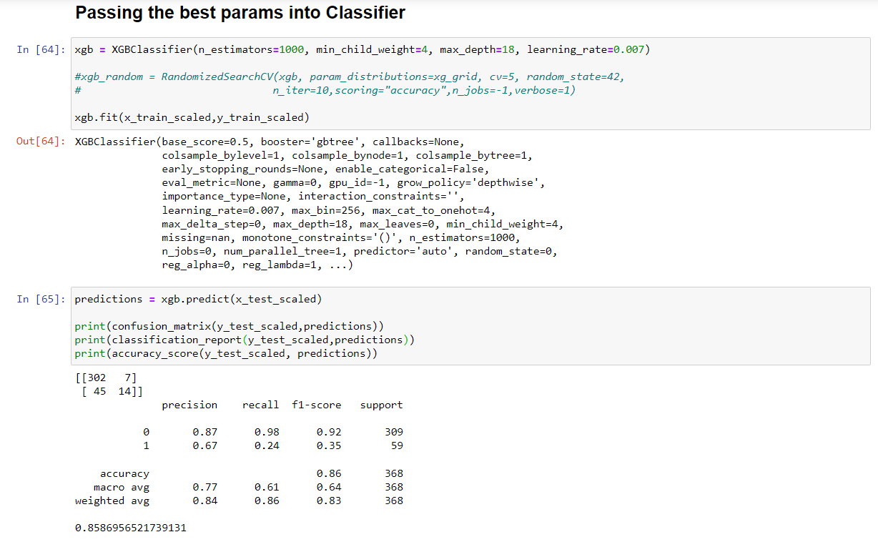
XgBoosting (Hyperparameter tuning)

Slide 28
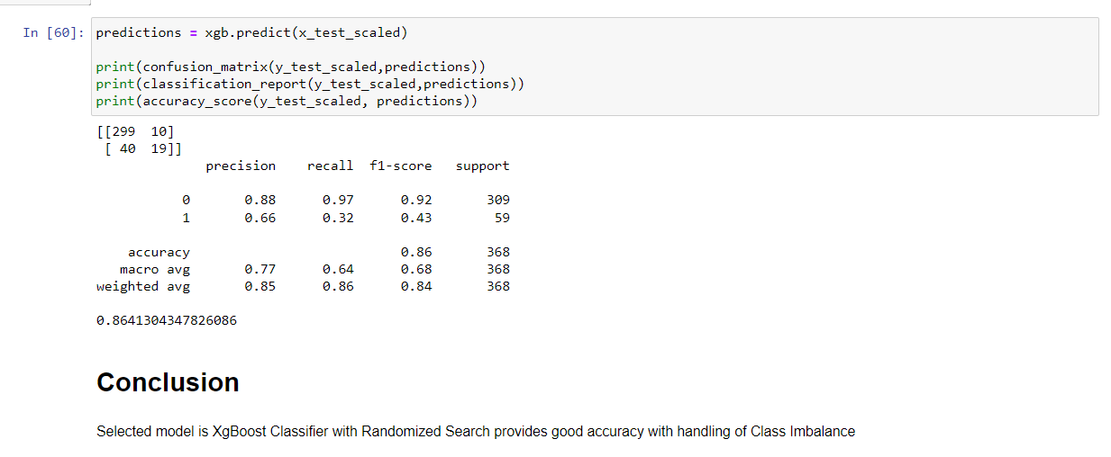
XgBoosting (RandomizedSearchCV)

Slide 29
Conclusion
Selected model is XgBoost Classifier with Randomized Search provides good accuracy with handling of Class Imbalance

