Slide 1
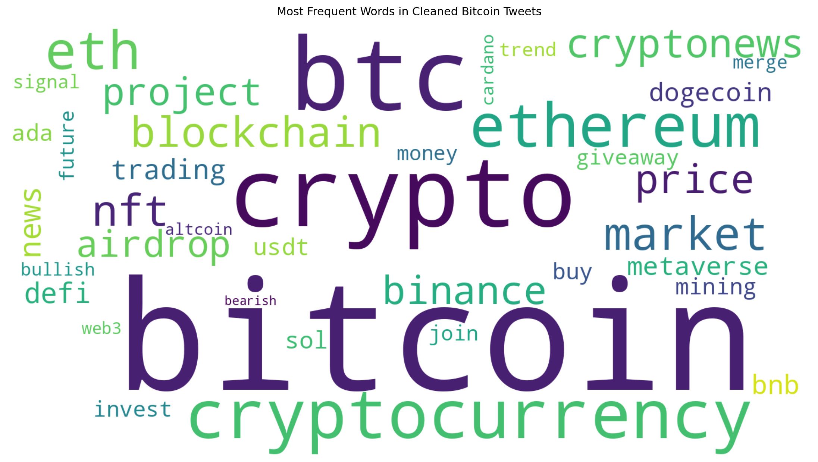
EDAB2724 · ASSIGNMENT 3
Topic Modelling
of Bitcoin Tweets
What was the Bitcoin conversation actually about — and how did the themes move through the evening?
50,000 tweets
6 themes
NMF · k = 6
GROUP 1
Mothae Ntoi · Katleho Rathaba · Oratile Moletsane
Ashley Ashirai Hlatshwayo · Mapitso Nyapholi · Pascal Jr Bessong
Source: Group 7 notebook
Notes:
Opening: Each speaker says their own name. Introduce the problem: 50,000 unlabeled Bitcoin tweets, and the goal was to discover the dominant themes without reading every post.

Slide 2
02 · BUSINESS CONTEXT
Why this matters for business
Topic modelling compresses a noisy social feed into a small number of interpretable themes.
01
02
03
LISTEN AT SCALE
SEPARATE SIGNAL FROM ECHO
WATCH THE CLOCK
A business cannot read 50,000 posts one by one.
Retweets, templates and promotion can exaggerate what looks like “public opinion”.
Hourly topic shares show when attention shifts — useful for monitoring and timing communications.
THE CORE IDEA
The computer finds the piles. Humans decide what the piles mean.
Topic labels are model-derived themes — not ground-truth classes.
Source: assignment brief + Group 7 notebook
Notes:
Explain the business value: scale, signal-versus-echo, and timing. Emphasise that topic labels are created by interpretation after the model finds word patterns.

Slide 3
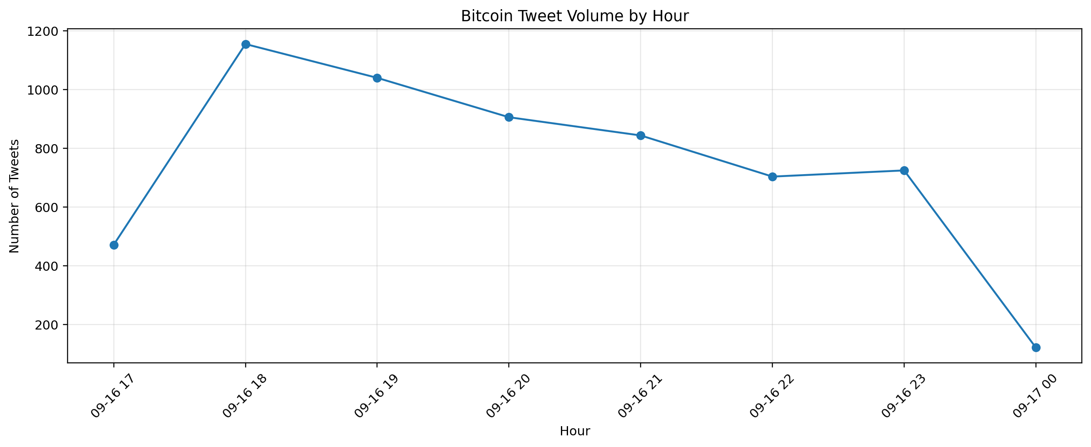
03 · THE DATA
What we started with
The raw feed is large, multilingual and dominated by reposting.
50,000
19
6.5 h
66.4%
67.8%
raw tweets
variables
observed window
retweets
English
AUDIT HIGHLIGHTS
• No missing tweet text
• No duplicate Tweet IDs
• Tweet timestamps: 17:33 → 00:04 UTC
• 564 missing language values
Peak: 18:00 UTC · 1,155 tweets
Notebook visual: Bitcoin Tweet Volume by Hour
Notes:
Give the scale first, then the audit findings. Be precise about UTC. The first and last hours are partial. Mention the 66.4% retweet share and the multilingual nature of the raw data.

Slide 4
04 · PREPROCESSING
From 50,000 tweets to 5,968
The cleaning pipeline was deliberately aggressive because repeated or non-English content would dominate the model.
50,000
RAW DATA
33,515
ENGLISH ONLY
12,985
RETWEETS REMOVED
12,048
EXACT DUPLICATES
11.9%
11,867
OFFENSIVE CONTENT
of raw tweets remained
11,430
< 3 USEFUL WORDS
−5,462
PREPROCESSING CHOICE
Keep hashtags as signals.
Remove URLs / @mentions.
Lemmatise for readable topics.
5,968
NEAR-DUPLICATES
Source: Group 7 preprocessing output
Notes:
Walk down the funnel. Explain that the shrinkage is intentional: English-only, retweet removal, duplicates, offensive content, very short texts, and near-duplicates. The purpose is to stop repeated templates from becoming “topics”.

Slide 5
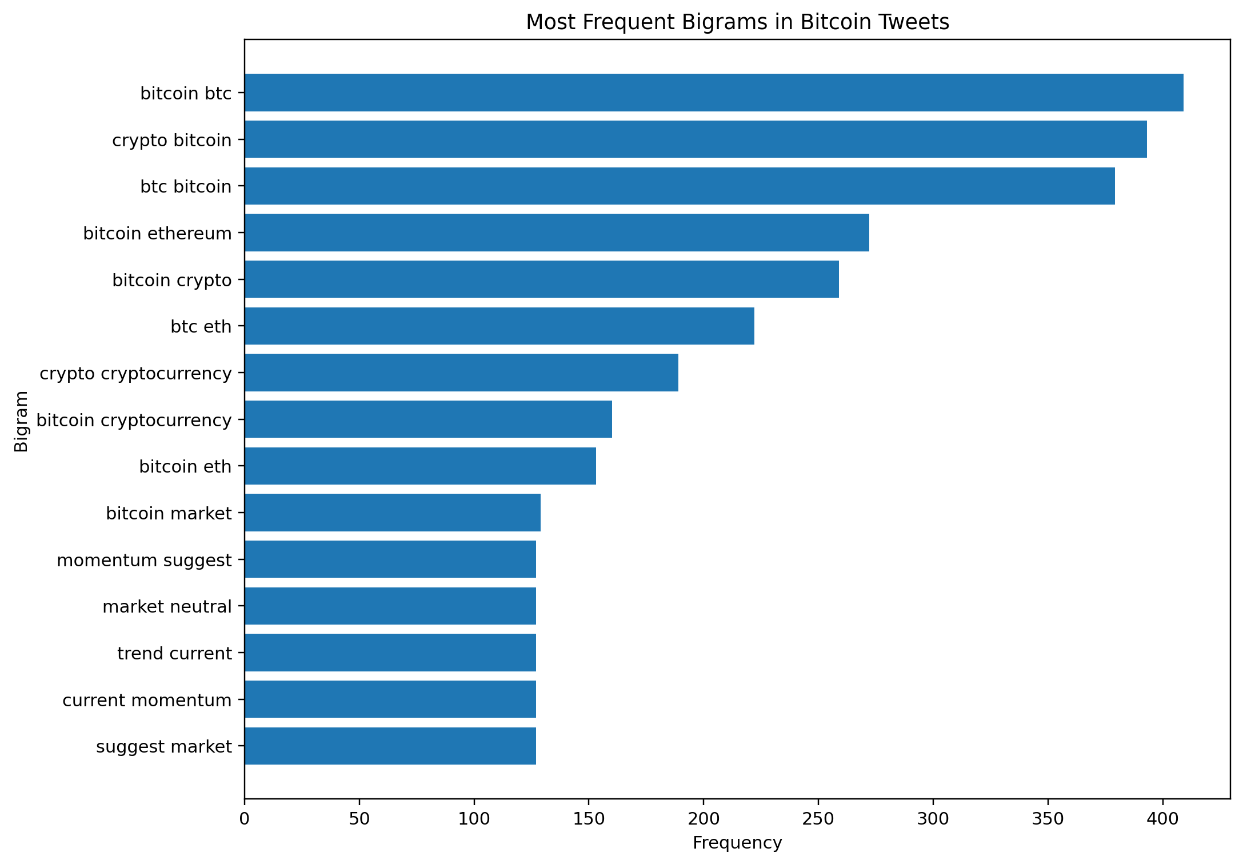
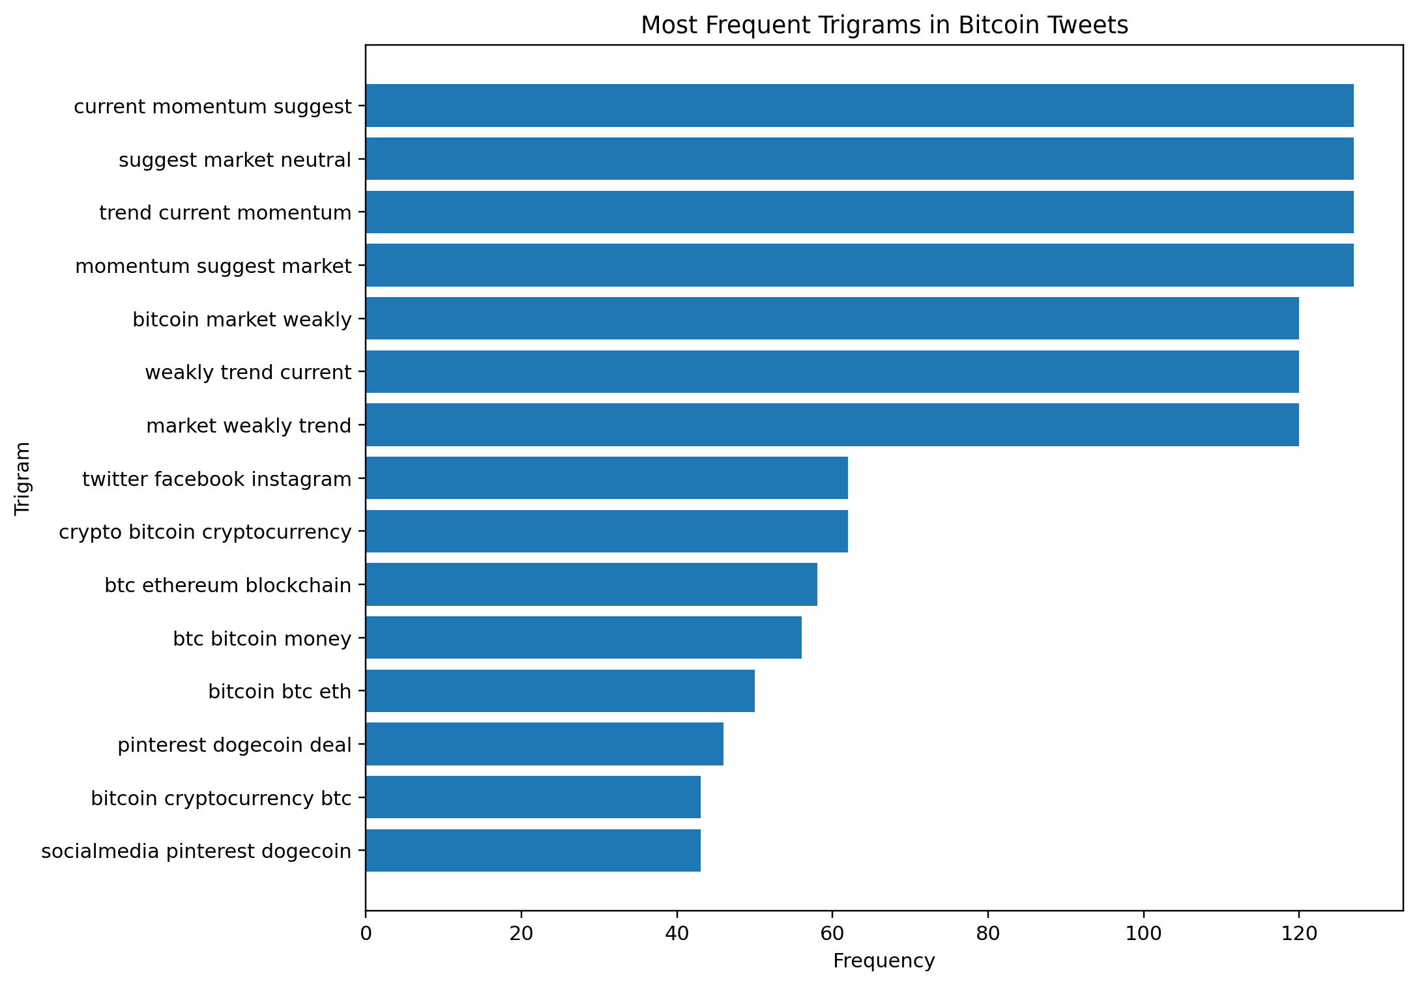
05 · EXPLORATION
What the cleaned tweets look like
The cleaned corpus still reads like crypto — but the repeated noise is reduced.
MOST FREQUENT WORDS
MEANINGFUL BIGRAMS
MEANINGFUL TRIGRAMS
Bitcoin remains central; Ethereum, NFTs, trading, blockchain and promotion are visible in the vocabulary.
“twitter facebook instagram” = 62× · “btc ethereum blockchain” = 58×
Notebook visuals: word cloud + bigrams + trigrams
Notes:
Use the visuals to show that the cleaned corpus contains a broad crypto vocabulary. The bigrams/trigrams add context: “twitter facebook instagram” points to social-media promotion, while “btc ethereum blockchain” shows the discussion extending beyond Bitcoin.

Slide 6
06 · REPRESENTATION + MODELLING
How we found the themes
Two numerical views of the same cleaned text were used to compare two topic-model families.
SAME CLEANED CORPUS
HOW WE JUDGED THEM
COUNTVECTORIZER
TF–IDF
01
Coherence
word counts → LDA
distinctiveness → NMF
Do the top words occur together?
02
Diversity
Are topic word lists actually different?
k = 4 · 5 · 6 · 7 · 8
5 model sizes
2 methods
03
Human interpretability
Can a person name the theme clearly?
Seed = 42 for the model comparison
Source: Group 7 notebook methodology
Notes:
Explain the two matrices simply: counts for LDA and TF-IDF for NMF. Each method was run at five topic counts: 4 through 8. We used coherence, diversity and human interpretability rather than one metric alone.

Slide 7
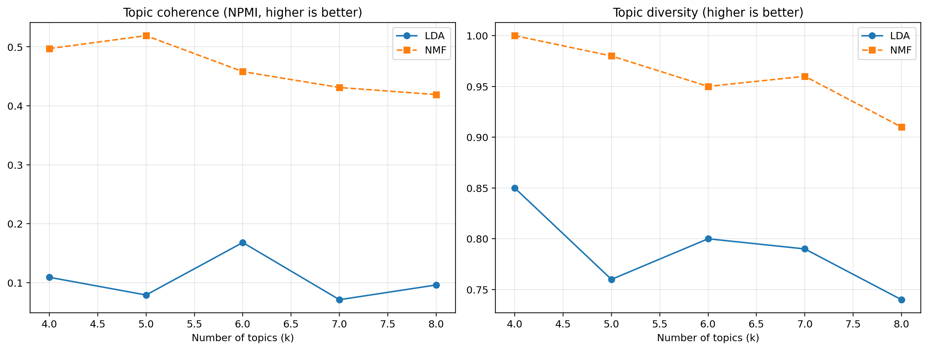
07 · MODEL COMPARISON
Which method we trusted
NMF produced clearer, more distinct and much more stable topic assignments than LDA.
FINAL CHOICE
NMF · k = 6
0.458
NPMI coherence
0.95
topic diversity
39.5%
largest topic
0.90
agreement on re-run
NMF k=4/5 excluded: 67.5% / 66.4% in one topic
Stability: agreement 0.90 vs 0.12
Human score shown = value currently entered in the notebook.
Notebook visual: coherence + diversity by k
Notes:
Lead with the choice, then the evidence. NMF k=4 and k=5 looked strong on paper but one topic absorbed about two-thirds of tweets. NMF k=6 balanced quality and separation. On rerun, NMF had an agreement score of about 0.90 versus 0.12 for LDA.

Slide 8
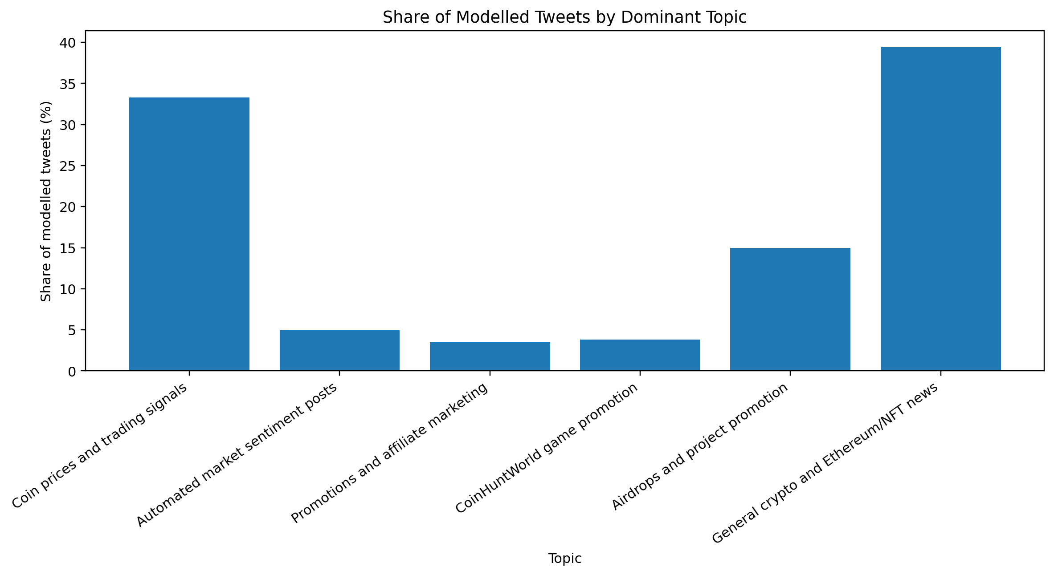
08 · RESULTS
The six themes
The labels below are our human interpretation of the model’s keyword patterns and examples.
39.5%
33.3%
General crypto and Ethereum/NFT news
Coin prices and trading signals
15.0%
4.9%
Airdrops and project promotion
Automated market sentiment posts
3.8%
3.5%
CoinHuntWorld game promotion
Promotions and affiliate marketing
Big picture
About 73% of modelled tweets sit in two broad themes: wider crypto news and prices/trading.
Notebook visual: share of modelled tweets by dominant topic
Notes:
Introduce the two largest themes first. Then the smaller promotional/automation themes. Make clear these are model-derived labels, not ground truth.

Slide 9
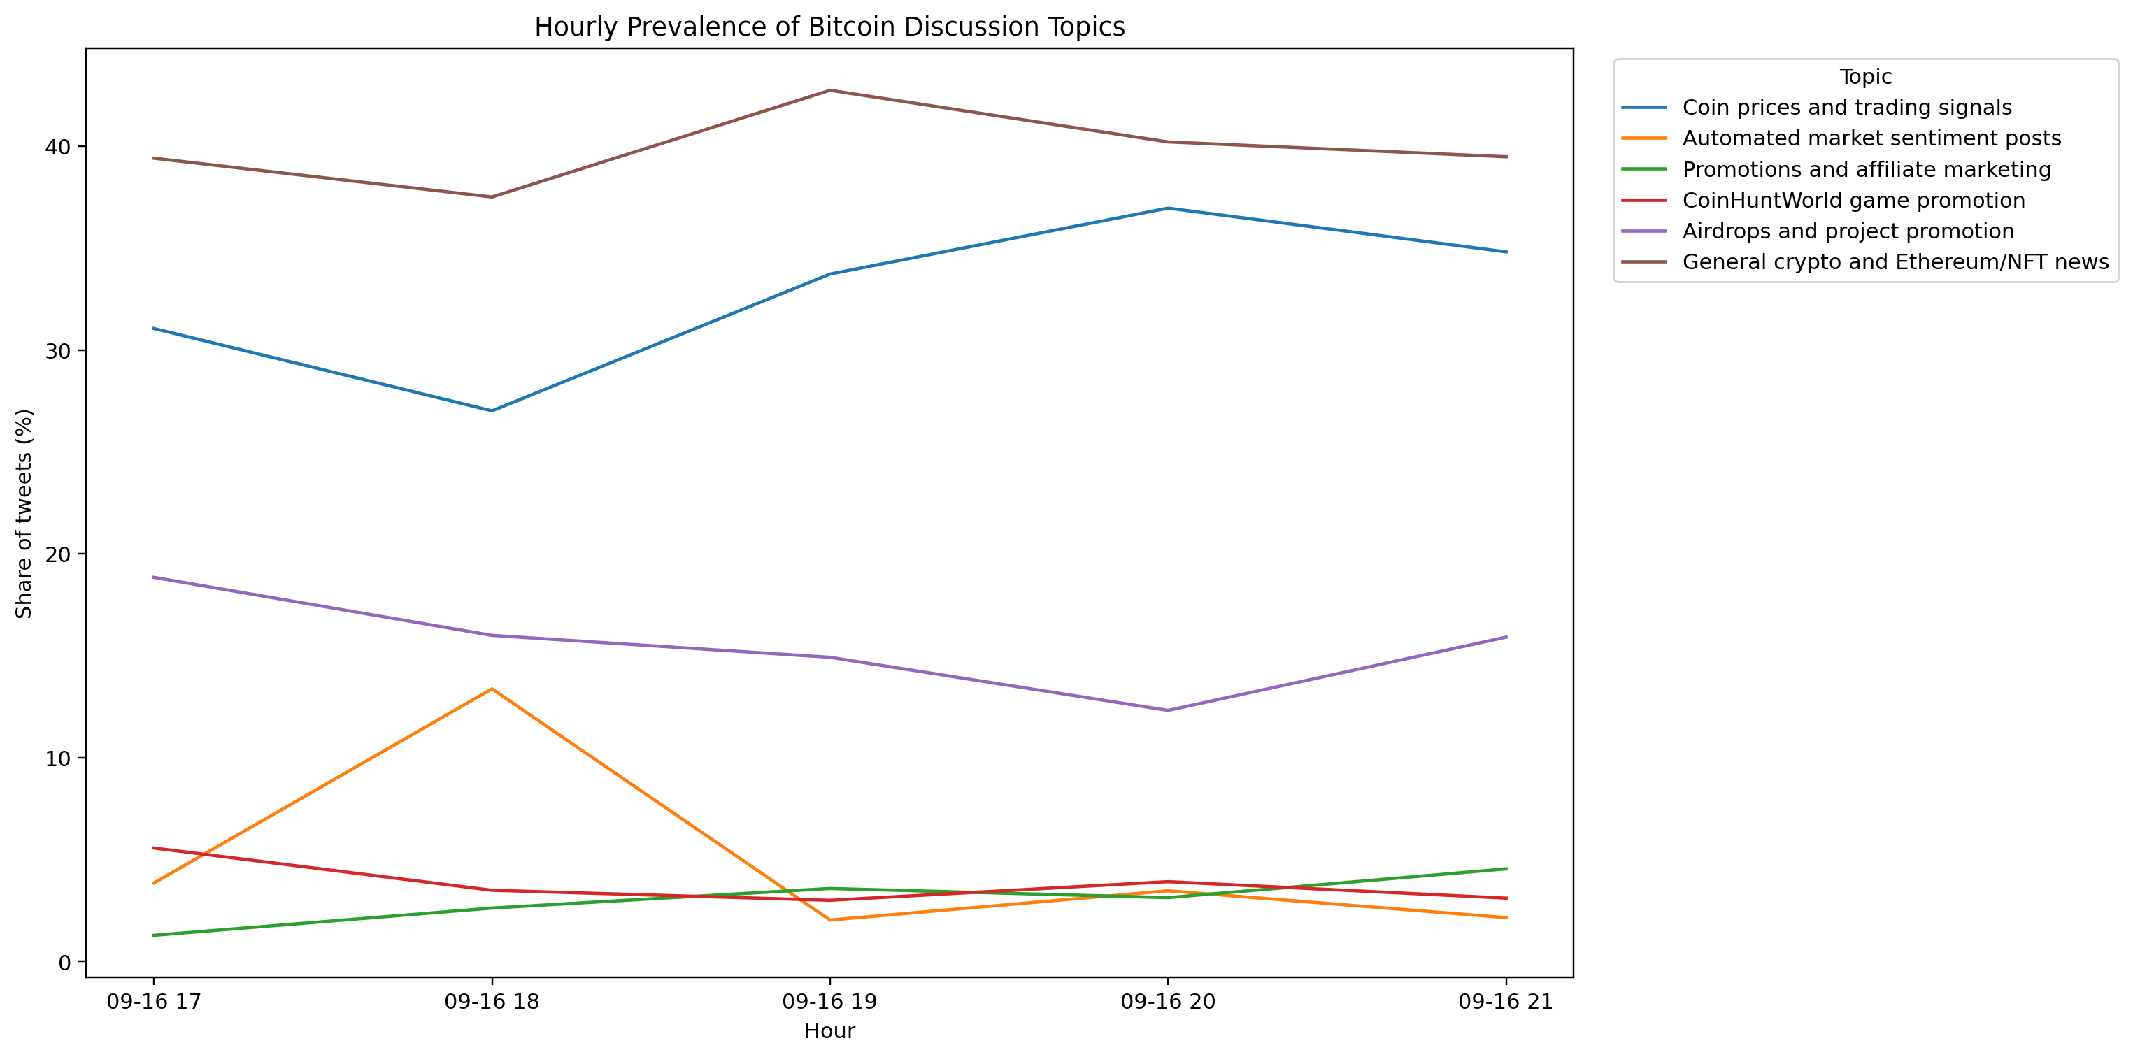
09 · TIME
How the evening unfolded
All timestamps are UTC. The first and last hours are partial; the topic chart shown is 17:00–21:00 from the notebook output.
WHAT CHANGED
NEWS
stays the steady backdrop
PRICE / TRADING
rises overall; peaks at 20:00
AIRDROPS
generally loses share
AUTOMATION
spikes at 18:00, then drops back
AFFILIATE
small, but rises to 4.5% at 21:00
18:00 UTC = 1,155 tweets · peak hour
Notebook visual: hourly topic prevalence
Notes:
Use “18:00 UTC” explicitly. The automated sentiment topic jumps from 3.9% to 13.4% at 18:00, then falls. Price/trading grows in relative share and peaks at 20:00. We do not claim to know why these changes happened.

Slide 10
10 · BUSINESS INSIGHTS
Four takeaways for business
Each takeaway separates what the model shows from what that pattern may mean.
01
Broad crypto news dominates
02
Price and trading gains share
WHAT THE MODEL SHOWS
WHAT THE MODEL SHOWS
39.5% of modelled tweets.
31.0% → 34.8% from 17:00 to 21:00; peak 37.0% at 20:00.
WHAT IT MAY MEAN
WHAT IT MAY MEAN
Monitor the wider ecosystem, not Bitcoin alone.
Market-monitoring content became relatively more prominent.
03
Airdrop promotion fades overall
04
Automation arrives in bursts
WHAT THE MODEL SHOWS
WHAT THE MODEL SHOWS
18.8% → 15.9%, with a low of 12.3% at 20:00.
3.9% → 13.4% at 18:00, then back to ~2–3.5%.
WHAT IT MAY MEAN
WHAT IT MAY MEAN
Promotional content competes with other themes as attention shifts.
Down-weight or filter bursts before interpreting “crowd sentiment”.
Source: Group 7 topic prevalence analysis
Notes:
Deliver the four takeaways briskly. Stress the difference between observed model output and interpretation. The model shows the pattern; it does not establish the cause.

Slide 11
11 · LIMITS + NEXT STEPS
Limits and next steps
Useful findings — but the evidence is bounded by the corpus, the cleaning choices and the current notebook state.
LIMITS
NEXT STEPS
• One short evening only — this is not a general Bitcoin-time pattern.
01
Replace notebook placeholder human scores with real group-average ratings.
• Topics 1–4 include repeated, templated or promotional language.
02
Export the required topic_assignments.csv before submission.
• High NMF coherence/stability may partly reflect repeated wording.
03
Include the full hourly output and update the discussion if more hours are retained.
• The model shows what was posted, not what people think.
04
Test on a longer time window to see whether the six-theme picture persists.
BOTTOM LINE
A six-theme picture emerged: broad crypto news + price/trading were the largest themes, alongside distinct promotional and automated bursts.
Source: Group 7 notebook + fix list
Notes:
Close with the limitation that this is one evening and that templated/promotional wording can make topic stability look stronger. Then give the concrete next steps: real human ratings, topic_assignments.csv, full hourly output, and a longer observation window.

