Slide 1
Accelerating evolution: Parallelisation of evolutionary algorithm on gpu
ASHIRBAD SARANGI
SC23M002

Slide 2
CONTENT
OBJECTIVE
GPU Pre-requisites
Evolutionary algorithms
PROJECT
COMPARISONs

Slide 3
OBJECTIVE
To try and implement evolutionary algorithm - ACO and compare the run time in CPU and GPU

Slide 4
GPU Pre-requisites

Slide 5
GPU Pre-requisites
GPU – Graphics Processing Unit
Fast amount of dense matrix multiplication due to parallelism
CUDA Basic Linear Algebra Subprograms
cuBLAS

Slide 6
What is cublas good for ?
Anything that uses heavy linear algebra computations (on dense matrices) can likely benefit from GPU acceleration
Graphics
Machine learning
Computer vision
Physical simulations
Finance
etc…..
cuBLAS excels in situations where the performance is needed to be maximized by batching multiple kernels using streams.
Like making many small matrix-matrix multiplications on dense matrices
cuBLAS selected column-first indexing

Slide 7
Features
All of the functions defined in cuBLAS have four versions which correspond to the four types of numbers in CUDA C
S, s : single precision (32 bit) real float
D, d : double precision (64 bit) real float
C, c : single precision (32 bit) complex float (implemented as a float2)
Z, z : double precision (64 bit) complex float
H, h : half precision (16 bit) real float
Functions used for Matrix / Vector Multiplication :
cublasSgemm → cublas S gemm
cublasHgemm
cublasDgemv → cublas D gemv

Slide 8
Array indexing
The arrays are linearized into one dimension, so we will use an indexing macro.
#define IDX2C(i,j,ld) (((j)*(ld))+(i))
Where “i” is the row, “j” is the column, and “ld” is the leading dimension.
In column major storage “ld” is the number of rows.

Slide 9
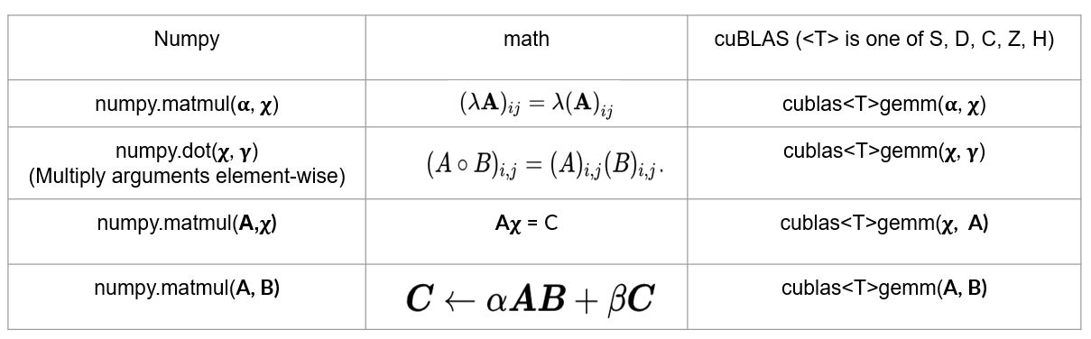
Numpy vs cublas

Slide 10
Evolutionary algorithms

Slide 11
EVOLUTIONARY ALGORITHMS
Evolutionary Algorithms (EAs) are a family of optimization algorithms inspired by the process of natural selection. They are used to find approximate solutions to optimization and search problems.
Key Concepts :
Natural Selection:
Mimics the process of natural selection where individuals with favorable traits are more likely to survive and reproduce.
Population:
Solutions are represented as individuals in a population. Multiple solutions coexist and evolve over generations.
Crossover and Mutation:
Individuals undergo genetic operations like crossover (recombination) and mutation to create new offspring.
Fitness Function:
Measures the quality of an individual. Individuals with higher fitness values are more likely to contribute to the next generation.

Slide 12
Ant colony optimisation
Initialize pheromone levels
Repeat for a fixed number of iterations or until a convergence criterion is met:
Place ants at the starting point
For each ant:
Construct a solution by probabilistically selecting components
Update pheromone levels based on the constructed solutions
Evaporate pheromones

Slide 13
PROJECT

Slide 14
AIM
To try to find out a path that touches important cities of India using ACO and compare the run time in CPU and GPU

Slide 15
Phases of project
Phase I
Process map of India and extract the pixel values of important cities.
Phase II
Code ACO in CPU and plot a solution path in the map based on the extracted points
Phase III
Repeat the same thing in GPU

Slide 16
Phases of project
Phase I
Process map of India and extract the pixel values of important cities.
Phase II
Code ACO in CPU and plot a solution path in the map based on the extracted points
Phase III
Repeat the same thing in GPU

Slide 17
AIM
To try to find out a path that touches important cities of India using ACO and compare the run time in CPU and GPU

Slide 18
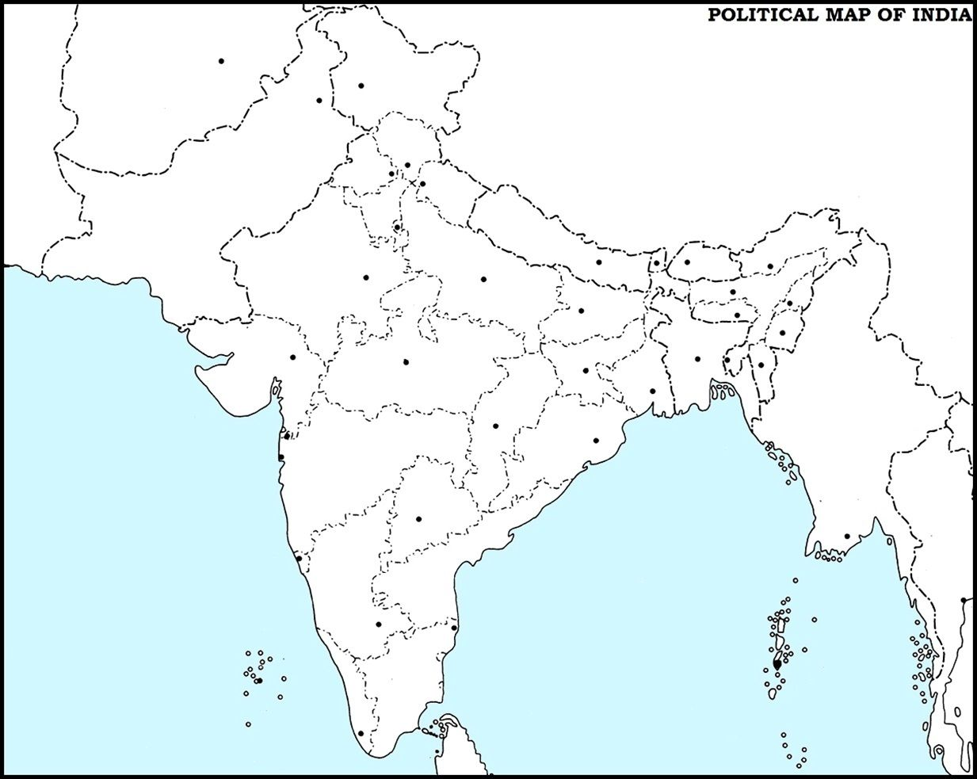
INITIAL MAP

Slide 19

Initial map

Slide 20
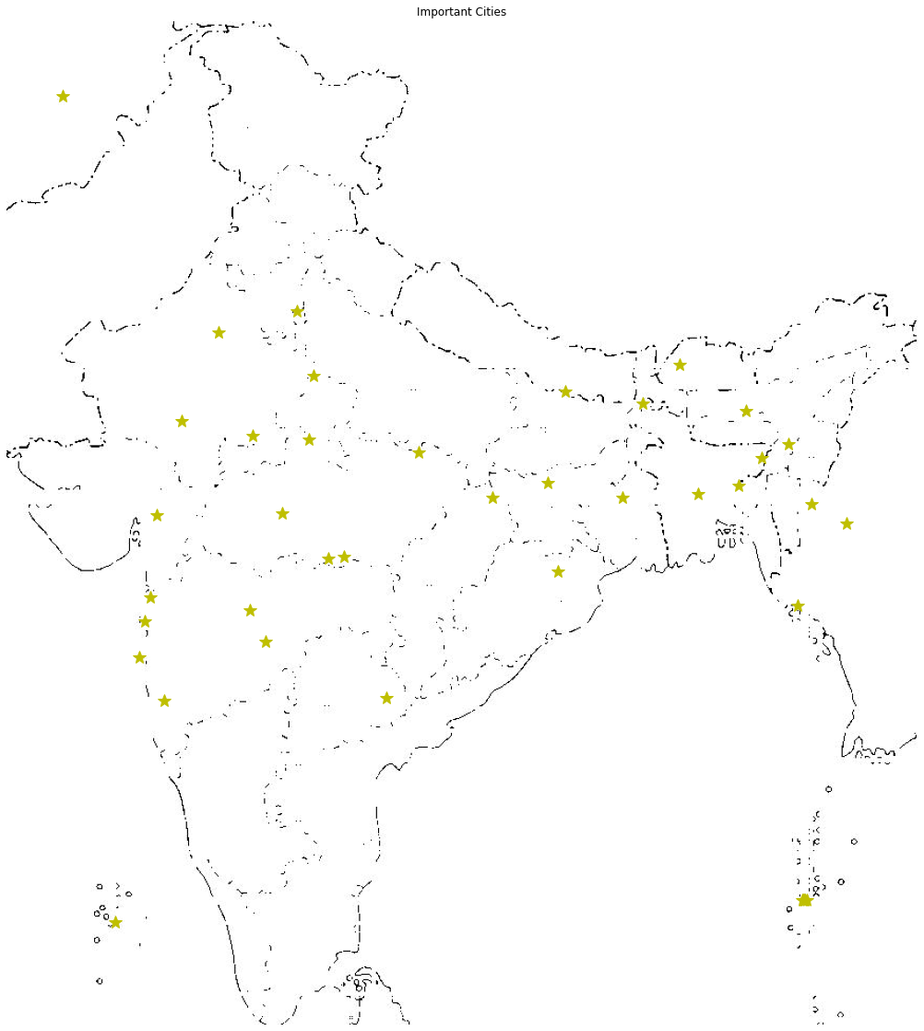
Map with cities

Slide 21
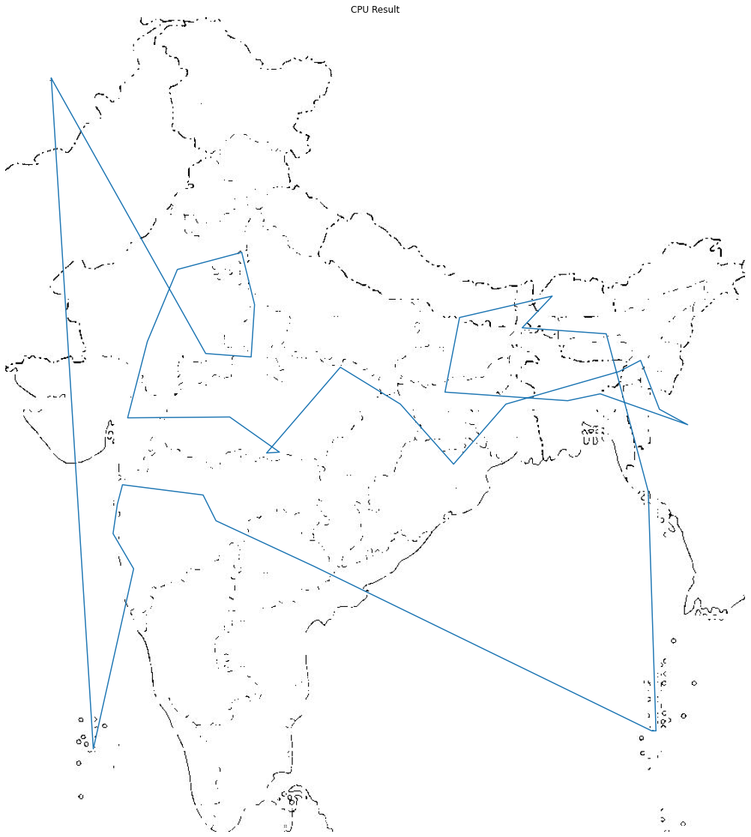
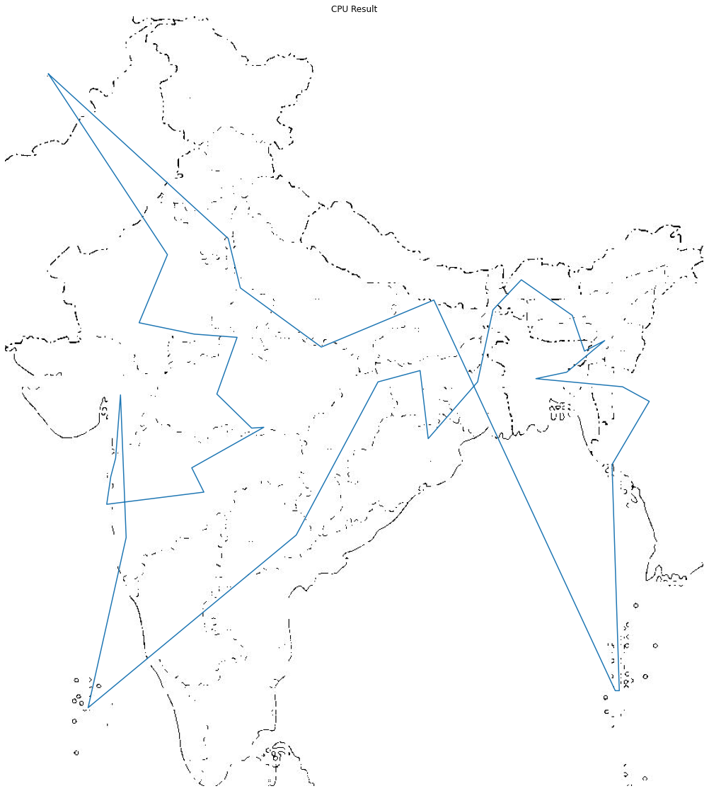
CPU Result
GPU Result
CPU Result
CPU Result

Slide 22
COMPARISONS

Slide 23
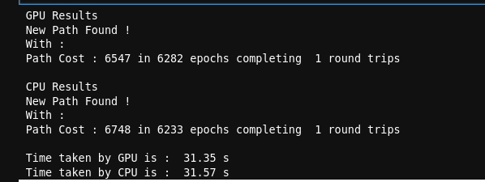
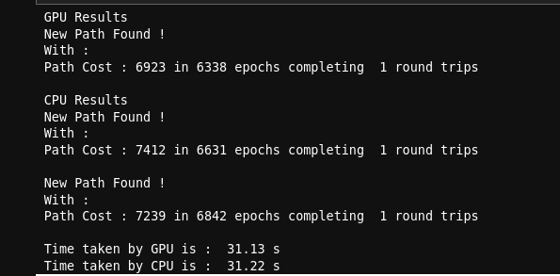
Time Taken by GPU is 0.7% less than CPU and the path cost is 2.97% less
Time Taken by GPU is 0.28% less than CPU and the path cost is 4.36% less

Slide 24
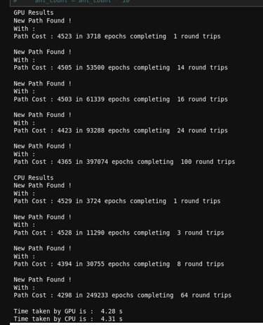
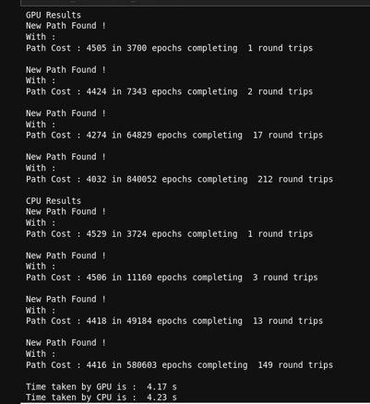
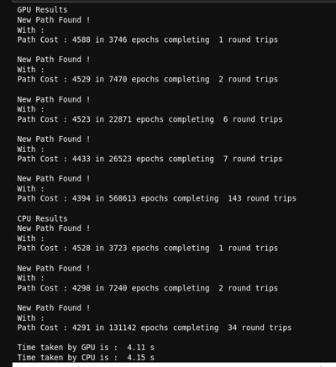
Overall time taken by GPU is 0.7% less than whereas time taken per epoch by GPU is ~50% less than time taken by CPU
Overall time taken by GPU is 1.41% less than whereas time taken per epoch by GPU is ~31% less than time taken by CPU
Overall time taken by GPU is 1% less than whereas time taken per epoch by GPU is ~77% less than time taken by CPU

Slide 25
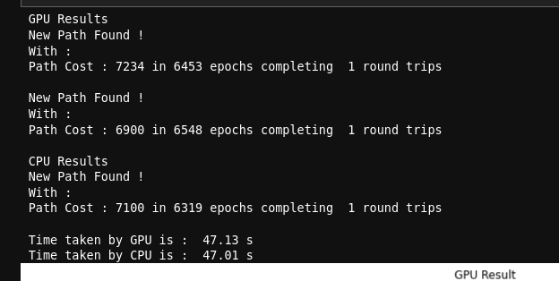
The path cost is 2.81% less in GPU and the time taken per epoch in GPU is around ~50% less

Slide 26
Thank you

