Slide 1
Introduction
Laravel is an open-source widely used PHP framework.
It uses MVC architectural pattern.
Taylor Otwell developed Laravel in July 2011

Slide 2
Laravel Versions
Laravel 1
Laravel 2
Laravel 3
Laravel 4
Laravel 5
Laravel 6
Laravel 7
Laravel 8
Laravel 9
Laravel 10
Laravel 11

Slide 3
Why Laravel?
A Progressive Framework
A Scalable Framework
A Community Framework
A full stack framework
Reusability
Rich set of features

Slide 4
Features of Laravel
Routing controllers - flexible approach to the user to define routes
Configuration management - provides a consistent approach to handle the configuration
Testability - features and helpers which helps in testing through various test cases
Authentication and authorization of users - features such as register, forgot password and send password reminders.
Modularity - built in libraries and modules which helps in enhancement of the application

Slide 5
Features of Laravel(contd.)
Query builder - incorporates a query builder which helps in querying databases using various simple chain methods
Provides a template engine - uses the Blade Template engine, a lightweight template language
Building schemas - maintains the database definitions and schema in PHP code
E-mailing facilities - includes a mail class which helps in sending mail with rich content and attachments from the web application

Slide 6
Composer
Composer is a dependency manager for a PHP.
The main purpose of the composer is to install the dependencies or libraries for an application.
Composer runs through the command line.

Slide 7
Artisan
Command line interface used in Laravel is called Artisan.
It includes a set of commands which assists in building a web application.

Slide 8
Installation Via Composer
Laravel implements a composer for managing dependencies within it.
Hence, before the use of Laravel, it needs to check whether you have a composer setup on your system or not.
If you don't have Composer installed on your computer, first visit this URL to download Composer:
https://getcomposer.org/download/

Slide 9
Installation Via Composer(contd.)
When you are done installing the Composer, cross-check whether it is installed or not by typing in the command prompt the composer command.
C:\Users\dell>composer

Slide 10
Creating project
The next thing you have to do is make a new folder in some specific path within your system for keeping your Laravel projects. Move to that location where the directory is created. For installing the Laravel, the following command you have to type:
composer create-project laravel/laravel Laravel2024
The command mentioned above will make Laravel installed on that specific directory.

Slide 11
Creating project(contd.)
php artisan serve
This above code will start the Laravel service

Slide 12
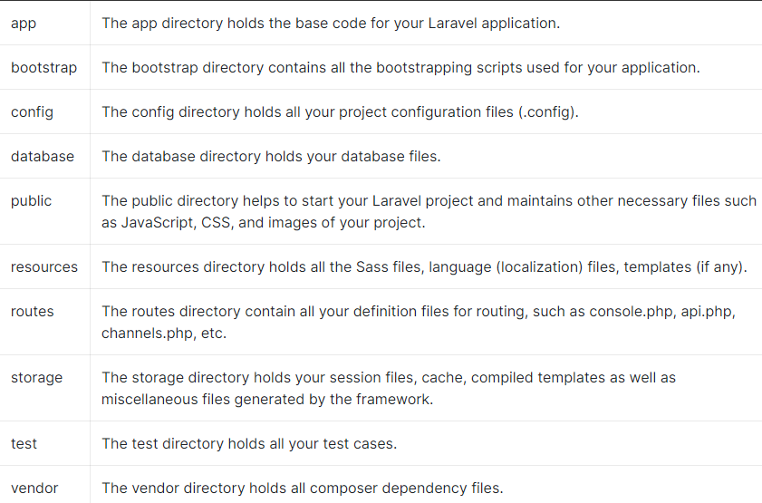
Laravel Application Structure

Slide 13
Laravel Application Structure(contd.)
For more information, go to
https://laravel.com/docs/11.x/structure

