Slide 1
Image restoration using deep learning-based approaches
ASHIRWAD GURAV
2GI20EC029

Slide 2
What is image restoration?
Image restoration refers to the process of improving the quality or appearance of a digital image that has been degraded or damaged by various factors. It involves applying techniques and algorithms to remove or reduce unwanted artifacts, noise, blur, or other imperfections in an image.

Slide 3
LITERATURE SURVEY
Ran Li, Lin Luo, and Yu Zhang offered a solution to the image restoration problem. 'Half-Quadratic Splitting using Convolutional Neural Network' 'Image Restoration Method'. It employs two approaches: model-based optimisation and discriminative learning. The researchers' main goal was to incorporate a trained convolutional neural network (CNN) for denoising as a model into a model-based optimisation strategy for solving picture restoration challenges. However, they utilised a Gaussian denoising model, which is insufficient to restore the details of low-quality photos in all circumstances.

Slide 4
METHODOLOGY
PIL(Python Image Library)
The Python Pillow module is based on PIL (Python Image Library). It is one of the most important Python modules for image processing.
we may use this module as a PIL with Python 3.x. It can handle a variety of image formats, including jpeg, png, bmp, gif, ppm, and tiff.
Using the pillow module, we can do anything with the digital photographs.
PyTorch
PyTorch is a tensor library designed for use in Deep Learning applications with GPUs and CPUs.
It is an opensource machine learning package written in Python that was primarily developed by the Facebook AI Research team. Along with TensorFlow and Keras, it is one of the most popular machine learning libraries.
PyTorch is known for its user-friendly interface, flexibility, and efficient execution.

Slide 5
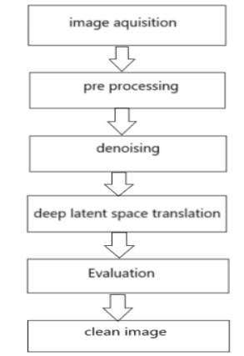
THE PROPOSED SYSTEM
The proposed system consists of the following stages

Slide 6
The process of capturing or getting digital images from various sources, such as cameras, scanners, or sensors, is referred to as image acquisition. It entails transforming a scene's optical information into a digital format that a computer can process and analyse.
Preprocessing is an essential step in image processing and computer vision pipelines to improve the accuracy and reliability of subsequent algorithms. These operations are aimed at enhancing the quality of the image, reducing noise, correcting distortions, or extracting relevant information for subsequent tasks.
Denoising: Noise reduction techniques are applied to remove unwanted noise that can degrade the quality of an image. Common denoising methods include median filtering, Gaussian filtering, or more advanced algorithms like wavelet denoising or non-local means denoising.
Deep latent space translation refers to the process of mapping images from one domain to another by leveraging a deep neural network to encode and decode images in a latent space. It involves learning a mapping between the latent representations of images from different domains, allowing for the translation of images while preserving their underlying semantics.
Evaluation in image restoration refers to the process of assessing the performance and quality of restored images. It involves comparing the restored image with the ground truth or a reference image to measure the effectiveness of the restoration algorithm or technique.
The clean image represents the original or pristine version of the image that is degraded or corrupted due to various factors such as noise, blur, compression artifacts, or sensor imperfections.

Slide 7
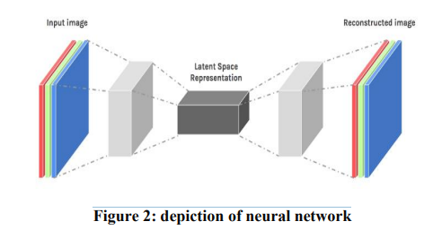
In Figure 2, we can notice that initially the input image ( png format) is converted into grey scale image. Then, it is sent to encoder which compresses the image using loss less compression so that all the extraneous information ( such as noise, blur, etc.,) and focuses only on the important pixels. This is then sent to decoder which will enlarge the image to its original size while storing the important pixels. At the end, we will be getting the reconstructed image without any degradations.

Slide 8
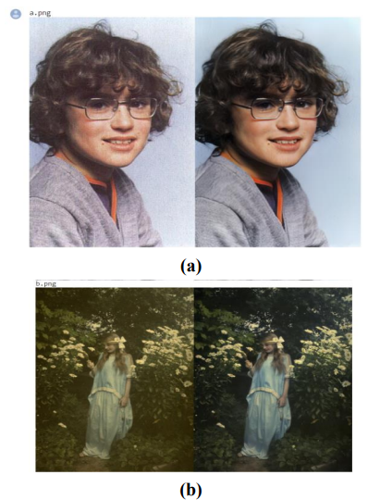
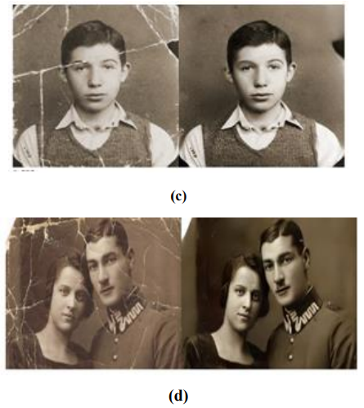
RESULT
The images (a), (b) shows the outputs by restoring the degraded image.
The images (c), (d) shows the outputs in which the scratches which are due to degradation are removed.

Slide 9
Application of image restoration
Photography and Digital Imaging
Medical Imaging
Forensics and Surveillance
Historical Image Restoration
Satellite and Aerial Imaging
Art Restoration and Conservation
Video Restoration

Slide 10
CONCLUSION
Image restoration using deep learning-based approaches has revolutionized the field of image processing and computer vision. Deep neural networks have shown remarkable performance in restoring degraded images by learning complex mappings between degraded and clean image pairs. These approaches have demonstrated significant improvements over traditional image restoration techniques, achieving state-of-the-art results in various restoration tasks such as denoising, deblurring, super-resolution, inpainting, dehazing, and artifact removal.

Slide 11
THANK YOU

