Slide 1


Slide 2
AngularJS
Superheroic JavaScript MVW Framework

Slide 3
What’s the plan?
Quick overview of AngularJS
Demo
Questions

Slide 4
From angularjs.org
AngularJS is a structural framework for dynamic web apps. It lets you use HTML as your template language and lets you extend HTML's syntax to express your application's components clearly and succinctly. Angular's data binding and dependency injection eliminate much of the code you would otherwise have to write. And it all happens within the browser, making it an ideal partner with any server technology.

Slide 5
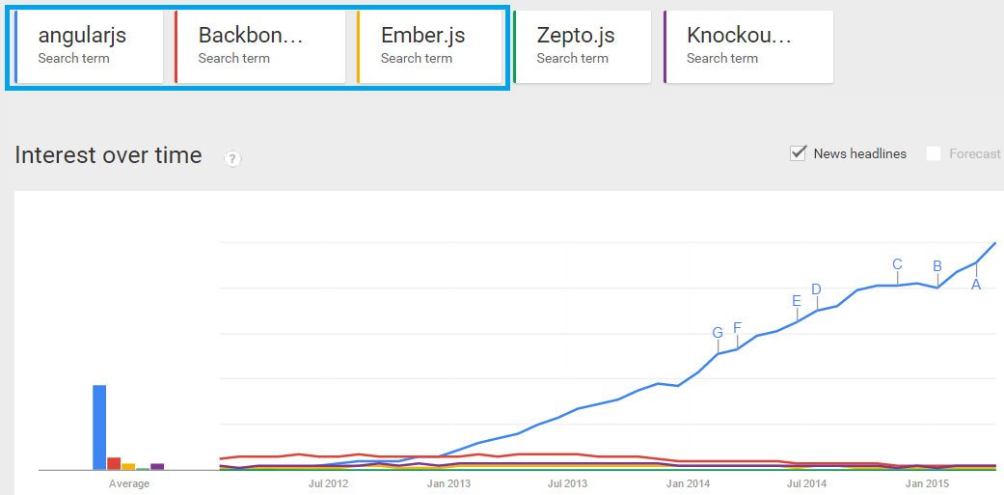
What’s Trending??? Nice article: https://www.airpair.com/js/javascript-framework-comparison

Slide 6
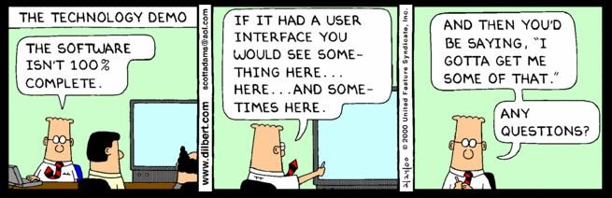
Time for the demo…

Slide 7
If time allows, an online tutorial intro to AngularJS
https://www.codeschool.com/

Slide 8

Questions?

Slide 9


