Slide 1

ASHIS DALAI

Slide 2

Why Java...?
Simple
Object – Oriented
Platform independent – WORA
Secured
Portable
Distributed
Robust
High Performance
Multithreaded

Slide 3
Overview
Basics
OOPs concepts
Strings
Exception Handling
Multithreading
IOStreams
Collections
JDBC
Servlets
JavaScript
JSON
Ajax
JSP
XML
JAXB

Slide 4
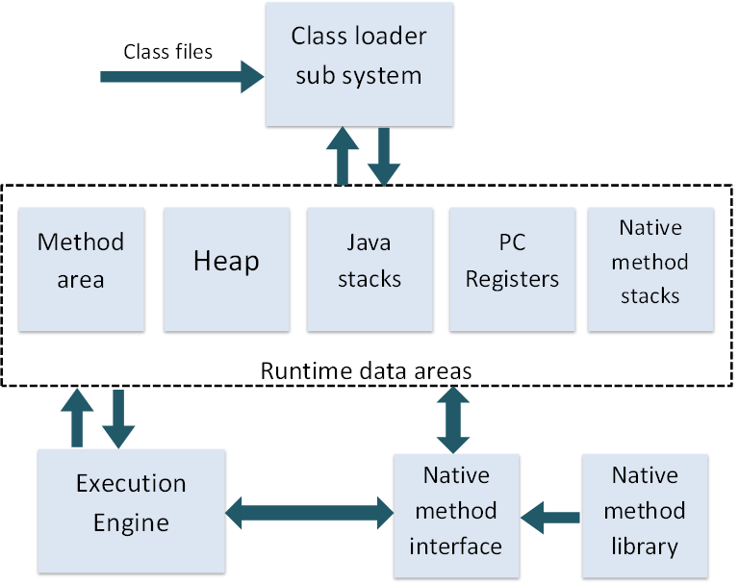
JDK , JRE & JVM
JVM – loads,verifies and executes the code and provides the runtime environment.

Slide 5
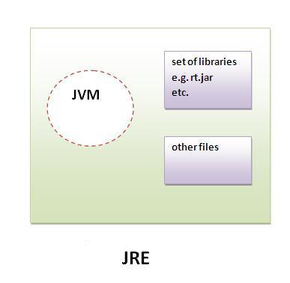
JRE – implementation of JVM, it physically
exists,has set of libraries(jars).

Slide 6
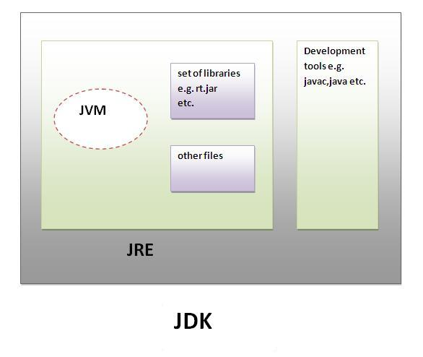
JDK – contains JRE with development tools(javac,java).

Slide 7
OOPs Concepts
Class
Object
Abstraction
Encapsulation
Inheritance
Polymorphism

Slide 8
Classes and Objects
Class – template or a blueprint where objects are created/group of similar objects
Object – instance of class & exists physically
Constructors – used to initialize the object & is invoked at the time of object creation
Wrapper Classes - to convert primitive datatypes into object and object into primitive datatypes
Autoboxing
unboxing

Slide 9
Inheritance
Parent – child relation
extends keyword
Types
  Single
  Multilevel
  Hierarchial
  Multiple
  Hybrid
this & super keywords
Method overriding – parameter different
Method overloading – parameter same

Slide 10
Polymorphism
Polymorphism – performing one action in different ways
Type casting – conversion of one datatype to other datatype
Upcasting - variable of Parent class refering to the object of Child class
Downcasting - an object of a base class convert into the type of one of the derived classes
instanceof operator – to check whether the object is an instance of the specified subclass or interface

Slide 11
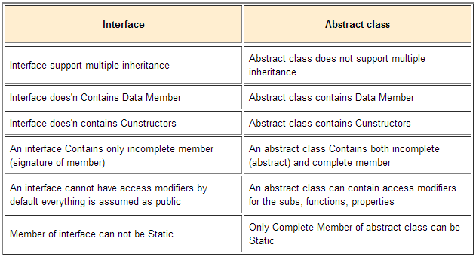
Abstraction & Interfaces
Abstraction - Hiding internal details and showing functionality
Abstract class – can have non-abstract classes
Interfaces – will have only abstract classes

Slide 12
Control Structures & Arrays
Looping Statements
  for
  while
  do..while
Control Statements
  if, else..if
  switch
Selection Statements – break,return
Single Dimensional array – a[]
Multi Dimensional array – a[][]

Slide 13
Strings
Immutable
Substring
Methods of String class
StringBuffer class
StringBuilder class
StringBuffer vs StringBuilder
StringTokenizer
String comparison – equals(),==,compareTo()
String concatenation – concat(),+

Slide 14
Exception Handling
Hierarchy
Types of exceptions
Keywords – try,catch,finally,throw,throws
Try – catch block
Finally block
Throw vs Throws
Exception Propagation
Final vs Finally vs Finalize
Custom Exception

Slide 15
Multithreading
Life cycle of a thread
Creating a thread
Sleep
Wait
Joining a thread
Thread priority
Daemon thread
Thread pool & Thread group
Thread Scheduler

Slide 16
Synchronization
What actually is Synchronization..?
Why synchronization..?
Thread synchronization & types
Mutual Exclusive
  Synchronized method.
  Synchronized block.
  Static synchronization.
Cooperation (Inter - thread communication)
Deadlock

Slide 17
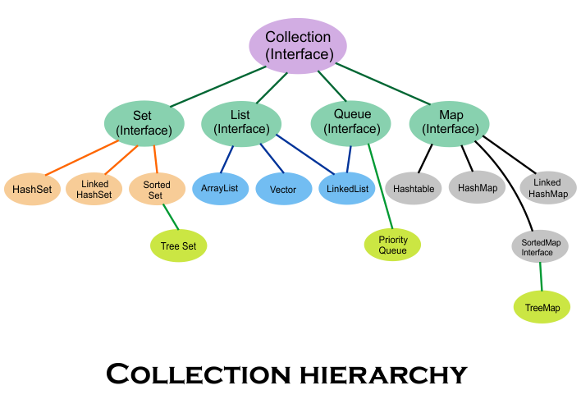
Collections
Collection represents a single unit of objects

Slide 18
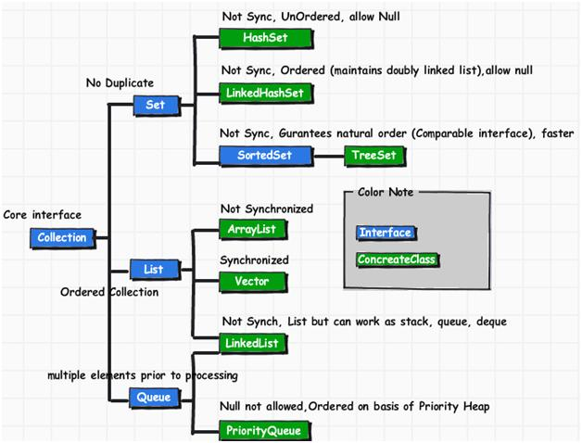

Slide 19
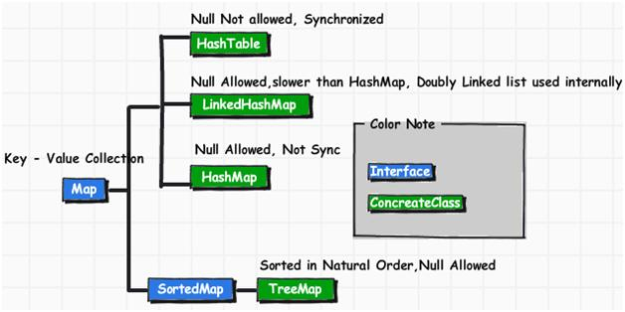

Slide 20
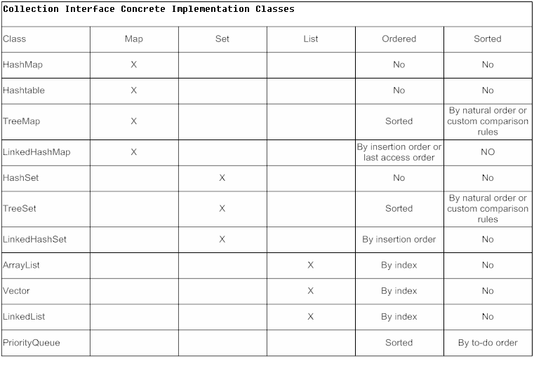

Slide 21
IOStreams
Types of streams
  Binary
  Character
Hierarchy
  InputStrream
  OutputStream
  Reader
  Writer

Slide 22
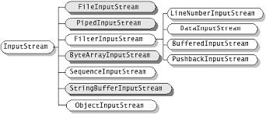
InputStream
Methods of InputStream
Hierarchy

Slide 23
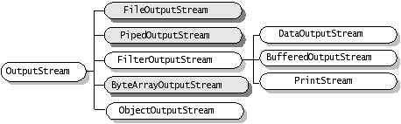
OutputStream
Methods of OutputStream
Hierarchy

Slide 24
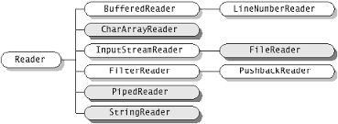
Reader class
Hierarchy

Slide 25
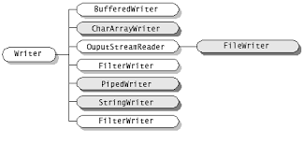
Writer Class
Hierarchy

Slide 26
Binary vs Character
InputStream
OutputStream
FileInputStream
FileOutputStream
StringBufferedInputStream
N/A
ByteArrayInputStream
ByteArrayOutputStream
PipedInputStream
PipedOutputStream
Reader
Writer
FileReader
FileWriter
StringReader
StringWriter
CharArrayReader
CharArrayWriter
PipedReader
PipedWriter

Slide 27
IOStreams contd...
Serialization – it is a mechanism of writing the state of an object into a byte stream.
Marker interface - interfaces with no field or methods or empty interface in java is called marker interface
Implements serializable interface
Deserialization
Transient keyword

Slide 28
JDBC
What is JDBC..?
Its uses..?
Types of Drivers
  JDBC-ODBC bridge driver
  Native - API driver
  Network Protocol driver
  Thin driver
Classes & Interfaces

Slide 29
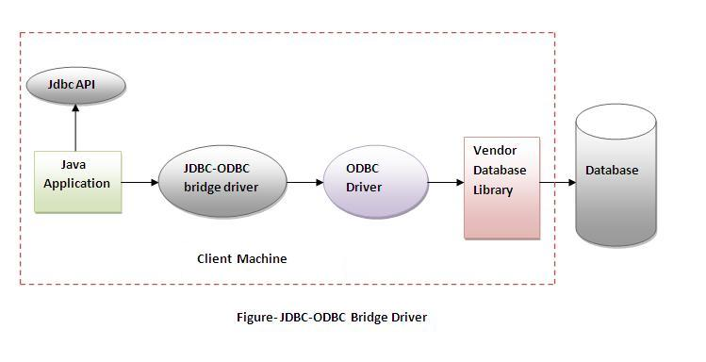
JDBC – ODBC Driver

Slide 30
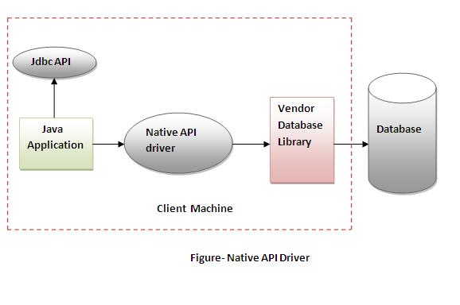
Native – API Driver

Slide 31
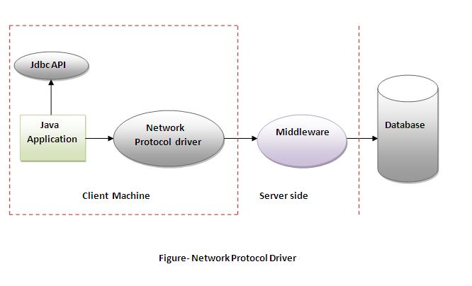
Network Protocol Driver

Slide 32
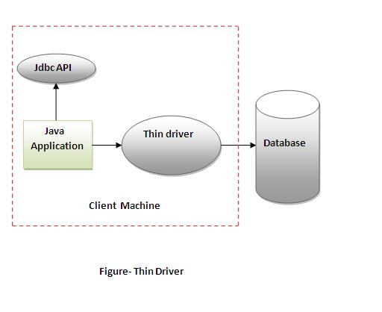
Thin Driver

Slide 33
Connectivity Steps
Register the driver class – Class.forName("oracle.jdbc.driver.OracleDriver");
Create the connection - Connection con=DriverManager.getConnection("jdbc:oracle:thin:@localhost:1521:xe","system","password");
Create the statement - Statement stmt=con.createStatement();
Execute queries & get the results - ResultSet rs=stmt.executeQuery("select * from emp");
Closing connection – con.close();

Slide 34
Prepared statement – parameterized query
Callable statement – for stored procedures & functions
Transaction management – ACID properties
  Atomicity
  Consistency
  Isolation
  Durability
Batch processing – addBatch(), executeBatch()
CLOB – file – setBinaryStream() & getClob()
BLOB – image - setBinaryStream() & getBlob()

Slide 35
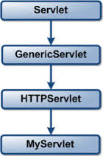
Servlets
What is a Web application..?
CGI
Servlet – used to create web application that resides at server side
Hierarchy
Life cycle
  Init
  Service
  Destroy

Slide 36
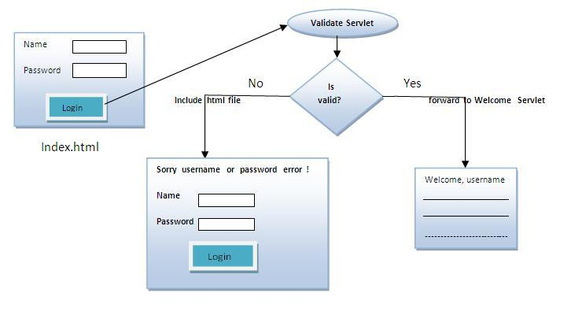
Servlet Collaboration
RequestDispatcher
  forward()
  include()
sendRedirect()

Slide 37
Session Tracking
        Cookies
        Hidden Form Field
        URL Rewriting
        HttpSession
ServletConfig - An object of ServletConfig is created by the web container for each servlet and can be used to get configuration information
ServletContext - There is only one ServletContext object per web application
Deployment Descriptor

Slide 38
JavaScript
What is JS..?
Uses of JS..?
Basics
  Datatypes & variables
  Comments
  Operators
  Control & looping statements
JavaScript objects
  String
  Array

Slide 39
JavaScript BOM
        Window object
        History object
        Navigator object
        Screen object
JavaScript DOM
        getElementsbyId
        getElementsbyName
        getElementsbyTagName
Event Handlers
JavaScript innerHTML & innerText property

Slide 40
AJAX
What is AJAX..?
Synchronous vs Asynchronous
AJAX Technologies
XMLHttpRequest object – properties,methods
How AJAX works..?
Working with text - responseText
Working with XML - responseXML
JSON - features
var jsonObj = JSON.parse(request.responseText);

Slide 41
JSP
Life cycle
  Translation of JSP Page
  Compilation of JSP Page
  Classloading
  Instantiation
  Initialization
  Request processing
  Destroy
JSP API
  javax.servlet.jsp
  javax.servlet.jsp.tagext

Slide 42
Scripting elements
        Scriplet tag - <% java source code %>
        Expression tag - <%= statement %>
        Declaration tag - <%! field declaration %>
Directive elements
        Page - <%@ directive attribute="value" %>
        Include - <%@ page attribute="value" %>
        Taglib - <%@ include file="resourceName" %>
Action elements
        Forward - <jsp:forwardpage="relativeURL"/>
        Include - <jsp:includepage="relativeURL"/>
        UseBean
        Set property
        Get property

Slide 43
Implicit objects – Objects created by the web container that are available to all the jsp pages.
Object | Type
out | JspWriter
request | HttpServletRequest
response | HttpServletResponse
config | ServletConfig
application | ServletContext
session | HttpSession
page | Object
pageContext | PageContext
exception | Throwable

Slide 44
JSTL - represents a set of tags to simplify the JSP development
        Core tags
        Sql tags
        Xml tags
        Function tags
        Internationalization tags
JSP Custom tags
        Tag handler class
        Tag Library Descriptor
        JSP file that uses custom tag

Slide 45
XML
What is XML..?
Well formed XML
  It must begin with the XML declaration.
  It must have one unique root element.
  Matching start and end tags.
  XML tags are case sensitive.
  All elements must be closed.
  All elements must be properly nested.
  All attributes values must be quoted.

Slide 46
Valid XML
        XML DTD
        XML Schema
XML DTD
        <!DOCTYPE employee SYSTEM "file">
        <!ELEMENT attribute (#PCDATA)>
        <!ENTITY entity-name "entity-value">
XML Schema
        <xs:element name="name">
        <xs:complexType>
        <xs:sequence>
        <xs:element name="name" type="xs:string"/>

Slide 47
DTD vs XSD
DTD | XSD
DTD doesn't support datatypes. | XSD supports datatypes for elements and attributes.
DTD doesn't support namespace | XSD supports namespace.
DTD doesn't define order for child elements. | XSD defines order for child elements.
DTD is not extensible | XSD is extensible.
DTD provides less control on XML structure. | XSD provides more control on XML structure.
DTDs are derived from SGML syntax. | XSDs are written in XML.
DTD stands for Document Type Definition. | XSD stands for XML Schema Definition.
DTD is not simple to learn. | XSD is simple to learn because you don't need to learn new language.

Slide 48
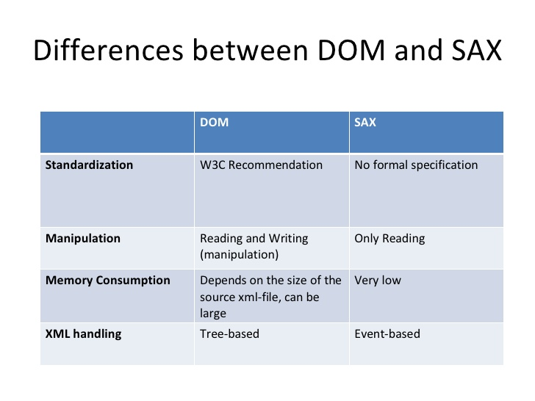
XML Parsers
        DOM Parser
        SAX Parser

Slide 49
XPATH
        Root Node – the root of the document
        Element Nodes – each element of document
        Attribute Nodes
        Namespace Nodes
        Processing Instruction Nodes
        Comment Nodes
        Text Nodes
JAXB – Java Architecture for XML Binding
        Javax.xml.bind.JAXB class
        Java object to XML – Marshalling
        XML to java object – Unmarshalling
        JAXBContext object

Slide 50
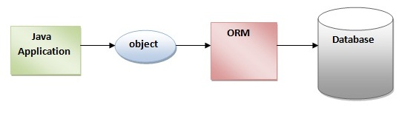
Hibernate
What is a Framework..?
What is hibernate..?
What actually is the concept of ORM(Object Relational Mapping)..?

Slide 51
Advantages of Hibernate Framework :
        Opensource
        Lightweight
        Fast performance
        Database Independent query – HQL
        Automatic table creation
        Simplifies complex join - To fetch data form multiple tables
        Provides query statistics and database status

Slide 52
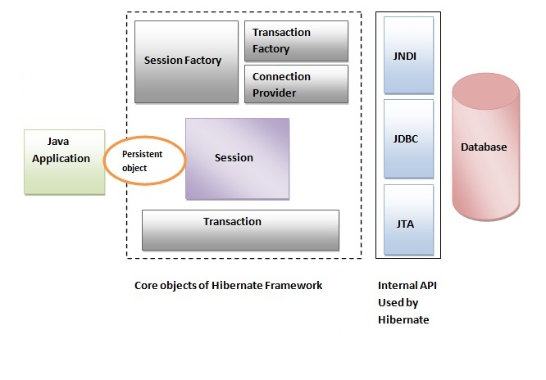
Architecture

Slide 53
Elements of Hibernate architecture
        SessionFactory –org.hibernate.SessionFactory - is a factory of session and client of ConnectionProvider
        Session - provides an interface between the application and data stored in the database
        Transaction – org.hibernate.Transaction – it specifies the unit of work done.
        ConnectionProvider – provides with connections
        TransactionFactory – factory of transaction

Slide 54
Steps to create hibernate application
        Create the Persistent class – POJO classes/getters and setters methods
        Create the mapping file for Persistent class
        Create the Configuration file – properties
        Create the class that retrieves or stores the persistent object – class file
        Load the jar file
        Run the application

Slide 55
Hibernate with annotations
        @Entity - marks the class as an entity.
        @Table - specifies the table name where data of this entity is to be persisted
        @Id - marks the identifier for this entity.
        @Column - specifies the details of the column for this property or field
Hibernate Dialects
        DB2 - org.hibernate.dialect.DB2Dialect
        MySQL - org.hibernate.dialect.MySQLDialect
        Oracle - org.hibernate.dialect.OracleDialect

Slide 56
THANK YOU

