Slide 1

Smart-draw using deep learning
By- Ashish Sharma ,Suraj Patni, Ayush Bhatt, Atul Kala

Slide 2
PURPOSE
•To make a flask application capable of recognising doodles using deep learning and able to give prediction in realtime in the form of text as well as voice

Slide 3
Real-world use of smart-draw
Promotes creativity amongst young children.
Students can learn to pronounce words correctly by the voice output feature.
Useful in development of user interactive games.
To enhance basic drawing skills of children.

Slide 4
About the dataset
Quickdraw dataset basically consists of 350 categories.
Over 15 million players have contributed millions of drawings playing Quick, Draw! These doodles are a unique data set that can help developers train new neural networks, help researchers see patterns in how people around the world draw, and help artists create things we haven’t begun to think of.

Slide 5
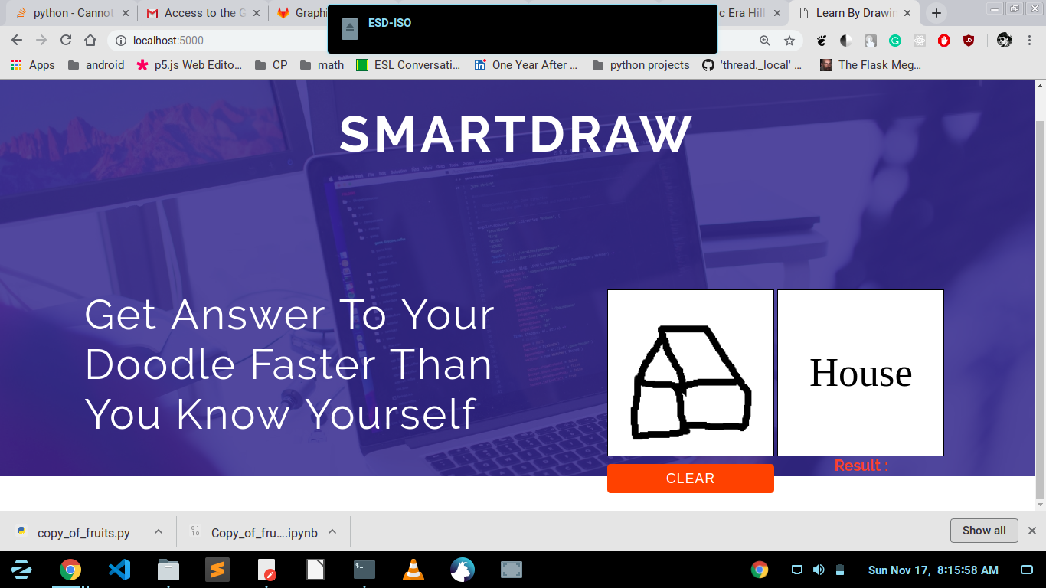
USER-INTERFACE

Slide 6
Modules and libraries --
•Convolutional Neural Network
•gTTs ( Used for Text to Speech )
•Numpy
•Sklearn
•Pillow
•Scikit-learn
•Scipy
•Tensorflow

Slide 7
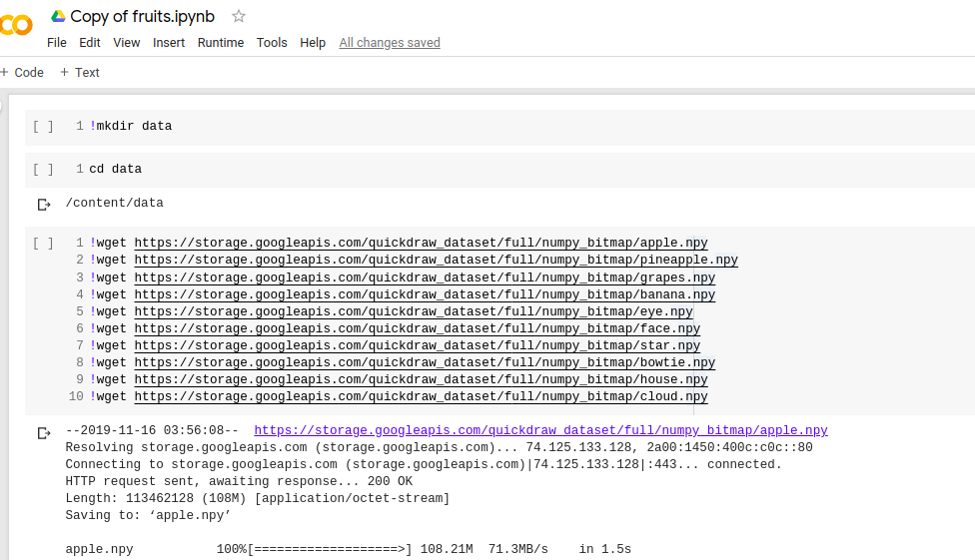
How are we doing it ?
Getting images to train and test

Slide 8
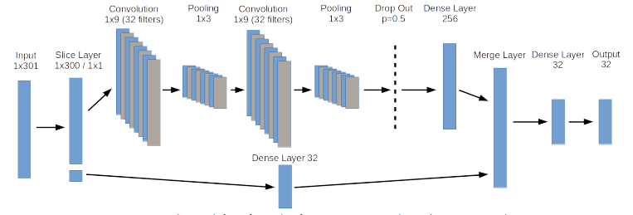
Applying CNN

Slide 9
CONCLUSIONS AND FUTURE PROSPECTS
This can be used to collect the dataset of any random object as a large number of people will draw on the canvas . If the object is not recognised, it will be added to the database

Slide 10
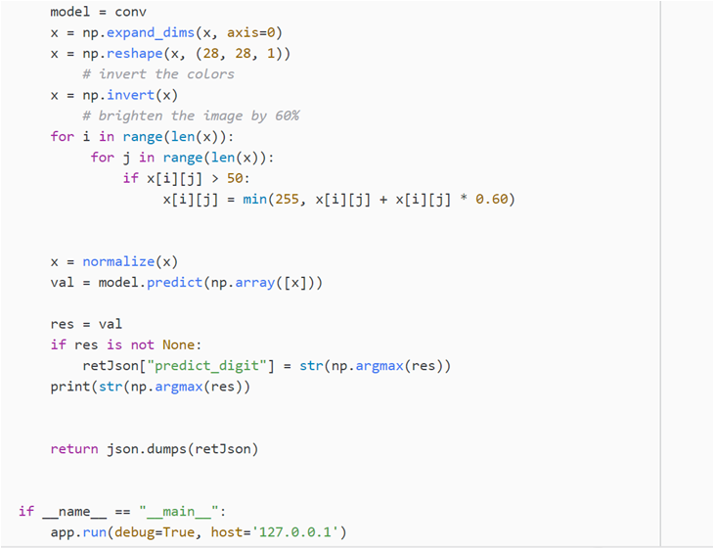
PREDICTING MODEL

Slide 11
THANK YOU

