Slide 1
Voguish - Home Decor & Handicraft Brand Overview
Notes:
Introduction to Voguish, About Us

Slide 2

Introduction to Voguish
Premium Handcrafted Decor
Voguish delivers handcrafted home decor combining traditional techniques with modern design aesthetics.
Quality and Uniqueness
The brand emphasizes quality, uniqueness, and meticulous attention to detail in every product.
Support for Artisans
Voguish supports skilled creators and preserves traditional art forms through its curated collections.
Personalized and Curated Designs
The brand offers personalized designs and curated collections reflecting individual style and taste.
Notes:
Voguish is a premium home decor and handicraft brand that focuses on bringing elegance, creativity, and craftsmanship into everyday living spaces. The company specializes in designing and delivering handcrafted decor products that seamlessly combine traditional techniques with contemporary design aesthetics. This unique blend allows Voguish to cater to a wide audience, from individuals seeking artistic additions to their homes to corporate clients looking for distinctive gifting options. The brand emphasizes quality, uniqueness, and attention to detail in every product, ensuring that each piece stands out as both functional and decorative. Additionally, Voguish aims to promote artisan craftsmanship by supporting skilled creators and preserving traditional art forms. By offering personalized designs and curated collections, the brand ensures that customers receive products that reflect their personal style and taste, making each purchase meaningful and memorable.

Slide 3

About Us
Creative Handcrafted Products
Voguish offers unique handcrafted decor that blends creativity, innovation, and cultural richness.
Customer Satisfaction Focus
The company adapts to market trends and customer preferences to ensure satisfaction and meaningful products.
Sustainable and Ethical Practices
Voguish incorporates eco-friendly materials and ethical production to promote sustainability and trust.
Notes:
Voguish is dedicated to delivering high-quality handcrafted home decor products that combine creativity, innovation, and cultural richness. The company’s mission is to transform ordinary spaces into beautiful, stylish environments through unique decor solutions. It prides itself on offering products that are not only visually appealing but also durable and meaningful. With a strong focus on customer satisfaction, Voguish continuously adapts its offerings to meet evolving market trends and preferences. The company works closely with artisans and designers to ensure that every piece reflects exceptional craftsmanship and originality. Furthermore, Voguish believes in sustainable practices and often incorporates eco-friendly materials in its production process. The brand’s commitment to quality, creativity, and ethical practices has helped it build trust and recognition among customers, making it a preferred choice for home decor and gifting solutions.

Slide 4
Products and Services
Notes:
Our Products, Corporate Gifting Services

Slide 5

Our Products
Diverse Product Range
Voguish offers handcrafted decorative showpieces, wall art, home accessories, and elegant gift hampers.
Blend of Aesthetics and Functionality
Products are crafted to combine beauty and functionality, suitable for personal use and gifting.
Originality and Design
Each item has a distinct design and artistic appeal, reflecting originality and craftsmanship.
Modern Trends with Tradition
Collections are updated regularly to align with modern trends while maintaining traditional craftsmanship.
Notes:
Voguish offers a diverse range of handcrafted products designed to enhance the beauty and ambiance of any space. The product portfolio includes decorative showpieces, wall art, home styling accessories, and elegant gift hampers. Each product is carefully crafted to ensure a perfect blend of aesthetics and functionality, making them suitable for both personal use and gifting purposes. The brand focuses on originality, ensuring that each item stands out with its distinct design and artistic appeal. Additionally, Voguish frequently updates its collections to align with modern design trends while maintaining the essence of traditional craftsmanship. Customers can choose from a wide variety of themes, materials, and styles, allowing them to find products that match their preferences and decor needs. Whether it is for home decoration or special occasions, Voguish products provide a perfect combination of beauty, quality, and uniqueness.

Slide 6
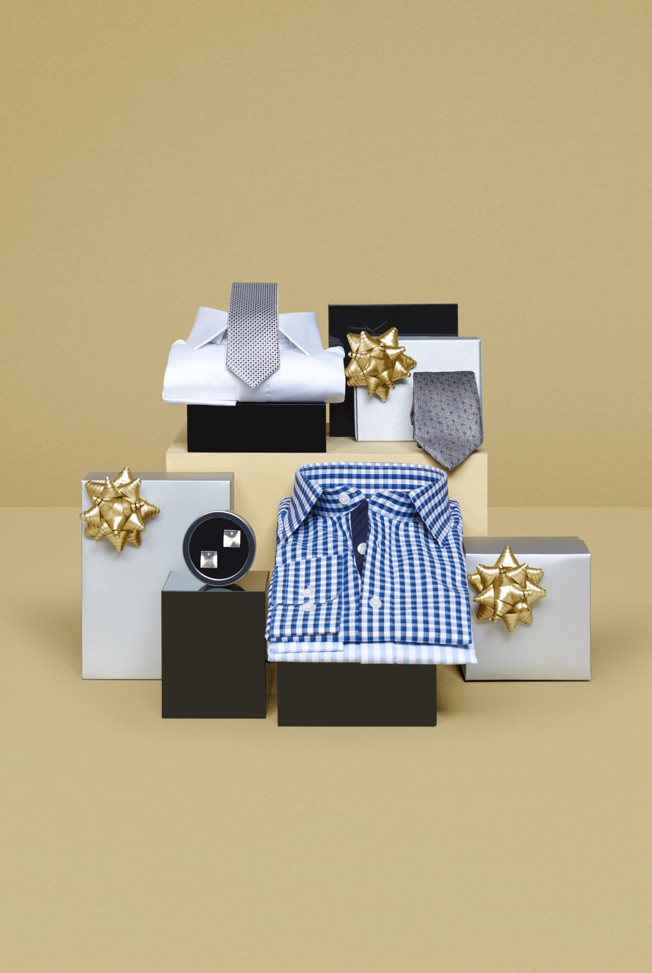
Corporate Gifting Services
Customized Corporate Gifts
Voguish provides customized gift products tailored to reflect a brand’s identity for various corporate occasions.
Premium Quality and Craftsmanship
All gifts are crafted with premium materials to ensure high quality and create lasting impressions.
Bulk Orders and Timely Delivery
The company offers bulk order options with consistent quality and reliable, timely delivery services.
Seasonal and Themed Collections
Voguish offers seasonal and themed gift collections, allowing alignment with specific occasions and festivals.
Notes:
Voguish specializes in corporate gifting solutions that cater to businesses looking for unique and high-quality gift items. The company offers customized products that can be tailored to reflect a brand’s identity, making them ideal for corporate events, employee recognition, client appreciation, and festive gifting. Voguish ensures that all corporate gifts are designed with premium materials and exceptional craftsmanship, creating a lasting impression on recipients. The brand also provides bulk order options, ensuring timely delivery and consistency in quality. By combining creativity with personalization, Voguish helps businesses strengthen relationships and enhance their brand image. Additionally, the company offers seasonal and themed collections, enabling organizations to select gifts that align with specific occasions. This focus on customization, quality, and reliability makes Voguish a trusted partner for corporate gifting needs.

Slide 7
Sales Channels
Notes:
E-commerce and Digital Presence, Retail and Direct Sales

Slide 8

E-commerce and Digital Presence
E-commerce Platform Usage
Voguish sells products on Amazon, providing customers with convenient and reliable online shopping options.
Social Media Marketing
Instagram is used as a visual marketing channel to engage customers and promote new collections effectively.
Customer Engagement and Feedback
Social media enables Voguish to gather feedback, understand preferences, and introduce innovative designs.
Integrated Digital Strategy
Combining e-commerce and social media ensures seamless experiences and strong customer connections.
Notes:
Voguish leverages multiple digital platforms to reach a broad customer base and enhance accessibility. The company actively sells its products through Amazon, ensuring convenience and reliability for customers who prefer online shopping. In addition, Voguish utilizes Instagram as a key marketing and sales channel, showcasing its products through visually appealing content, reels, and customer engagement activities. This strong digital presence allows the brand to connect directly with its audience, build relationships, and promote new collections effectively. The use of social media also helps Voguish gather customer feedback, understand preferences, and introduce innovative designs. By combining e-commerce platforms with social media strategies, Voguish ensures seamless customer experiences and efficient product discovery. This approach enables the brand to stay competitive in the digital marketplace while maintaining a strong connection with its customers.

Slide 9
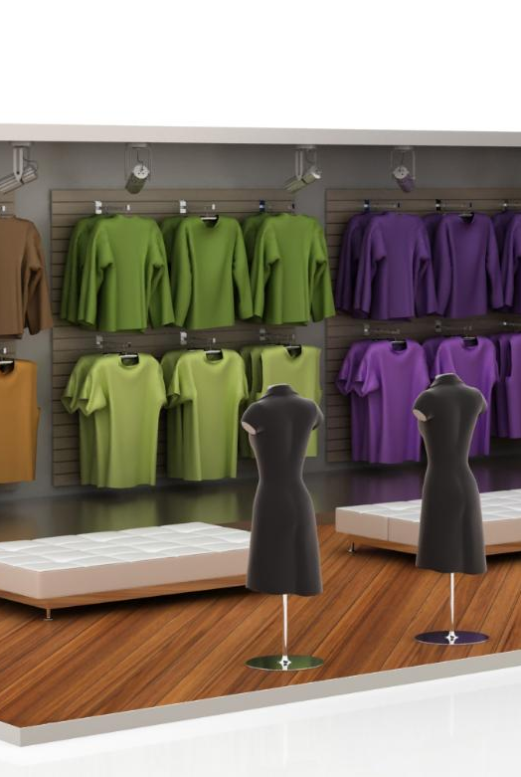
Retail and Direct Sales
Personalized Shopping Experience
Retail channels allow customers to explore products physically and appreciate their craftsmanship for informed decisions.
Direct Customer Engagement
Direct sales through pop-up stores and exhibitions help build trust and brand loyalty via face-to-face interaction.
Multi-Channel Market Reach
Balancing online and physical sales channels maximizes market reach and caters to diverse shopping preferences.
Brand Visibility and Credibility
Retail presence enhances brand visibility and credibility, making the brand easier to recognize and trust.
Notes:
In addition to its online presence, Voguish also focuses on retail and direct sales to expand its reach and provide customers with a personalized shopping experience. Retail channels allow customers to physically explore the products, appreciate their craftsmanship, and make informed purchase decisions. Direct sales, including exhibitions, pop-up stores, and local events, help the brand engage with customers face-to-face, building trust and brand loyalty. This multi-channel approach ensures that Voguish caters to diverse customer preferences, whether they prefer online convenience or in-person shopping. Furthermore, retail presence enhances brand visibility and credibility, making it easier for customers to recognize and trust the brand. By maintaining a balance between digital and physical sales channels, Voguish maximizes its market reach and strengthens its connection with customers.

Slide 10
Value Proposition
Notes:
Unique Selling Points

Slide 11
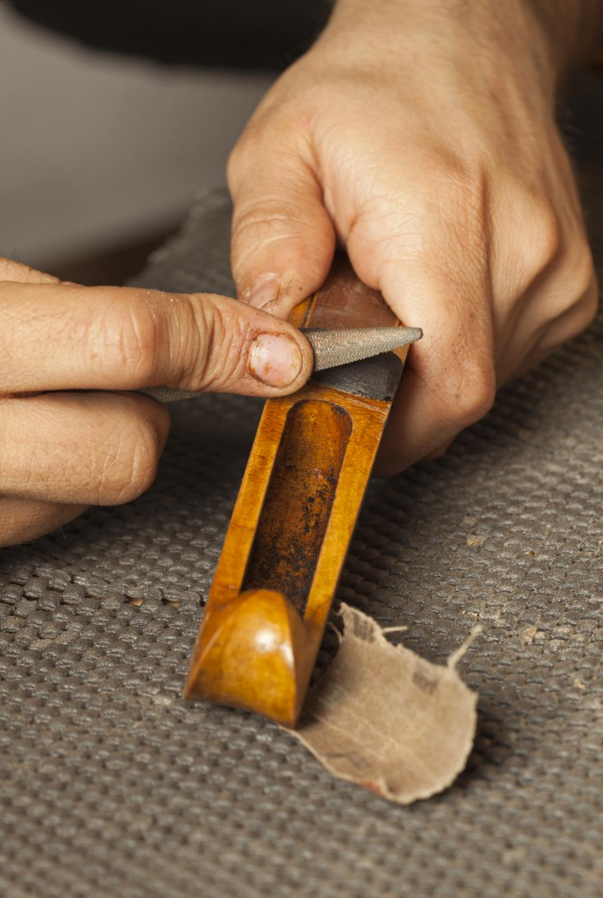
Unique Selling Points
Quality and Craftsmanship
Voguish emphasizes handcrafted excellence, ensuring precision and attention to detail in every product.
Creativity and Uniqueness
Products reflect individuality and artistic expression, making each piece unique and special.
Customization Options
Customers can personalize decor and gifting solutions to suit their individual preferences.
Affordable Premium Products
Offering high-quality decor at accessible prices attracts a wide range of customers.
Notes:
Voguish stands out in the home decor and handicraft industry due to its strong focus on quality, creativity, and personalization. One of its key selling points is the uniqueness of its products, which are designed to reflect individuality and artistic expression. The brand’s commitment to handcrafted excellence ensures that every item is made with precision and attention to detail. Additionally, Voguish offers customization options, allowing customers to create personalized decor and gifting solutions. The combination of traditional craftsmanship and modern aesthetics further sets the brand apart, appealing to a wide range of customers. Another important aspect is the affordability of premium products, making high-quality decor accessible to more people. By consistently delivering distinctive, well-crafted, and customizable products, Voguish builds strong customer loyalty and positions itself as a trusted brand in the market.

Slide 12
Customer Experience
Notes:
Customer Engagement and Satisfaction

Slide 13

Customer Engagement and Satisfaction
Seamless Customer Experience
Voguish prioritizes a smooth journey from product selection to delivery for customer satisfaction.
Active Customer Engagement
Engagement through social media helps Voguish respond to queries and build trust with customers.
Quality and Timely Delivery
Ensuring secure packaging and timely delivery contributes to positive customer satisfaction.
Encouraging Repeat Purchases
Offering new designs regularly helps maintain customer loyalty and encourages repeat buying.
Notes:
Customer satisfaction is a core priority for Voguish, and the brand takes multiple steps to ensure a positive experience at every stage of the customer journey. From product selection to delivery, Voguish focuses on providing seamless and reliable service. The company actively engages with customers through social media, responding to queries, sharing updates, and gathering feedback. This interaction helps build trust and fosters long-term relationships. Additionally, Voguish ensures timely delivery, secure packaging, and high product quality, which contribute to customer satisfaction. The brand also encourages repeat purchases by offering new designs and collections regularly. By prioritizing customer needs and maintaining consistent quality, Voguish creates a strong and loyal customer base. This commitment to excellence ensures that customers not only receive great products but also enjoy a memorable and satisfying shopping experience.

Slide 14
Contact Information
Notes:
Contact Us

Slide 15

Contact Us
Email Communication
Customers can contact via email for inquiries, orders, and customization with prompt, professional responses.
Social Media Engagement
Active Instagram presence allows users to view collections, get updates, and interact directly with the team.
Phone Support
Phone support provides quick assistance and direct communication for customer convenience.
Notes:
Voguish provides multiple channels for customers and businesses to connect and explore its offerings. Customers can reach out via email for inquiries, orders, or customization requests, ensuring prompt and professional responses. The brand is also active on Instagram, where users can view product collections, stay updated with new launches, and directly interact with the team. Additionally, Voguish offers phone support for quick assistance and communication. These contact channels ensure accessibility and convenience for customers, allowing them to easily engage with the brand. Whether it is for corporate gifting, retail purchases, or product inquiries, Voguish ensures that its communication process is efficient and user-friendly. By maintaining strong customer support and communication channels, the company reinforces its commitment to customer satisfaction and long-term relationships.

