Slide 1
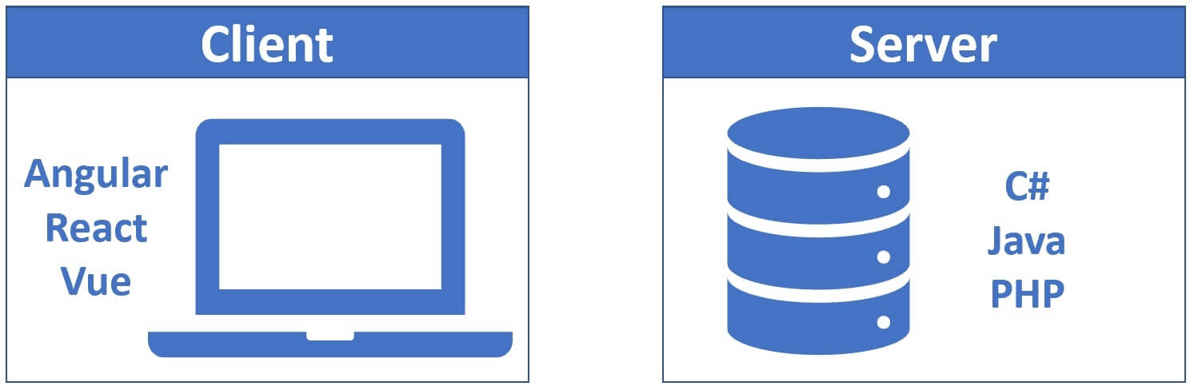
Traditional Web Development
Server-side: C#, Java, PHP
Client-side: Angular, React, Vue
Need to learn multiple technologies

Slide 2
Problem Statement
Why use two different languages?
Can we use C# for both client and server?

Slide 3
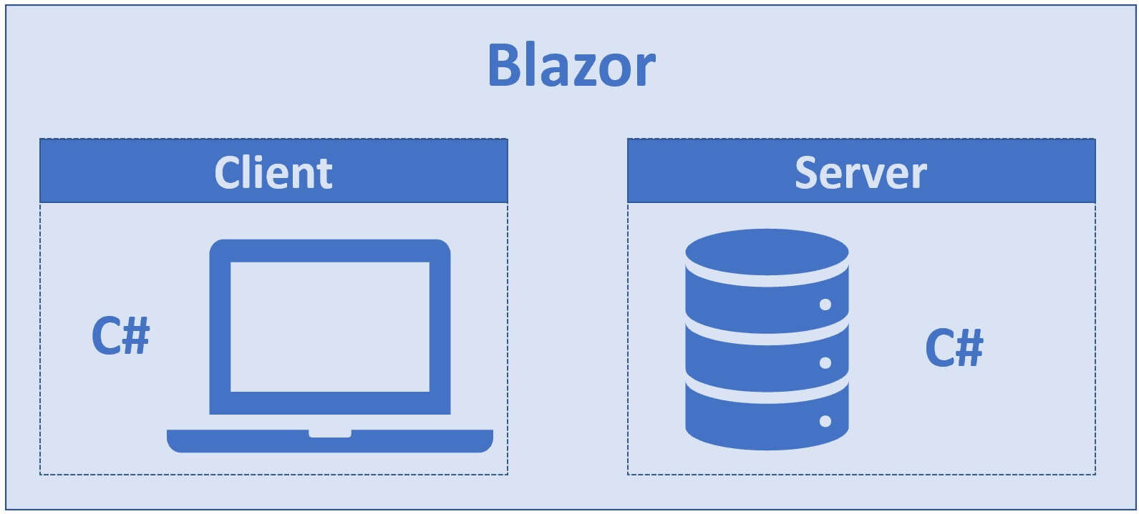
What is Blazor
Component based architecture.
Supports SPA.
Uses Razor syntax
Runs on WebAssembly or Server
Full-stack development with C#
Reduces need for JavaScript

Slide 4
What is Blazor
Blazor .NET 8 supports:
Static SSR (Server-Side Rendering)
Interactive Server
Interactive WebAssembly
Interactive Auto

Slide 5
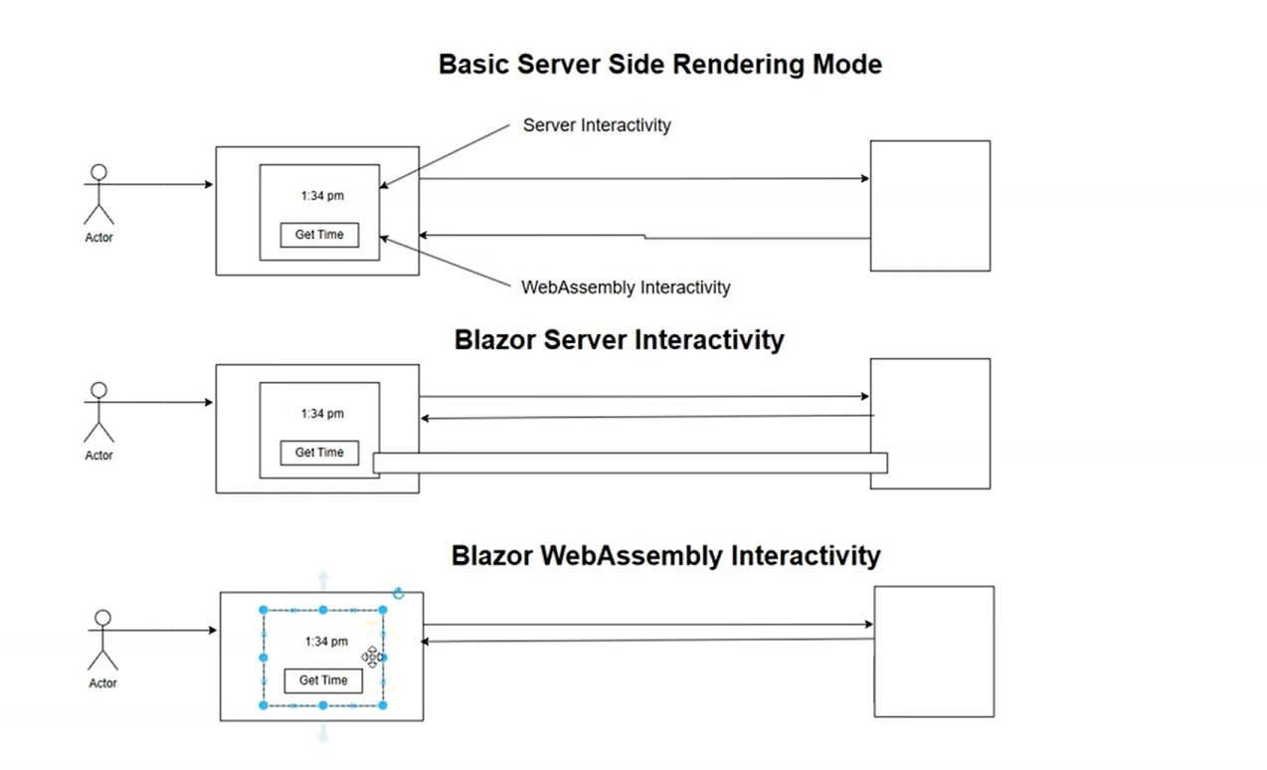
What is Blazor

Slide 6
Rendering Mode Comparison
Mode | Runs Where | Requires SignalR | Offline Support
Static SSR | Server | No | No
Interactive Server | Server | Yes | No
Interactive WebAssembly | Browser | No | Yes
Interactive Auto | Server → Browser | Initially Yes | Partial

Slide 7
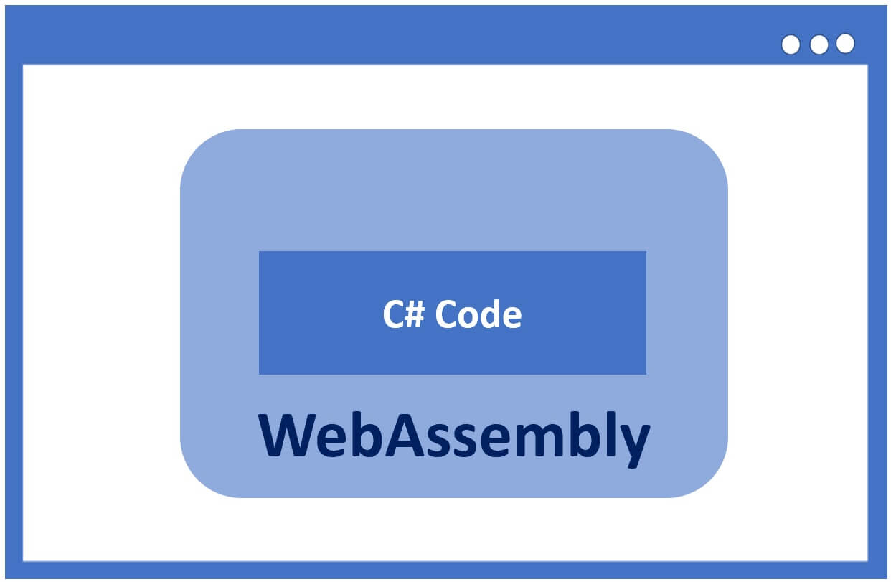
What is WebAssembly (WASM)?
Allows running C# in browser
Works in all modern browsers
No plugins required

Slide 8
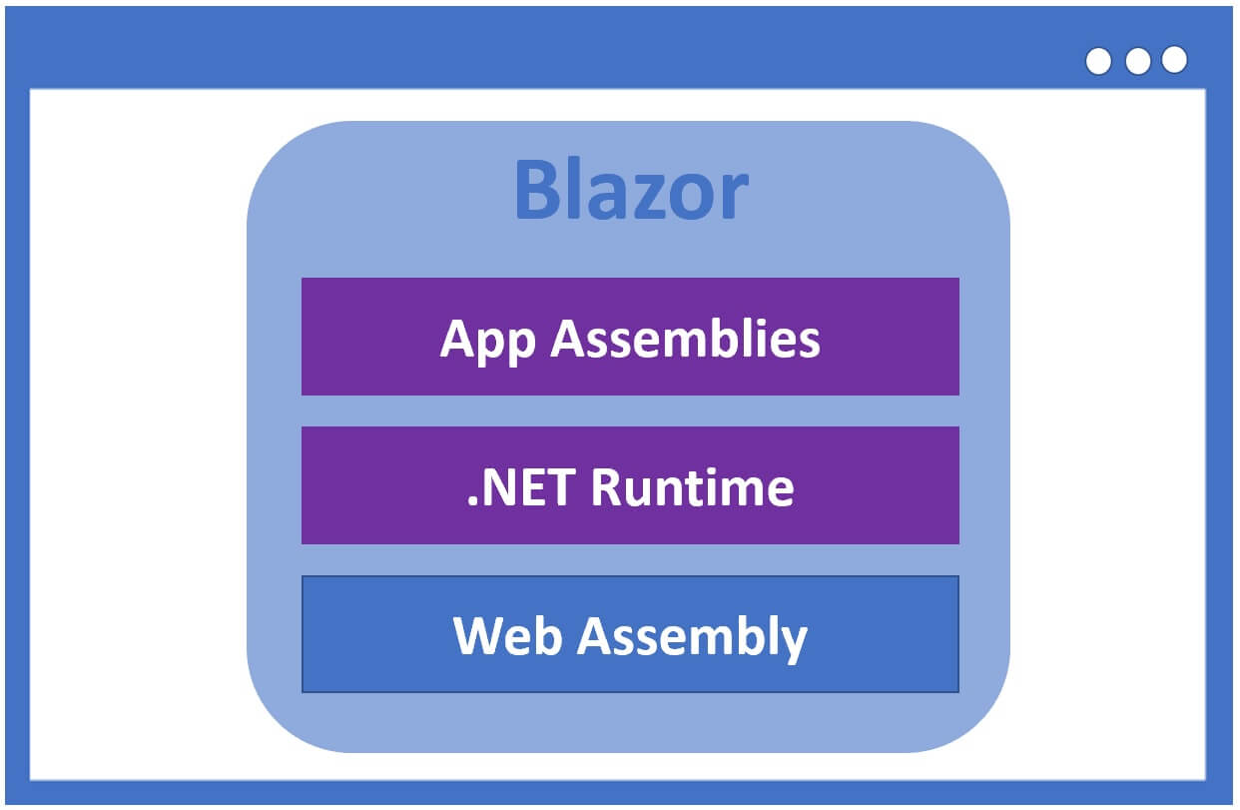
How Blazor WebAssembly Works
C# code compiled into .NET assemblies
Downloaded .NET assemblies ,Runtime to browser.
Executed using WebAssembly runtime.

Slide 9
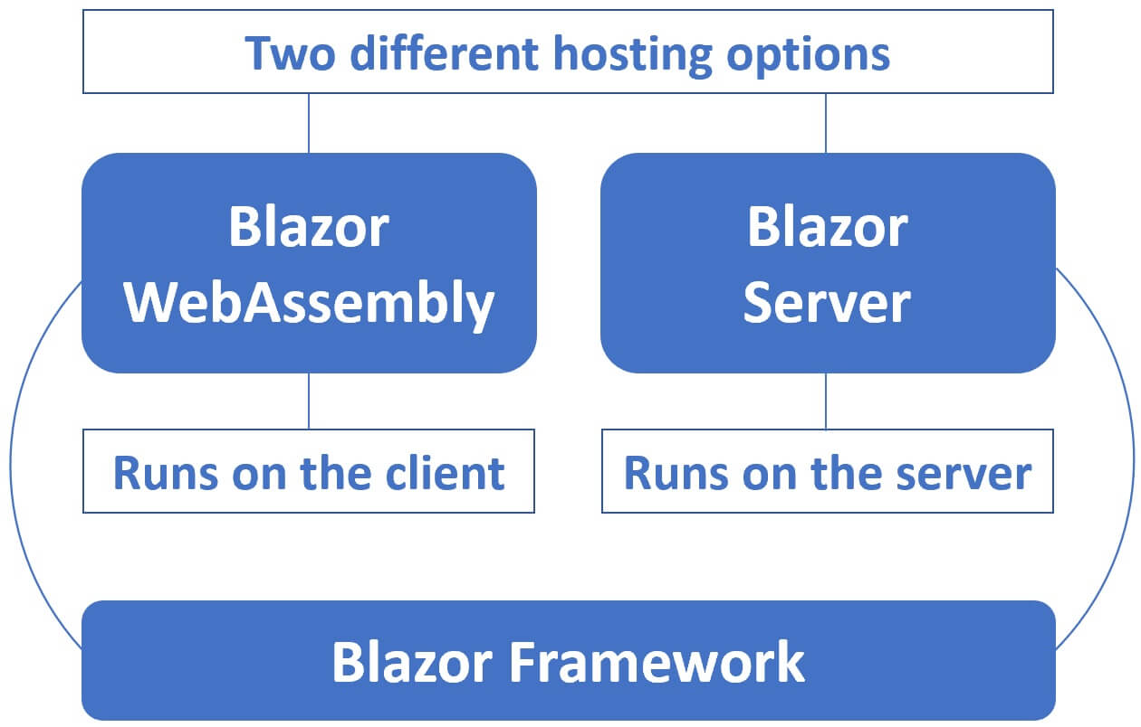
Blazor Hosting Models
Blazor WebAssembly (Client-side)
Blazor Server (Server-side)
Both use same framework

Slide 10
Conclusion
Blazor simplifies development
Reuse .NET skills
Growing Microsoft support

