Slide 1



GHG EMISSION PREDICTION
Ashish Kumar
Student ID- STU68270edeb87111747390174

Slide 2

Learning Objectives
Gain hands-on experience with data preprocessing and feature engineering
Learn to build, train, and evaluate regression models for real-world datasets
Implement a user-friendly web interface using Streamlit for live predictions
GOAL
Interpret model outputs to support environmental decision-making
Work with supply chain data to predict greenhouse gas (GHG) emissions with margin factors
Source :
www.freepik.com/

Slide 3
Tools and Technology used
Python – Core programming language for data analysis and model development
pandas – For data manipulation and cleaning
scikit-learn – To train and evaluate the Linear Regression model
NumPy – For numerical operations and array handling
joblib – For saving and loading the trained model and scaler
Streamlit – To build an interactive web-based prediction app
Jupyter Notebook – For model experimentation and visualization
GitHub – For version control and code collaboration

Slide 4
Methodology
Data Extraction & Cleaning
Feature Engineering
Data Preprocessing
Model Training
Model Deployment
User Input Interface

Slide 5
Problem Statement:
Accurate estimation of supply chain greenhouse gas (GHG) emissions is critical for sustainability and compliance
Existing methods are often manual, inconsistent, and lack scalability
Emission estimates are influenced by data quality (DQ) factors such as reliability, geography, technology, and timeliness
Organizations need a smart, automated solution that integrates these DQ metrics for better prediction
Objective: Develop a Machine Learning model that predicts Supply Chain Emission Factors with Margins, based on emission data and associated DQ metrics

Slide 6
Solution:
Developed a Machine Learning-based regression model to predict supply chain emissions with margins
Incorporated multiple Data Quality (DQ) parameters as input features
Used Linear Regression to model the relationship between DQ metrics and emission factors
Created a user-friendly web application using Streamlit
Enabled scalable and consistent predictions across different substances and sources (Commodity/Industry)

Slide 7
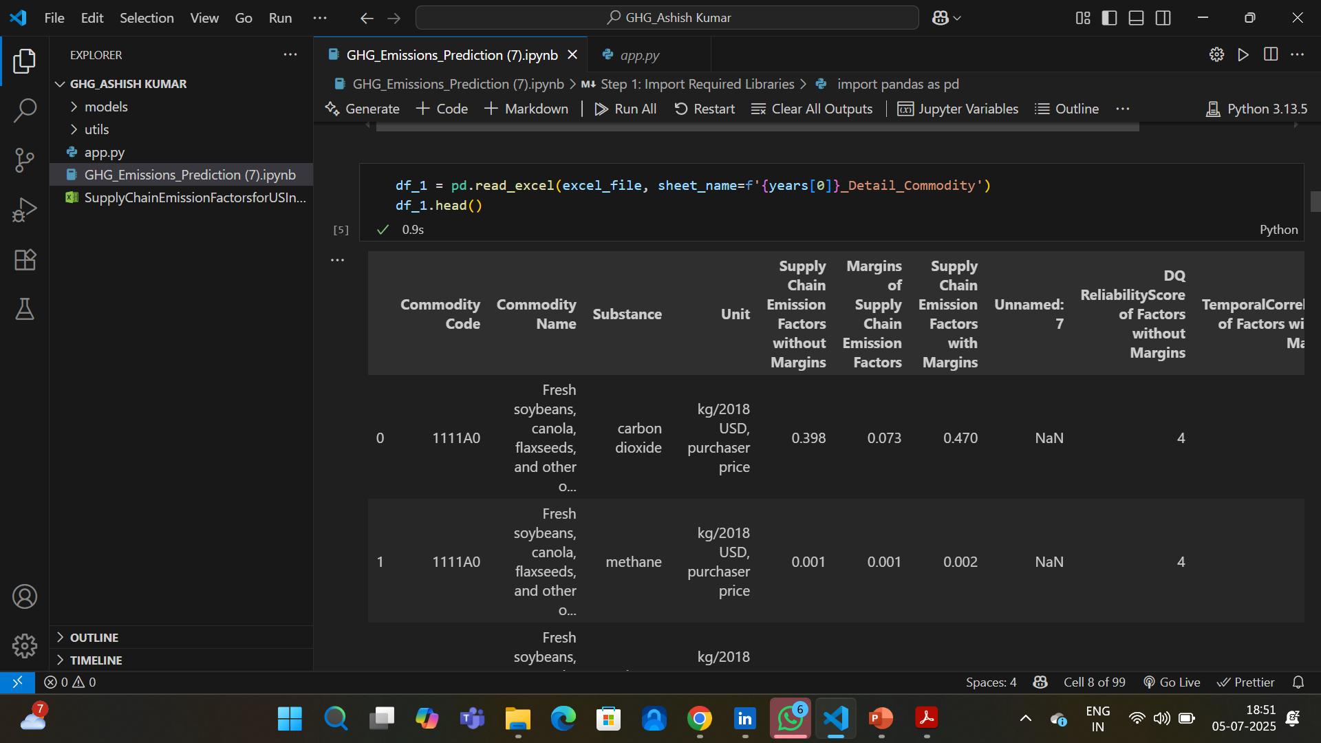
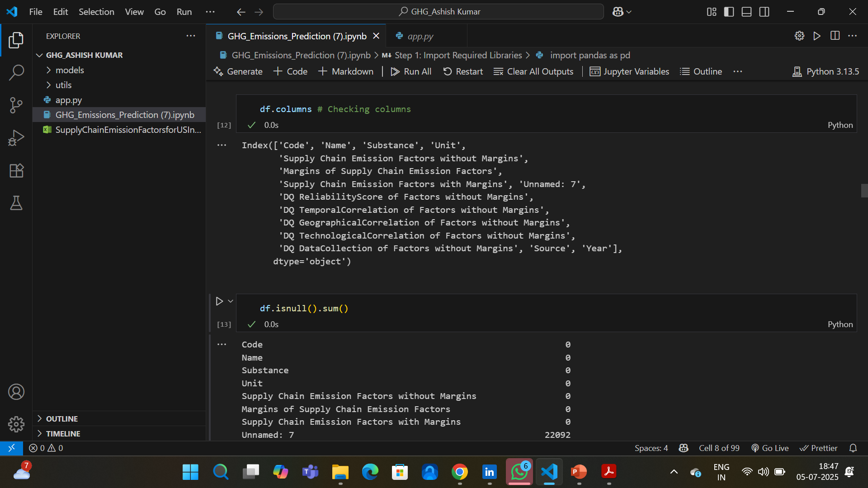
Screenshot of Output:
EDA & Preprocessing

Slide 8
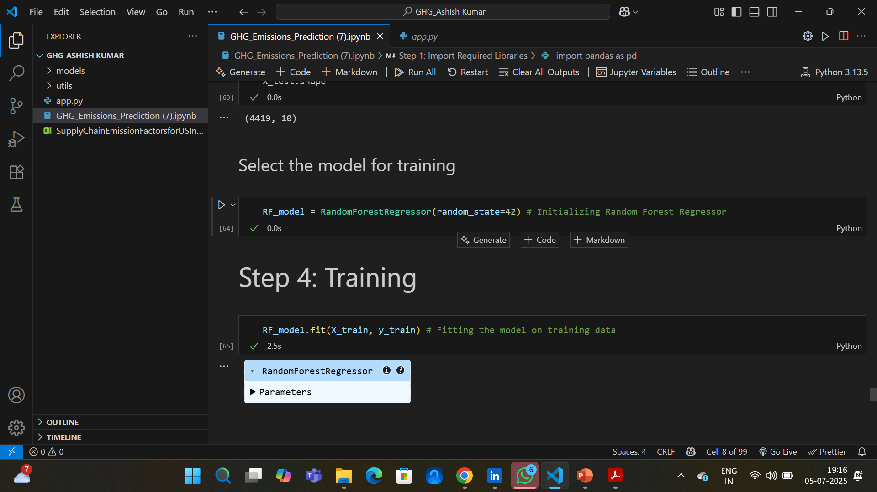
Screenshot of Output:
Model

Slide 9
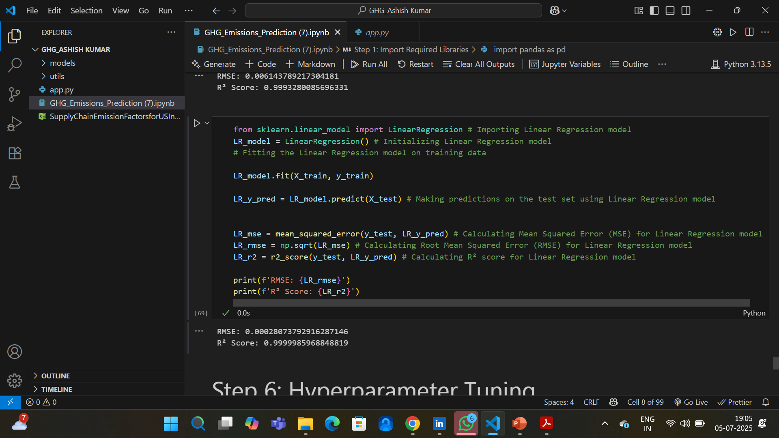
Screenshot of Output:
Evaluation

Slide 10
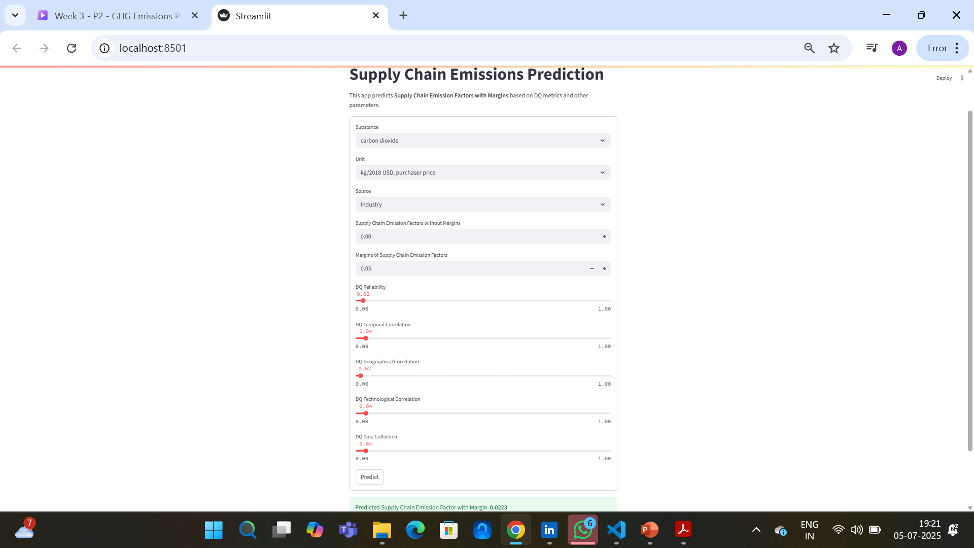
Screenshot of Output:
Deployment

Slide 11
Conclusion:
Successfully developed a machine learning model to predict supply chain GHG emission factors with margins
Applied a complete ML pipeline: from EDA and preprocessing to model training and deployment
Achieved meaningful results using Linear Regression, with performance validated using RMSE and R²
Built an interactive Streamlit app to make real-time predictions based on user input
Gained valuable hands-on experience in data science, model deployment, and application development

