Slide 1
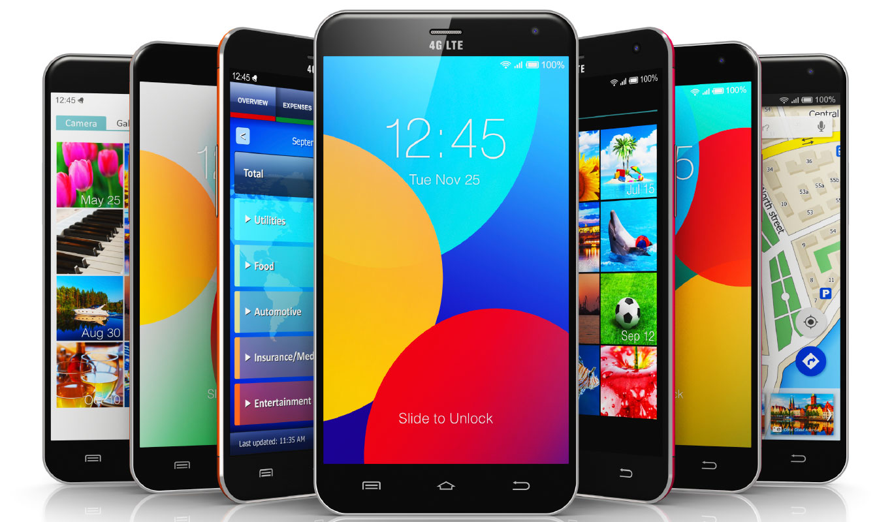
Smart phones

Slide 2
What is the smart phones?
a mobile phone that performs many of the functions of a computer, typically having a touchscreen interface, Internet access, and an operating system capable of running downloaded apps.

Slide 3
Uses of smart phones
We can use it for communications to other devices.
For sending massages and receive.
Capture all thing with camera that we want.
For take information about any think from the internet.
For entertainment(youtube,games,some applications)etc.

Slide 4
Why smart phones is important?
Smartphones are so important these days due to the connectivity they provide. This isn't just improvements in phone calls and text messaging. ... This saves money on your phone call allowance. One of the most popular connectivity apps for smartphones is facebook,whatsapp.hike,skype,Instagram etc.

Slide 5
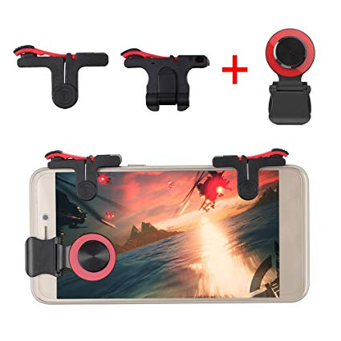
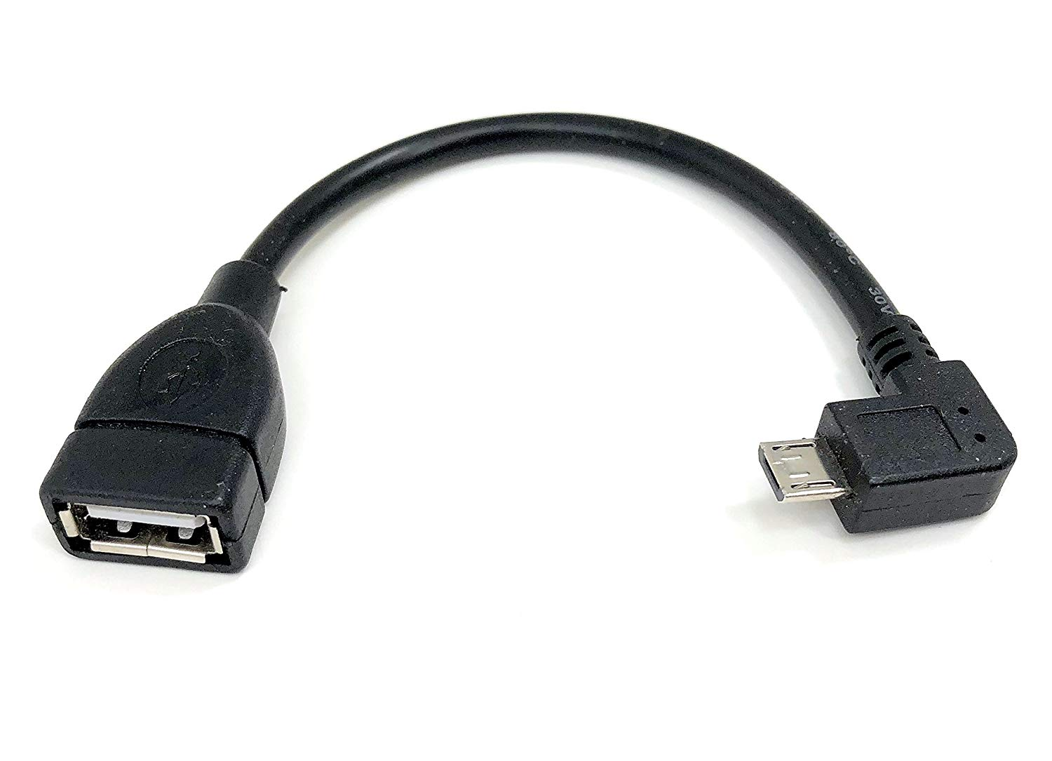
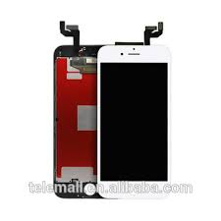
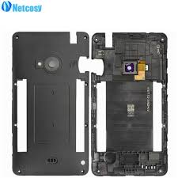
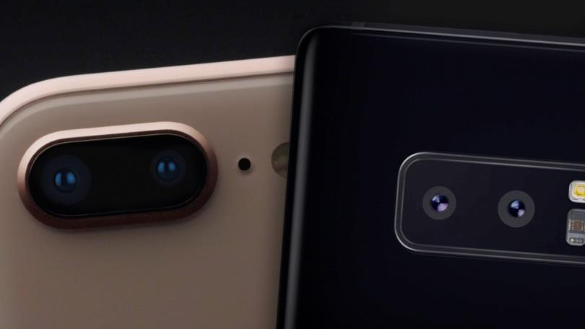
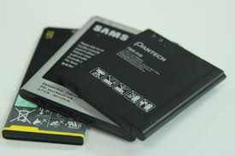
There are some sapre parts of smart phones .
Sound and vibrating spares
Buttons and joysticks
Housing
Batteries
Cameras
Connectors

Slide 6
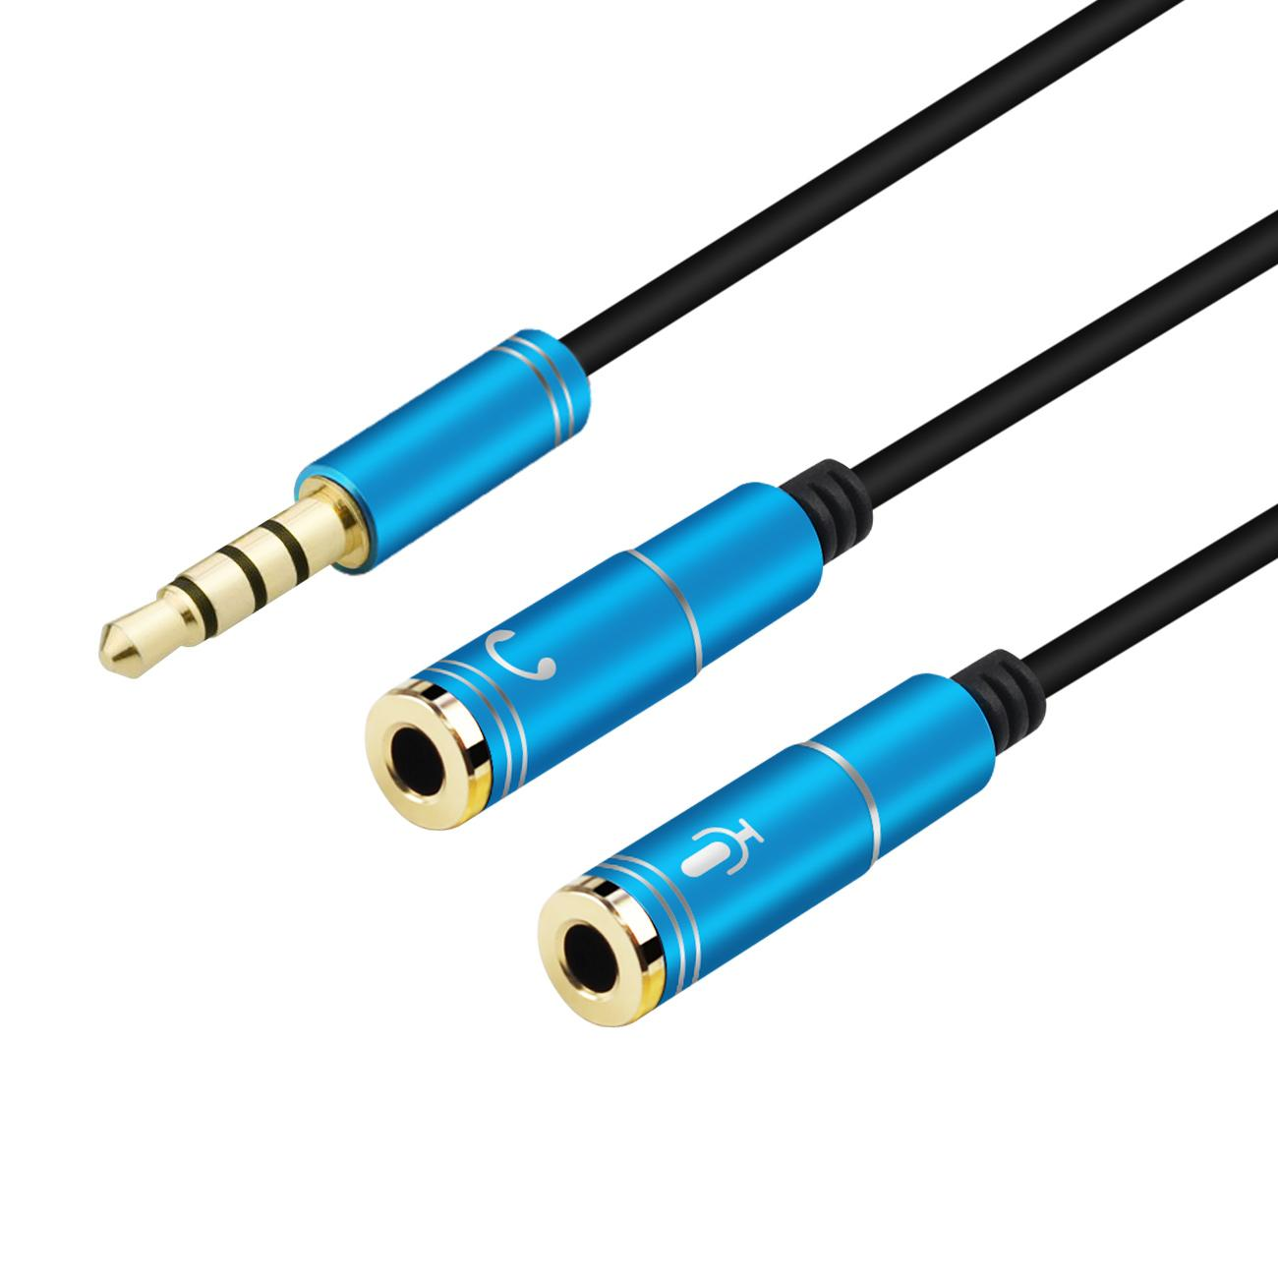
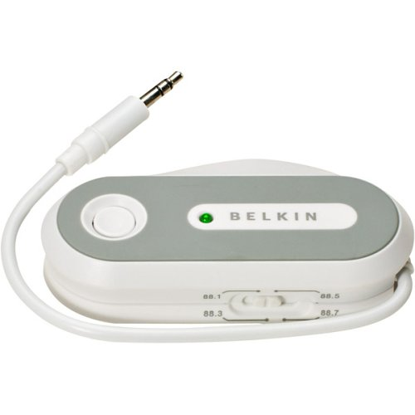
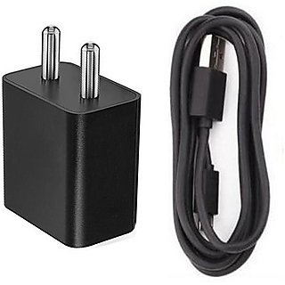
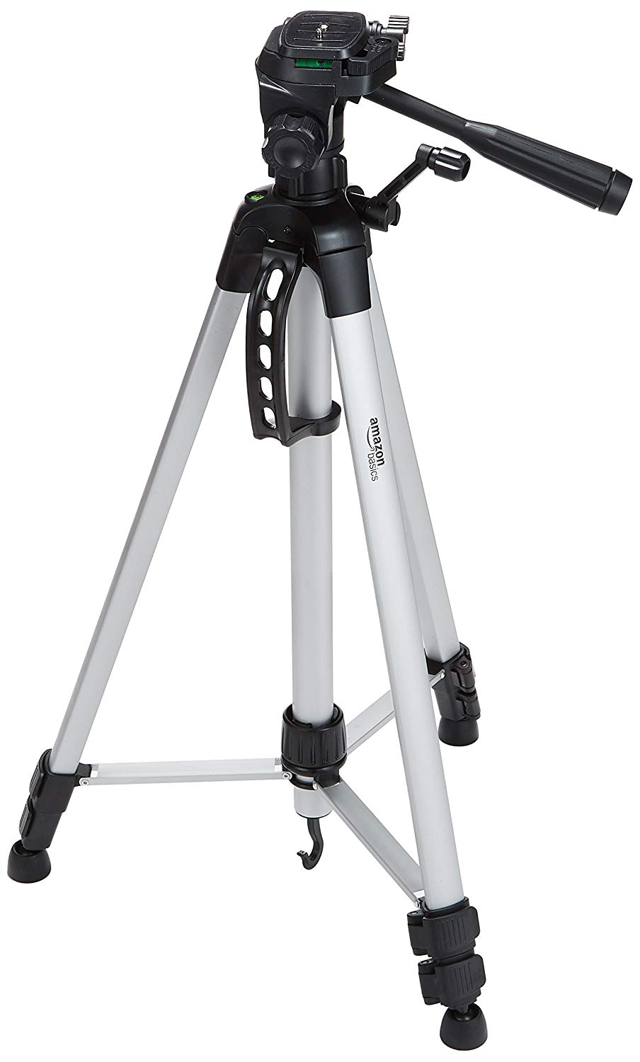
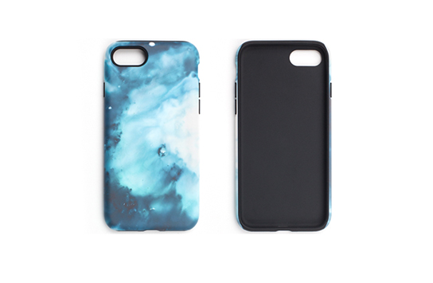
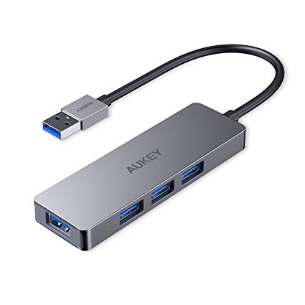
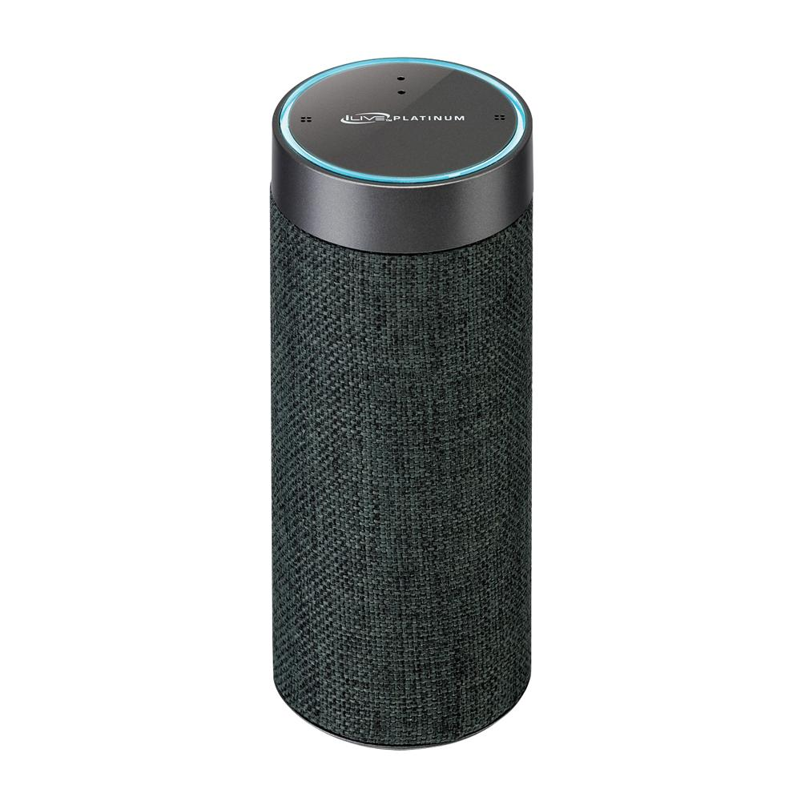
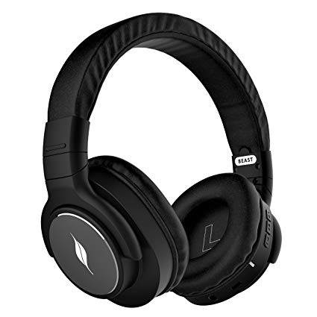
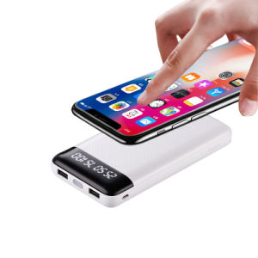
There are some accessories of smart phones
Cables adapters
Cases
Portable wireless speakers
Holders
Fm transmitters
Headphones
Chargers
Power banks
tripods

