Slide 1
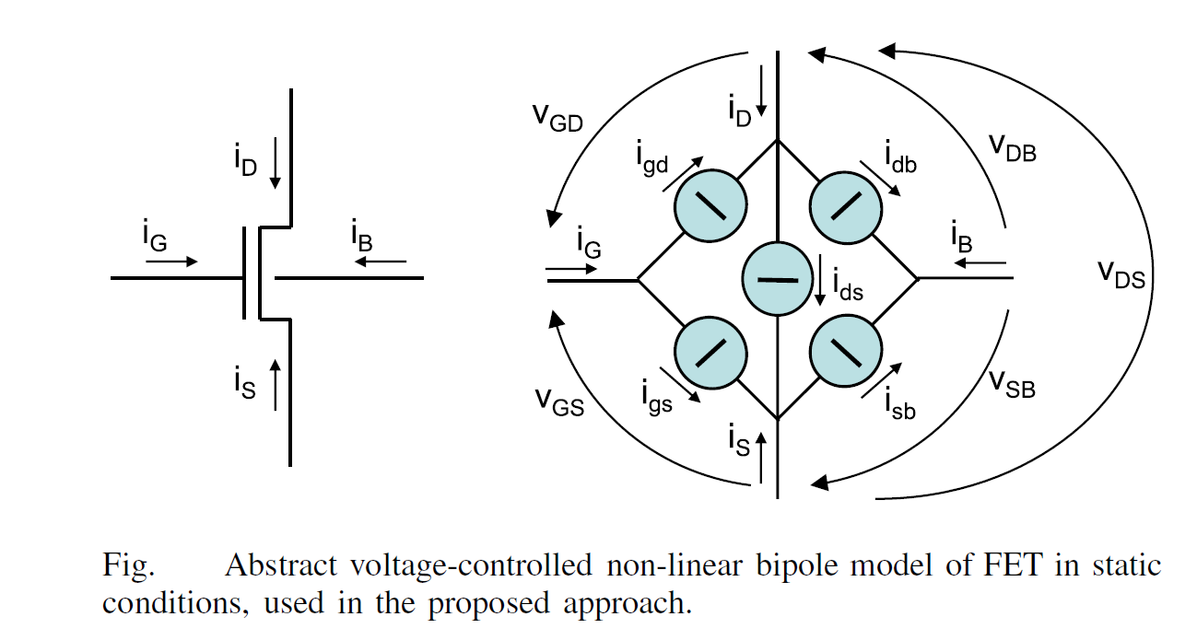

Slide 2
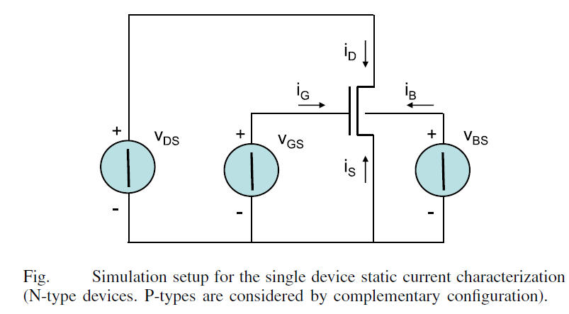

Slide 3
Single_4MOS_Package
-- 20n_1Wmin_Nfin_cond
constant one_mos_matrix_20n_1Wmin_Nfin_cond: one_mos_matrix := (
-temp vdd vdr vgt vsc vbk idrain igate isource ibulk
(30 5.000e-02, 0.000e+00, 5.000e-02, 0.000e+00, 0.000e+00, 5.506e-20, -5.713e-17, 5.506e-20, 7.023e-18), -- 0
(30 1.000e-01, 0.000e+00, 1.000e-01, 0.000e+00, 0.000e+00, 1.522e-18, -1.104e-16, 1.522e-18, 7.388e-18), -- 1
(30 1.500e-01, 0.000e+00, 1.500e-01, 0.000e+00, 0.000e+00, 3.949e-17, -2.348e-16, 3.949e-17, 5.829e-18), -- 2
(30 2.000e-01, 0.000e+00, 2.000e-01, 0.000e+00, 0.000e+00, 7.912e-16, -1.786e-15, 7.912e-16, 4.088e-18), -- 3
(30 2.500e-01, 0.000e+00, 2.500e-01, 0.000e+00, 0.000e+00, 8.578e-15, -1.741e-14, 8.578e-15, 2.688e-18), -- 4
(30 3.000e-01, 0.000e+00, 3.000e-01, 0.000e+00, 0.000e+00, 4.604e-14, -9.238e-14, 4.604e-14, 1.697e-18), -- 5
(30 3.500e-01, 0.000e+00, 3.500e-01, 0.000e+00, 0.000e+00, 1.514e-13, -3.031e-13, 1.514e-13, 1.041e-18), -- 6
(30 4.000e-01, 0.000e+00, 4.000e-01, 0.000e+00, 0.000e+00, 3.687e-13, -7.377e-13, 3.687e-13, 6.260e-19), -- 7
(30 4.500e-01, 0.000e+00, 4.500e-01, 0.000e+00, 0.000e+00, 7.419e-13, -1.484e-12, 7.419e-13, 3.704e-19), -- 8
(30 5.000e-01, 0.000e+00, 5.000e-01, 0.000e+00, 0.000e+00, 1.313e-12, -2.627e-12, 1.313e-12, 2.165e-19), -- 9
(30 5.500e-01, 0.000e+00, 5.500e-01, 0.000e+00, 0.000e+00, 2.124e-12, -4.248e-12, 2.124e-12, 1.254e-19), -- 10
(30 6.000e-01, 0.000e+00, 6.000e-01, 0.000e+00, 0.000e+00, 3.214e-12, -6.429e-12, 3.214e-12, 7.359e-20), -- 11
(30 6.500e-01, 0.000e+00, 6.500e-01, 0.000e+00, 0.000e+00, 4.626e-12, -9.252e-12, 4.626e-12, 7.651e-20), -- 12
(30 7.000e-01, 0.000e+00, 7.000e-01, 0.000e+00, 0.000e+00, 6.403e-12, -1.281e-11, 6.403e-12, 8.361e-19), -- 13
(30 7.500e-01, 0.000e+00, 7.500e-01, 0.000e+00, 0.000e+00, 8.592e-12, -1.718e-11, 8.592e-12, 1.978e-17), -- 14
(30 8.000e-01, 0.000e+00, 8.000e-01, 0.000e+00, 0.000e+00, 1.124e-11, -2.249e-11, 1.124e-11, 5.053e-16), -- 15
(30 8.500e-01, 0.000e+00, 8.500e-01, 0.000e+00, 0.000e+00, 1.441e-11, -2.884e-11, 1.441e-11, 1.347e-14), -- 16
(30 9.000e-01, 0.000e+00, 9.000e-01, 0.000e+00, 0.000e+00, 1.816e-11, -3.669e-11, 1.816e-11, 3.717e-13), -- 17
(30 9.500e-01, 0.000e+00, 9.500e-01, 0.000e+00, 0.000e+00, 2.255e-11, -5.567e-11, 2.255e-11, 1.057e-11), -- 18
(30 1.000e+00, 0.000e+00, 1.000e+00, 0.000e+00, 0.000e+00, 2.765e-11, -3.641e-10, 2.765e-11, 3.088e-10), -- 19
(30 1.050e+00, 0.000e+00, 1.050e+00, 0.000e+00, 0.000e+00, 3.355e-11, -9.294e-09, 3.355e-11, 9.227e-09), -- 20
(30 1.100e+00, 0.000e+00, 1.100e+00, 0.000e+00, 0.000e+00, 4.034e-11, -2.814e-07, 4.034e-11, 2.813e-07), -- 21
(30 1.150e+00, 0.000e+00, 1.150e+00, 0.000e+00, 0.000e+00, 4.811e-11, -8.732e-06, 4.811e-11, 8.732e-06), -- 22
(30 1.200e+00, 0.000e+00, 1.200e+00, 0.000e+00, 0.000e+00, 5.697e-11, -2.754e-04, 5.697e-11, 2.754e-04), -- 23

Slide 4
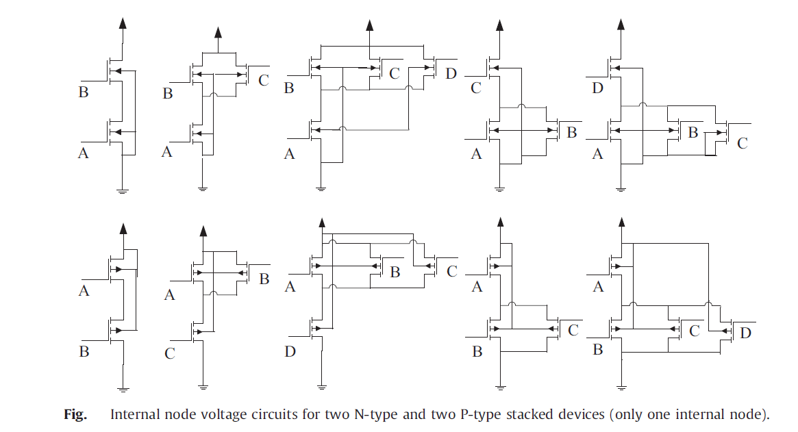

Slide 5
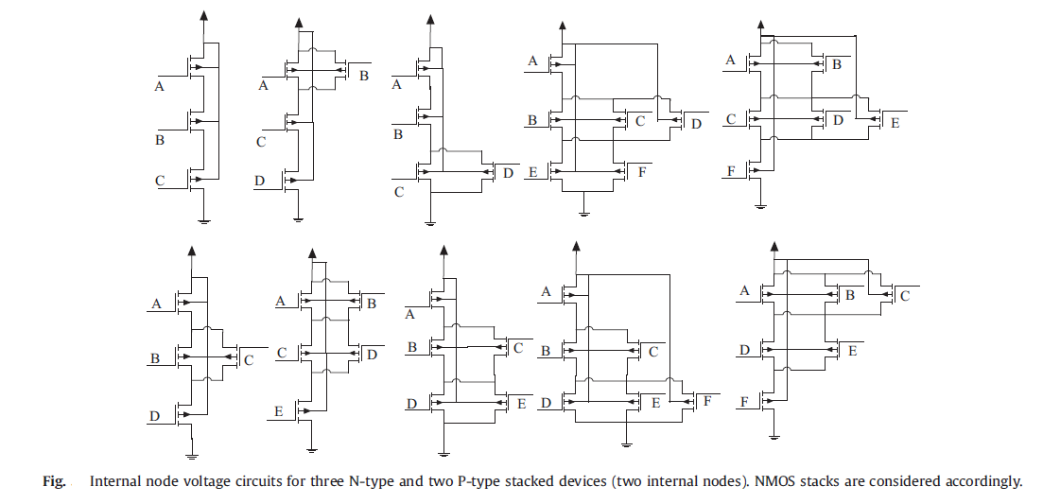

Slide 6
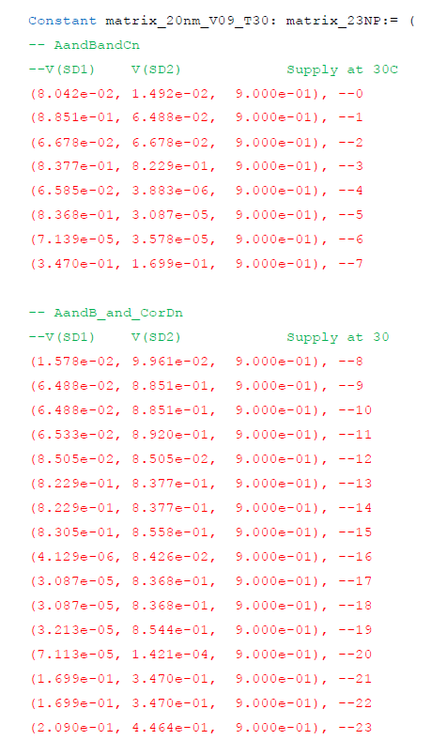
INV_Package

Slide 7
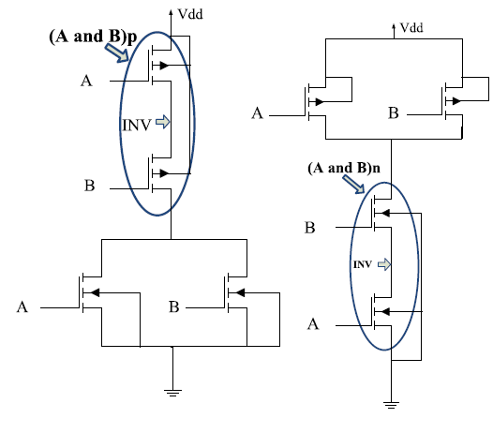

Slide 8
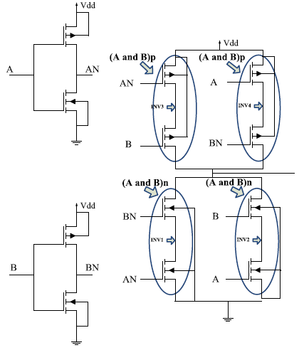

Slide 9
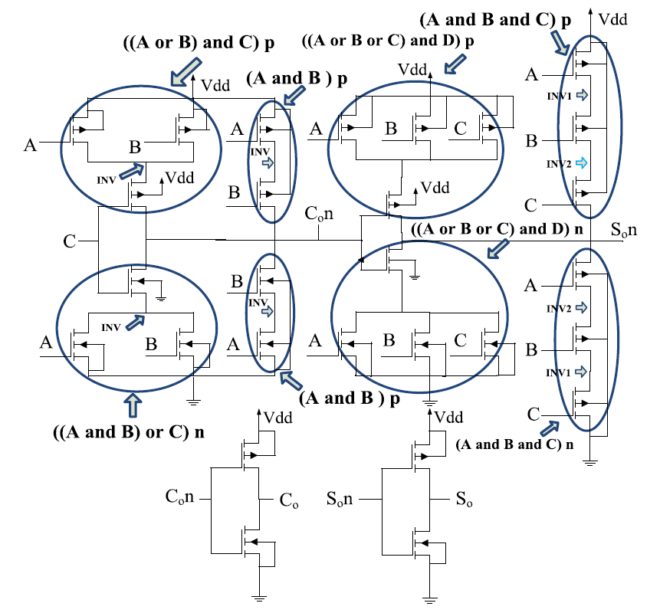

Slide 10
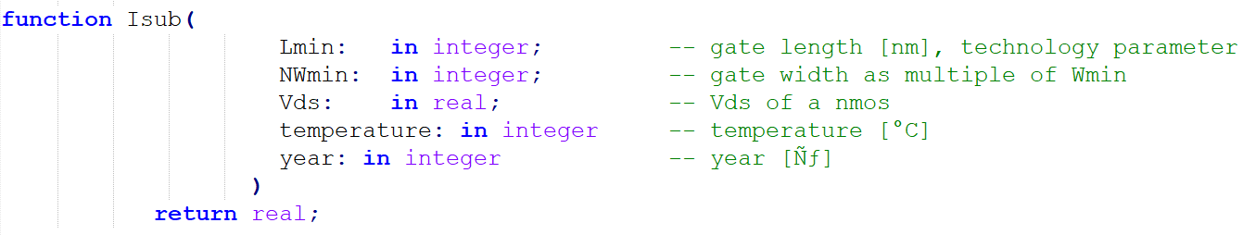
LEAKAGE CURRENTs FUNCTION DECLARATIONS
Sub-threshold leakage current
I_{sub} generates subthreshold current , being V_{ds} and V_{gs} known

Slide 11
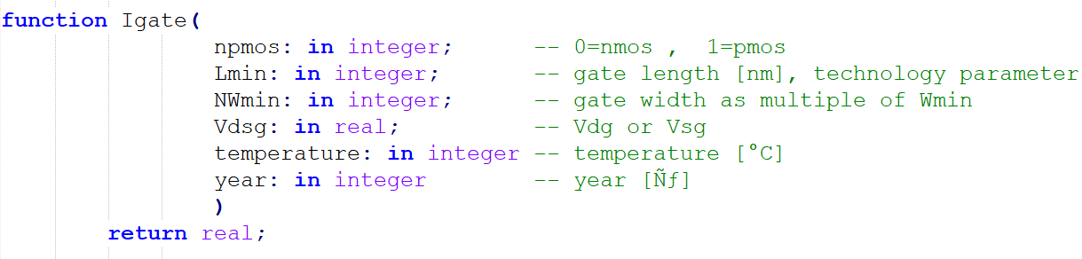
LEAKAGE CURRENTs FUNCTION DECLARATIONS
Gate leakage current
I_{gate} generates only one I_{gate} component, that means I_{gd} or I_{gs} at each call of this function

Slide 12
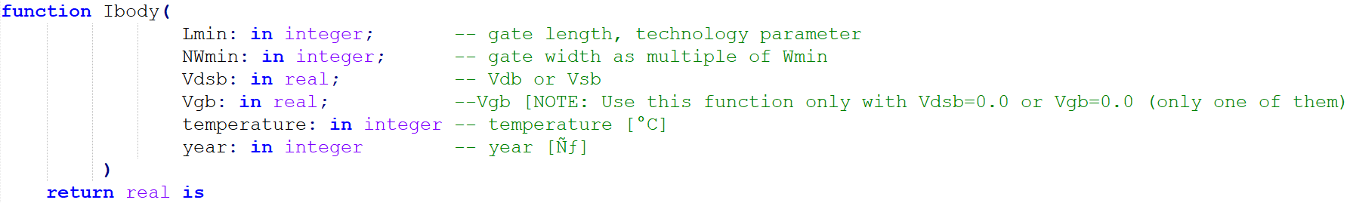
LEAKAGE CURRENTs FUNCTION DECLARATIONS
Body leakage current
I_{body} generates only one I_{body} component, that means I_{db} or I_{sb} at each call of this function.

Slide 13
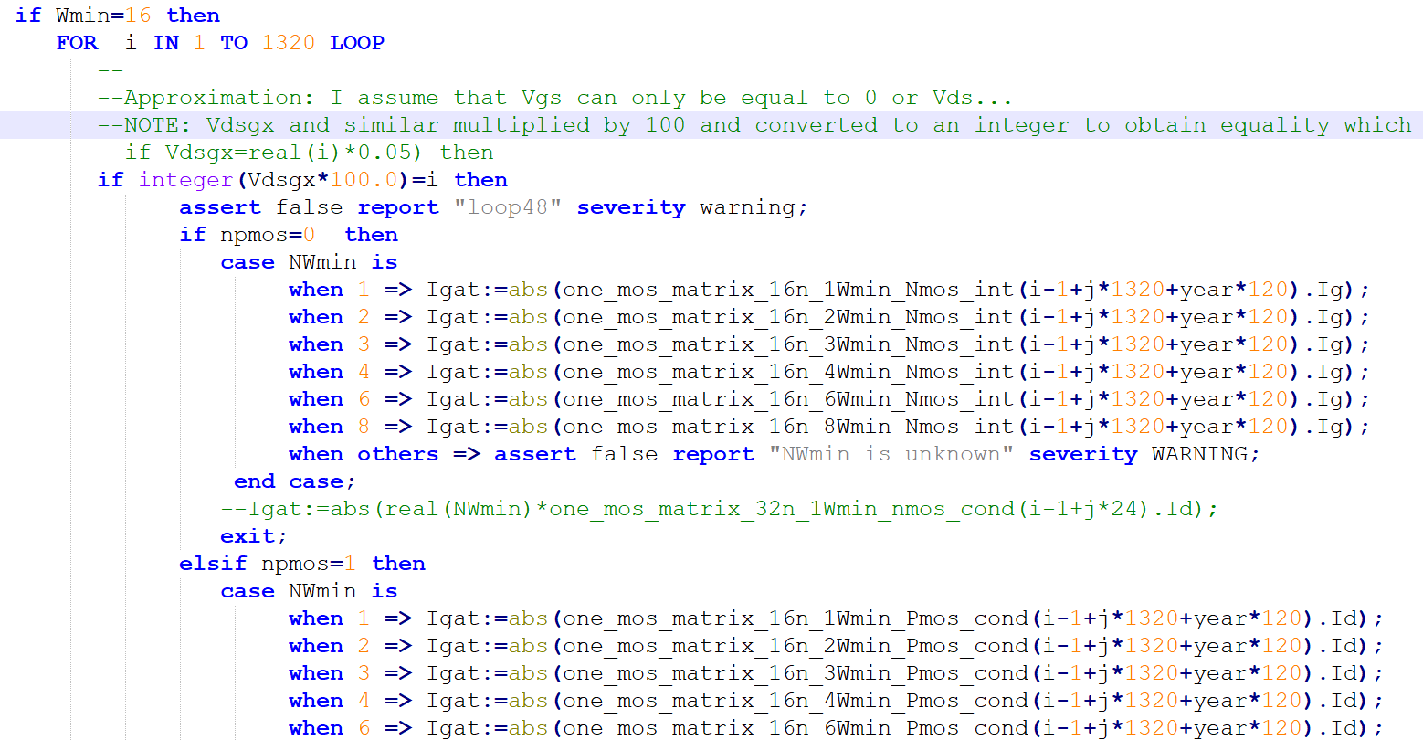
Example:

Slide 14
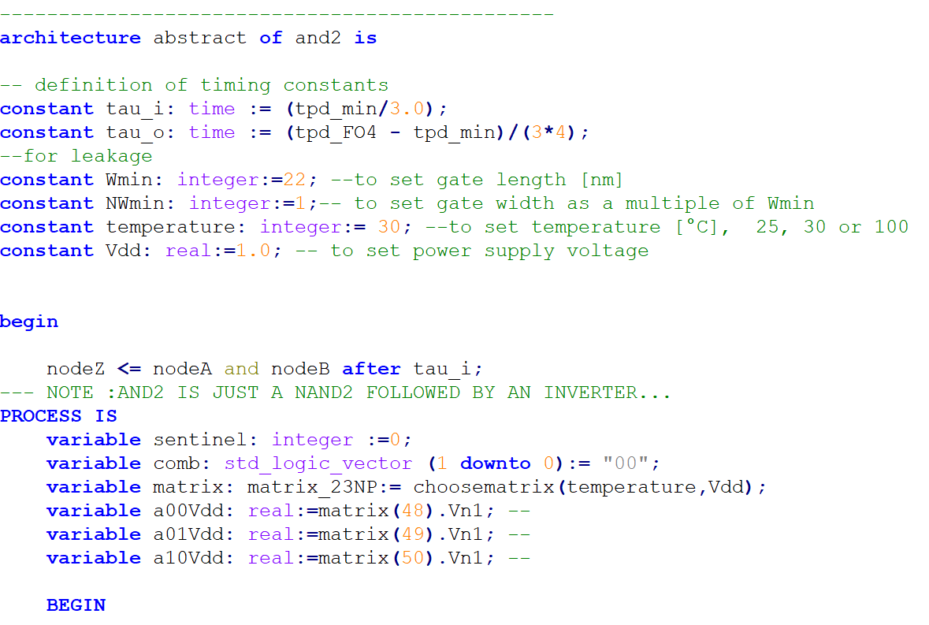

Slide 15
