Slide 1
IMAGE STEGANOGRAPHY IN MATLAB
USING LSB ALGORITHM

Slide 2
CONTENTS
 | TITLE
1. | Introduction
2. | Steganography vs. Cryptography
3. | Types of Steganography
4. | Image Steganography using LSB algorithm
5. | How are message bits embedded in the LSB ?
6. | Comparison between original and stego image
7. | Conclusion

Slide 3
INTRODUCTION
Steganography is the art of hiding information imperceptibly in a cover medium. The word "Steganography" is of Greek origin and means "covered or hidden writing". The main aim in steganography is to hide the very existence of the message in the cover medium. Steganography and cryptography are counter parts in digital security the obvious advantage of steganography over cryptography is that messages do not attract attention to themselves, to messengers, or to recipients. Also, the last decade has seen an exponential growth in the use of multimedia data over the Internet. These include Digital Images, Audio and Video files.

Slide 4
STEGANOGRAPHY VS. CRYPTOGRAPHY
STEGANOGRAPHY
CRYPTOGRAPHY
Steganography is hiding the message in another median so that nobody will notice the message.
Goal is to prevent an observant intermediary from even obtaining knowledge of the mere presence of the secret data.
Imperceptible by human vision.
The encrypted message could be seen by anyone but cryptography makes the message not understandable.
Goal is to prevent an interceptor from gaining any information about the plaintext.
Easily detectable by human vision.

Slide 5
Types of Steganography
1. Image Steganography–The most popularly used cover objects are images.
2. Text Steganography- Can be achieved by alternating the text formatting .
3. Video Steganography-Alteration is done in the digitized signal .
4. Protocol

Slide 6
Image Steganography using LSB algorithm
Least significant bit (LSB) insertion is a common, simple approach to embedding information in a cover image. The least significant bit (in other words, the 8th bit) of some or all of the bytes inside an image is changed to a bit of the secret message. When using a 24-bit image, a bit of each of the red, green and blue colour components can be used, since they are each represented by a byte. In other words, one can store 3 bits in each pixel.

Slide 7
How are message bits embedded in the LSB of the image?
For example a grid for 3 pixels of a 24-bit image can be as follows:
(00101101 00011100 11011100)
(10100110 11000100 00001100)
(11010010 10101101 01100011)
When the character T(ASCII value-84) binary representation is 01010100, is embedded into the least significant bits of this part of the image, the resulting grid is as follows:
(00101100 00011101 11011100)
(10100111 11000100 00001101)
(11010010 10101100 011000101)

Slide 8
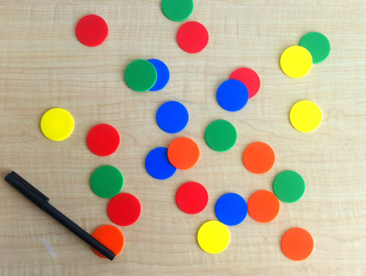

The LSB substitution results in very minor changes in the resultant image which is very much negligible for the human perception.
Original Image
Stego Image

Slide 9
CONCLUSION
The security of the image steganography process mainly resides in the fact that the attacker does not know they are looking at a stego-image. If the message is hidden well enough in the cover image, then the attacker will not know to check the image.
Image Steganography is very applicable to this day and age as the internet and social media are main communication avenues. A well-crafted stego-image could easily pass thousands of eyes without a second thought before it reached its destination and delivered a message.
Image Steganography will be present in Cryptology in the years to come because it is a method that is impossible to break when it is not known that it is there.

Slide 10
THANKYOU

