Slide 1

PURNEA COLLEGE OF ENGINEERING
A Project on
VEHICLE MOVEMENT STREET LIGHT WITH AUTOMATIC LIGHT SENSING
Department of
Electronics & Communication Engineering
PREPARED BY:- GUIDED BY:-
Shubham Kumar (17104131027) Prof. Vikas Kumar
Ashish Kumar Gupta (17104131023) Asst. Professor ECE Department
Ankit Kumar (17104131025) PCE, PURNEA
Bambam Kumar (17104131028)
Bishwabhandhu Kumar (17104131024)
Shatrudhan Kumar (17104131026)
Shubham Kumar (17104131022)

Slide 2
Contents:
Introduction
Arduino UNO R3
Circuit Diagram
Circuit Component
Working Procedure
Results
Advantages
Applications
Conclusion

Slide 3
INTRODUCTION:
Automation plays an increasingly very important role in the world economy and in daily life. Automatic systems are being preferred over any kind of manual system. We can also call it an “SMART STREET LIGHT SENSING”. Intelligent light sensing refers to public street lighting that adapts to movement by pedestrians, cyclists and cars. Intelligent street lighting, also referred to as adaptive street lighting, dims when no activity is detected, but brightens when movement is detected. This type of lighting is different from traditional, stationary and illumination, or dimmable street lighting that dims at pre-determined times.

Slide 4
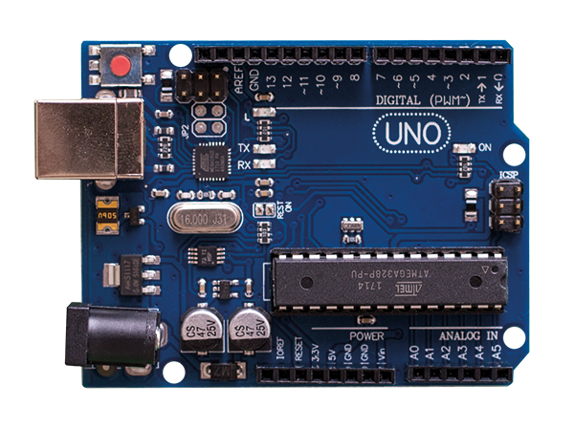
Arduino UNO R3: Arduino Uno R3 is one kind of ATmega328P based microcontroller board. It includes the whole thing required to hold up the microcontroller; just attach it to a PC with the help of a USB cable, and give the supply using AC-DC adapter or a battery to get started. The term Uno means “one” in the language of “Italian” and was selected for marking the release of Arduino’s IDE 1.0 software. The R3 Arduino Uno is the 3rd as well as most recent modification of the Arduino Uno. Arduino board and IDE software are the reference versions of Arduino and currently progressed to new releases. The Uno-board is the primary in a sequence of USB-Arduino boards, & the reference model designed for the Arduino platform.

Slide 5
Arduino Uno R3 Specifications:
It is an ATmega328P based Microcontroller
The Operating Voltage of the Arduino is 5V
The recommended input voltage ranges from 7V to 12V
The i/p voltage (limit) is 6V to 20V
Digital input and output pins-14
Digital input & output pins (PWM)-6
Analog i/p pins are 6
DC Current for each I/O Pin is 20 mA
DC Current used for 3.3V Pin is 50 mA
Flash Memory -32 KB, and 0.5 KB memory is used by the boot loader
SRAM is 2 KB
EEPROM is 1 KB
The speed of the CLK is 16 MHz
In Built LED
Length and width of the Arduino are 68.6 mm X 53.4 mm
The weight of the Arduino board is 25 g

Slide 6
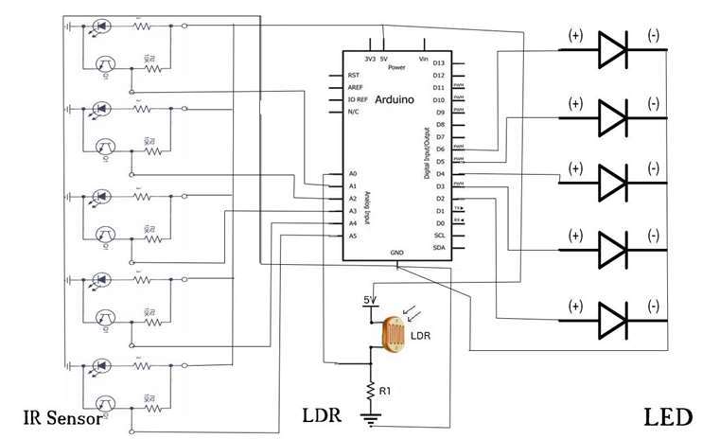
Circuit Diagram:

Slide 7
Circuit Component:
IR Sensor
Light Dependent Sensor
Light Emitting Diode
Transistor(BC547)

Slide 8
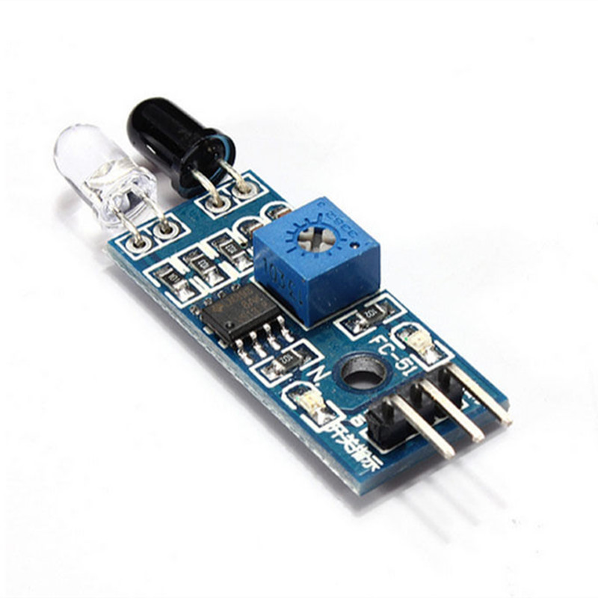
IR Sensor: IR sensor is an electronic device, that emits the light in order to sense some object of the surroundings. An IR sensor can measure the heat of an object as well as detects the motion. Usually, in the infrared spectrum, all the objects radiate some form of thermal radiation. These types of radiations are invisible to our eyes, but infrared sensor can detect these radiations.

Slide 9
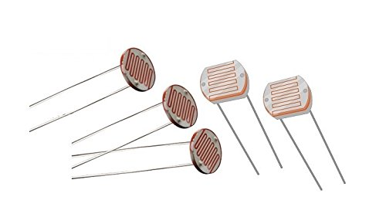
Light Dependent Sensor:
Light dependent resistors, LDRs or photoresistors are often used in electronic circuit designs where it is necessary to detect the presence or the level of light.
These electronic components can be described by a variety of names from light dependent resistor, LDR, photoresistor, or even photo cell, photocell or photoconductor.

Slide 10
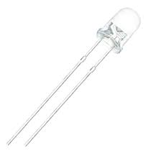
Light Emitting Diode:
A light-emitting diode (LED) is a semiconductor light source that emits light when current flows through it. Electrons in the semiconductor recombine with electron holes, releasing energy in the form of photons. The color of the light (corresponding to the energy of the photons) is determined by the energy required for electrons to cross the band gap of the semiconductor.^{[5]} White light is obtained by using multiple semiconductors or a layer of light-emitting phosphor on the semiconductor device.

Slide 11
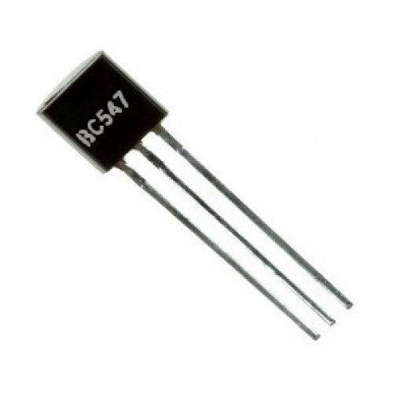
Transistor(BC 547): The BC547 transistor is an NPN transistor. A transistor is nothing but the transfer of resistance which is used for amplifying the current. A small current of the base terminal of this transistor will control the large current of emitter and base terminals. The main function of this transistor is to amplify as well as switching purposes. The maximum gain current of this transistor is 800A.

Slide 12
Working Procedure: The working procedure of the Smart street light using IR sensors is explained below. The following are the different steps included in building a Smart street light. Output of the LDR pin is connected to A0 (analog) port of Arduino Uno board. Connect all output of the IR sensors to port numbers A1, A2, A3, A4 and A5 respectively (analog) which is the input signal to the Arduino board. Connect the ground of all the IR sensors to GND port. The output signals from LED are connected to port number 5, 6, 9, 10 and 11 respectively. Again connect all the negative terminals of LED’s to GND port. Power is passed to the Arduino (7-12V)

Slide 13
Result: The project is designed to detect vehicle movement on highways to switch ON only a block of street lights before of vehicles and to switch OFF the behind lights to save energy. Now a days during night all the lights ON in highway, but lots of energy is wasted when there is no vehicle movement.

Slide 14
Advantages:
This circuit uses LED Bulbs, so it is very low cost and it has more life span.
Maximum energy can be saved.
Low maintenance and low power consumption.
Low power consumption.
Less manpower required.
Light Sensors used have high sensitivity and are Easily implementable.

Slide 15
Application: Parking Lightings Street Lights Garden Lights Highways

Slide 16
Conclusion:
By using Smart Street light, one can save surplus amount of energy which is done by replacing sodium vapor lamps by LED and adding an additional feature for security purposes. It prevents unnecessary wastage of electricity, caused due to manual switching of streetlights when it’s not required. It provides an efficient and smart automatic streetlight control system with the help of IR sensors. It can reduce the energy consumption and maintains the cost. The system is versatile, extendable and totally adjustable to user needs.
The system is now used only for One way traffic in highways.
Continuous uses of LDR and IR sensors even in day time.
Not switched on before the sunset.
The Smart light system can be further extended to make the current system in two- way traffic, making the system more flexible in case of rainy days and introduction of ways to control the lights through GSM based service.

Slide 17
Thank you.

