Slide 1
CNS PROJECT
REMOTE HEALTH MONITORING SYSTEM USING SOCKETS AND MACHINE LEARNING
ASHISH M BHAT ( 1BM16IS022 )
M S SHREYAS ( 1BM16IS050 )

Slide 2
PROBLEM STATEMENT
There exists a certain problem with the hospital system’s tradition of patients having to take appointments. Often, the appointments get filled up and there is a high chance that a patient’s situation with a serious illness may escalate. The only option is for them to look into other hospitals for appointments with no guarantee of actually getting one.

Slide 3
MOTIVATION
The motivation behind our project is to have patients diagnosed early, predicting the disease inflicting them and prevent the patient’s situation to worsen by providing them prescribed medicines.

Slide 4
EXISTING SYSTEM
For a patient to visit a doctor to get their illness diagnosed, the existing system provides a way of taking appointments at the reception desk in hospital. The number of patients being consulted by a specific medical practitioner is limited and so there is no guarantee of a patient getting a successful appointment.

Slide 5
OUR SOLUTION
Remote health monitoring, also referred to as remote patient monitoring, is the process of using technology to monitor patients in non-clinical environments, such as in the home. When incorporated in the management of chronic diseases, remote health monitoring has the potential to significantly improve quality of life for patients.
Here, the patient communicates with a server ( or a ‘doctor bot’ ) revealing their symptoms. The server, acting as a doctor, based on the data of symptoms provided by the patients, employs machine learning to predict the illness the person has and also a medical prescription, listing out the medicines to be taken and it’s dosage.

Slide 6
Implementation
Step 1 : The server is assumed to be up and running, listening for incoming connections on a specific port.
Step 2 : The client connects to the server by specifying the IP address of the server and the port number.If the
server is active, a TCP connection is formed.
Step 3: The client (patient) is asked to specify the symptoms he is currently facing. A file is then sent to the
server(doctor), specifying the symptoms.
The patient then waits for the server to send the report.
Step 4: The doctor applies a machine learning algorithm to find the disease the client has.

Slide 7
Step 5: If the accuracy of the predicted disease is too low, the doctor bot asks the patient to visit a doctor in person.
Else, the server accesses a database that has prescriptions for the disease. The server then writes the
disease name along with the prescriptions into a text file and sends it to the client, who is still waiting for the results.
Step 6: The patient receives the file from the server which specifies the disease and the prescription, or a
message saying to visit the doctor.

Slide 8
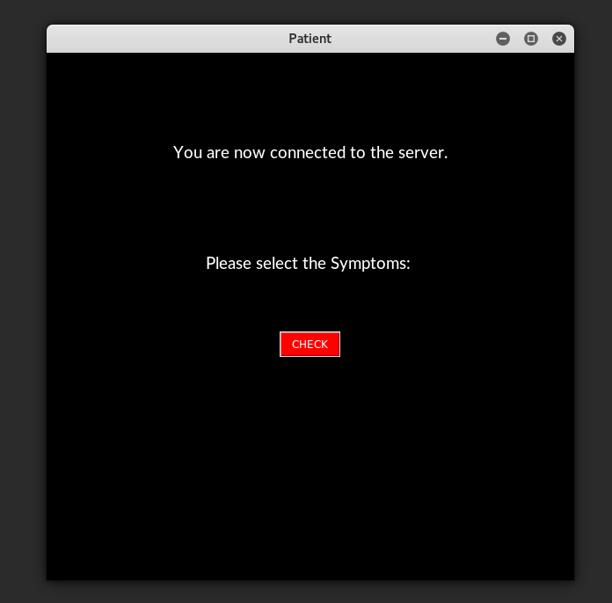
Screenshots

Slide 9
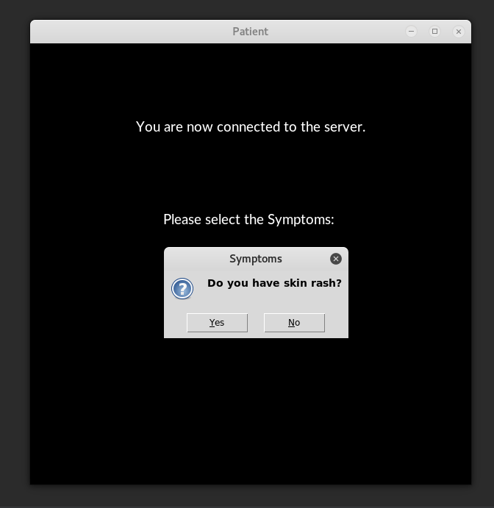
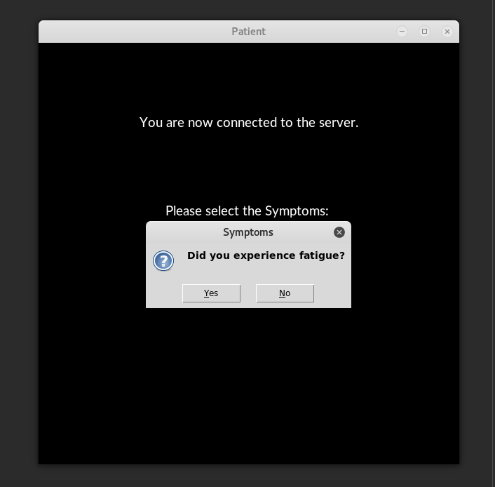

Slide 10
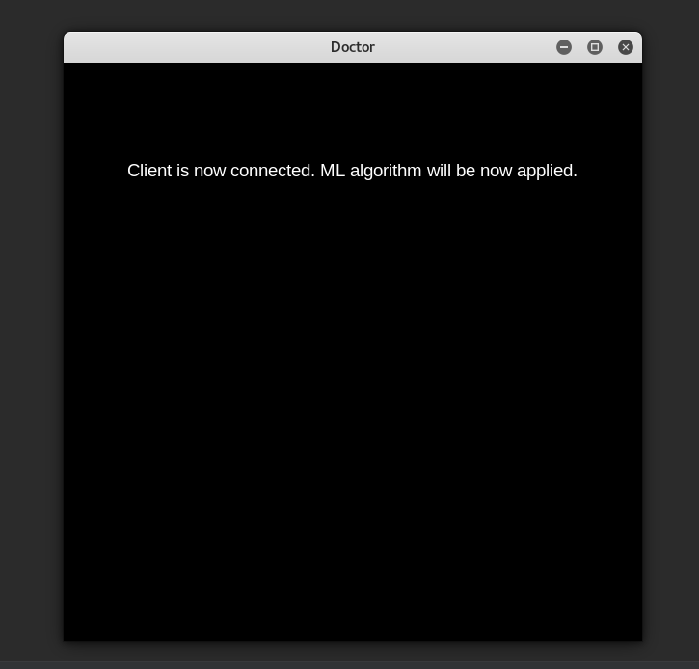
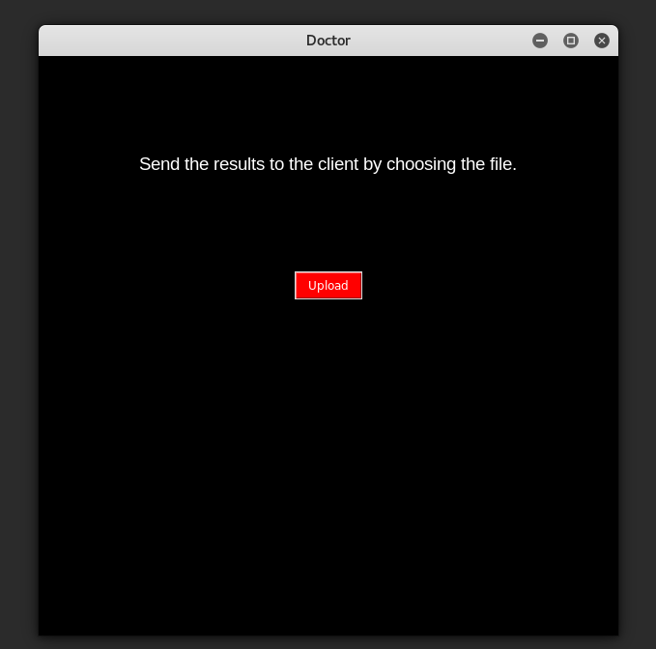

Slide 11
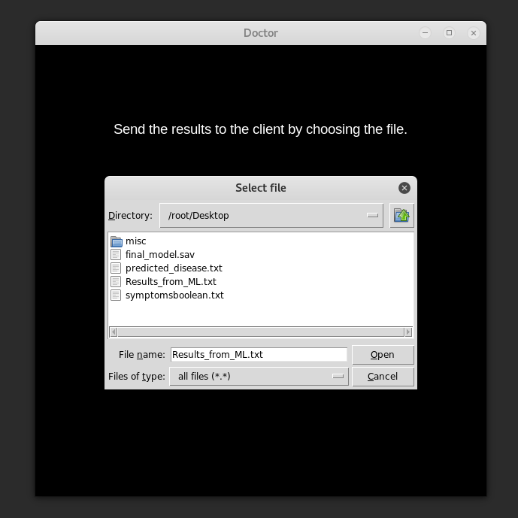
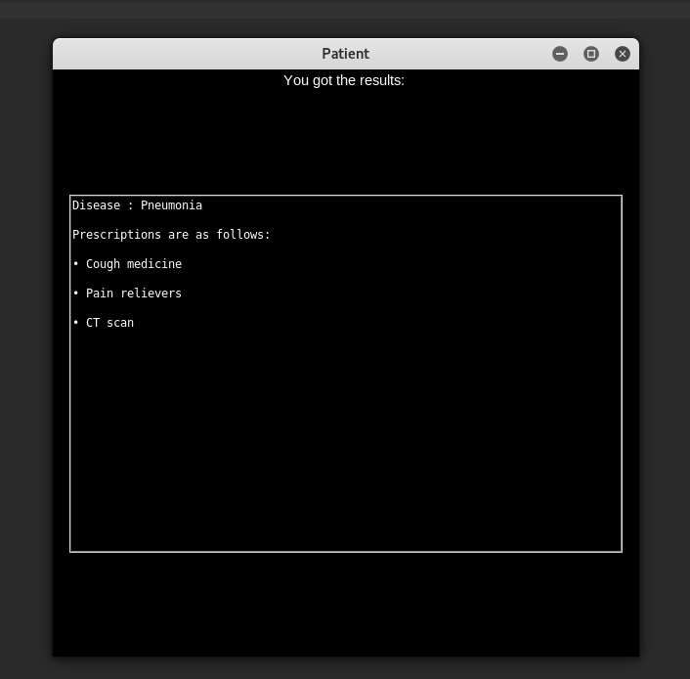

Slide 12
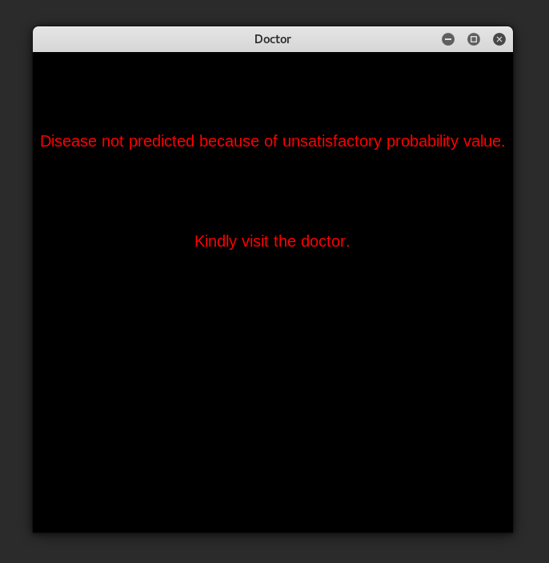
Case when the disease couldn’t be predicted

Slide 13
Tools Used
Pycharm / Spyder as the IDE
Sqlite3 for the database
Tkinter for the GUI
Socket modules
ML modules

Slide 14
Thank You

