Slide 1
Parthasarathi Ponnapalli Ashish Mahajan
C++ / Qt6
Python / PySide6
Expense Tracker
C++ vs Python — Language Comparison
Cross Language Application Development — Team 4
Group Members
Parthasarathi Ponnapalli
Ashish Mahajan
University of the Cumberlands
Advanced Programming Languages (MSCS-632)
February 22, 2026

Slide 2
What We Built
A desktop Expense Tracker built TWICE — once in C++ with Qt6, once in Python with PySide6.
Same features. Same .ui files. Same JSON data. Two completely different languages.
💰
🔍
📊
👥
Expense CRUD
Filtering
Summary Panel
Multi-User
Add · Edit · Delete
with validation
Date range &
category dropdown
Totals · Pie chart
per-category
User switcher
& management
Shared: .ui files (Qt Designer) · .qss stylesheet · JSON data file · MVC architecture
Different: Data structures · Memory model · Type system · Error detection timing

Slide 3
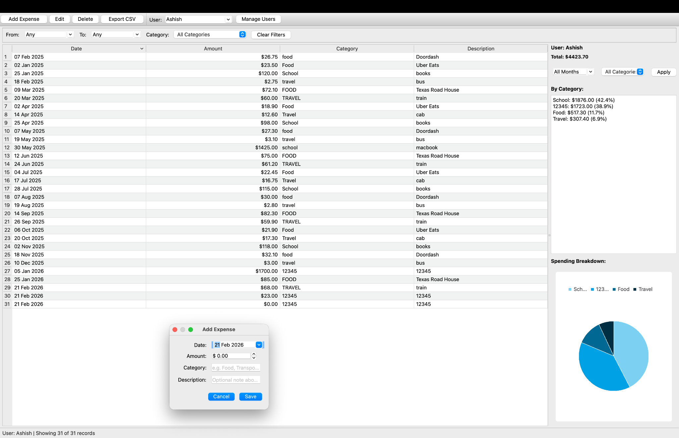
Python UI (PySide6)

Slide 4
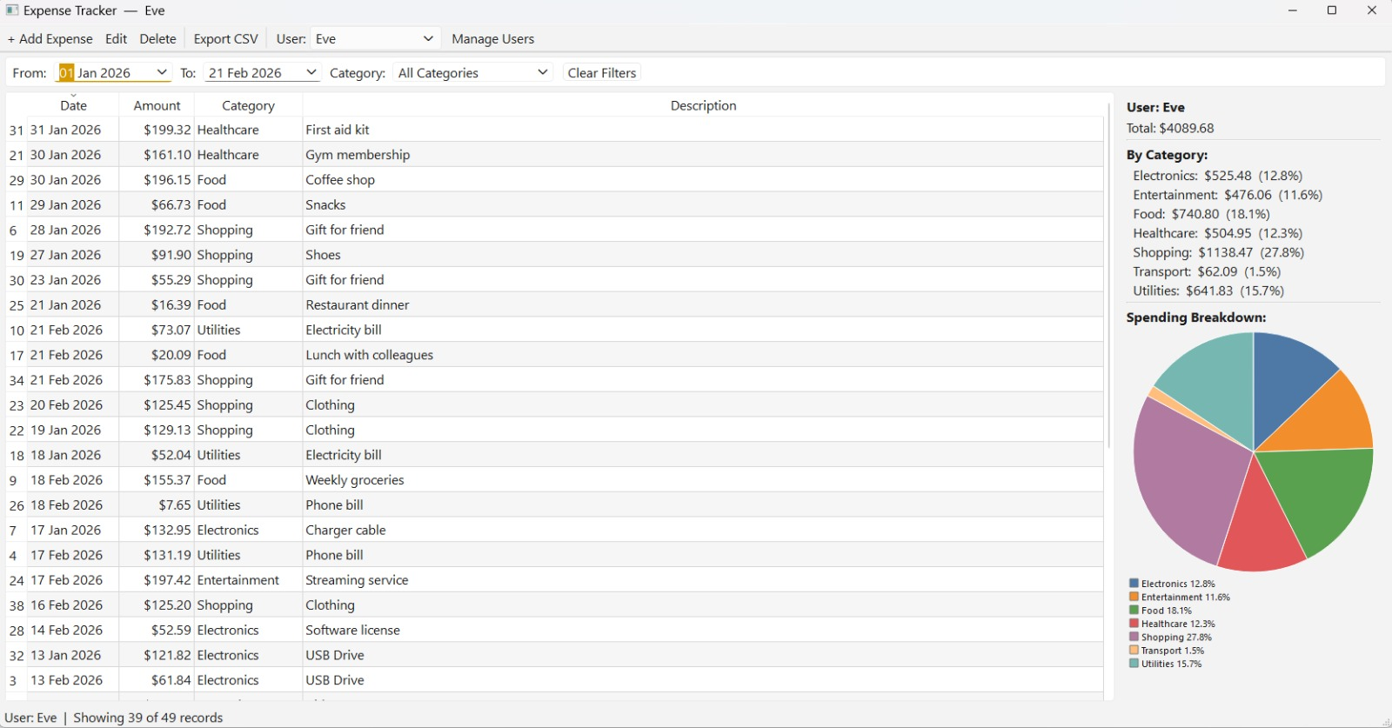
C++ UI (Qt6)

Slide 5
Data Representation
How each language models an expense

Slide 6
C++ / Qt6
Python / PySide6
C++
Modeling an Expense Record
Python
// Typed struct — every field declared
struct ExpenseRecord {
int id;
int userId;
QDate date;
double amount;
QString category;
QString description;
// Safe defaults at construction time
ExpenseRecord()
: id(-1), userId(-1), amount(0.0) {}
bool isValid() const { ... }
};
# Dict — no fixed shape required
expense = {
'date': '2026-01-15',
'amount': 45.0,
'category': 'Food',
'description': 'Lunch',
'user': 'Alice',
}
# Type hints added for safety
expenses: list[dict[str, Any]] = []
# validate_expense() normalizes fields
# at runtime before storing
✓ Compile-time guarantee: Wrong type = error before the app runs. Fields cannot be missing.
✓ Runtime flexibility: No boilerplate needed. validate_expense() enforces shape when data enters the system.
Key difference: C++ catches wrong data at compile time. Python catches it at runtime.

Slide 7
C++ / Qt6
Python / PySide6
C++
Storage & Containers
Python
// TYPED — can only hold ExpenseRecord
std::vector<ExpenseRecord> m_expenses;
std::vector<UserRecord> m_users;
// SORTED automatically by key
std::map<QString, double> totals;
totals[category] += amount;
// Filtering — manual loop
for (auto& e : m_expenses) {
if (e.userId==id && e.date>=from)
result.push_back(e);
}
# Untyped — holds anything
self.expenses: list[dict[str, Any]] = []
# Filtering — list comprehension
filtered = [
e for e in self.expenses
if e['user'] == user_filter
and from_dt <= date <= to_dt
]
# Auto-initialising totals
from collections import defaultdict
totals: defaultdict[str, float] = defaultdict(float)
Container
std::vector<T> — typed
list — accepts anything
Category map
std::map — typed + auto-sorted
defaultdict(float) — flexible
Filtering
Explicit for-loop
List comprehension (concise)

Slide 8
Memory Management
Who owns objects and who cleans them up

Slide 9
C++ / Qt6
Python / PySide6
C++
Ownership & Cleanup
Python
// Manually owned — we delete these
Ui::MainWindow* m_ui;
ExpenseRepository* m_repo;
ExpenseTableModel* m_model;
// Qt parent-child — auto-deleted
QSortFilterProxyModel* m_proxy; // parent=this
SummaryWidget* m_summary;
// Stack allocation — no new/delete at all
int main(int argc, char* argv[]) {
QApplication app(argc, argv);
MainWindow window; // RAII
} // destructors called automatically
# Python handles this automatically
# via reference counting (CPython GC)
class MainWindow:
def __init__(self):
self.manager = ExpenseManager()
self.model = ExpenseTableModel()
# When window goes out of scope,
# GC decrements reference counts
# and frees objects — eventually.
# No destructors, no delete, no RAII.
Qt parent-child
Manual new/delete
RAII / Stack
Python GC
Programmer controls exact moment of cleanup
Qt deletes child widgets when parent closes
Reference counting frees objects automatically — no manual cleanup ever needed.
Destructor runs automatically at scope exit
C++ cleanup is deterministic (exact moment known). Python GC cleanup is non-deterministic ("sometime later").

Slide 10
Type System & Safety
When do errors get caught?

Slide 11
Compile-Time vs Runtime Safety
Feature
C++ / Qt6
Python / PySide6
Typed containers
std::vector<ExpenseRecord> cannot hold a string — compiler error immediately
list accepts anything — mistake only visible at runtime when .amount fails
const correctness
const on method = compiler verifies it never modifies data. const& = read-only reference
No equivalent — runtime convention only
override keyword
Typo in overridden method name → compiler error. Saves hours of debugging
No equivalent — wrong name creates new method silently
Private members
private: compiler physically blocks outside access to m_expenses
_name is convention only — external code can still access it
Type hints
Built into the language — no choice
Optional (list[dict[str,Any]]) — helps IDEs but not enforced at runtime

Slide 12
UI Architecture
MVC - shared pattern, different wiring

Slide 13
Model-View-Controller
MODEL
VIEW
CONTROLLER
PERSIST
C++
C++
C++
C++
ExpenseRepository holds
std::vector<ExpenseRecord>.
Private data — compiler enforced.
.ui files compiled by uic at build time.
ExpenseTableModel overrides data().
PieChartWidget paints with QPainter.
MainWindow::refresh() is the
single update point. Signals/slots
wired with typed connect().
QJsonDocument writes to
QStandardPaths::AppLocalDataLocation.
Saves on every write.
Python
Python
Python
Python
ExpenseManager holds
list[dict[str, Any]].
validate_expense() enforces shape.
.ui files loaded at runtime via
uic.loadUiType(). Same table model
pattern with PySide6.
MainWindow filters and refreshes.
Slots use @Slot decorator
and .connect() method.
Python stdlib json module.
ExpenseManager.save_to_json() /
load_from_json().

Slide 14
C++ / Qt6
Python / PySide6
C++
Signal / Slot Wiring
Python
// Type-safe — compiler checks signature
connect(actAdd,
&QAction::triggered,
this,
&MainWindow::onAdd);
// Slot implementation
void MainWindow::onAdd() {
AddExpenseDialog dlg(this);
if (dlg.exec() == QDialog::Accepted)
m_repo->addExpense(dlg.getRecord());
refresh();
}
# Decorator marks the slot
@Slot()
def on_add(self) -> None:
dlg = AddEditDialog(self)
if dlg.exec() == QDialog.Accepted:
values = dlg.get_values()
self.manager.add_expense(**values)
self.refresh()
# Connection wiring
self.add_btn.clicked.connect(
self.on_add
)
C++ Signal/Slot
Python Signal/Slot
Q_OBJECT macro enables meta-object system
connect() uses pointer-to-member — type-checked at compile time
Wrong slot signature = compile error, not crash
@Slot() decorator registers with PySide6 runtime
.connect() takes any callable — very flexible
Wrong name = AttributeError at runtime

Slide 15
C++ / Qt6
Python / PySide6
C++
Add/Edit Dialog & Validation
Python
// C++ — UI from compiled .ui file
AddExpenseDialog::AddExpenseDialog(
QWidget* parent)
: QDialog(parent)
, m_ui(new Ui::AddExpenseDialog) {
m_ui->setupUi(this);
connect(m_ui->saveButton,
&QPushButton::clicked,
this, &AddExpenseDialog::onSave);
}
bool AddExpenseDialog::validate() {
if (m_ui->categoryLineEdit
->text().trimmed().isEmpty())
{ QMessageBox::warning(...); return false; }
# Python — UI loaded at runtime
class AddEditDialog(QDialog):
def __init__(self, parent=None,
expense=None):
loader = QUiLoader()
widget = loader.load(ui_file)
self.saveButton = widget.findChild(
QPushButton, 'saveButton')
self.saveButton.clicked.connect(
self.on_save)
def on_save(self) -> None:
if not self.categoryLineEdit
.text().strip(): QMessageBox...
C++ Dialog
Python Dialog
Ui:: class generated at compile time — fields are typed properties
setupUi() wires everything; missing widget = linker error
validate() returns bool — caller decides action
QUiLoader loads .ui at runtime — very flexible
findChild() looks up widgets by name string — typo = None at runtime
on_save() calls accept() directly after validation

Slide 16
C++ / Qt6
Python / PySide6
C++
JSON Data Persistence
Python
// Qt's built-in JSON library
void ExpenseRepository::save() const {
QJsonArray arr;
for (auto& e : m_expenses) {
QJsonObject o;
o["date"] = e.date.toString(
Qt::ISODate);
o["amount"] = e.amount;
arr.append(o);
}
QFile f(m_filePath);
f.open(WriteOnly);
f.write(QJsonDocument(root).toJson());
}
# Python stdlib — two lines
def save_to_json(self,
file_path: str | Path) -> None:
target = Path(file_path)
target.parent.mkdir(
parents=True, exist_ok=True)
with target.open('w',
encoding='utf-8')
as handle:
json.dump(self.expenses,
handle, indent=2)
# merge=True supports incremental load
C++ data path: QStandardPaths::AppLocalDataLocation — resolves to a per-user OS directory (AppData\Local on Windows, ~/.local/share on Linux). Seeds from shared/data/ on first run only.
Python data path: Path(__file__) relative or passed explicitly — works in both dev and packaged (PyInstaller) modes.
C++ Persistence
Python Persistence
QJsonDocument — Qt's own library, no dependency
Saves on every single write (add/edit/delete)
load() runs once at startup
json.dump / json.load — zero dependencies
merge=True option allows incremental loading
validate_expense() re-validates on load

Slide 17
Key Differences
At a glance
what each language brings

Slide 18
C++ vs Python — Feature Summary
C++ / Qt6
Python / PySide6
Data model
struct with typed fields + isValid()
dict — flexible, validated at entry
Containers
std::vector<T> — typed, compiler enforced
list — untyped, accepts anything
Error detection
Compile time — before the app runs
Runtime — when bad data is accessed
private keyword
Compiler enforced — truly private
_name convention — not enforced
const correctness
Guaranteed read-only methods & params
No equivalent
override keyword
Compile-time check on method signature
No equivalent — silent wrong name
Memory cleanup
RAII + Qt parent-child + manual delete
Garbage collector — automatic
Signal/slot
Typed connect() — signature verified
@Slot + .connect() — flexible callable
UI loading
Compiled at build time (uic)
Loaded at runtime (QUiLoader)
JSON
QJsonDocument (Qt built-in)
json stdlib (zero deps)
Packaging
CMake + Qt — compiled binary
PyInstaller — bundles interpreter

Slide 19
The Core Theme: When Are Errors Caught?
Write Code
Compile
Run Tests
User Runs App
C++ catches here →
Python catches here →
🔒
Wrong container type
Compile error — cannot add wrong type to vector<ExpenseRecord>
AttributeError at runtime when .amount is called on a string
✏️
Typo in override
Compile error — 'override' keyword catches wrong method name
Silent new method created — table never redraws, hard to find
🔑
Missing dict key
N/A — struct fields are always present by definition
KeyError at runtime — caught by validate_expense() if called

Slide 20
Conclusion
Same app. Same features. Very different languages.
🛡️ C++ strength
⚡ Python strength
🤝 Shared strength
Compiler catches errors before runtime
Precise memory control (RAII + Qt parent-child)
const correctness as live documentation
Typed containers eliminate whole bug classes
Far less boilerplate — faster to write
Runtime flexibility enables dynamic loading
List comprehensions are concise and readable
GC means zero memory management burden
Same .ui files — Qt Designer used once
Same JSON format — data is interoperable
Same MVC pattern — identical architecture
Same features — parity achieved in both
The overarching principle: C++ shifts error detection to compile time. Python is more expressive, with safety enforced at runtime.

Slide 21
Thank You
Questions?
Repository
https://github.com/Ashish-M87/MS_CS_Project_Feb_2026
Demo flow
1) Select user
2) Add expense
3) Filter (date/category)
4) Review totals + category breakdown
5) Export CSV
Notes:
[Sources]
- https://github.com/Ashish-M87/MS_CS_Project_Feb_2026
[/Sources]

