Slide 1
OFFICIAL PROJECT BRIEFING · OCTOBER 2026
🌾 FarmRescue
Emergency Agricultural Early-Warning & Response Platform
“What should I do when the farm suddenly goes wrong?”
Farmers get no trustworthy guidance in the hours that decide whether a crop survives.
FarmRescue answers that window with a deterministic agronomic decision engine: raw field evidence becomes a validated, expert-authored action plan in seconds — where data and rules decide, and AI only explains.
Next.js 14 (App Router) · TypeScript · Tailwind CSS · MongoDB · Gemini explanation layer
7-slide brief · Hackathon product demo
Notes:
One-line pitch: FarmRescue answers the 3 a.m. question — what do I do right now? Emphasise that the product is deterministic by design and that AI never decides.

Slide 2
CONTEXT
The Problem
01
A crop emergency does not wait for the extension officer.
Waterlogging, submergence and heat stress cross critical thresholds within a single day — the window to act is measured in hours, not weeks.
Invisible onset
Generic, sometimes dangerous advice
No traceability
Stress crosses damaging thresholds silently overnight. By the time the damage is visible, the highest-value intervention window has already closed.
Blanket advisory ignores field state. Telling a farmer to top-dress urea into standing flood water does not just fail — it makes the loss worse.
Guidance arrives by word of mouth with no record of the evidence used, who verified it, or whether the crop recovered. Nothing is auditable, so nothing improves.
The agronomic knowledge already exists — ICAR / IRRI protocols are well documented. The failure is delivery: it does not reach the farmer at the moment of need, in a form that is actionable and safe.
FarmRescue · Emergency Agricultural Early-Warning & Response Platform
Notes:
Frame the problem as a delivery and trust failure, not a knowledge gap. Unsafe advice is worse than no advice.

Slide 3
DESIGN PRINCIPLE
The Solution in One Rule
02
“Data and validated agricultural rules determine risk and allowed actions. AI explains validated results; AI does not independently decide what a farmer should do.”
The decision pipeline
1
2
3
4
5
6
Inputs
Evidence
Risk rules
Safety gate
Action library
Explain & verify
Live weather (Open-Meteo + calibrated fallback), farmer observations, ground measurements.
Typed evidence carrying source, reliability, strength and freshness.
Versioned deterministic rules map evidence → severity, with no randomness.
Validates every action and injects AVOID interceptions for hazards.
Pre-stored expert plans: DO NOW, DO NEXT, AVOID, MONITOR, ESCALATE.
AI explains the validated result; a field worker verifies; the outcome is logged.
The AI layer runs strictly after these steps. It may explain a validated result, but it cannot alter severity, change an action plan, or override a safety interception — and the product still works when Gemini is unavailable.
Persistence · MongoDB hydrate-on-boot, write-behind (debounced ≈800 ms), transparent in-memory fallback · health at GET /api/system/persistence
FarmRescue · Emergency Agricultural Early-Warning & Response Platform
Notes:
The credibility slide. Explain WHY determinism matters: agricultural advice is safety-critical, so a stochastic decision-maker is unacceptable — and determinism makes the system testable.

Slide 4
INTELLIGENCE
Deterministic Risk Engine & Content Library
03
Paddy waterlogging severity ladder (as implemented)
CRITICAL
rainfall ≥ 100 mm, or ≥ 75 mm with ≥ 36 h standing water (poor drainage)
12 pre-stored expert action plans
• Waterlogging — 5 severities; heat stress and pest / disease cover every severity the engine emits.
• Keyed by ruleFamily::riskLevel — plans appear instantly, with no generation step, identical on every recurrence.
HIGH
rainfall ≥ 60 mm, or ≥ 24 h standing water, or ≥ 15 cm depth
MODERATE
rainfall ≥ 30 mm, or standing water ≥ 8 h
LOW
rainfall ≥ 15 mm, or any standing water > 0 h
Safety gate
• Validates every plan before display; blocks hazardous actions and escalates to a human when evidence is thin.
• The engine never recommends a pesticide — verified diagnosis first.
NORMAL
otherwise
AVOID: “Do not apply granular urea into standing flood water — it is lost and worsens the anaerobic condition.”
Rule priority: an explicitly reported type always routes to its dedicated rule; ambient signals only auto-route ‘Something else’.
Review cadence: CRITICAL 3 h / HIGH 6 h / otherwise 12 h. HIGH and CRITICAL auto-escalate to the field-worker queue.
FarmRescue · Emergency Agricultural Early-Warning & Response Platform
Notes:
Heat stress adds CRITICAL at ≥40 °C during flowering or panicle initiation. Pest / disease deliberately never recommends a pesticide.

Slide 5
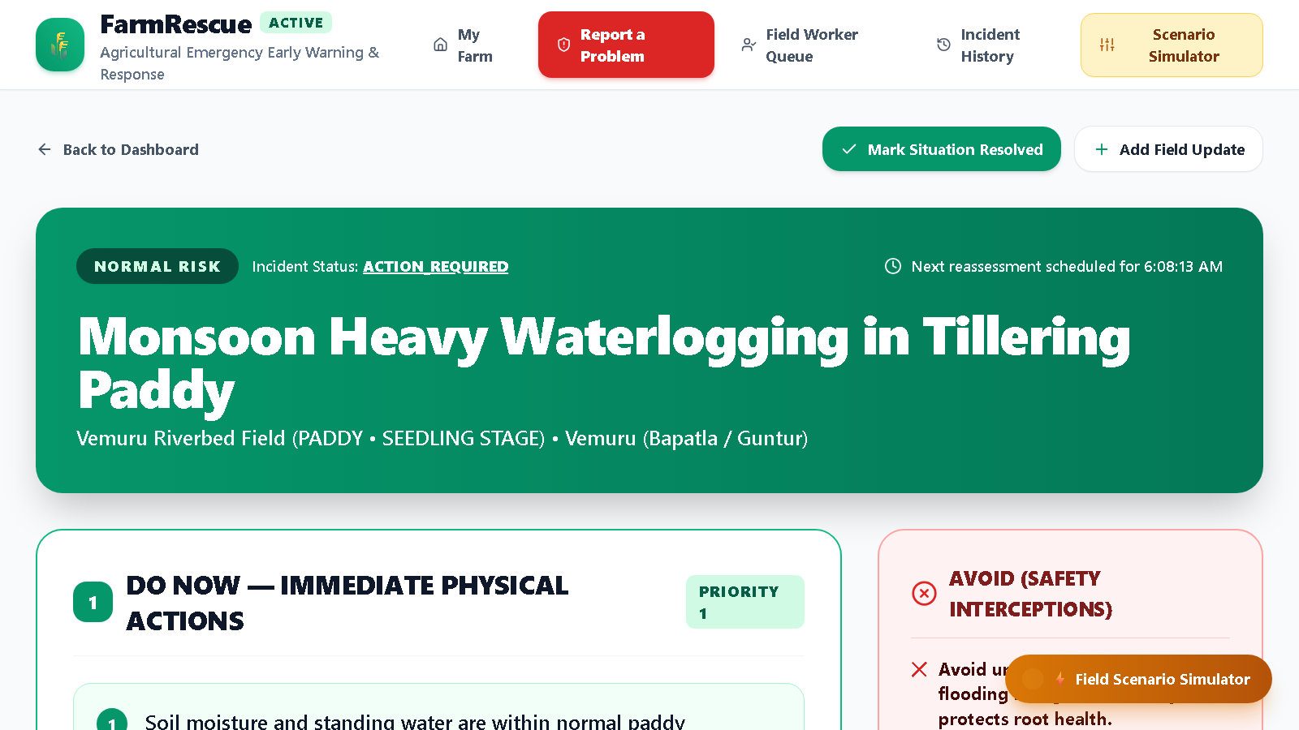
PRODUCT TOUR
The Product in Action
04
Assessed in seconds. Validated before it is ever shown.
• DO NOW
• Immediate physical interventions — e.g. cut the drainage breach at the lowest bund corner.
• AVOID (safety interceptions)
• Harmful actions the Safety Gate blocks, such as urea into standing water or contact pesticide sprays.
• MONITOR
• Symptoms and submergence thresholds to watch, with a review deadline.
• WHY THIS RECOMMENDATION?
• Plain-language explanation generated strictly from the validated result.
• Evidence view
• Source, reliability and freshness — 🟢 Fresh 🟡 Aging 🔴 Stale.
• Reassess and resolve
• New ground measurements recalculate live; the outcome is recorded.
Emergency Action Screen — /incidents/:id
DO NOW, AVOID and MONITOR for a live high-risk paddy incident.
Also shipped: the farmer dashboard with live weather, a 3-step reporting wizard, the field-worker verification queue, auditable history, and a scenario simulator.
FarmRescue · Emergency Agricultural Early-Warning & Response Platform
Notes:
If time allows, demo only two things live: the AVOID interception and the simulator escalating to CRITICAL.

Slide 6
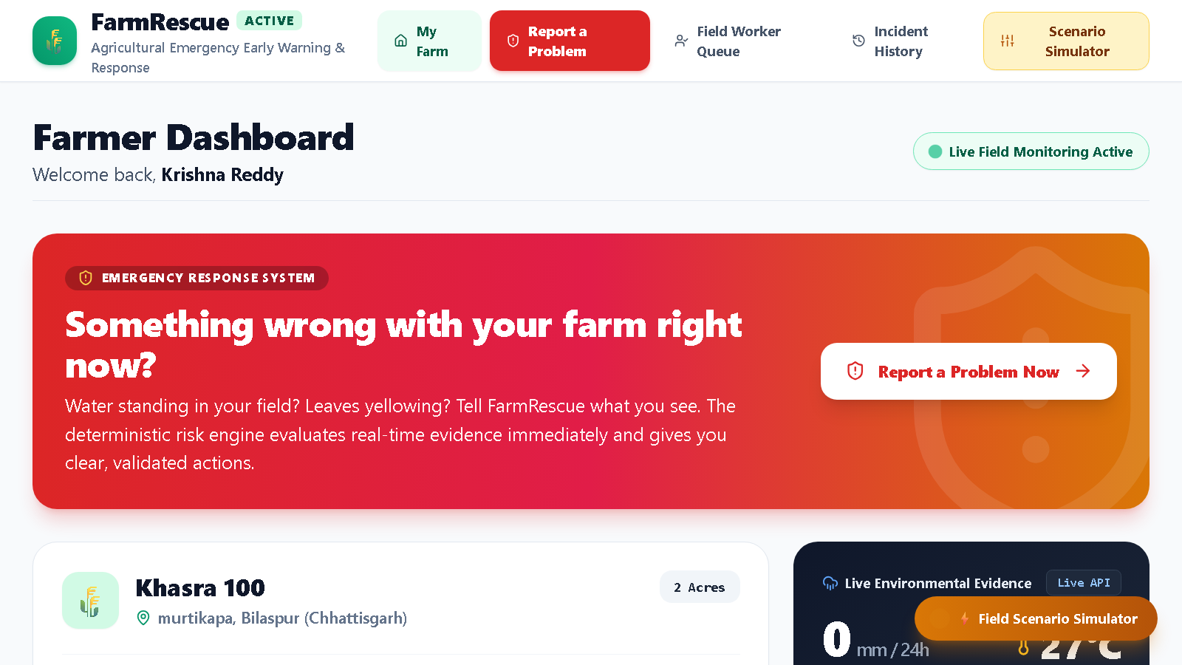
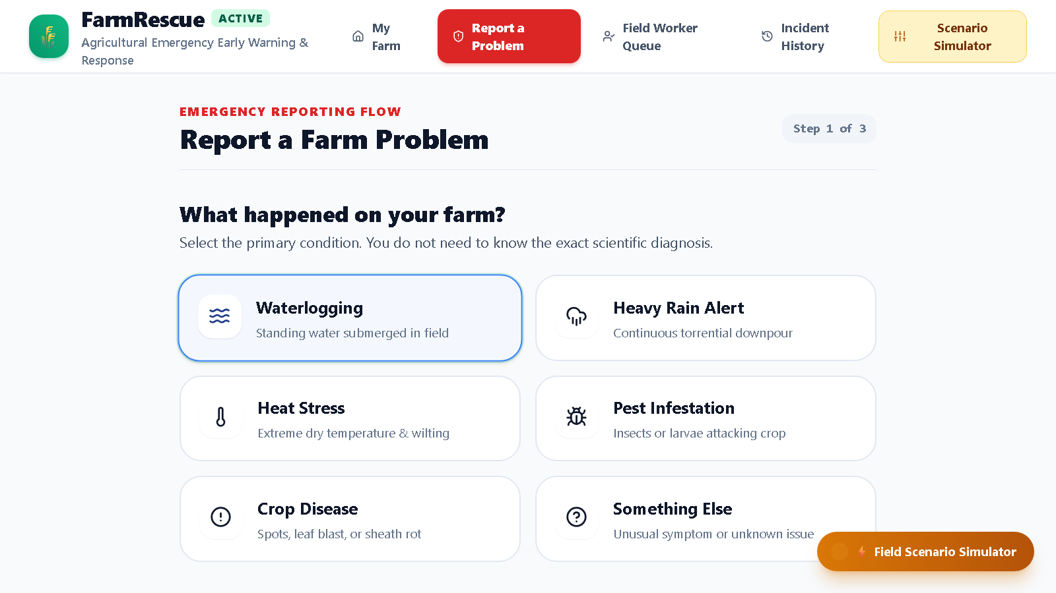
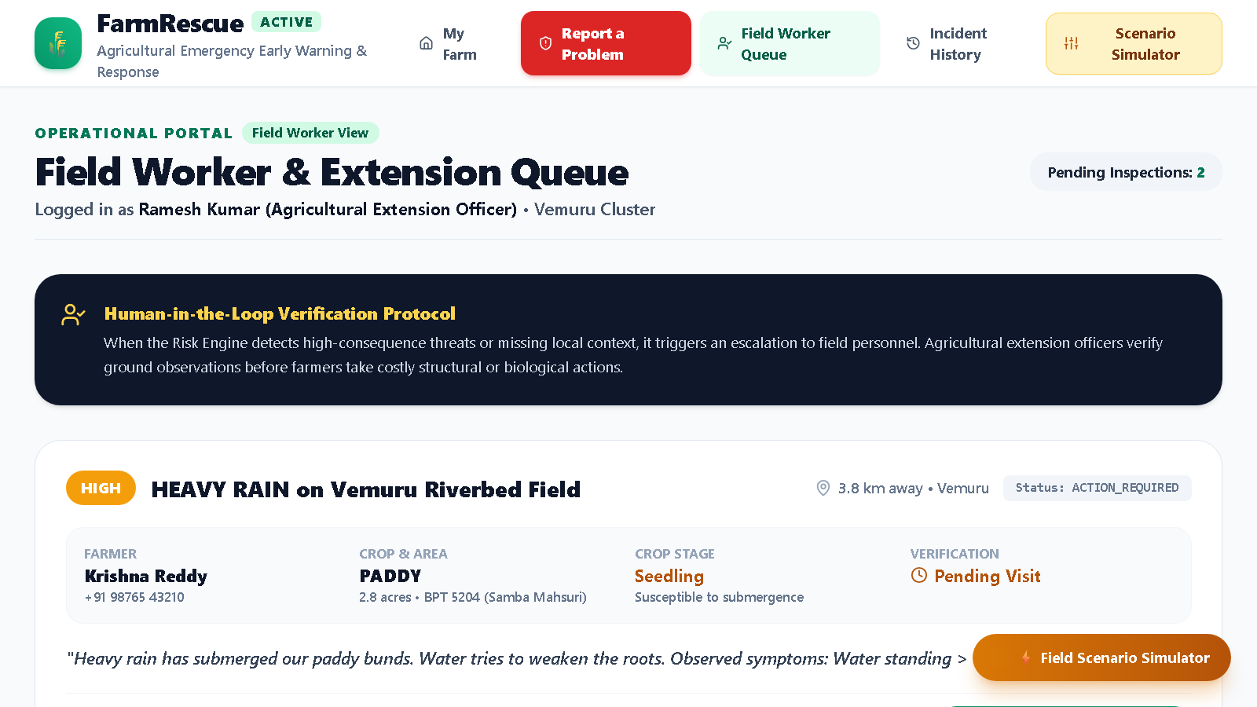
FORWARD LOOK
Scope: Shipped, Parked and Next
05
Shipped today
Parked for the demo
Next
• Dashboard, 3-step reporting wizard, emergency action screen.
• Field-worker verification queue and auditable, non-destructive history.
• 12-plan expert library with safety-gate interceptions.
• Scenario simulator with instant reassessment everywhere.
• Optional MongoDB persistence — hydrate-on-boot, in-memory fallback.
• 31 automated tests passing; 19 documented API routes.
• Field Map (/field) and Plot Registry (/plots) are disabled — 404, not linked in the navigation.
• The registry could only find plots registered inside FarmRescue; there is no government land-records verification.
• Two concurrent dev servers overwrote each other in the shared database, so the feature looked broken in front of evaluators.
• Implementation is preserved, not deleted — a one-step restore when a Bhulekh / ULPIN-style API and a single-writer data policy exist.
• P1 · Hardening — rule-boundary tests, a real scheduled reassessment loop, live weather evidence on incident creation, basic role authentication.
• P2 · Breadth — multi-crop action plans, photo evidence capture → storage → verification, more agro-climatic regions.
• P3 · Depth — offline-first PWA, sensor / IoT intake, outcome learning loop, FPO multi-tenancy, land-records integration.
Farmer Dashboard — /
Reporting Wizard — /incidents/new
Field Worker Queue — /field-worker
Known gaps, stated plainly: no authentication yet; the waterlogging library is paddy-centric; incident creation seeds a fixed 65 mm rainfall reading; “next reassessment scheduled” is display-only; no real SMS / WhatsApp delivery.
FarmRescue · Emergency Agricultural Early-Warning & Response Platform
Notes:
Volunteer the parked scope and the gaps unprompted — it buys credibility for everything else. Do not run two dev servers against the same data during the demo.

Slide 7
CLOSING
When the farm goes wrong at 3 a.m.,
FarmRescue already knows what to do.
A deterministic agronomic decision engine, an expert-authored response library, a safety gate that blocks harmful advice, and a human verification loop — with AI strictly in the role of explainer.
31
12
19
0
automated tests passing (zero-dependency Node runner)
expert-authored action plans (ICAR / IRRI-aligned)
documented REST API routes
decisions authored by the AI layer
Thank you · Questions welcome
FarmRescue — Emergency Agricultural Early-Warning & Response Platform · October 2026
Notes:
Close on determinism, then invite questions — they will be about safety and trust, which is exactly the ground the system is built to defend.

