Slide 1
OFFICIAL PROJECT BRIEFING · OCTOBER 2026
🌾 FarmRescue
Emergency Agricultural Early-Warning & Response Platform
“What should I do when the farm suddenly goes wrong?”
Deterministic agronomic risk intelligence that turns raw field evidence into validated, expert-authored action plans in seconds —
where data and rules decide, and AI only explains.
Next.js 14 (App Router) · TypeScript · Tailwind CSS · MongoDB · Gemini explanation layer
Hackathon Product Demo · Prototype Grade: Demo-Ready
Notes:
Opening. One-line pitch: FarmRescue answers the 3 a.m. question a farmer asks when the crop suddenly goes wrong. Emphasise that the system is deterministic by design and that AI never decides.

Slide 2
OVERVIEW
Executive Summary
01
The problem
Crop-loss emergencies unfold in hours, but trusted, location-specific agronomic guidance reaches farmers in days.
The solution
A field-evidence early-warning platform that assesses a reported problem in seconds and returns a specific, safety-checked response plan.
The difference
Data and validated rules decide risk and allowed actions. AI only explains validated results — it never overrides a classification or invents a plan.
Implementation at a glance
31
12
19
0
automated tests passing (zero-dependency Node runner)
expert-authored action plans (ICAR / IRRI-aligned)
documented REST API routes
decisions authored by the AI layer
FarmRescue · Emergency Agricultural Early-Warning & Response Platform
Notes:
Three-beat summary. The '0 decisions authored by AI' stat is the headline governance claim — be ready to defend it.

Slide 3
CONTEXT
The Problem
02
A crop emergency does not wait for the extension officer.
Waterlogging, heat stress and outbreaks escalate within a single day — the window to act is measured in hours.
Invisible onset
Generic, sometimes dangerous advice
No traceability
Waterlogging, submergence and heat stress cross critical thresholds silently overnight. By the time damage is visible, the highest-value intervention window has already closed.
Blanket advisory (apply urea, spray on schedule) is unsafe under active flooding. Advice that ignores field state can make the loss worse — e.g. granular urea in standing water.
Advice arrives by word of mouth with no record of the evidence used, who verified it, or whether the crop recovered. Nothing is auditable, so nothing improves.
The agronomic knowledge exists — ICAR / IRRI protocols are well documented. The failure is delivery: it does not reach the farmer at the moment of need, in a form that is actionable and safe.
FarmRescue · Emergency Agricultural Early-Warning & Response Platform
Notes:
Frame the problem as a delivery and trust failure, not a knowledge gap. Land the idea that unsafe advice is worse than no advice.

Slide 4
DESIGN PRINCIPLE
The Non-Negotiable Invariant
03
“Data and validated agricultural rules determine risk and allowed actions. AI explains validated results; AI does not independently decide what a farmer should do.”
✅ The deterministic core
🤖 The AI layer (subordinate)
• Versioned rule set evaluates evidence → severity.
• Pre-stored action library keyed by ruleFamily::riskLevel.
• Safety gate validates every plan before display.
• Same inputs → identical plan, every single time.
• Gemini runs strictly after risk + safety decisions.
• Strict prompt boundary: explain only, never classify.
• Cannot alter severity, actions or safety interceptions.
• Deterministic fallback — the app works with Gemini offline.
Consequence: the platform stays useful, auditable and defensible even when the model is unavailable, wrong or over-eager.
FarmRescue · Emergency Agricultural Early-Warning & Response Platform
Notes:
This is the credibility slide. Explain WHY: agricultural advice is safety-critical, so a stochastic decision-maker is unacceptable. Determinism also makes the system testable.

Slide 5
SYSTEM DESIGN
Architecture & Decision Pipeline
04
1
Inputs
Live weather (Open-Meteo + calibrated agro-climatic fallback), farmer observations, ground measurements.
2
Evidence Engine
Normalizes every signal into typed evidence carrying source, strength, reliability and freshness.
3
Deterministic Risk Engine
Versioned rule set maps evidence → severity (NORMAL → CRITICAL) with no randomness.
4
Safety Gate
Validates the planned actions and injects AVOID interceptions for hazardous interventions.
5
Action Plan Library
Returns a pre-stored expert plan: DO NOW, DO NEXT, AVOID, MONITOR, ESCALATE.
6
Explain & Verify
AI explains the validated result; field workers verify ground truth; outcome is logged.
Persistence layer · MongoDB hydrate-on-boot, write-behind (debounced ≈800 ms) · transparent in-memory fallback if the database is unreachable · live health at GET /api/system/persistence
FarmRescue · Emergency Agricultural Early-Warning & Response Platform
Notes:
Walk the pipeline top to bottom in one breath. Stress that the AI step sits near the END, after every safety decision is already made.

Slide 6
USERS
Roles & Personas
05
FARMER
FIELD_WORKER
Report incidents; view farm status, live weather and active incidents; follow the validated plan; add ground measurements; run the scenario simulator; submit outcome feedback.
See a queue of incidents flagged for verification, with distance indicators; submit ground-truth verification and optionally override severity.
Screens: / /incidents/new /incidents/:id /history
Screens: /field-worker
FPO_ADMIN
SYSTEM_ADMIN
Planned role for FPO-level coordination — community drainage canals, pump support, seed and nursery logistics. Today it appears only in escalation text.
Inspect persistence and platform health via the system API.
Screens: — (planned)
Screens: GET /api/system/persistence
Demo personas: Krishna Reddy — farmer, 2.8-acre paddy (“Vemuru Riverbed Field”, BPT 5204 / Samba Mahsuri, tillering, poor drainage). Ramesh Kumar — agricultural field officer.
FarmRescue · Emergency Agricultural Early-Warning & Response Platform
Notes:
Be explicit that authentication is NOT implemented — roles exist in the type system and UI. Say it before someone finds it.

Slide 7
PRODUCT
Core Capabilities
06
1
2
3
Farmer Dashboard
Emergency Reporting Wizard
Hero Action Screen
Live 24h rainfall, temperature, humidity and wind with active incidents and severity badges.
Non-academic 3-step flow: condition, symptom chips, evidence confirmation.
DO NOW / AVOID / MONITOR, why-this-recommendation, evidence traceability, live reassessment.
4
5
6
Field Worker Queue
Auditable History
Scenario Simulator
Human-in-the-loop verification: confirm, partially confirm, reject or request more information.
Non-destructive timeline preserving every assessment version, action plan and outcome.
Manipulate rainfall, duration, depth, drainage and crop stage → instant re-assessment everywhere.
Plus, on every screen:
• Pre-stored recommendation library — 12 expert plans, delivered instantly (no generation step, identical on every recurrence).
• Optional durable persistence — set MONGODB_URI and restarts survive; otherwise the app runs transparently in memory.
FarmRescue · Emergency Agricultural Early-Warning & Response Platform
Notes:
Do not read every card. Pick two or three and spend the time on the live demo instead.

Slide 8
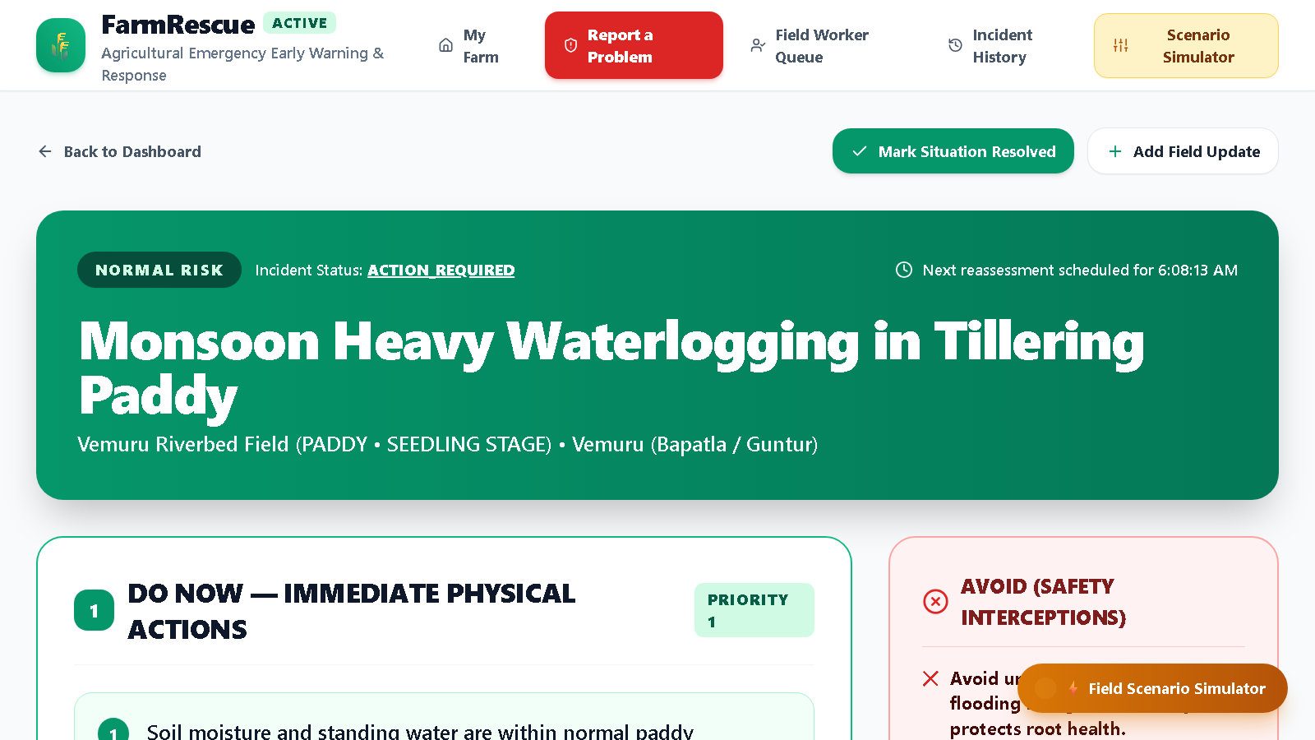
CORE UI
The Emergency Action Screen
07
• DO NOW
• Step-by-step immediate physical interventions (e.g. cut the drainage breach at the lowest bund corner).
• AVOID (safety interceptions)
• Harmful actions the Safety Gate blocks — e.g. no granular urea into standing flood water, no contact pesticide sprays.
• MONITOR
• Symptoms and submergence thresholds to watch, with a review deadline.
• WHY THIS RECOMMENDATION?
• Plain-language explanation generated strictly from the validated result.
• Evidence view
• Traceability cards showing source, reliability and freshness (🟢 Fresh 🟡 Aging 🔴 Stale).
• Reassess or resolve
• Add new ground measurements for live recalculation, then submit the outcome.
Incident response screen — /incidents/:id (live build)
FarmRescue · Emergency Agricultural Early-Warning & Response Platform
Notes:
This is the money screen. If demoing live, show DO NOW, then AVOID, then open the Simulator drawer.

Slide 9
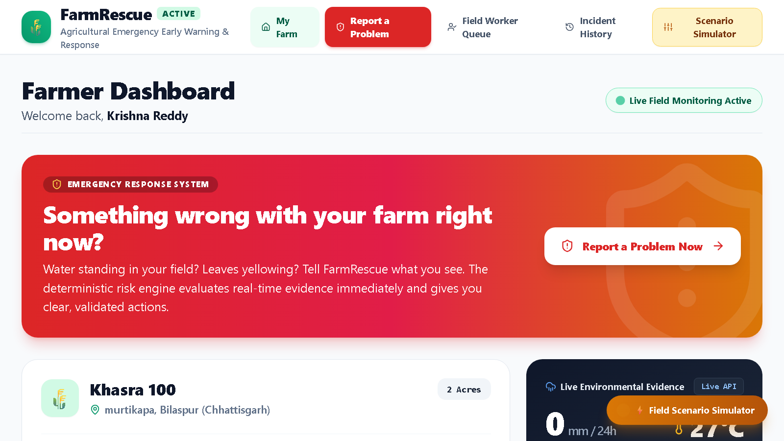
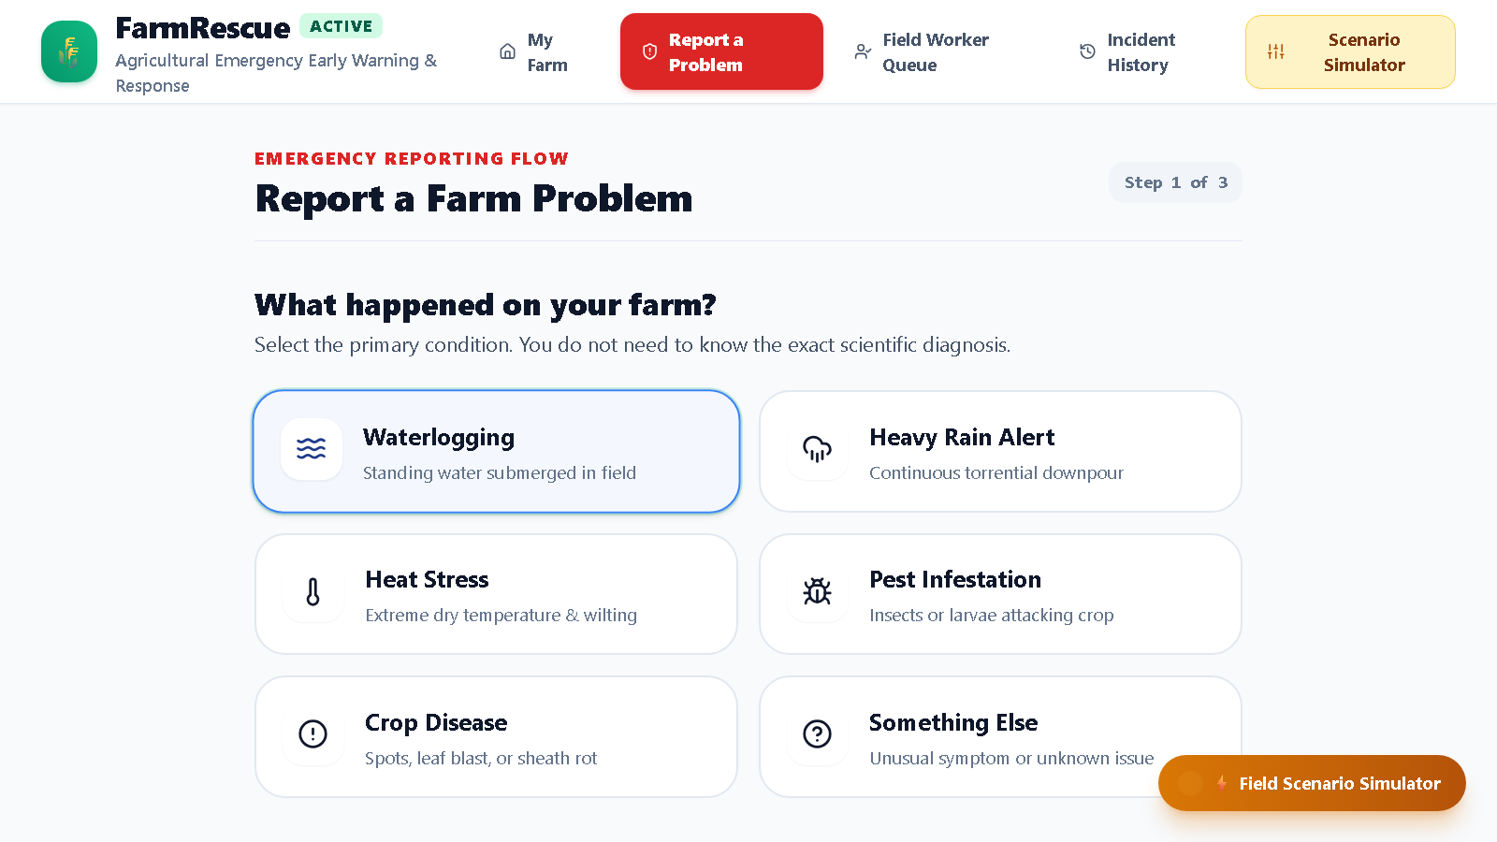
PRODUCT TOUR
Dashboard & Emergency Reporting
08
Farmer Dashboard — /
Live environmental conditions, active incidents with severity badges, and a prominent emergency CTA: “Something wrong with your farm right now?”
Reporting Wizard — /incidents/new
Three steps: what happened, quick symptom chips (e.g. “water standing > 15 cm”), then “Let’s check what we know” before the risk engine runs.
FarmRescue · Emergency Agricultural Early-Warning & Response Platform
Notes:
The wizard is deliberately non-academic — the farmer never needs the scientific name of the problem.

Slide 10
INTELLIGENCE
Deterministic Risk Engine
09
Paddy waterlogging thresholds (as implemented)
CRITICAL
rainfall ≥ 100 mm OR (rainfall ≥ 75 mm AND standing water ≥ 36 h) — both require poor drainage
Escalates
HIGH
rainfall ≥ 60 mm OR standing water ≥ 24 h OR depth ≥ 15 cm OR rainfall ≥ 50 mm in a sensitive stage
Escalates
MODERATE
rainfall ≥ 30 mm OR standing water ≥ 8 h
No escalation
LOW
rainfall ≥ 15 mm OR any standing water > 0 h
No escalation
NORMAL
otherwise
No escalation
Rule-priority policy: an explicitly reported incident type always routes to its dedicated rule. Ambient signals (heavy rain, standing water, extreme heat) only auto-route ‘Something else’ reports — so a heat-stress report can never be hijacked into a waterlogging plan.
Review cadence: reviewAt = assessedAt + { CRITICAL: 3 h, HIGH: 6 h, otherwise: 12 h }.
FarmRescue · Emergency Agricultural Early-Warning & Response Platform
Notes:
Heat stress adds CRITICAL at ≥40°C during flowering / panicle initiation. Pest/disease deliberately never recommends a pesticide.

Slide 11
CONTENT
Recommendation Library & Safety Gate
10
12 pre-stored expert action plans
Safety Gate
• Waterlogging — 5 severities (NORMAL → CRITICAL).
• Heat stress and pest / disease cover every severity the engine emits.
• Keyed by ruleFamily::riskLevel — plans appear instantly, with no generation step.
• Identical plan every time the same conditions recur (deterministic).
• Validates every plan before it is displayed.
• Blocks hazardous interventions outright (AVOID).
• Escalates to a human when evidence is thin or conflicting.
• The engine never recommends a pesticide — verified diagnosis first.
Representative interceptions
DO NOT apply granular urea into standing flood water — it is lost and worsens the anaerobic condition.
DO NOT spray contact pesticides on a water-stressed or submerged canopy — phytotoxicity risk.
DO NOT re-transplant or top-dress until standing water has receded and the review deadline has passed.
FarmRescue · Emergency Agricultural Early-Warning & Response Platform
Notes:
The safety gate is what makes this credible to an agronomist. It is also the clearest demonstration that AI does not decide.

Slide 12
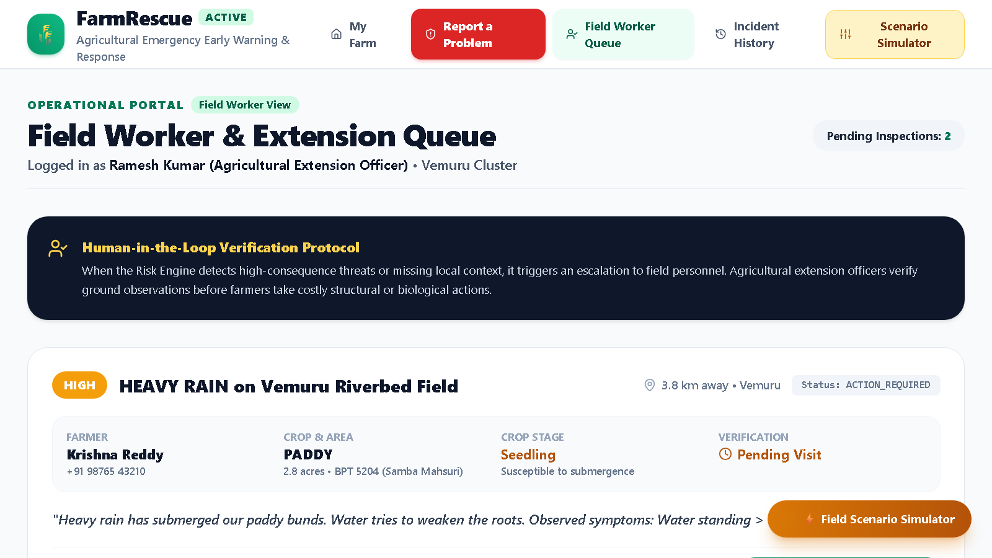
TRUST
Evidence Quality & Human Verification
11
Every assessment is traceable
• Each observation carries source, reliability, strength and timestamps (observedAt / retrievedAt / freshnessMinutes).
• Freshness is surfaced, never hidden: 🟢 Fresh 🟡 Aging 🔴 Stale.
• Observed vs forecast values are labelled distinctly — no silent blending.
• Unified evidence view returns verdicts plus what is still missing.
Human-in-the-loop escalation
• HIGH / CRITICAL incidents auto-escalate to the field-worker queue.
• Officer confirms, partially confirms, rejects or requests more information, and may override severity.
• Verified ground truth is appended to the audit trail, not overwritten.
Field Worker & Extension Queue — /field-worker
Pending inspections with distance indicators and a structured verification form.
FarmRescue · Emergency Agricultural Early-Warning & Response Platform
Notes:
Emphasise the design intent: the system knows what it does not know, and it hands uncertainty to a human rather than guessing.

Slide 13
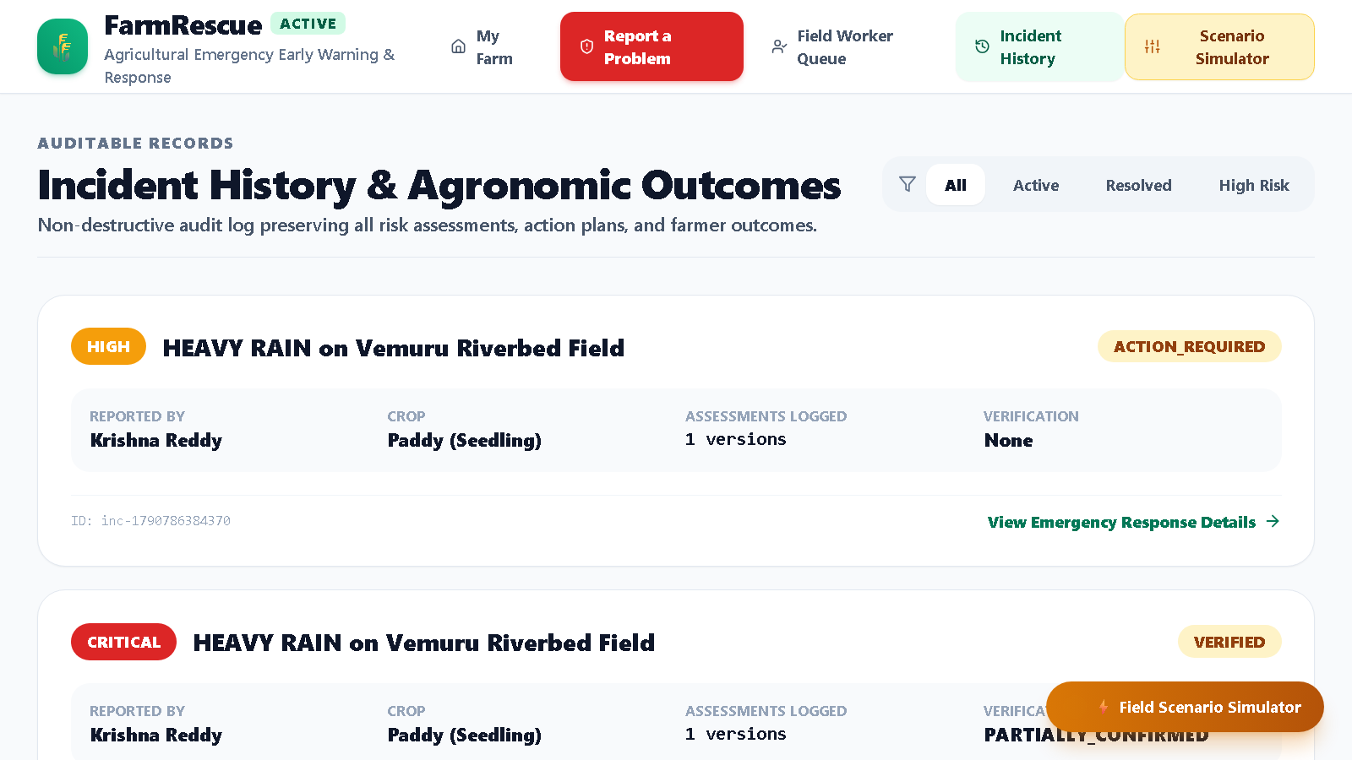
RELIABILITY
Persistence, Degradation & Audit
12
Durable by default, graceful by design
• Set MONGODB_URI and every incident / farm mutation is persisted.
• Write-behind, debounced ≈800 ms after each mutation.
• Boot hydrates from the database — restarts survive.
• If the database is unreachable the app transparently runs in memory and retries in the background.
• Live health: GET /api/system/persistence.
• Reassessments append; nothing is destroyed or silently rewritten.
Auditable History — /history
Non-destructive audit log preserving every assessment version, action plan, verification and farmer outcome.
FarmRescue · Emergency Agricultural Early-Warning & Response Platform
Notes:
Honesty note to be ready for: two dev servers running against the same database overwrote each other's data. One writer at a time.

Slide 14
ENGINEERING
Technology Stack
13
Application
Data & Decisions
• Next.js 14 — App Router
• TypeScript (strict)
• Tailwind CSS
• Lucide React icons
• Versioned deterministic rule engine
• 12-plan expert action library
• Evidence freshness & verdict pipeline
• Safety gate interceptions
External Services
Quality
• Open-Meteo live weather API
• Calibrated agro-climatic fallback model
• Google Gemini — explanation layer only
• MongoDB — optional durable store
• Zero-dependency Node test runner
• 31 tests passing
• Strict prompt boundary on the AI layer
• ICAR / IRRI-aligned agronomic content
No exotic dependencies, no paid services required to run the demo — GEMINI_API_KEY and MONGODB_URI are both optional.
FarmRescue · Emergency Agricultural Early-Warning & Response Platform
Notes:
If asked about scale: the persistence layer was the last milestone and is deliberately swappable behind a store interface.

Slide 15
WALKTHROUGH
Primary Demonstration Script
14
1
Baseline
Krishna Reddy’s paddy field in tillering faces 82 mm of rain and 24 h of standing water → HIGH RISK.
2
Review the plan
Inspect DO NOW (breach bunds, clear drainage), AVOID (urea application blocked) and Why This Recommendation.
3
Field verification
Open the Field Worker Queue, inspect the incident and submit official verification.
4
Simulate escalation
In the Scenario Simulator push rainfall to 115 mm and duration to 48 h → instant CRITICAL RISK.
5
Simulate de-escalation
Drop rainfall to 5 mm, standing water to 0 h and set drainage to good → LOW / NORMAL.
6
Report and persist
Report a new incident through the wizard and watch the deterministic engine assess it live; restart the server to prove persistence.
Run the demo from a single dev server. Only one process should own the shared Atlas data at a time.
FarmRescue · Emergency Agricultural Early-Warning & Response Platform
Notes:
Keep the demo under four minutes. The escalation / de-escalation pair is the strongest thirty seconds — it proves determinism live.

Slide 16
HONEST SCOPE
Parked for the Demo Build
15
⚠ Field Map (/field) and Plot Registry (/plots) are disabled in the demo build — they return 404 and are not linked in the navigation.
Why they were parked
• The registry could only find plots that had been registered inside FarmRescue — there is no government land-records verification, so it made a promise the data could not keep.
• Plot coordinates came from user-placed map taps or GPS, not cadastral survey data.
• Two concurrent dev servers overwrote each other in the shared database, making the feature look broken in front of evaluators.
Status and path forward
• The full implementation is preserved, not deleted — cascading State → Village → Khasra lookup, map chips, register-on-the-spot, Bhuiyan-style khasra report entry.
• Restore is a one-step move from the parked folder.
• Revisit requires a real land-records API — a Bhulekh / ULPIN-style integration, plus a single-writer data policy.
Decision: show a smaller honest product rather than a larger one that cannot be defended in a live demo.
FarmRescue · Emergency Agricultural Early-Warning & Response Platform
Notes:
Say this unprompted. Volunteering the parked scope buys credibility for everything else in the deck.

Slide 17
FORWARD LOOK
Known Gaps & Roadmap
16
Known gaps (honest list)
Roadmap
• No authentication — roles exist in the type system and UI, but API routes accept no credentials.
• Recommendation library is paddy-centric for waterlogging; other crops fall through to the generic plan.
• Incident creation seeds a fixed 65 mm rainfall reading; standing water defaults to 12 h / 10 cm.
• “Next reassessment scheduled” is display-only — no background scheduler exists.
• Test coverage is partial: risk boundaries, safety-gate rules and library coverage are still untested.
• No real SMS / WhatsApp / IVR delivery — notification exists only as escalation text.
P1 · Hardening
Boundary tests for risk + safety rules; a real scheduled reassessment loop; live weather evidence on incident creation; basic role authentication.
P2 · Breadth
Multi-crop action plans; photo evidence capture → storage → verification; more agro-climatic regions.
P3 · Depth
Offline-first PWA; sensor / IoT intake; outcome learning loop; multi-tenancy for FPOs; land-records integration.
The P0 MVP is complete and demo-ready. Everything above is scheduled work, not a hidden failure.
FarmRescue · Emergency Agricultural Early-Warning & Response Platform
Notes:
Cite gaps from the PRD, not from memory — they are documented in section 14 and roadmap phases in section 15.

Slide 18
CLOSING
When the farm goes wrong at 3 a.m.,
FarmRescue already knows what to do.
A deterministic agronomic decision engine, an expert-authored response library, a safety gate that blocks harmful advice, and a human verification loop — with AI strictly in the role of explainer.
Thank you · Questions welcome
FarmRescue — Emergency Agricultural Early-Warning & Response Platform · October 2026
Notes:
Close on the determinism message, then invite questions — the questions will be about safety and trust, which is exactly the ground the system is built to defend.

