Slide 1
Smart Attendance System
Using Face Recognition
Institution Name: Indus University
Department: IICT
Course/Sem. : MSC-IT / 3 - C
Project Guide/Mentor: Ms. Archana Srivastava
Team Members:
Yash Italiya : [IU2554100005]
Ashish Vaghasiya : [IU2554100015]

Slide 2
Introduction
Overview: A modern, automated web-based application designed to streamline attendance tracking.
Core Objective: Eliminate manual roll-calls and proxy attendance.
Leverages advanced biometric face recognition and liveness detection.
Technology Stack:
Frontend: HTML,CSS(BOOTSTRAP),JS, AJAX
Backend: Python, Flask Framework
Database: MySQL
AI/CV Engine: OpenCV, face_recognition library(dlib)
Plateform : VS CODE

Slide 3
Existing System
Manual Roll-Call:
Faculty calling names or passing around sheets during class.
Legacy ERP Entry:
Faculty manually entering data into portals after class.
Traditional Biometrics:
Shared RFID cards or fingerprint scanners at classroom doors.

Slide 4
Problem Areas of Existing System
Time Consumption: Wastes 5-10 minutes of valuable instructional time.
Proxy Attendance: High risk of buddy punching (fake attendance).
Administrative Burden: Manual percentage calculations and absentee management.
Hygiene & Bottlenecks: Fingerprint scanners create long queues and pose hygiene concerns.

Slide 5
Need for the New System
Complete Automation:
Zero-touch, self-service attendance linked to live class schedules.
Uncompromised Security:
Advanced anti-spoofing pipeline ensures strict liveness detection.
High Precision Accuracy:
Deep learning-based 128-d face encodings provide highly accurate matches.
Real-Time Analytics:
Instant, role-based dashboards for students and faculty.

Slide 6
System Flow Diagram

Slide 7
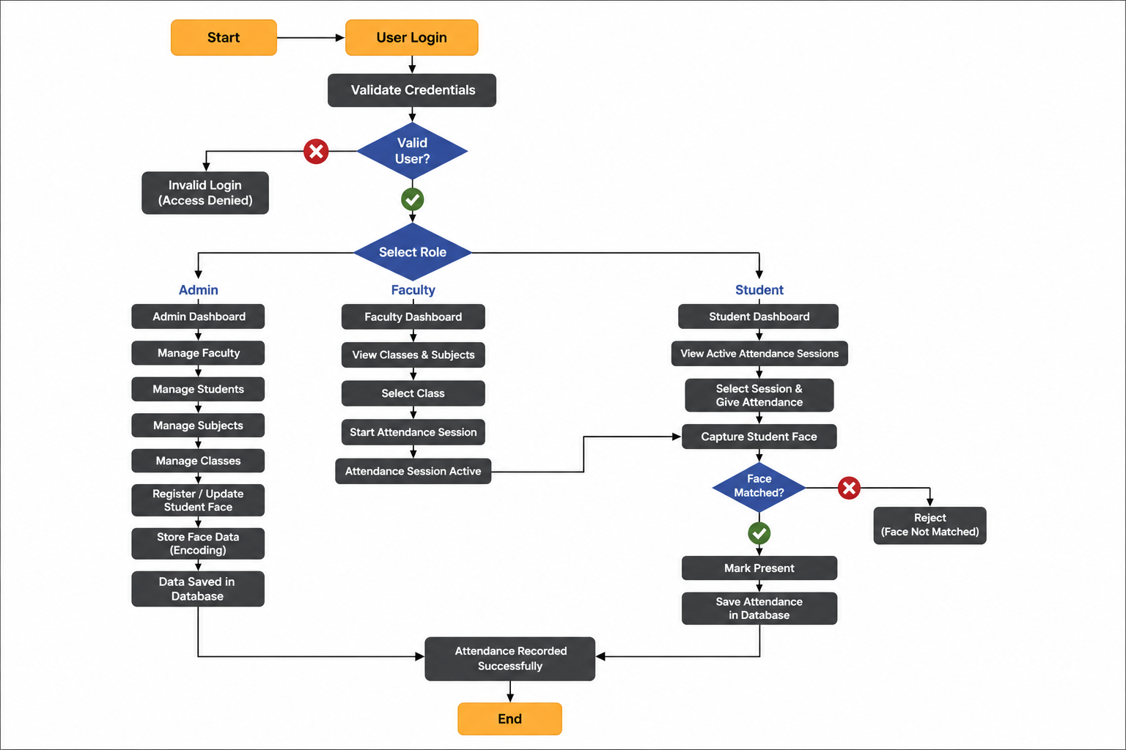

Slide 8
THANK YOU

