Slide 1
Smart Attendance System
Using Face Recognition
Institution Name: Indus University
Department: IICT
Course/Sem. : MSC-IT / 3 - C
Project Guide/Mentor: Ms. Archana Srivastava
Team Members:
Yash Italiya : [IU2554100005]
Ashish Vaghasiya : [IU2554100015]

Slide 2
Introduction
Overview: A modern, automated web-based application designed to streamline attendance tracking.
Core Objective: Eliminate manual roll-calls and proxy attendance.
Leverages advanced biometric face recognition and liveness detection.
Technology Stack:
Frontend: HTML,CSS(BOOTSTRAP),JS, AJAX
Backend: Python, Flask Framework
Database: MySQL
AI/CV Engine: OpenCV, face_recognition library(dlib)
Plateform : VS CODE

Slide 3
Existing System
Manual Roll-Call:
Faculty calling names or passing around sheets during class.
Legacy ERP Entry:
Faculty manually entering data into portals after class.
Traditional Biometrics:
Shared RFID cards or fingerprint scanners at classroom doors.

Slide 4
Problem Areas of Existing System
Time Consumption: Wastes 5-10 minutes of valuable instructional time.
Proxy Attendance: High risk of buddy punching (fake attendance).
Administrative Burden: Manual percentage calculations and absentee management.
Hygiene & Bottlenecks: Fingerprint scanners create long queues and pose hygiene concerns.

Slide 5
Need for the New System
Complete Automation:
Zero-touch, self-service attendance linked to live class schedules.
Uncompromised Security:
Advanced anti-spoofing pipeline ensures strict liveness detection.
High Precision Accuracy:
Deep learning-based 128-d face encodings provide highly accurate matches.
Real-Time Analytics:
Instant, role-based dashboards for students and faculty.

Slide 6
Proposed System
AttendEase – proposed solution for automated, secure and real-time attendance
This system replaces manual attendance with a centralized, face-based web system that automates verification and record management.
1
Role-Based Management
2
Face-Based Verification
Admin manages students, faculty, courses, semesters, subjects and scheduled classes through a centralized dashboard.
Students register their face once; the system captures and compares facial encodings during an attendance session.
3
Automated Attendance
4
Real-Time Tracking
Faculty starts the active class session and successful face verification records attendance with time and confidence data.
Faculty and students can view attendance information, while the database maintains accurate and centralized records.
Core Technologies
Flask • MySQL • OpenCV • face_recognition / dlib • HTML/CSS/Bootstrap • JavaScript/AJAX

Slide 7
System Flow Diagram

Slide 8
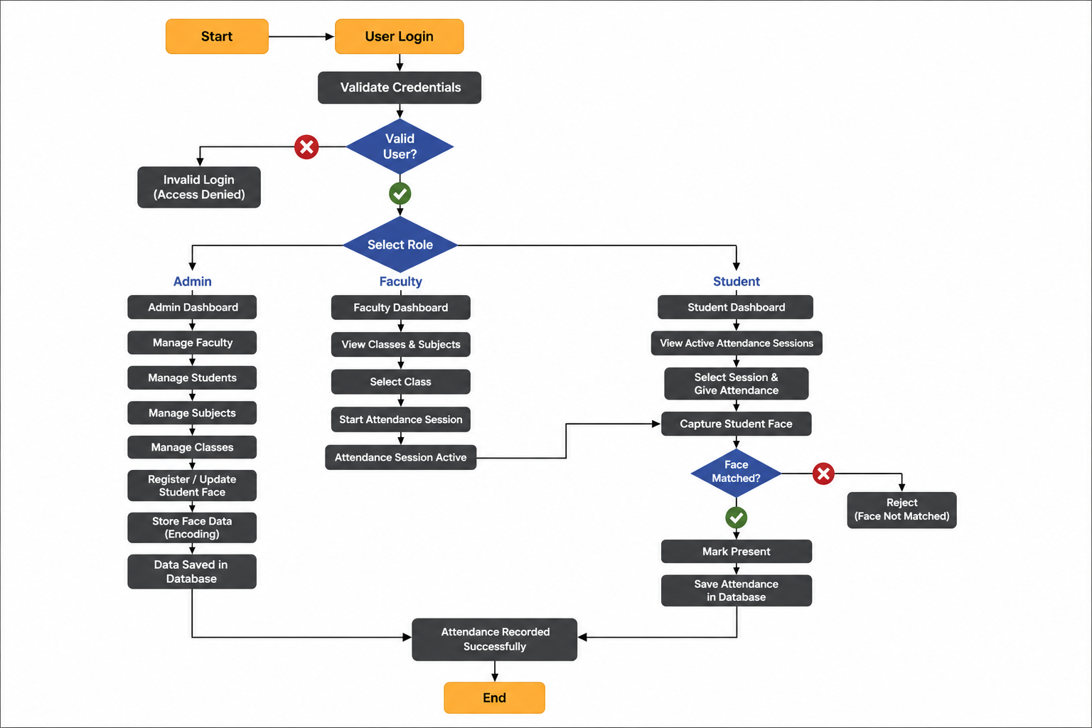

Slide 9
Data Dictionary

Slide 10
Table: roles
Field | Data Type | Description
role_id | INT | Unique role ID (PK)
role_name | VARCHAR(100) | Admin / Faculty / Student

Slide 11
Table: users
Field | Data Type | Description
user_id | INT | Unique user ID (PK)
role_id | INT | User role (FK)
full_name | VARCHAR(100) | User's full name
email | VARCHAR(50) | Login email
password | VARCHAR(255) | Hashed password
profile_img | VARCHAR(100) | Profile image path
status | INT | Account status
created_at | TIMESTAMP | Account creation time

Slide 12
Table: students
Field | Data Type | Description
student_id | INT | Unique student ID (PK)
user_id | INT | Linked user ID (FK)
course_id | INT | Student course (FK)
semester_id | INT | Student semester (FK)
face_registered | TINYINT(1) | Face registration status

Slide 13
Table: faculty
Field | Data Type | Description
faculty_id | INT | Unique faculty ID (PK)
user_id | INT | Linked user ID (FK)
designation | VARCHAR(100) | Faculty designation

Slide 14
Table: courses
Field | Data Type | Description
course_id | INT | Unique course ID (PK)
course_name | VARCHAR(100) | Course name
course_code | VARCHAR(20) | Unique course code

Slide 15
Table: semesters
Field | Data Type | Description
semester_id | INT | Unique semester ID (PK)
semester_name | VARCHAR(30) | Semester name

Slide 16
Table: subjects
Field | Data Type | Description
subject_id | INT | Unique subject ID (PK)
course_id | INT | Linked course (FK)
semester_id | INT | Linked semester (FK)
faculty_id | INT | Assigned faculty (FK)
subject_name | VARCHAR(100) | Subject name
subject_code | VARCHAR(20) | Unique subject code

Slide 17
Table: face_data
Field | Data Type | Description
face_id | INT | Unique face record ID (PK)
student_id | INT | Linked student (FK)
image_path | VARCHAR(255) | Registered face image path
face_encoding | MEDIUMTEXT | Stored facial encoding

Slide 18
Table: classes
Field | Data Type | Description
class_id | INT | Unique class ID (PK)
subject_id | INT | Class subject (FK)
faculty_id | INT | Class faculty (FK)
class_date | DATE | Date of class
start_time | TIME | Class start time
end_time | TIME | Class end time
attendance_started | TINYINT(1) | Attendance session status

Slide 19
Table: attendance
Field | Data Type | Description
attendance_id | INT | Unique attendance ID (PK)
class_id | INT | Related class (FK)
student_id | INT | Student (FK)
attendance_time | DATETIME | Attendance time
status | VARCHAR(10) | Present / Absent
confidence_score | DECIMAL(5,2) | Face-match confidence

Slide 20
Table: feedback
Field | Data Type | Description
feedback_id | INT | Unique feedback ID (PK)
name | VARCHAR(50) | Sender's name
email | VARCHAR(50) | Sender's email
subject | VARCHAR(100) | Feedback subject
message | TEXT | Feedback message

Slide 21
Use Case Diagram

Slide 22
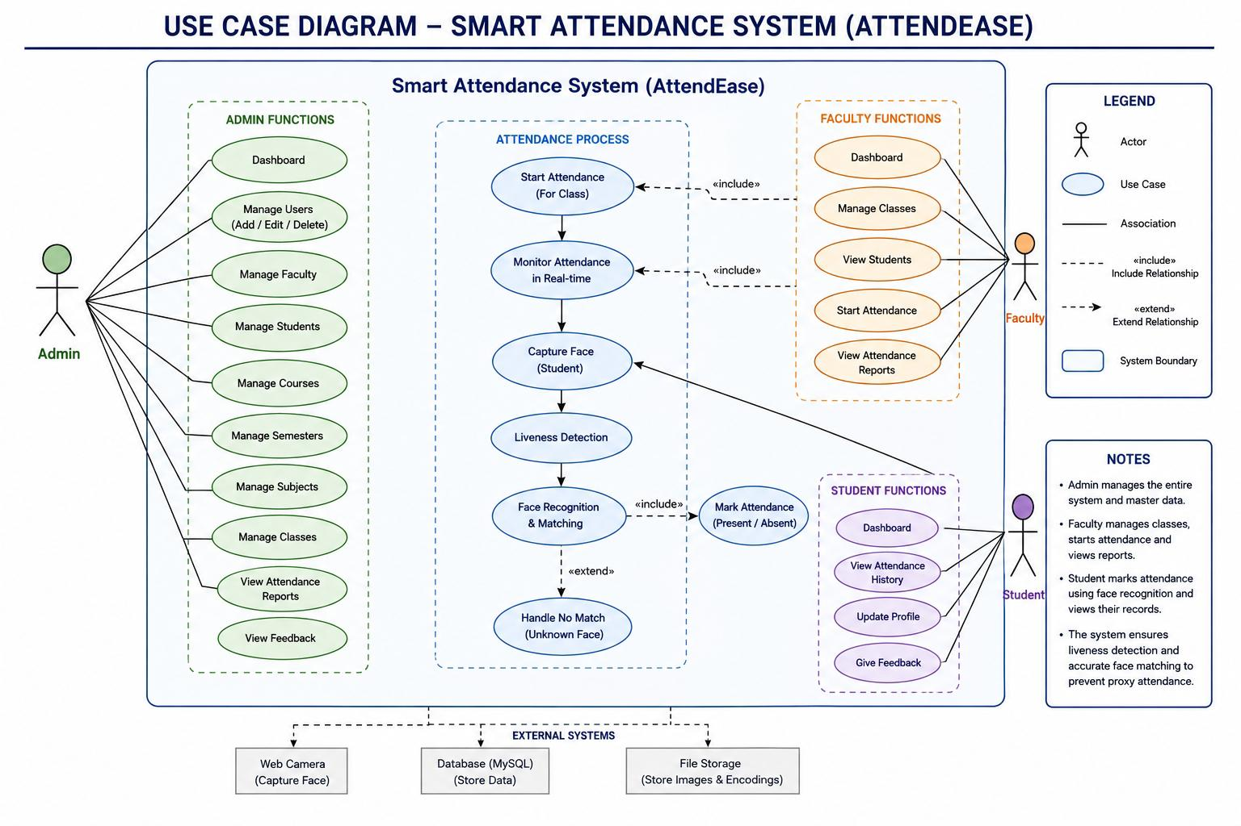

Slide 23
THANK YOU

